Slide 1
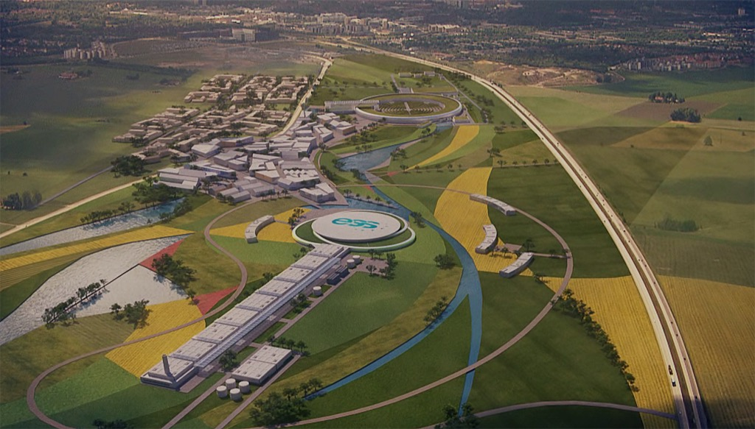


Neutrino CP Violation with the European Spallation Source neutrino Super Beam project
E. Baussan, M. Dracos
IPHC-IN2P3 Strasbourg
On behalf of ESSνSB
Abstract ID: 109
The ESSnuSB project proposes to add on the European Spallation Source under construction at Lund (Sweden) a Super Beam neutrino facility devoted to the discovery of a leptonic CP violation. The main characteristics of this facility are:
5 MW/2 GeV protons,
accumulation ring of ∅400 m,
4 target/horn system,
25 m decay tunnel,
near detector at 500 m, far megaton Cherenkov detector at 540 km.
This facility will be operated exclusively at the second neutrino oscillation maximum aiming to cover after 10 years data taking more than 50% of δ_{CP} values assuming 5%/10% systematic errors on signal/background.
A copious number of muons will also be produced which could be used for studies of muon ionisation cooling for a future Neutrino Factory or a muon collider.
The far megaton Cherenkov detector has a rich astrophysical program by detecting cosmological neutrinos. It can also be used to study proton decays.
Poster session: Wednesday 6 June
Wall #39

Slide 2
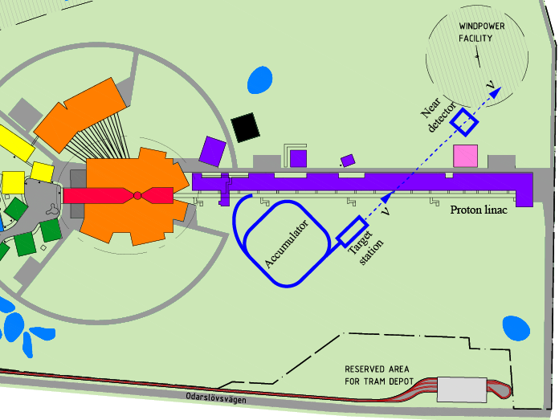
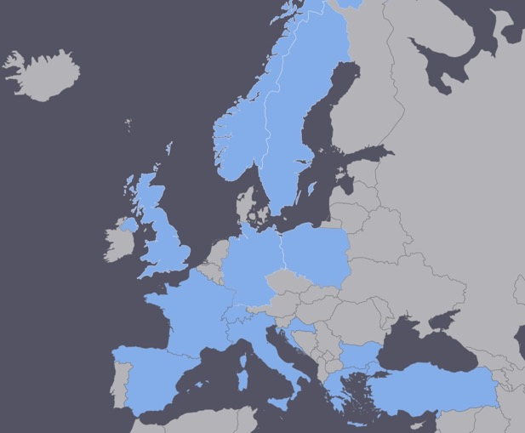
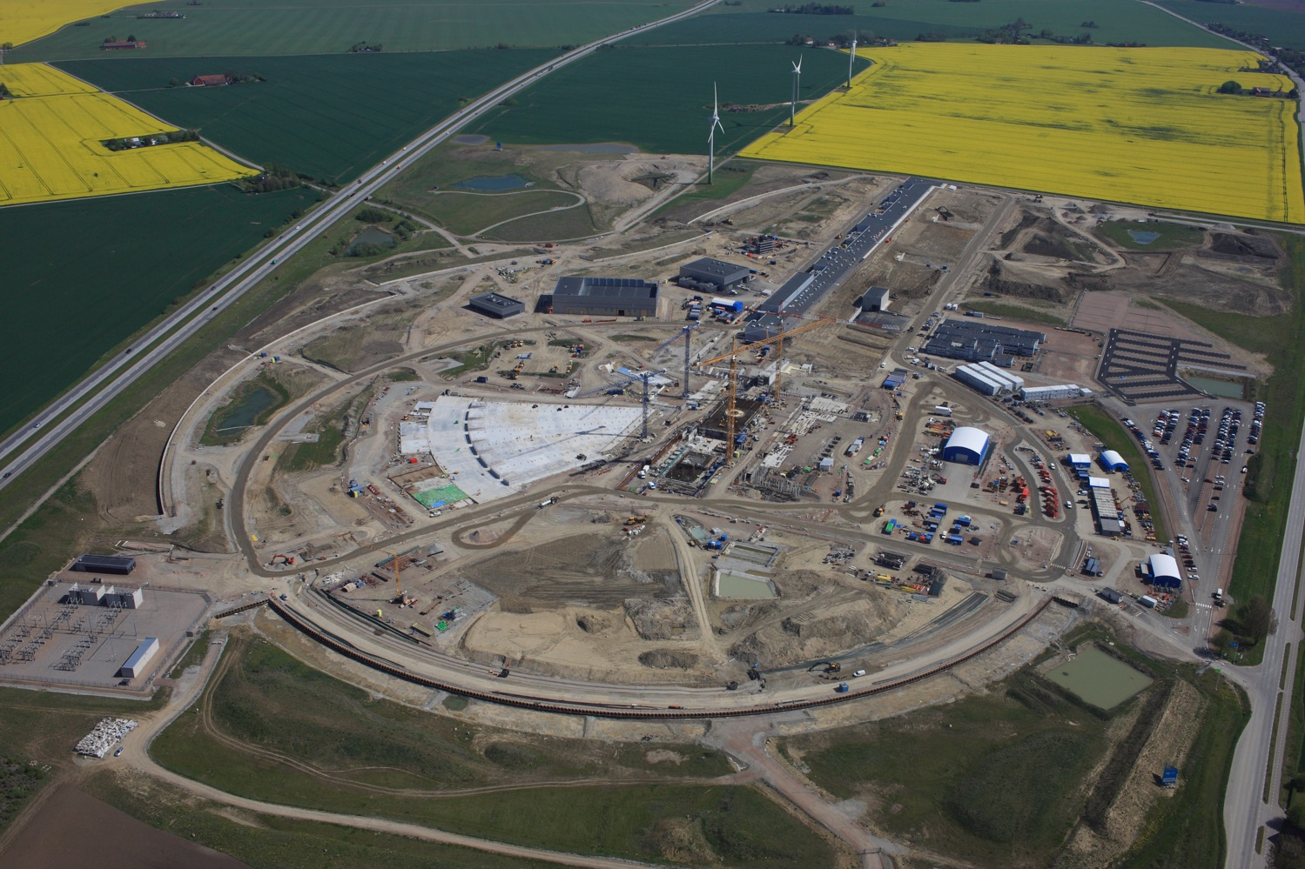
The EU H2020 Design Study and COST Action EuroNuNet
Two European Projets to support ESSnuSB:
  COST: EuroNuNet, 3rd year (2016-2020)
    Combining forces for a novel European facility for neutrino-antineutrino symmetry violation discovery
    13 country members
  ESSnuSB: H2020 Design Study, 4.7 M€ (3 M€ by EU)
    15 institutes including ESS and CERN
    Approved in August 2017
    Start beginning of January 2018
    Duration: 4 years (2018-2021)
    5 Work Packages
ESSνSB
BENE (2004-2008)
ISS (2005-2007)
EUROν (2008-2012)
LAGUNA (2008-2010)
LAGUNA-LBNO (2010-2014)
COST Action CA15139 (2015-2019)
ν
p
n
H⁻
Poster session: Wednesday 6 June
Wall #39

