Slide 1
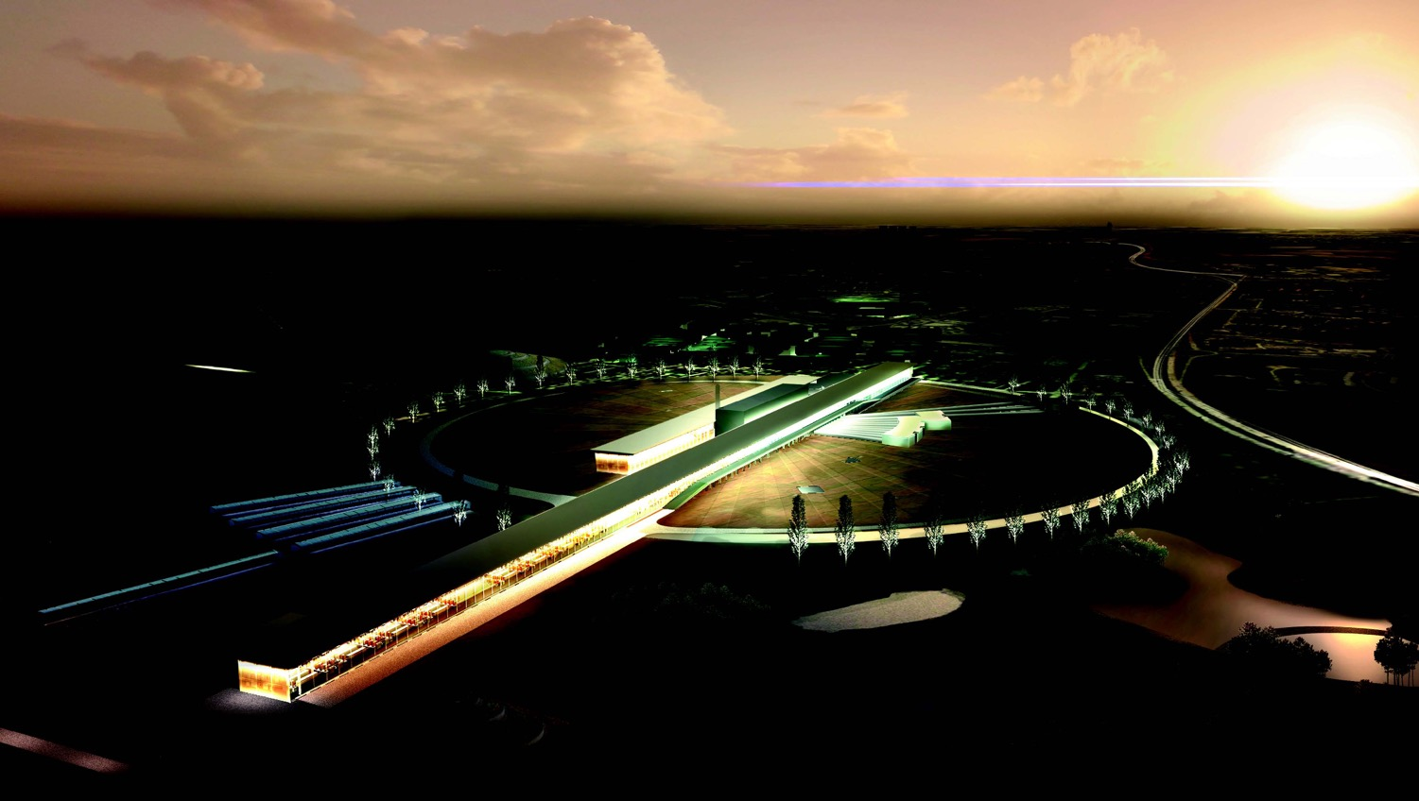
Neutrino CP Violation with the ESS neutrino
Super Beam
(ESSνSB)
Marcos Dracos
on behalf of the ESSνSB/EuroNuNet project

Slide 2
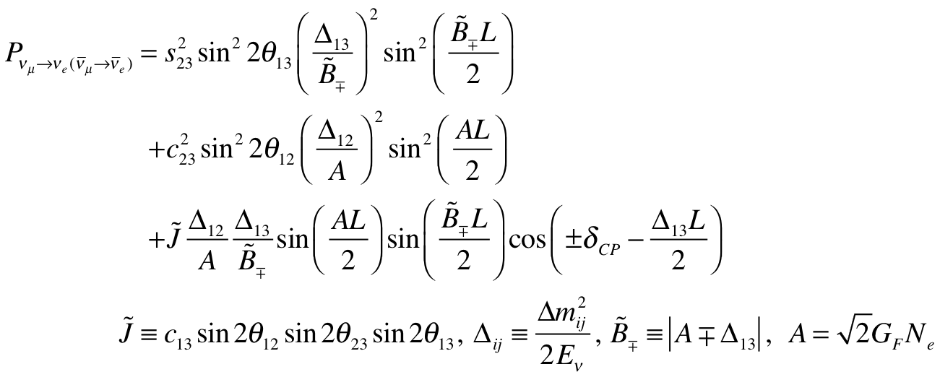
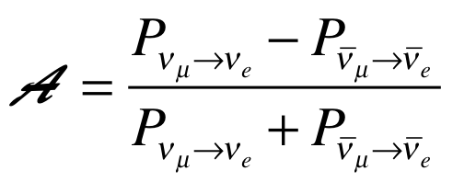
CP Violating Observables
(ν_{μ}→ν_{e})
atmospheric
Non-CP terms
solar
interference
CP violating
matter effect
⇒ accessibility to mass hierarchy
⇒ very long baseline
(small in our case)
≠0 ⇒ CP Violation
be careful, matter effects also create asymmetry

Slide 3
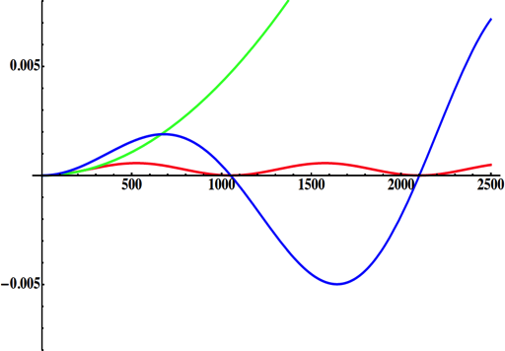
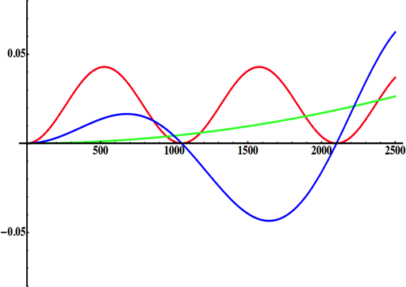
Why to go to the 2nd Oscillation Max.
solar
atmospheric
for "large" θ₁₃ 1st oscillation maximum is dominated by atmospheric term
for small θ₁₃ 1st oscillation maximum is better
atmospheric
solar
L/E
L/E
CP interference
(arXiv:1110.4583)
θ₁₃=1º
CP interference
θ₁₃=8.8º
2nd oscillation maximum
δ_{CP}=-90
δ_{CP}=0
δ_{CP}=+90
P(ν_{μ}→ν_{e})
1st oscillation max.: A=0.3sinδ_{CP}
2nd oscillation max.: A=0.75sinδ_{CP}
θ₁₃=8.8º
("large" θ₁₃)
(see arXiv:1310.5992 and arXiv:0710.0554)
L/E
more sensitivity at 2nd oscillation max.
very intense neutrino beam needed

Slide 4
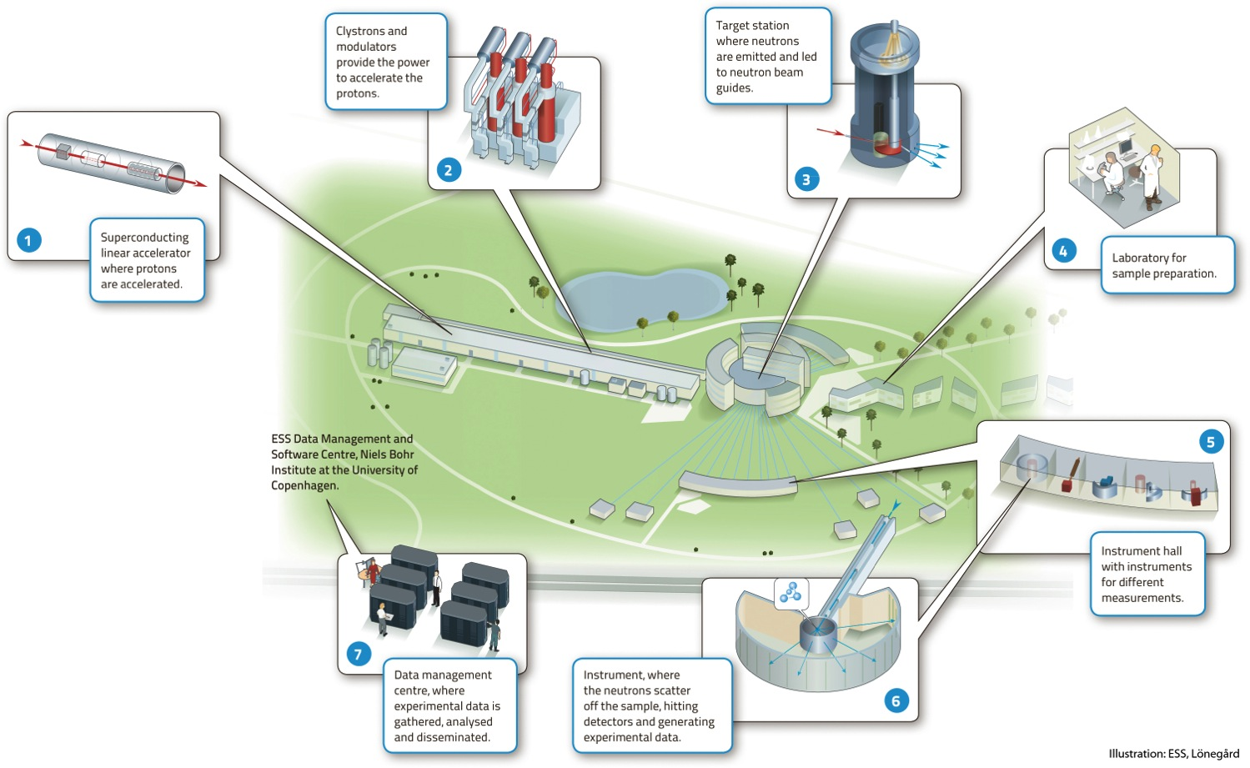




European Spallation Source
under construction phase
(~1.85 B€ facility)

Slide 5
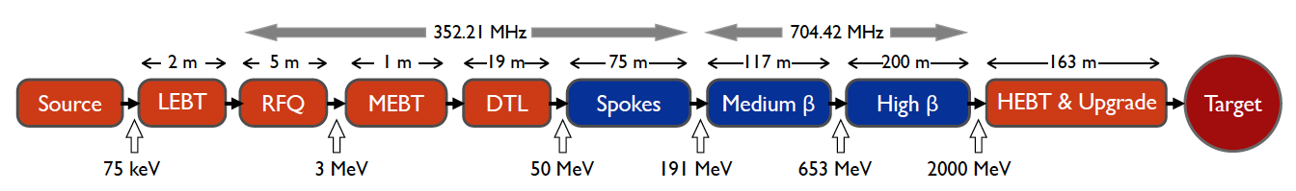
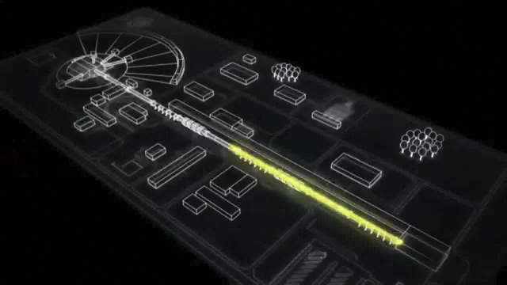
ESS proton linac
The ESS will be a copious source of spallation neutrons.
5 MW average beam power.
125 MW peak power.
14 Hz repetition rate (2.86 ms pulse duration, 10¹⁵ protons).
Duty cycle 4%.
2.0 GeV protons
  up to 3.5 GeV with linac upgrades
>2.7x10²³ p.o.t/year.
Linac ready by 2023 (full power)

Slide 6
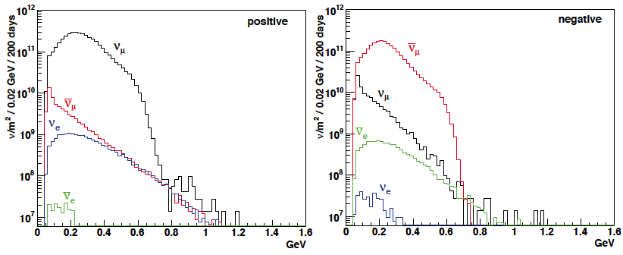
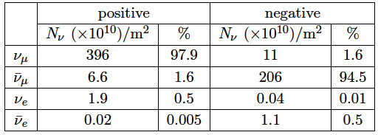
ESSνSB ν energy distribution
(without optimisation)
neutrinos
anti-neutrinos
almost pure ν_{μ} beam
small ν_{e} contamination which could be used to measure ν_{e} cross-sections in a near detector
at 100 km from the target and per year (in absence of oscillations)
(Nucl. Phys. B 885 (2014) 127)

Slide 7
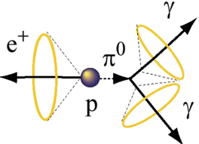
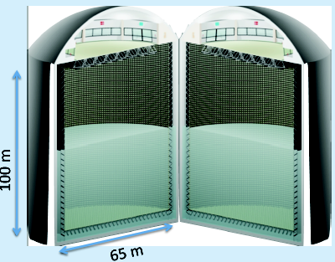
Can we go to the 2nd oscillation maximum using our proton beam?
Yes, if we place our far detector at around 500 km from the neutrino source.
MEMPHYS like Cherenkov detector
(MEgaton Mass PHYSics studied by LAGUNA)
(arXiv: hep-ex/0607026)
Neutrino Oscillations
Proton decay
Astroparticles
Understand the gravitational collapsing: galactic SN ν
  Supernovae "relics"
Solar Neutrinos
Atmospheric Neutrinos
500 kt fiducial volume (~20xSuperK)
Readout: ~240k 8” PMTs
30% optical coverage
with now improved detection efficiency not yet taken into account

Slide 8
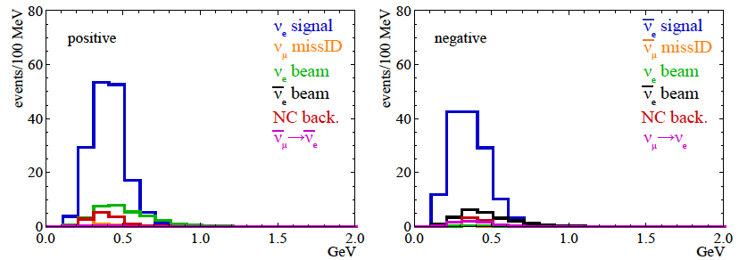
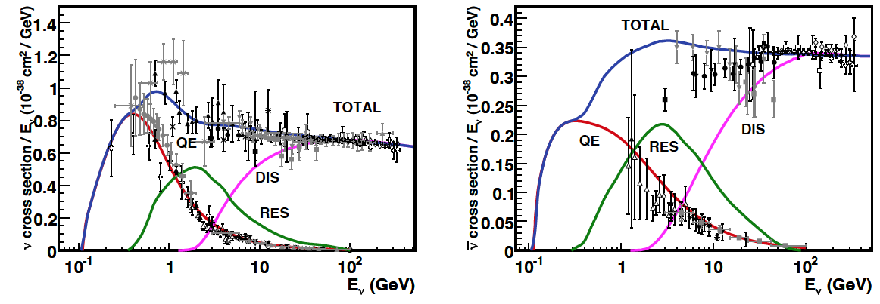
Neutrino spectra
540 km (2 GeV), 10 years
below ν_{τ} production, almost only QE events
neutrinos
anti-neutrinos
δ_{CP}=0
2 years
8 years

Slide 9
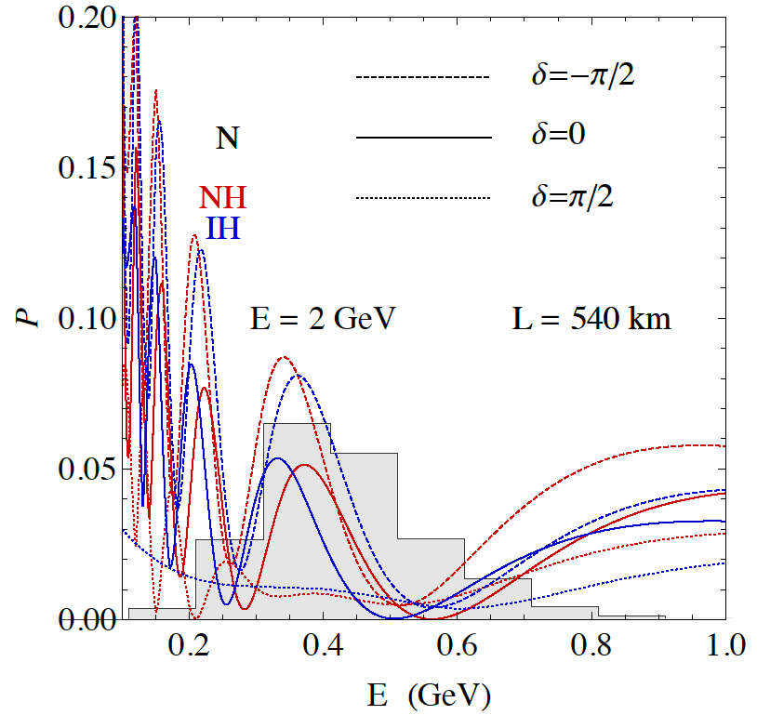
2nd Oscillation max. coverage
2nd oscillation max.
well covered by the ESS neutrino spectrum
1st oscillation max.

Slide 10
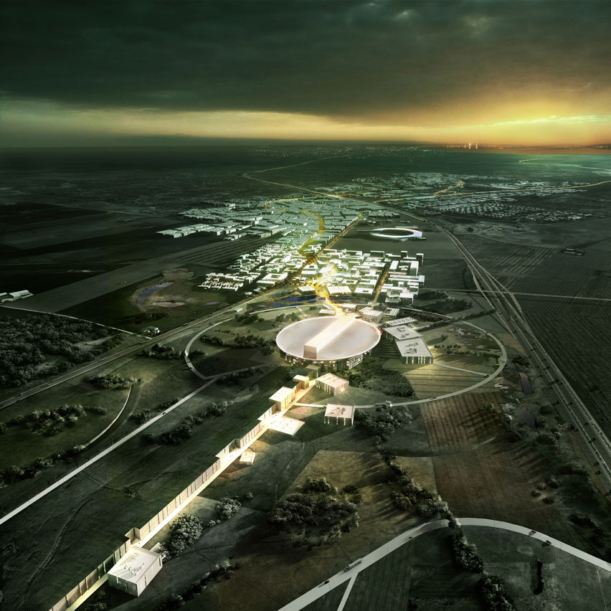
ESS Linac modifications to produce a neutrino Super Beam
European Spallation Source Linac

Slide 11
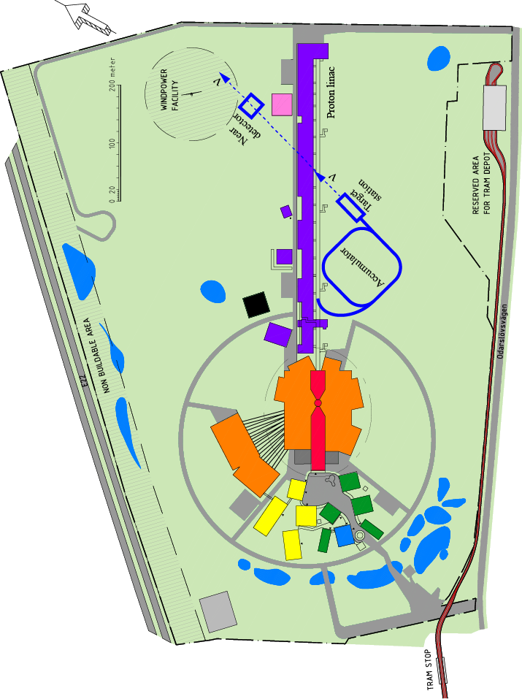
How to add a neutrino facility?
The neutron program must not be affected and if possible synergetic modifications.
Linac modifications: double the rate (14 Hz → 28 Hz), from 4% duty cycle to 8%.
Accumulator (C~400 m) needed to compress to few μs the 2.86 ms proton pulses, affordable by the magnetic horn (350 kA, power consumption, Joule effect)
  H⁻ source (instead of protons),
  space charge problems to be solved.
~300 MeV neutrinos.
Target station (studied in EUROν).
Underground detector (studied in LAGUNA).
Short pulses (~μs) will also allow DAR experiments (as those proposed for SNS) using the neutron target.

Slide 12
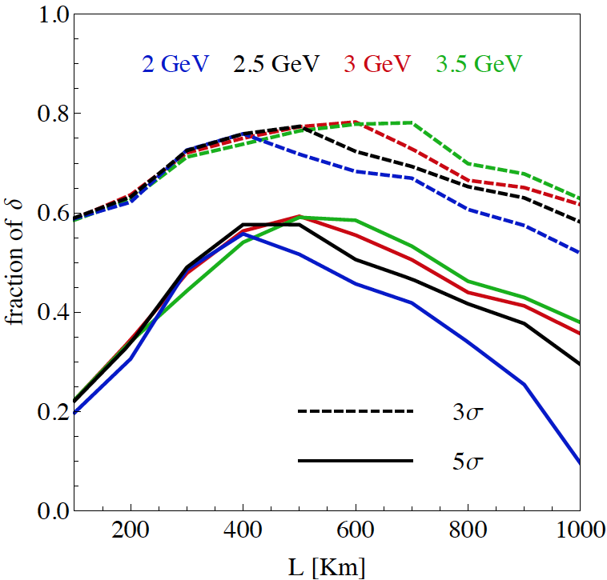
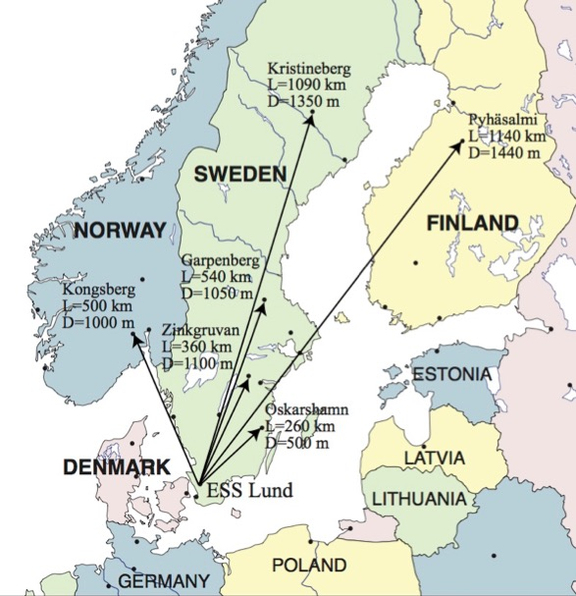
Which baseline?
CPV (Nucl. Phys. B 885 (2014) 127)
Garpenberg
Zinkgruvan
~60% δ_{CP} coverage at 5 σ C.L.
>75% δ_{CP} coverage at 3 σ C.L.
systematic errors: 5%/10% (signal/backg.)
Candidate active mines

Slide 13
Physics Performance
540 km
little dependence on mass hierarchy (not so long baseline),
δ_{CP} coverage at 5 σ C.L. up to 60%,
δ_{CP} accuracy down to 6° at 0° and 180° (absence of CPV for these two values),
not yet optimized facility,
5/10% systematic errors on signal/background.

Slide 14
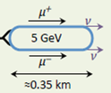
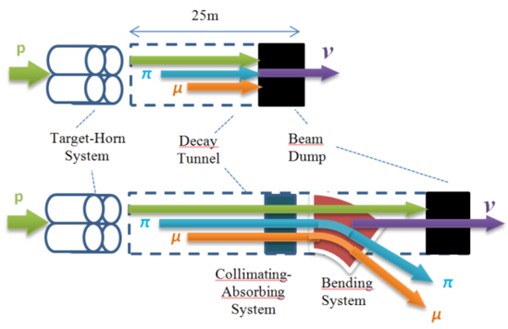
ESS neutrino and muon facility
2.7x10²³ p.o.t/year
Neutrons to ESS
ESS proton driver
Protons dump
ν_{μ} or ‾ν_{μ}
Long
Baseline
Detector
π decay
ESSnuSB
Test Facility
μ⁺ or μ⁻
ν_{μ} + ‾ν_{e}
Short
Baseline
Detector
Short
Baseline
Detector
Accumulator
Decay
channel or ring
nuSTORM
Front end
ν_{e} + ‾ν_{μ}
Muons of average energy ~0.5 GeV at the level of the beam dump (per proton)
RLA
acceleration
Storage
ring
Cooling
Long
Baseline
Detector
Neutrino
Factory
RCS
acceleration
Collider
ring
Muon Collider
→ ←
μ⁺ μ⁻

Slide 15
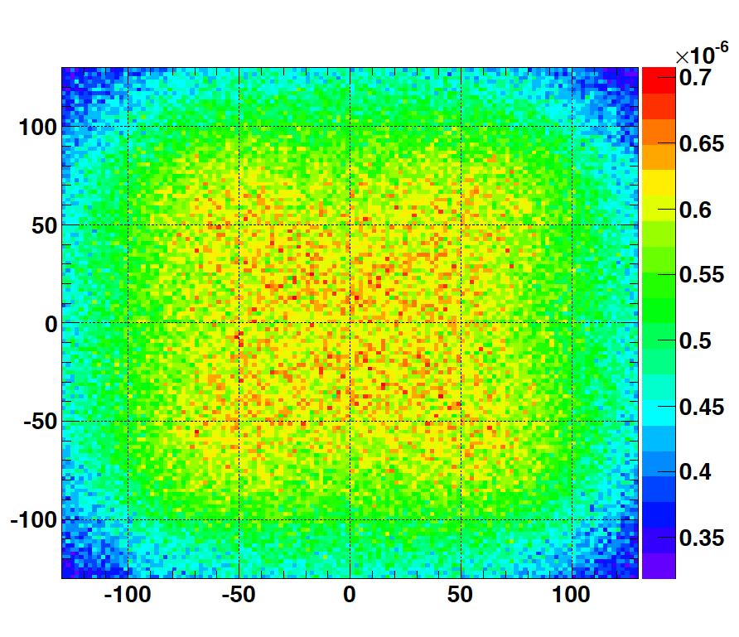
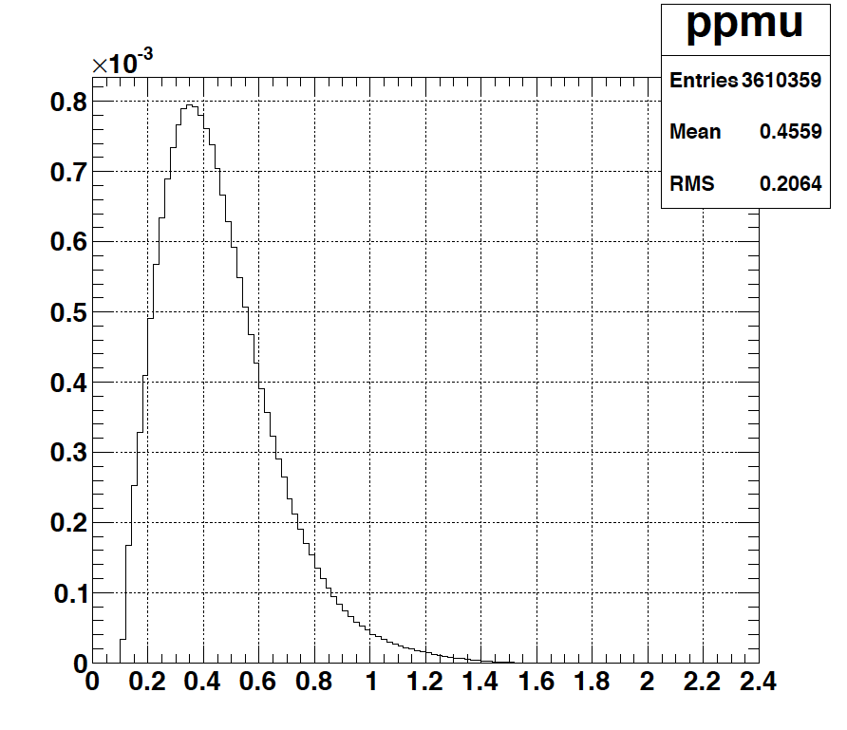
Muons at the level of the beam dump
2.7x10²³ p.o.t/year
y (cm)
muons at the level of the beam dump
(per proton)
more than 4x10²⁰ μ/year from ESSS compared to 10¹⁴ μ used by all experiments up to now (10¹⁸ μ for COMET in the future).
4.2x10²⁰ μ/year
(16.3x10²⁰ for 4 m²)
x (cm)
10⁻³
4.1x10²⁰ μ/year
input beam for future 6D μ cooling experiments (for muon collider),
low energy nuSTORM,
Neutrino Factory,
Muon Collider.
muons/proton
<E_{μ}>~0.46 GeV
<L_{μ}>~2.9 km

Slide 16
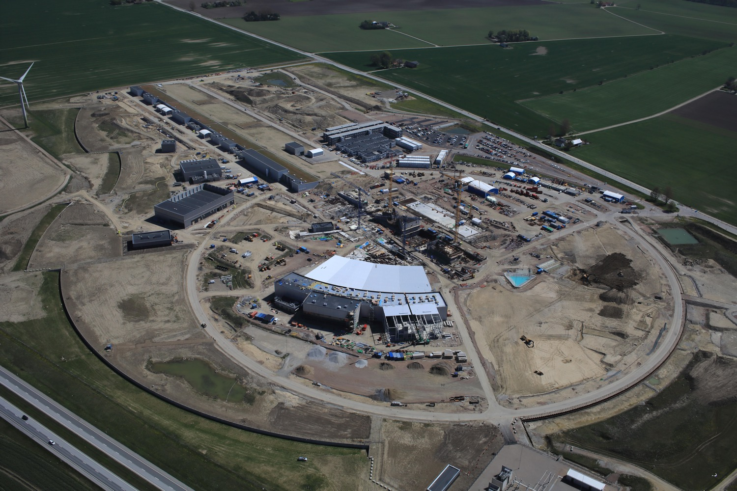
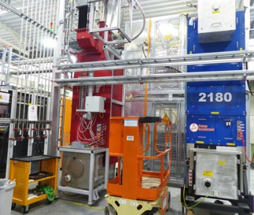
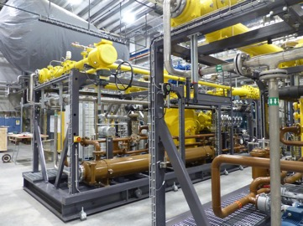
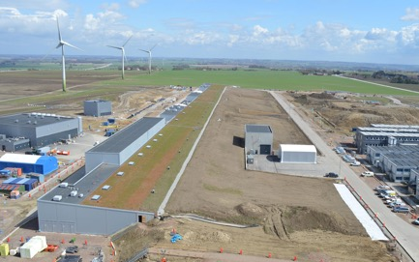
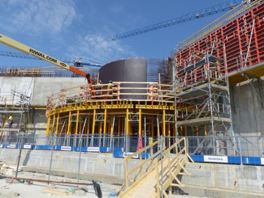
European Spallation Source
May 2018
Target station
klystrons
cryoplants
Proton linac

Slide 17

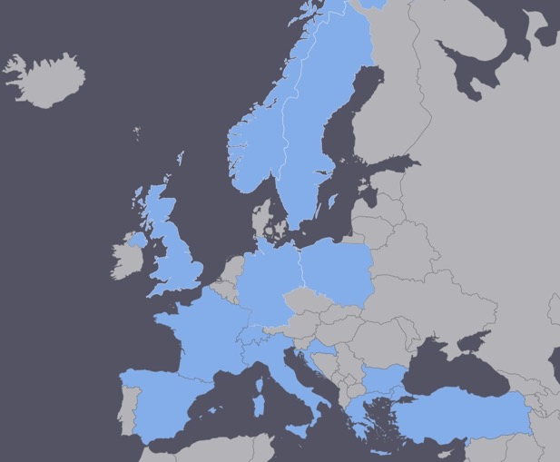
ESSνSB at the European level
COST application for networking: CA15139 (2016-2019)
  EuroNuNet : Combining forces for a novel European facility for neutrino-antineutrino symmetry violation discovery (http://www.cost.eu/COST_Actions/ca/CA15139)
  Major goals of EuroNuNet:
    to aggregate the community of neutrino physics in Europe to study the ESSνSB concept in a spirit of inclusiveness,
    to impact the priority list of High Energy Physics policy makers and of funding agencies to this new approach to the experimental discovery of leptonic CP violation.
  13 participating countries (network still growing).
http://euronunet.in2p3.fr/

Slide 18

ESSνSB at the European level
A H2020 EU Design Study (Call INFRADEV-01-2017)
Title of Proposal: Discovery and measurement of leptonic CP violation using an intensive neutrino Super Beam generated with the exceptionally powerful ESS linear accelerator
Duration: 4 years
Total cost: 4.7 M€
Requested budget: 3 M€
15 participating institutes from
11 European countries including CERN and ESS
6 Work Packages
Approved end of August 2017
ESSνSB
BENE (2004-2008)
ISS (2005-2007)
EUROν (2008-2012)
LAGUNA (2008-2010)
LAGUNA-LBNO (2010-2014)
COST Action CA15139 (2015-2019)

Slide 19
Design Study ESSνSB
(2018-2021)
Kick-off meeting in January 2018.
ESSνSB has already started engaging postdocs.
More information on:
http://essnusb.eu/
partners: IHEP, BNL, SCK•CEN, SNS, PSI, RAL

Slide 20
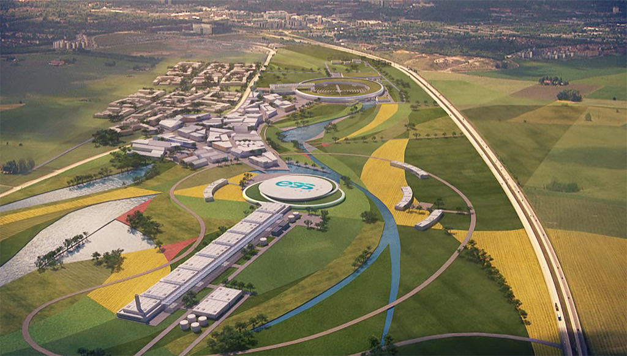
Conclusion
ESS will have enough protons to go to the 2nd oscillation maximum and increase its CPV sensitivity.
CPV: 5 σ could be reached over 60% of δ_{CP} range by ESSνSB with large potentiality.
Large associated detectors have a rich astroparticle physics program.
The European Spallation Source Linac will be ready by 2023, upgrade decisions by this moment.
Rich muon program.
COST network project CA15139 supports this project.
The EU-H2020 Design Study ESSνSB has just started (2018-2021).

Slide 21
Backup

Slide 22
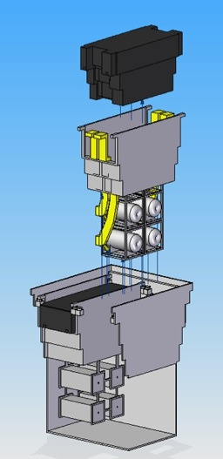
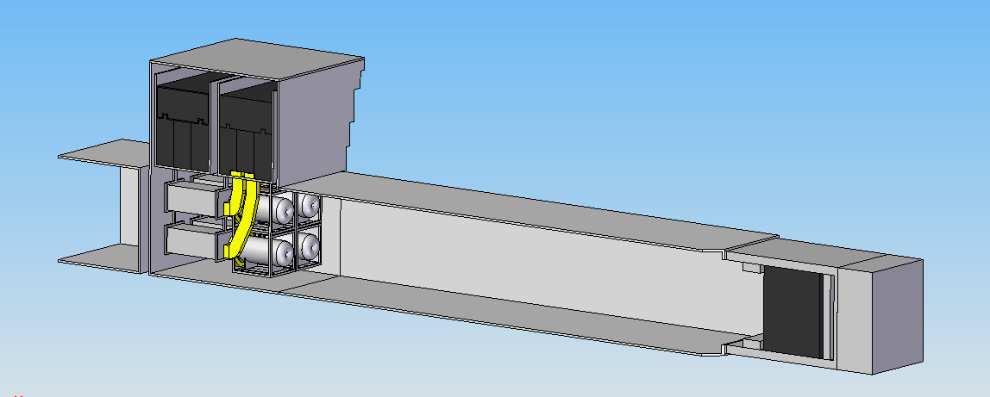
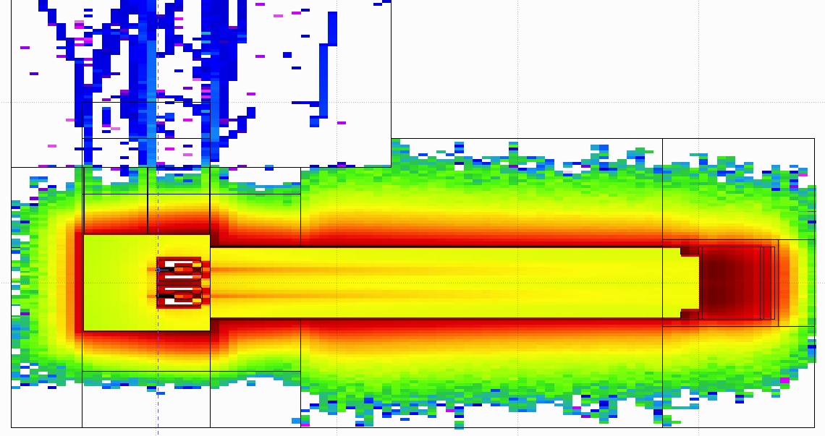
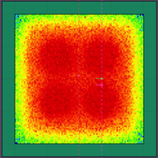
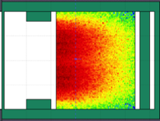
General Layout of the target station
(copied from EUROν DS)
Shield Blocks
Horn Support Module
8 m concrete
Split Proton Beam
Horns and Targets
Collimators
Decay Volume
(He, 4x4x25 m³)
Neutrino Beam Direction
Beam Dump

Slide 23
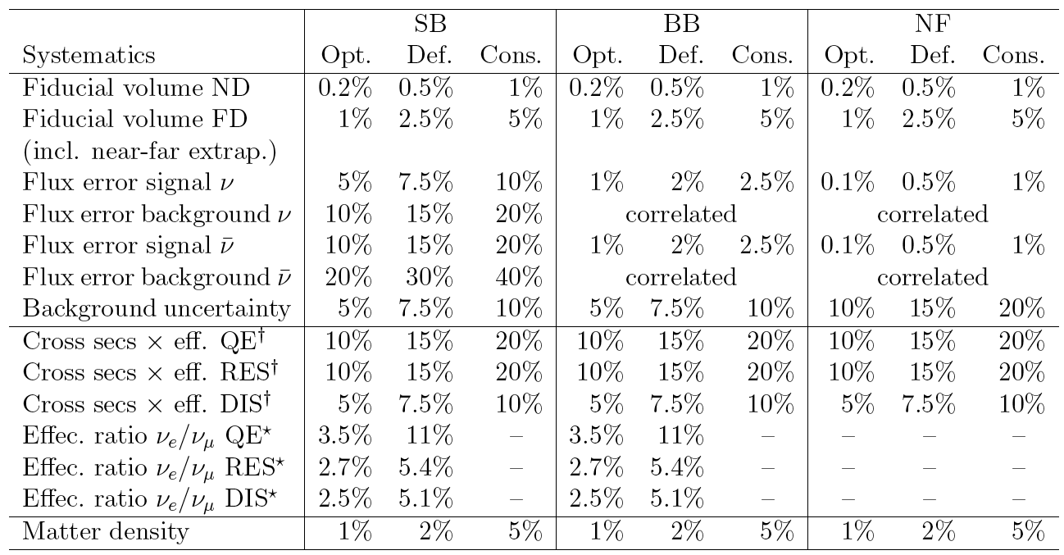
Systematic errors
Phys. Rev. D 87 (2013) 3, 033004 [arXiv:1209.5973 [hep-ph]]

Slide 24
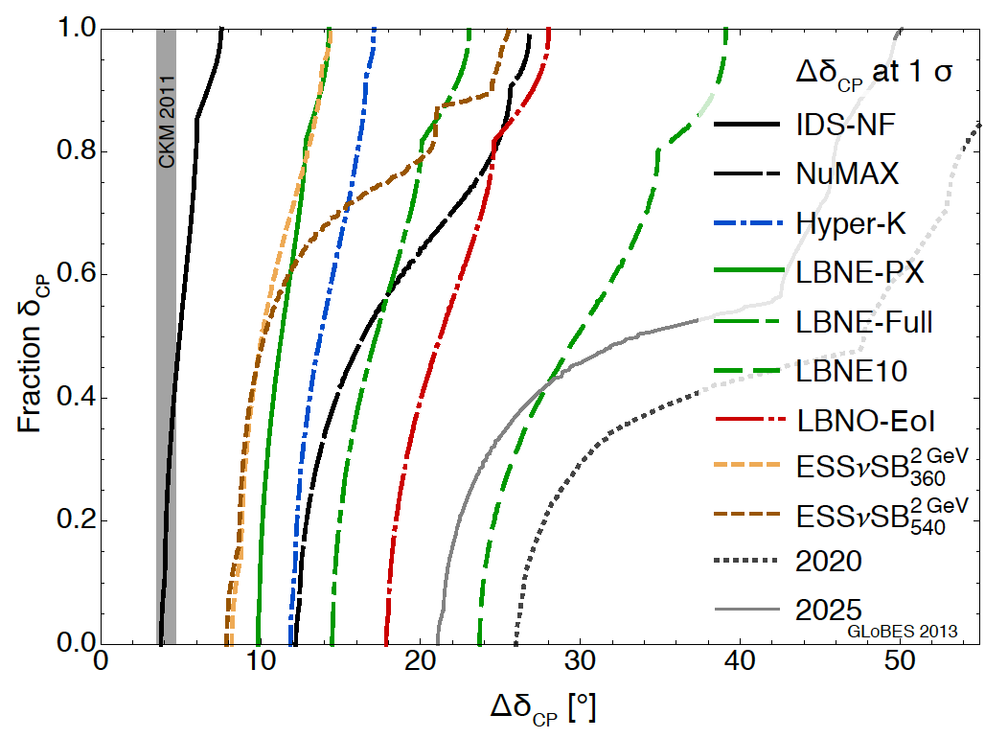
δ_{CP} accuracy performance
(USA snowmass process, P. Coloma)
"default" column
for systematic errors see (7.5%/15% for ESSnuSB):
Phys. Rev. D 87 (2013) 3, 033004 [arXiv:1209.5973 [hep-ph]]
arXiv:1310.4340 [hep-ex] Neutrino "snowmass" group conclusions

Slide 25
Comparisons
Comparison using the same systematic errors
Phys. Rev. D 87 (2013) 3, 033004 [arXiv:1209.5973 [hep-ph]]

