Slide 1
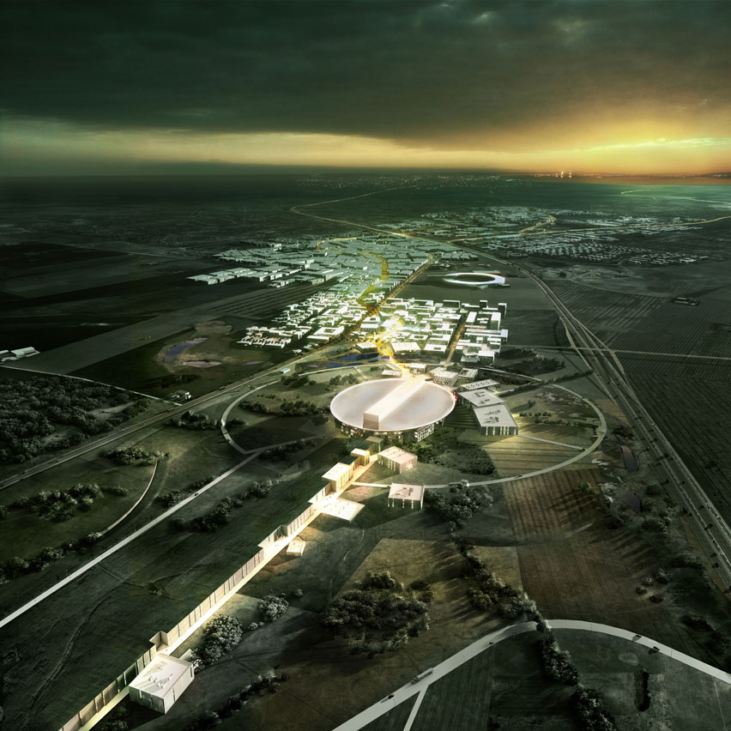
The proposed ESS neutrino Super Beam project ‘ESSnuSB’ and its physics case
NBI, Copenhagen 2018-02-13
Tord Ekelöf
Uppsala University

Slide 2

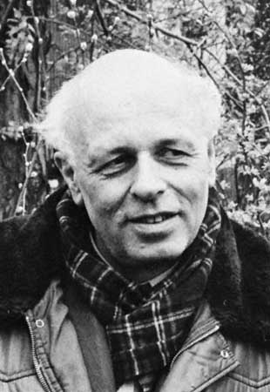
The Sakharov conditions (necessary but not sufficient) to explain the Baryon Asymmetry of the Universe (BAU):
1. At least one B-number violating process.
2. C- and CP-violation
3. Interactions outside of thermal equilibrium
Grand Unified Theories can fulfill the Sakharov conditions. However, in each m³ of the Universe there are on average ca 10⁹ photons, one proton and no antiproton. The CP violation measured in the quark sector is far too small (by a factor 10⁹) to explain this 10⁹ photon to baryon ratio.
Now, neutrino CP-violation, so far not observed, may very well be large enough to permit an explanation of BAU through the leptogenesis mechanism which relates the matter-antimatter asymmetry of the universe to neutrino properties: decays of heavy Majorana neutrinos generate a lepton asymmetry which is partly converted to a baryon asymmetry via sphaleron processes.
.
Why is there only matter and
no antimatter in Universe?

Slide 3
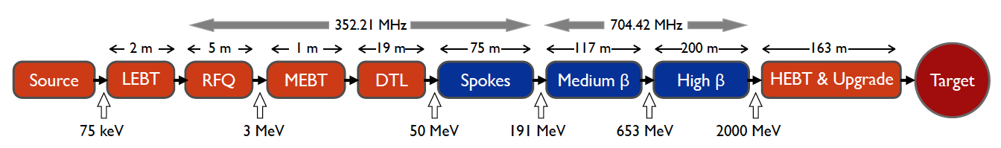
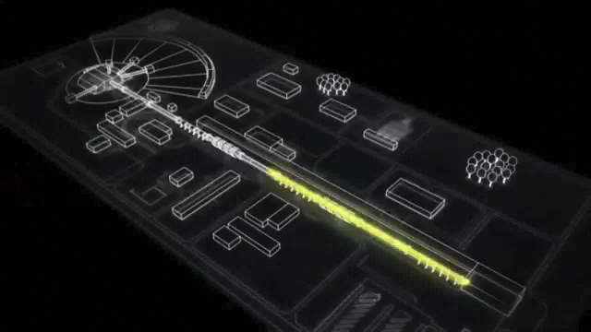
ESS proton linac
The ESS will be a copious source of spallation neutrons.
5 MW average beam power.
125 MW peak power.
14 Hz repetition rate (2.86 ms pulse duration, 10¹⁵ protons).
Duty cycle 4%.
2.0 GeV protons
  up to 3.5 GeV with linac upgrades
>2.7x10²³ p.o.t/year.

Slide 4
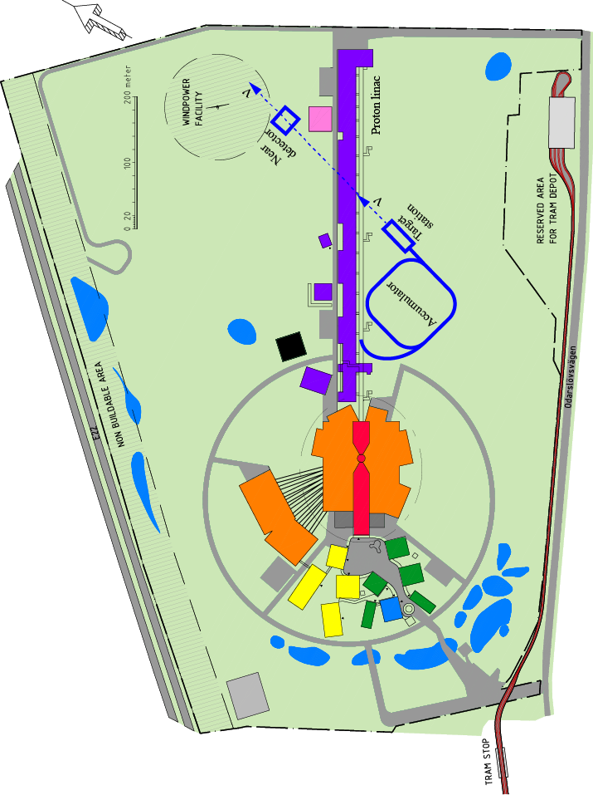
How to add a neutrino facility?
The neutron program must not be affected and if possible synergetic modifications.
Linac modifications: double the rate (14 Hz → 28 Hz), from 4% duty cycle to 8%.
Accumulator (C~400 m) needed to compress to few μs the 2.86 ms proton pulses, affordable by the magnetic horn (350 kA, power consumption, Joule effect)
  H⁻ source (instead of protons),
  space charge problems to be solved.
~300 MeV neutrinos.
Target station (studied in EUROν).
Underground detector (studied in LAGUNA).
Short pulses (~μs) will also allow DAR experiments (as those proposed for SNS) using the neutron target.

Slide 5
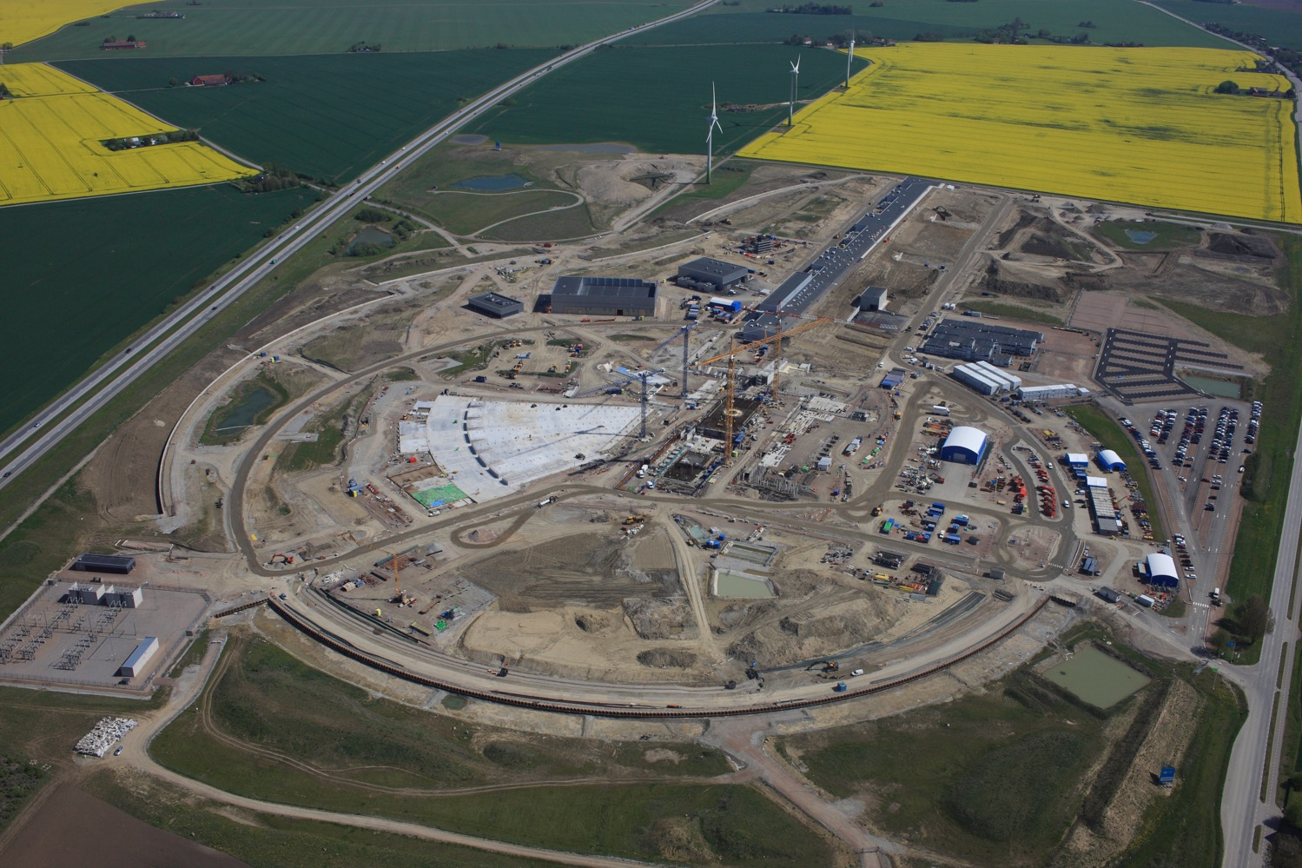
The neutron and neutrino beams
ν
p
n
H⁻
May 2017

Slide 6
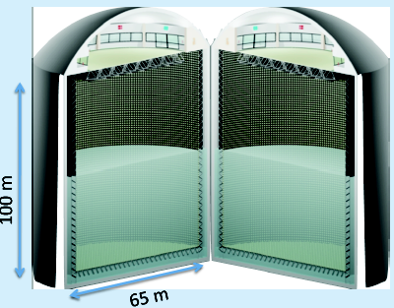
The EUROnu MEMPHYS MegatonWater Cherenkov Detector
MEMPHYS like Cherenkov detector(MEgaton Mass
PHYSics studied by LAGUNA)
500 kt fiducial volume
(~20xSuperK)
Readout: ~240k 8” PMTs
30% optical coverage
(arXiv: hep-ex/0607026)

Slide 7
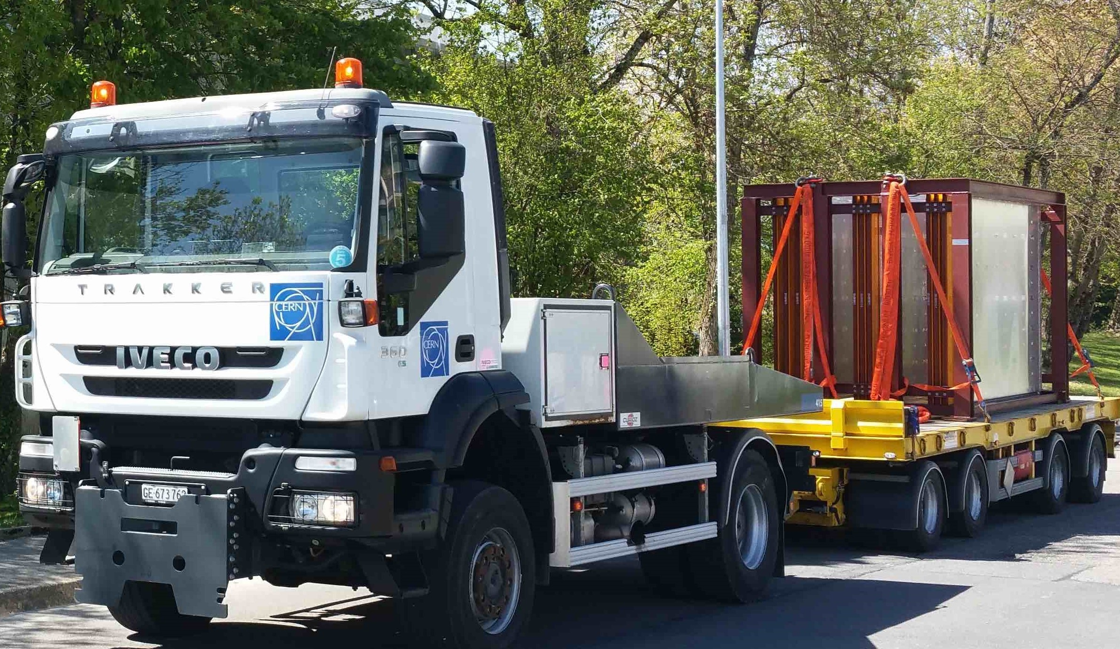
Near detector studies
Alexander Burgman
Master thesis
Cylindrical kiloton water Cherenkov detector
Radius ∼ 5 m.
Length ∼ 10 m.
Patrik Simion
Master thesis
Participated last summer
with Geneva Group in
the PS beam tests of
Baby MIND now sent
to Japan
Scintillator Cubes detector
is part of a Development
and Test Proposal to the
SPSC by the ND280
Collaboration – Sofia and
Uppsala Groups has declared
an interest to take part

Slide 8
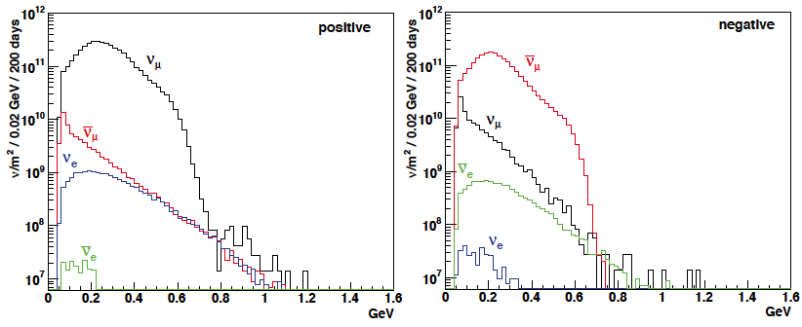
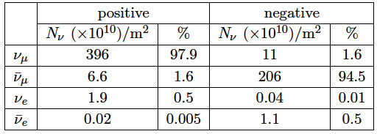
ESSνSB ν energy distribution
(without optimisation)
neutrinos
anti-neutrinos
almost pure ν_{μ} beam
small ν_{e} contamination which could be used to measure ν_{e} cross-sections in a near detector
at 100 km from the target and per year (in absence of oscillations)

Slide 9
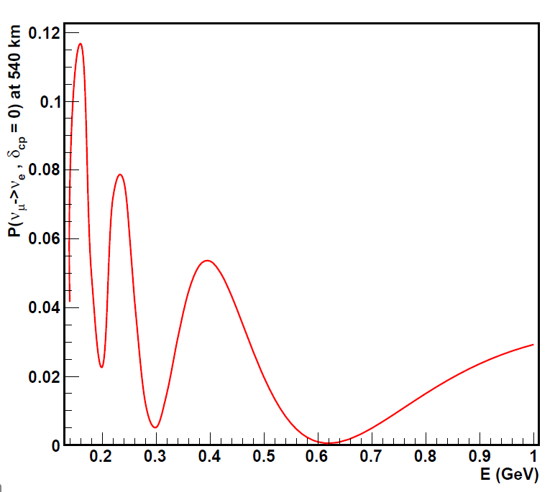
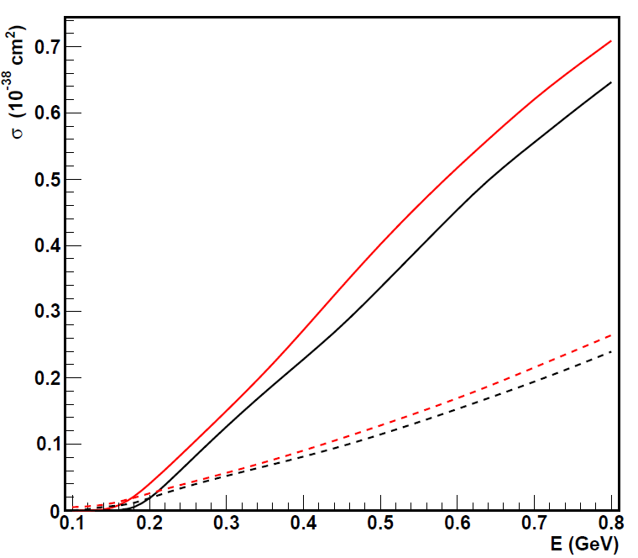
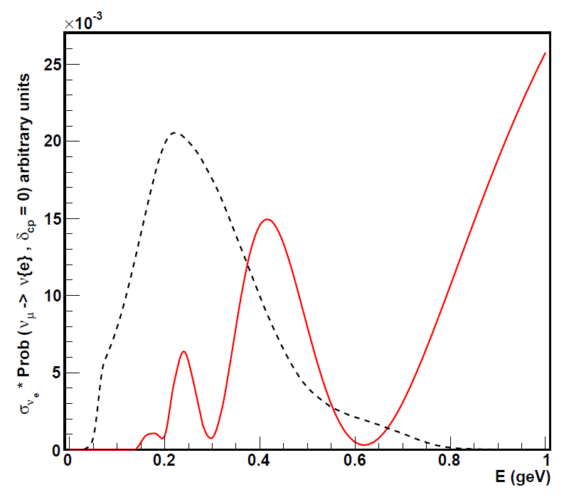
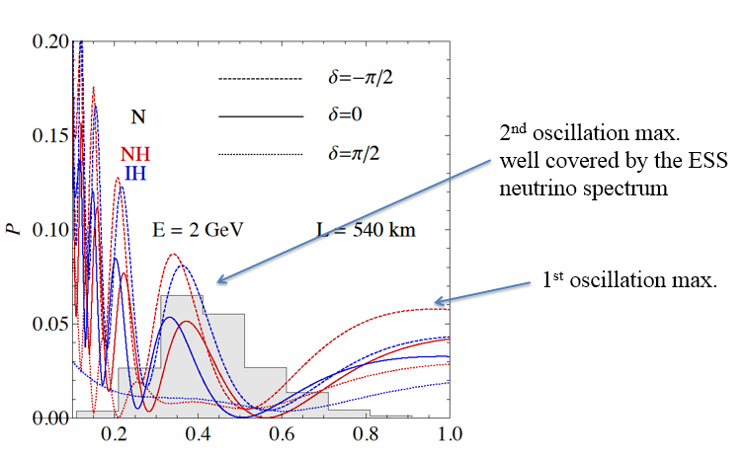
Convolution (prob*xs) vs flux
xs CC, wat.dat file (Enrique)
nue
anue
numu
anumu
flux(E)
2.5 GeV
E=2 GeV
L=540 km
(prob*xs)(E)
dcp=0, NH
CC = mass*(flux*xs*prob*ε)(E)

Slide 10
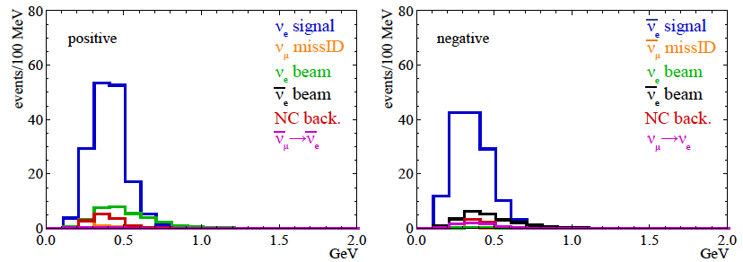
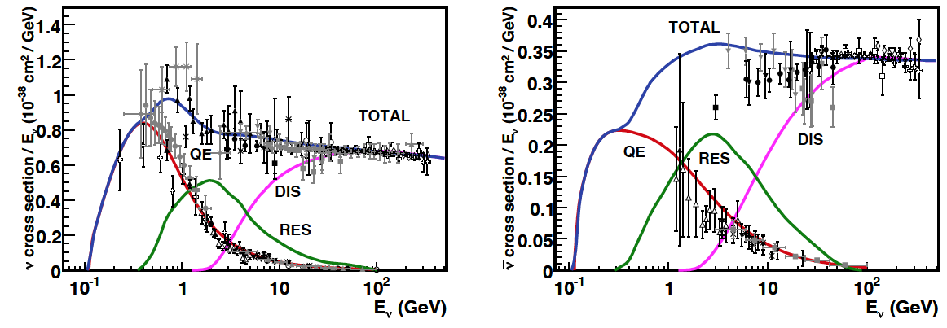
Neutrino spectra
540 km (2 GeV), 10 years
below ν_{τ} production, almost only QE events
neutrinos
anti-neutrinos
δ_{CP}=0
2 years
8 years

Slide 11
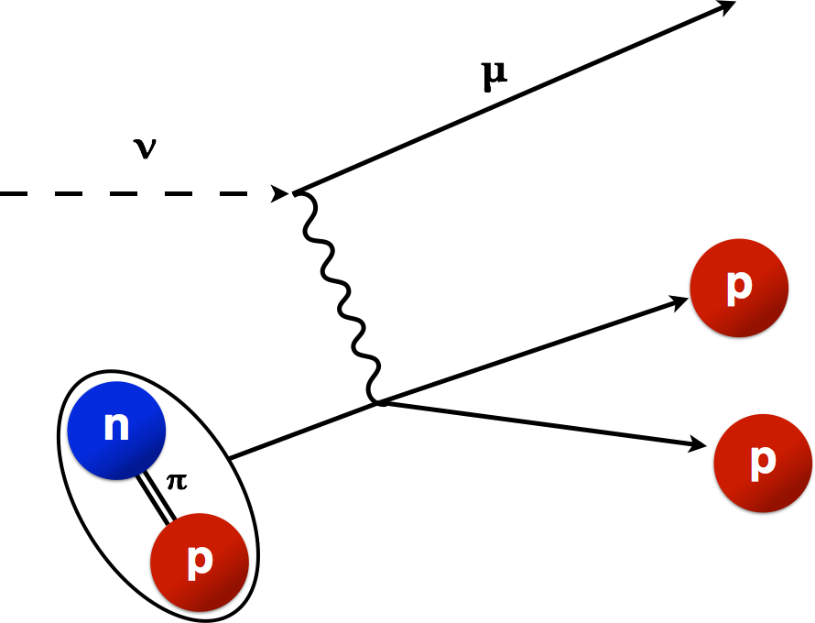
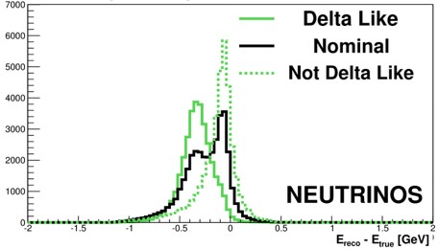
Systematic error sources
ν_{e} in the beam from K and µ decays
Events with π ͦand γ production
ν_{µ} misidentified as ν_{e}
ν-nucleus cross-section uncertainty for QE, RES and DIS scattering
E_{ν} reconstruction error due to multi-nucleon effects
Super-K has achieved a systematic error level of 5-6% after ca 10
years of operation using a by now very sophisticated Near Detector.

Slide 12
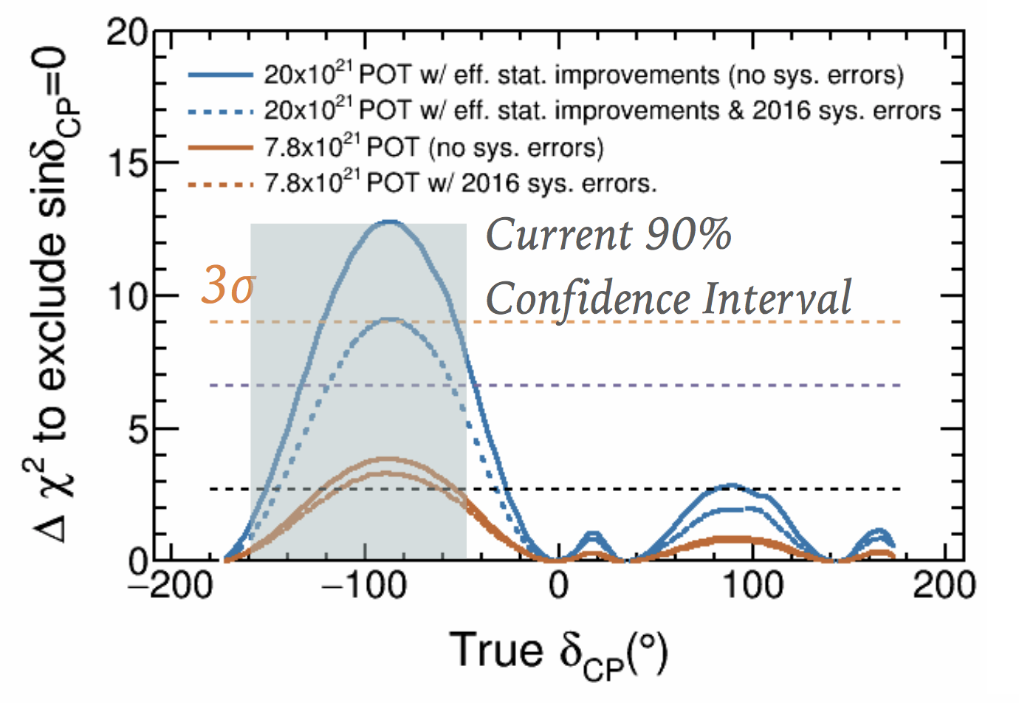
Status of T2K δ_{CP} search
By 2026
By 2017

Slide 13
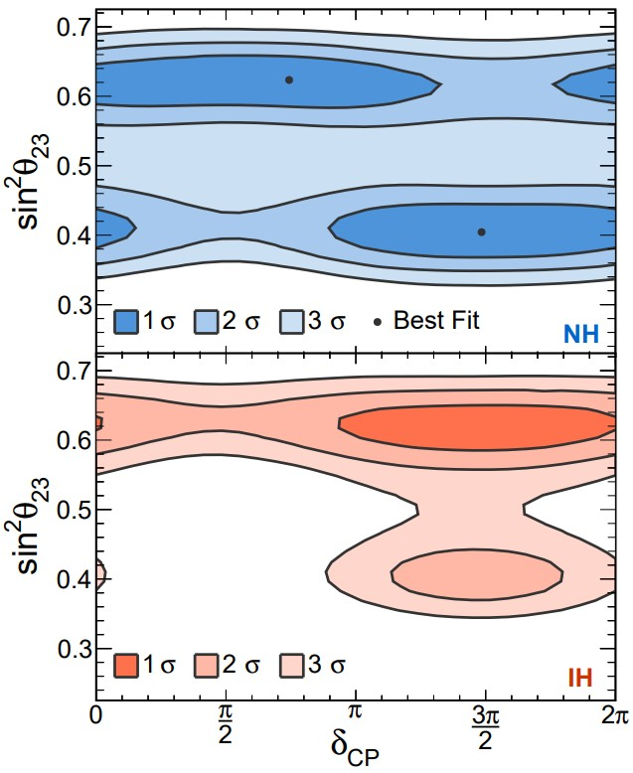
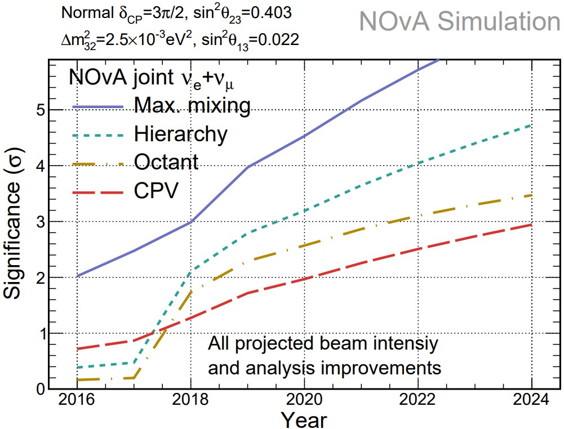
Status of NOνA δ_{CP} search
Significance at
which the
value of δ_{CP}
is disfavored
for each of
the four
possible
combinations
of mass
hierarchy
▪Two statistically degenerate best fit points in Normal Hierarchy :
sin2𝜽𝟐𝟑= 𝟎.𝟒𝟎𝟒, δCP= 1.48π, and
sin2𝜽𝟐𝟑= 𝟎.𝟔𝟐𝟑,δCP= 0.74π

Slide 14
ESSnuSB δ_{CP} sensitivity
little dependence on mass hierarchy (not so long baseline),
δ_{CP} coverage at 5 σ C.L. up to 60%,
δ_{CP} accuracy down to 6° at 0° and 180° (absence of CPV for these two values),
not yet optimized facility.

Slide 15
Systematic errors and exposure
High potentiality
5% systematic error
(courtesy P. Coloma)

Slide 16
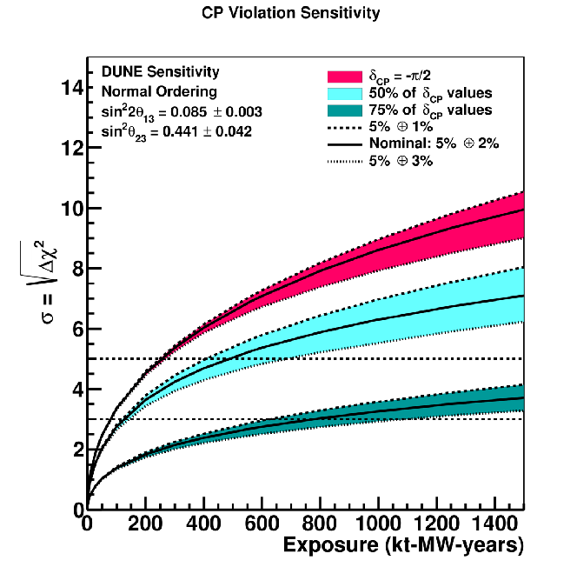
DUNE and HK δ_{CP} sensitivity
DUNE: 1-3% νe signal normalisation uncertainty
For CP, important to keep uncertainty at ≲2%
DUNE
DUNE
10 years exposure
10 years at 1 MW

Slide 17
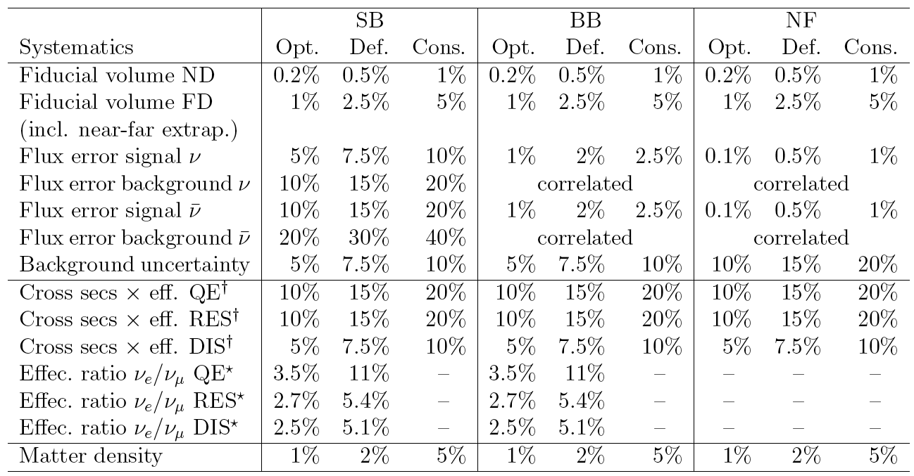
Systematic errors
Systematic uncertainties in long-baseline neutrino oscillations for large θ13
Pilar Coloma, Patrick Huber, Joachim Kopp, and Walter Winter
Phys. Rev. D 87, 033004 – Published 11 February 2013

Slide 18
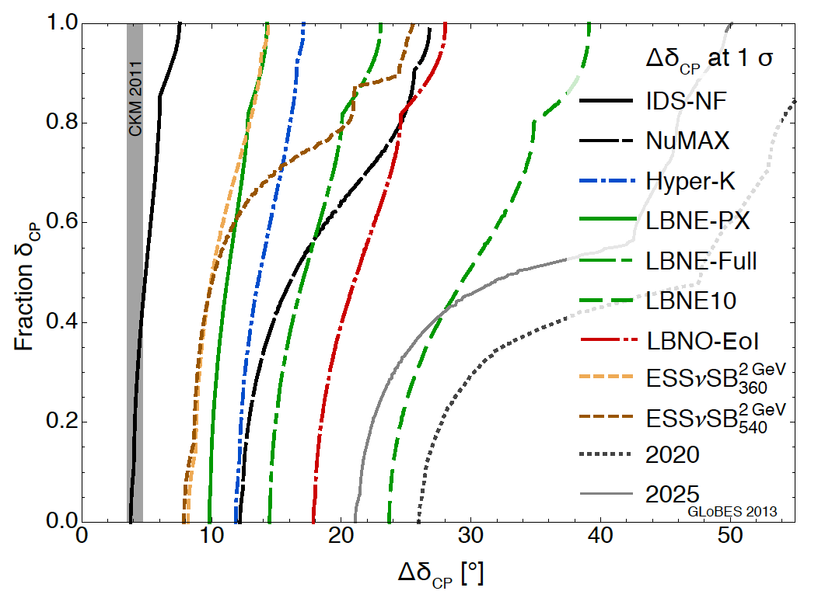
δ_{CP} accuracy performance
(USA snowmass process, P. Coloma)
"default" column
for systematic errors see (7.5%/15% for ESSnuSB):
Phys. Rev. D 87 (2013) 3, 033004 [arXiv:1209.5973 [hep-ph]]
arXiv:1310.4340 [hep-ex] Neutrino "snowmass" group conclusions

Slide 19
Comparisons under the assumption of 5% systematic error and 10 years of data taking for ESSnuSB, Hyper-K and DUNE

Slide 20
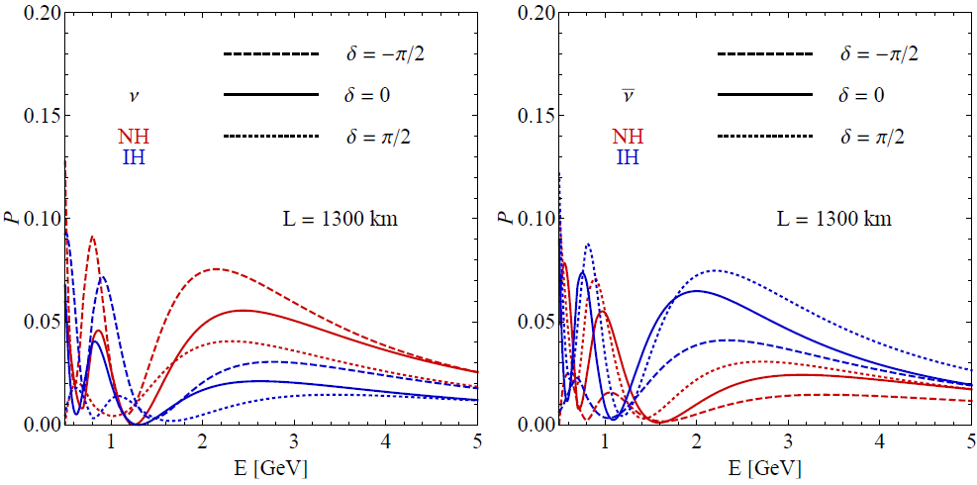
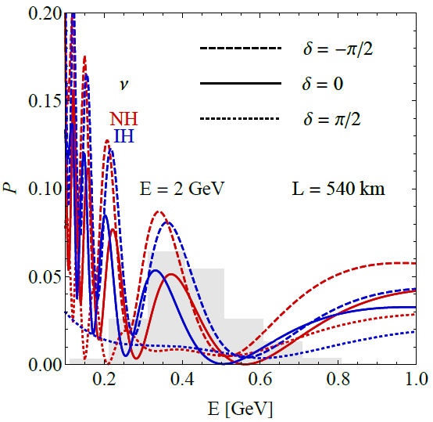
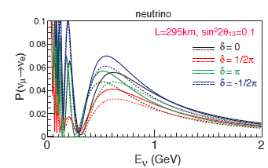

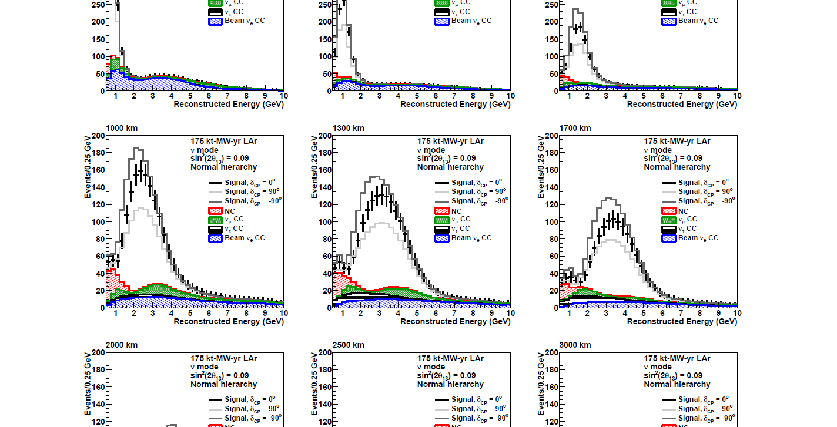
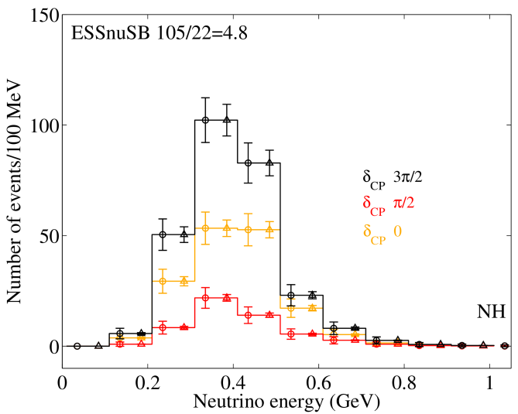
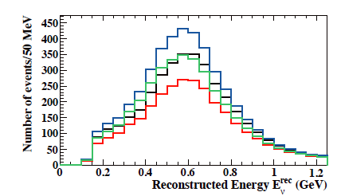
The sensitivity of the neutrino energy distribution to δ_{CP}
Hyper-K first maximum LBNE/DUNE first maximum ESSnuSB second maximum
Hyper-K
Hyper-K
Events/100MeV
Relative difference in counts at maximum between δ_{CP} = 3π/2 and π/2 :
430/275 = 1.6 150/100 = 1.5 105/22 = 4.8

Slide 21
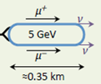
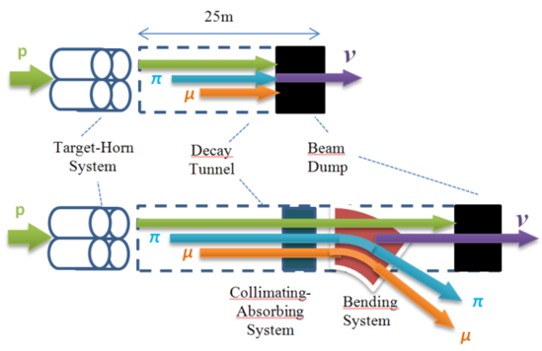
Future further option form a
ESS neutrino and muon facility
Neutrons to ESS
ESS proton driver
Protons dump
ν_{μ} or ‾ν_{μ}
Long
Baseline
Detector
π decay
ESSnuSB
2.7x10²³ p.o.t/year
Test Facility
μ⁺ or μ⁻
ν_{μ} + ‾ν_{e}
Short
Baseline
Detector
Short
Baseline
Detector
Accumulator
Decay
channel or ring
nuSTORM
Front end
ν_{e} + ‾ν_{μ}
Muons of average energy ~0.5 GeV at the level of the beam dump (per proton)
RLA
acceleration
Storage
ring
Cooling
Long
Baseline
Detector
Neutrino
Factory
RCS
acceleration
Collider
ring
Muon Collider
→ ←
μ⁺ μ⁻
more than 4x10²⁰ μ/year from ESSS compared to 10¹⁴ μ used by all experiments up to now (10¹⁸ μ for COMET in the future).

Slide 22
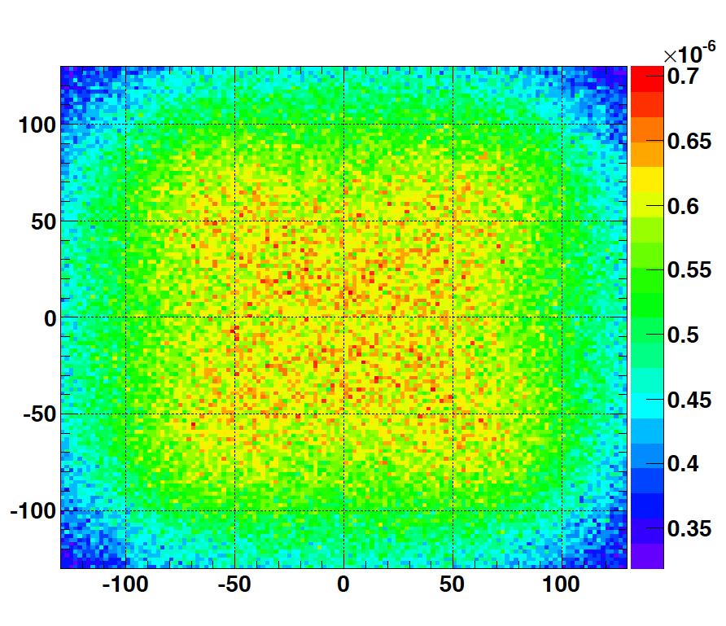
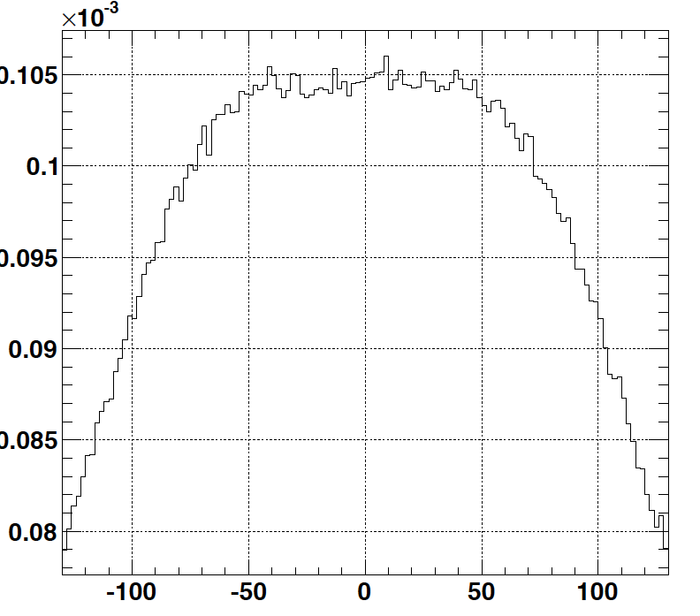
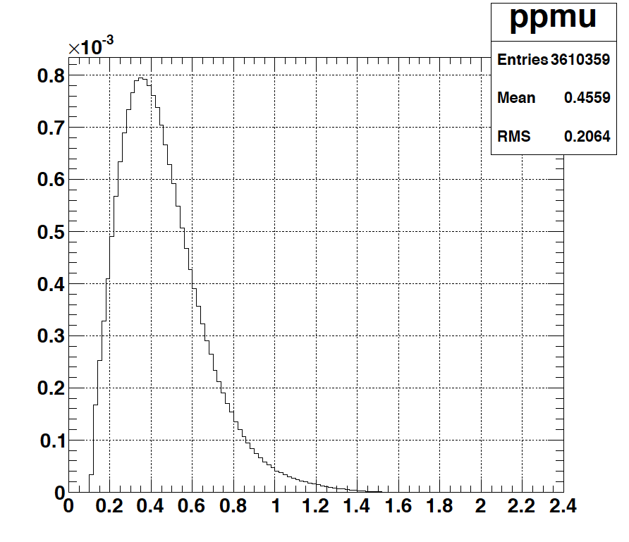
Muons at the level of the beam dump
2.7x10²³ p.o.t/year
y (cm)
muons at the level of the beam dump
(per proton)
4.2x10²⁰ μ/year
16.3x10²⁰ for 4 m²
x (cm)
10⁻³
4.1x10²⁰ μ/year
x (cm)
input beam for future 6D μ cooling experiments (for muon collider),
good to measure neutrino x-sections (ν_{μ}, ν_{e}) around 200-300 MeV using a near detector,
low energy nuSTORM,
Neutrino Factory,
Muon Collider.
muons/proton
<E_{μ}>~0.46 GeV
<L_{μ}>~2.9 km

Slide 23
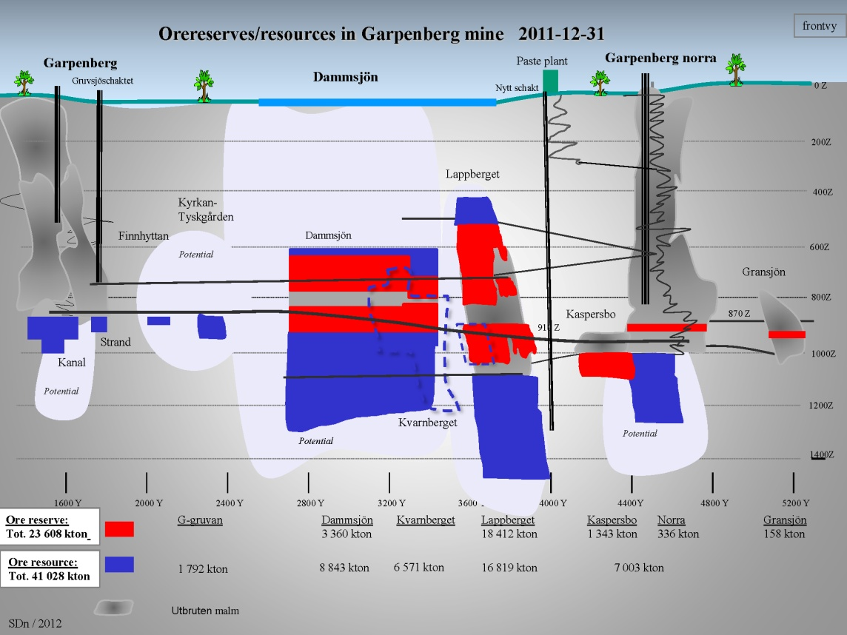
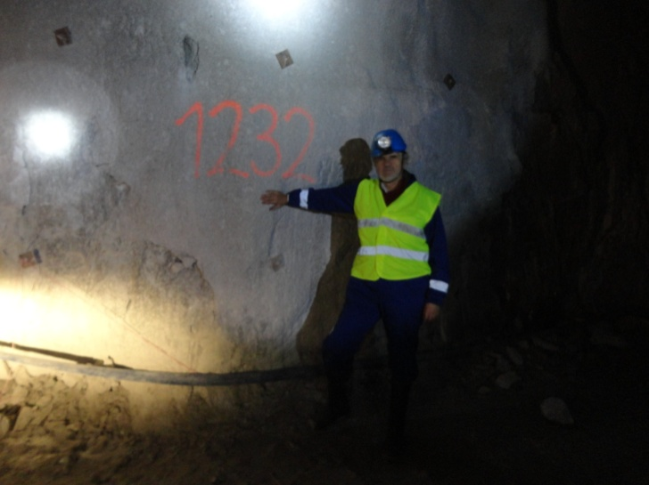
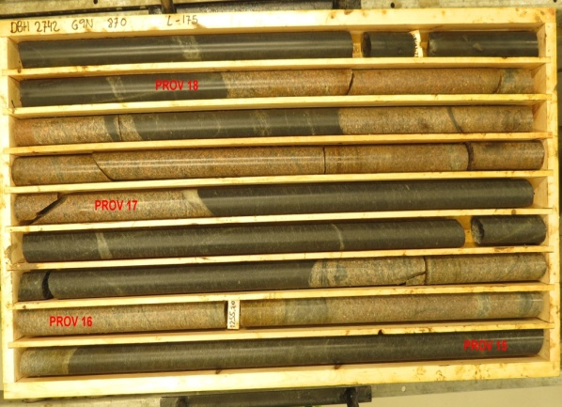
Gruvsjöschaktet
Nytt schakt
The MEMPHYS
Detector to be
located down in the
Garpenberg Mine
Distance from ESS Lund 540 km
Depth 1232 m
Truck access tunnels
Recently a new ore-hoist shaft
was taken into operation,
leaving the old Garpenberg Norra
shaft free for other uses
SDn / 2012
Granite drill cores

Slide 24
Garpenberg Bed Rock Investigation started
Working Team:
Morwan Derrien, Geologist. Boliden
Anders Österberg, Bedrock Engineer, Boliden
Lars Norling, Consultant
Kjell Grundström, Coordinator
Project Plan – 18 March 2018
Extent, Costs, Financing
Discusion – Ministry of Foreign Affairs –
Minister EU (A Linde)
15-18 M SEK

Slide 25
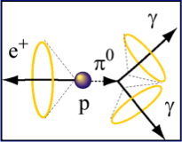
The MEMPHYS WC Detector underground detector physics
Proton decay
SuperNova neutrinos
  Supernovae "relics"
Solar Neutrinos
Atmospheric Neutrinos
Neutrino Oscillations
500 kt fiducial volume (~20xSuperK)
Readout: ~240k 8” PMTs
30% optical coverage
(arXiv: hep-ex/0607026)

Slide 26
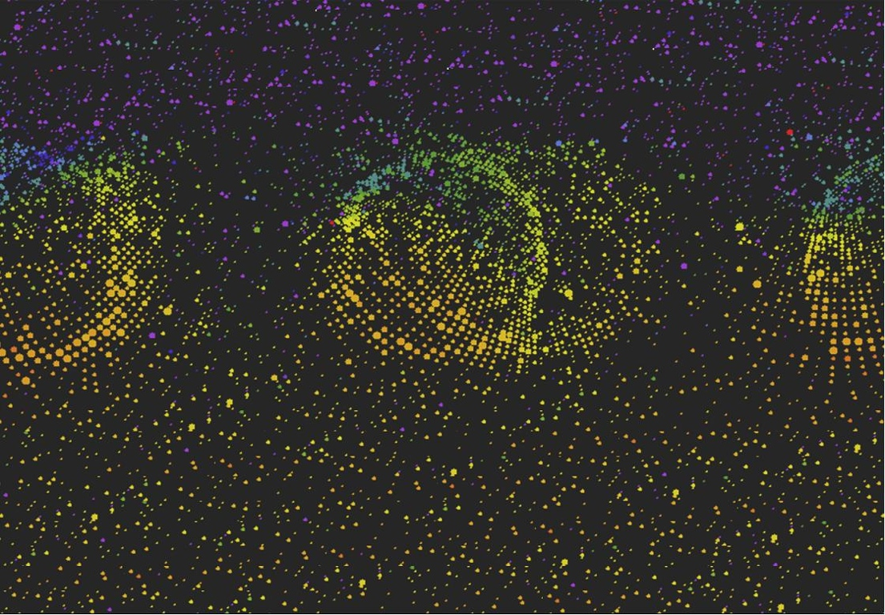
Proton Decay
26

Slide 27
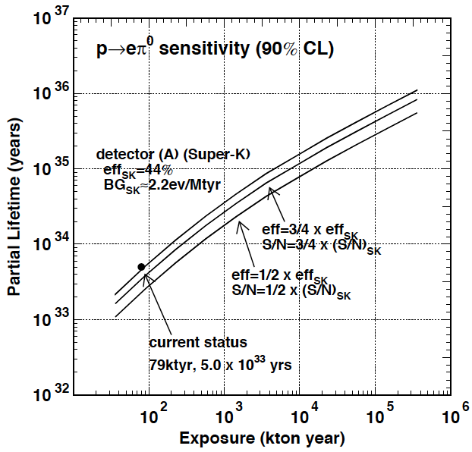
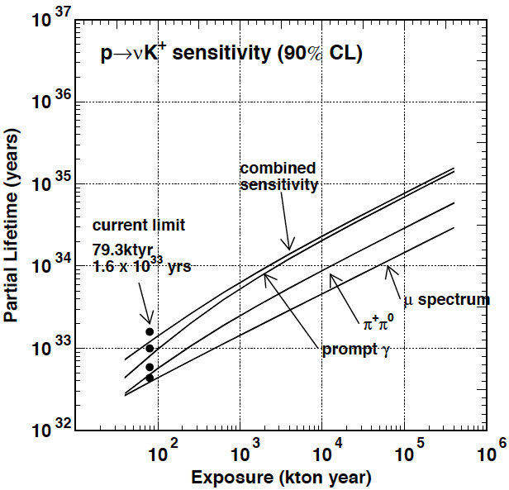
ESSnuSB-MEMPHYS sensitivities
proton decay
(arXiv: hep-ex/0607026)

Slide 28
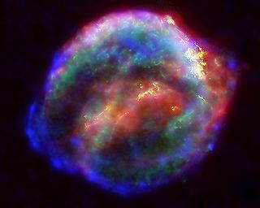
Supernova
28

Slide 29
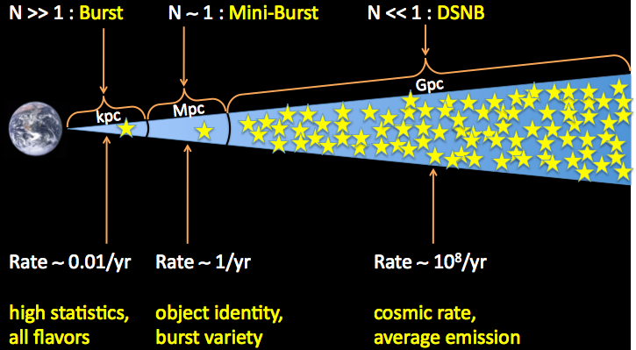
Distance scale and exp’d rate
Milky way
Nearby galaxies
Distant galaxies
29
Beacom@NU2012

Slide 30
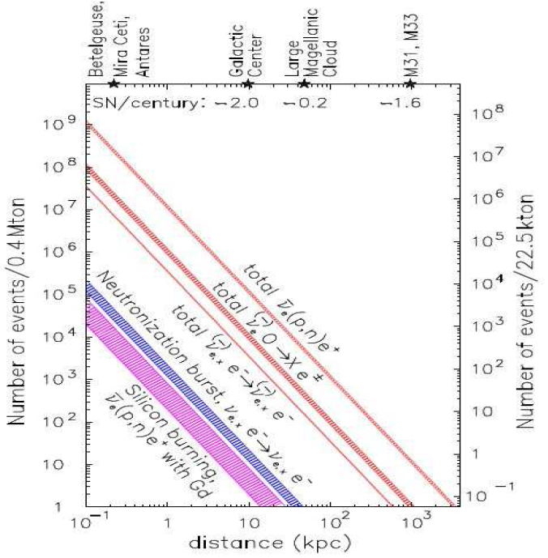
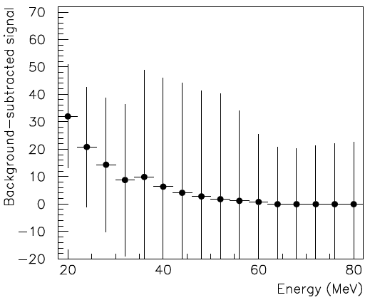
ESSnuSB-MEMPHYS sensitivities
Supernova explosion and relics
MEMPHYS
SUPERK
Diffuse Supernova Neutrinos
(10 years, 440 kt)
For 10 kpc: ~10⁵ events

Slide 31


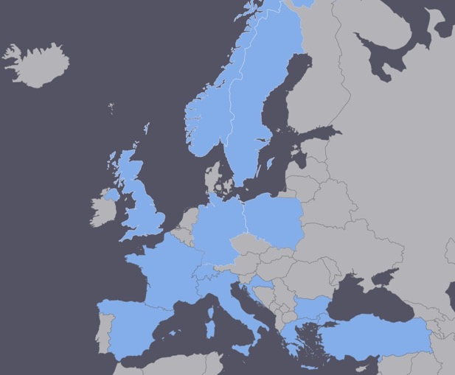
ESSνSB organization and plans
EU COST Action for networking approved in Spring 2016 for 2016-2019
  EuroNuNet : Combining forces for a novel European facility for neutrino-antineutrino symmetry violation discovery (http://www.cost.eu/COST_Actions/ca/CA15139)
  Major goals of EuroNuNet:
    to aggregate the community of neutrino physics in Europe to study the ESSνSB concept in a spirit of inclusiveness,
    to impact the priority list of High Energy Physics policy makers and of funding agencies to this new approach to the experimental discovery of leptonic CP violation.
  13 participating countries (network still growing).

Slide 32
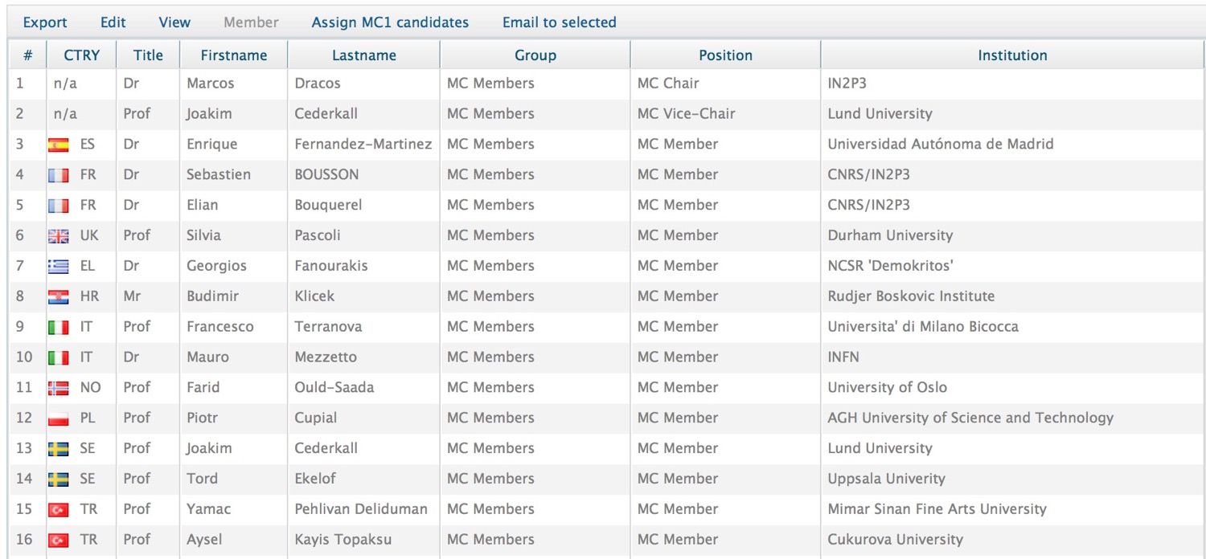
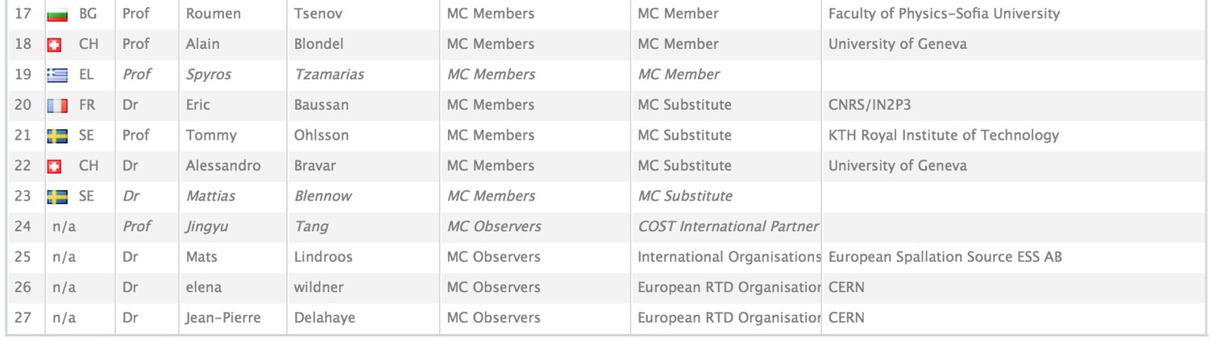
15 European Countries + Turkey members of EuroNuNet

Slide 33
EU Design Study for ESSnuSB approved by EU in December 2017 for 2018-2021
Title of Proposal: Discovery and measurement of leptonic CP violation using an intensive neutrino Super Beam generated with the exceptionally powerful ESS linear accelerator
Duration: 4 years
Total cost: 4.7 M€
Requested budget: 3 M€
15 participating institutes from
11 European countries including CERN and ESS
6 Work Packages
ESSνSB
BENE (2004-2008)
ISS (2005-2007)
EUROν (2008-2012)
LAGUNA (2008-2010)
LAGUNA-LBNO (2010-2014)
COST Action CA15139 (2015-2019)

Slide 34
Impact criterion
4.5 of 5 points
The project will have significant impact on enhancing attractiveness of Europe in future neutrino programs in the long baseline scheme. The
technical and scientific impacts due to the upgrade of ESS linac power, the construction of a high flux neutrino beam, implementation of the
near and far detectors and also the potential discovery of CP violation in the lepton sector are high. The project is strongly supported by the
main players in the field. CERN established a strong scientific case for long baseline neutrino program exploring CP violation. In addition, the
proposed design is recognized to address all critical issues by the scientific community. The project has a potential to increase and diversify the user community of ESS. Building an infrastructure in an currently unused mine will also have a local social impact.

Slide 35
Design Study ESSνSB
(2018-2021)
Very supportive letter from ESS director
The ESSnuSB Design Study is starting today with our kick-off in Lund, Sweden on 15-16 January 2018
ESSνSB has already started engaging postdocs.
partners: IHEP, BNL, SCK•CEN, SNS, PSI, RAL

Slide 37
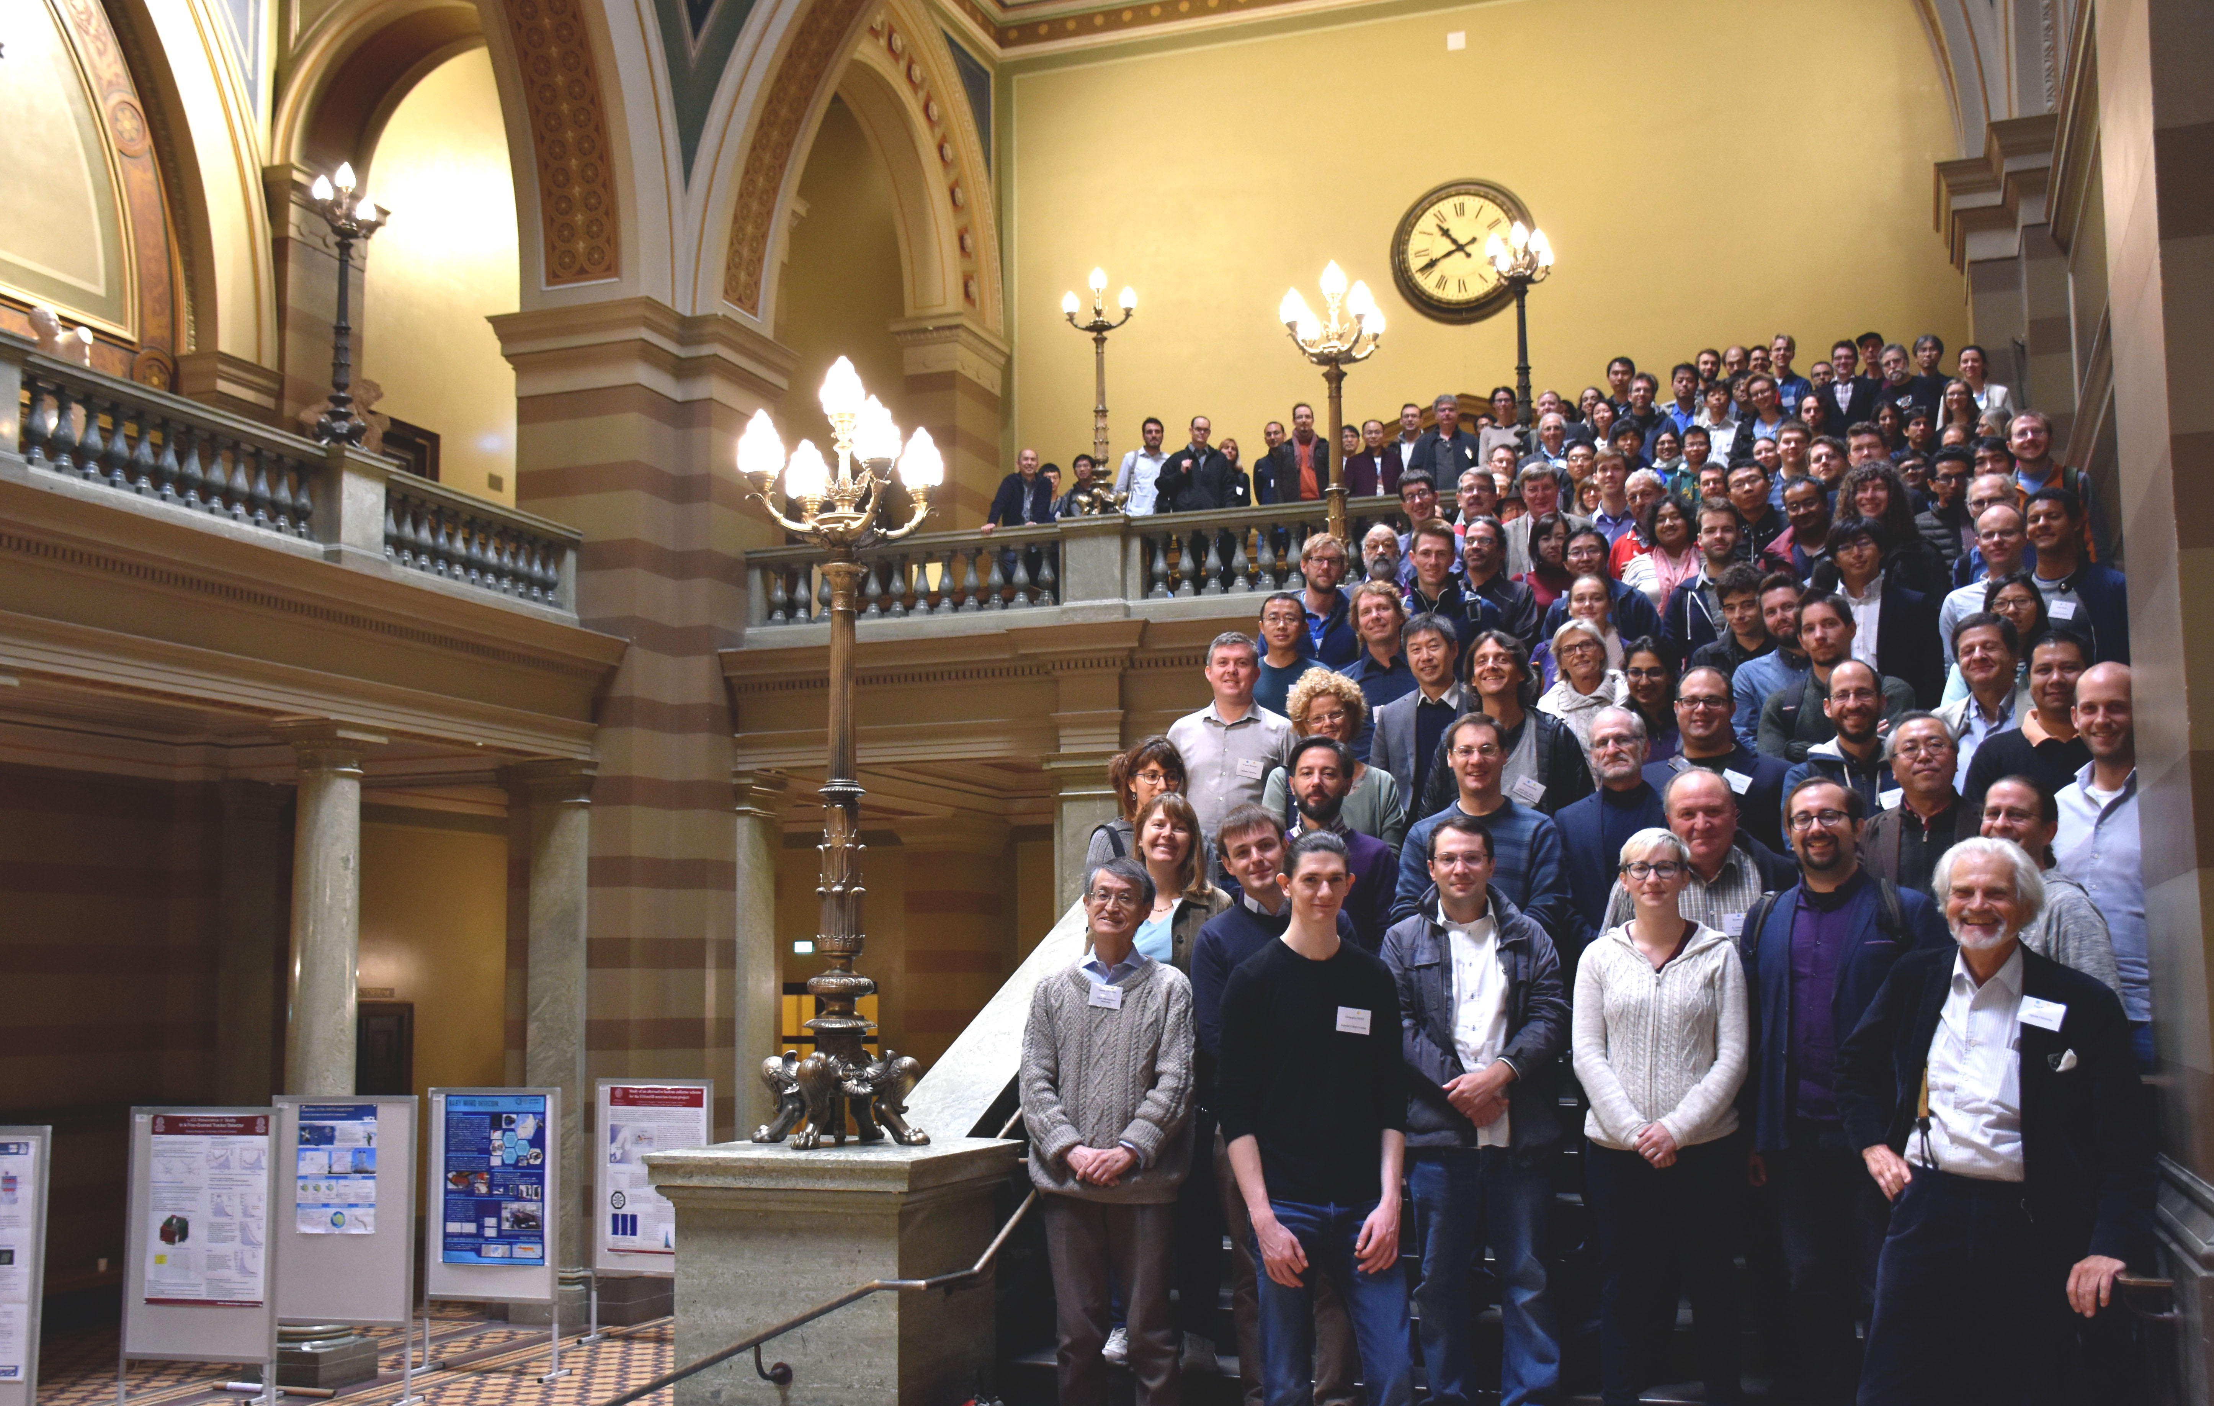

Slide 38
Mats Lindroos’ summary of his talk on the ESS linac
ESS is well into construction and the accelerator project is progressing according to plan towards first beam for target in October 2020
The ESS facility is built by a collaboration of some 100 research institutes and universities
Installation has started of cryogenics and for the ion source
The Accelerator Division is recruiting according to plan and will be ready to take ownership of the accelerator, install it, commission it and enter it into operation
Most future large scale project are likely to be IK projects and this is a very powerful model. Together we are strongest!
(TE: “IK projects” assumes the full involvement of the AMICI-type EU Technological Infrastructures like STFC, DESY, PSI, INFN, CEA, IN2P3, CERN, IFJ-PAN, KIT & FREIA)
38

Slide 39
Mamad Eshrai’s conclusion of his talk on ESS linac upgrade
• The identified major modifications for the doubling of the beam power via a higher
repetition rate and higher beam energy are (in no particular order):
‣ Three new electrical substations along the RF gallery.
‣ A third main electrical station, alongside the 2 existing ones.
‣ HV cable trenches and pulling of additional HV cables from the main station towards the new substations. New HV cables between the substations and the modulators in the RF gallery.
‣ Installation of 8 new cryo modules and associated RF stations to increase energy to 2.5 GeV.
‣ Change of klystron collectors, so that 60% more average power can be produced. If klystrons are at the end of their lifetime, they could be exchanged against more powerful models.
‣ Installation of additional capacitor chargers to allow faster pulsing of the modulators. This is only possible if the modular design developed in-house is adopted.
‣ Installation of a H- source + RFQ + MEBT + beam funnel alongside the existing protons source.
‣ Exchange trim magnets and associated power supplies against pulsed versions
• The reviewers, Frank and Eric, did not find any show stoppers for theaddition of 5 MW H- acceleration capability in the current state of the ESS linac.’
Ref.: Frank Gerigk and Eric Montesinos, CERN-ADD-NOTE-2016-0050

Slide 40
A slide from Mauro Mezzeto’s Future Outlook talks

Slide 41
Garpenberg Research Infrastructure Project for Neutrinos (GRIPnu) http://www.physics.uu.se/digitalAssets/374/c_374310-l_1-k_gripnu-english-version.pdf

Slide 43
Draft ESSnuSB Schedule
Draft schedule:
2018-2021 Design Study -> Conceptual Design Report
2022-2024 Preparatory Phase -> Technical Design Report
2025-2026 Preconstruction phase
2027-2033 Build-up of ESSnuSB
2034-2035 Commissioning
2036-2045 Data taking -> CP angle and other measurement
In order to get EU financing 2021 for the Preparatory Phase convincing Design Study results need to be delivered already by autumn 2019 as input to the CERN Strategy Council preparation of its input to the ESFRI update in 2020
.

Slide 44

Summary
Significantly better CPV sensitivity at the 2nd oscillation maximum.
ESS will have enough protons to go to the 2nd oscillation maximum and increase its CPV sensitivity.
CPV: 5 σ could be reached over 60% of δ_{CP} range (ESSνSB) with large potentiality.
The large ν detector has a rich astroparticle and p lifetime program.
Rich muon program.
COST network project CA15139 supports this project.
ESSνSB Design Study is approved and is starting now.

