Slide 1
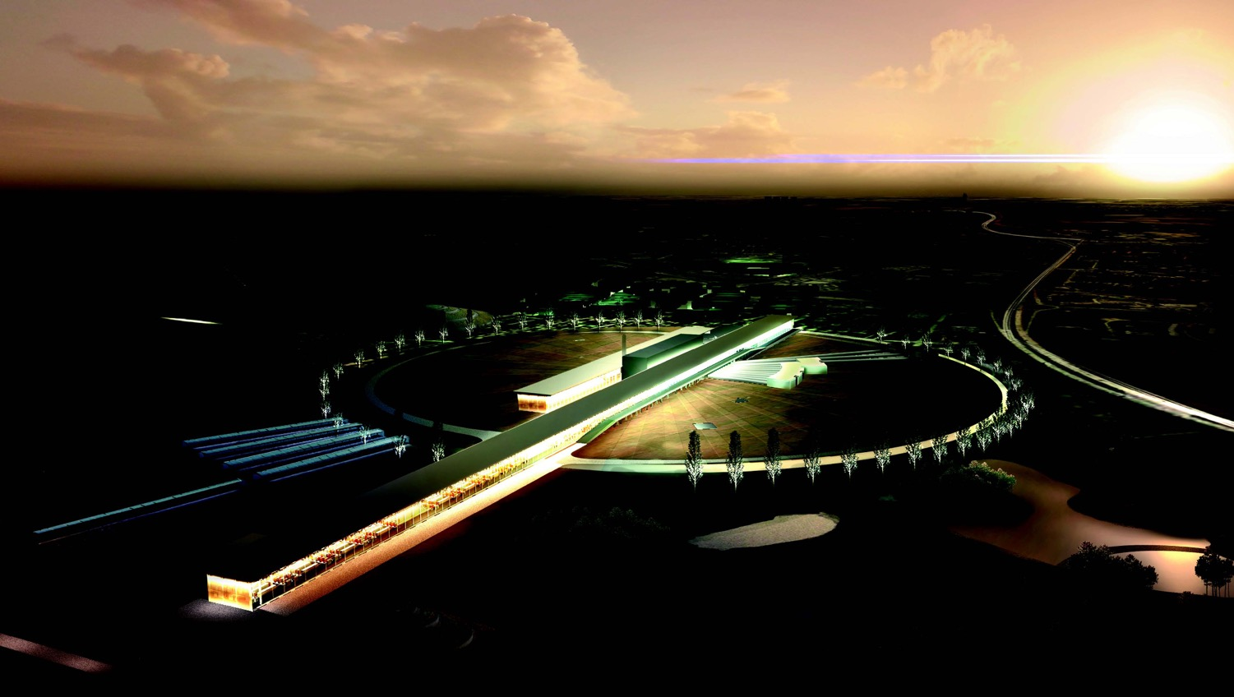
The European Spallation Source neutrino
Super Beam
(ESSνSB)
Marcos Dracos
on behalf of the ESSνSB/EuroNuNet project

Slide 2
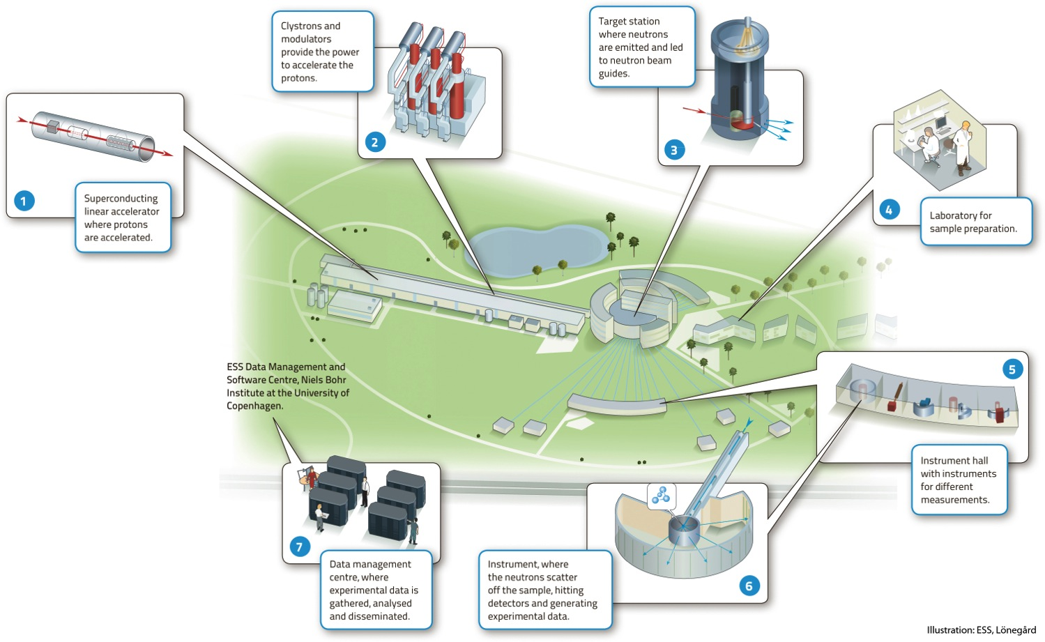

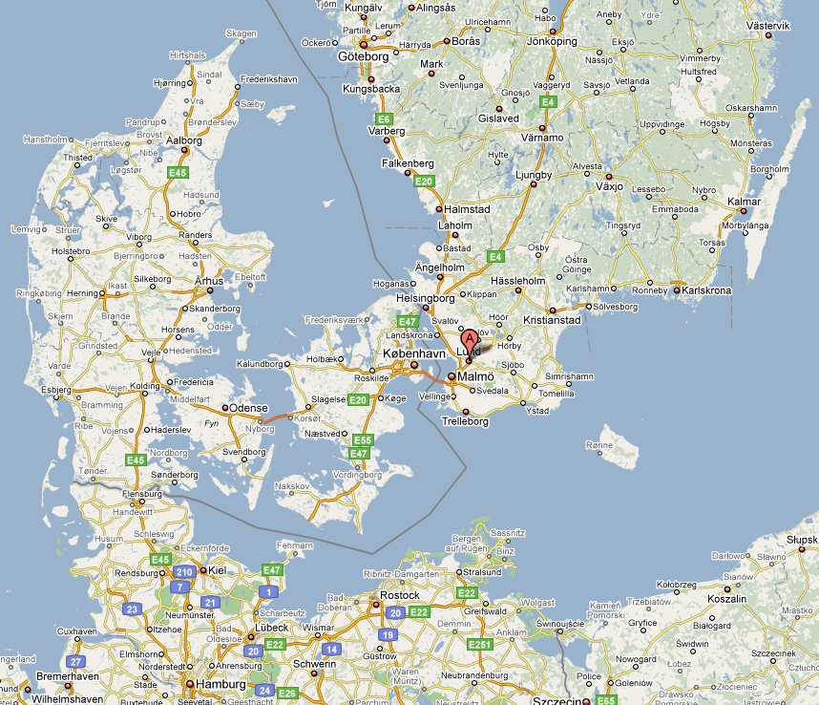
European Spallation Source
under construction phase
(~1.85 B€ facility)

Slide 3
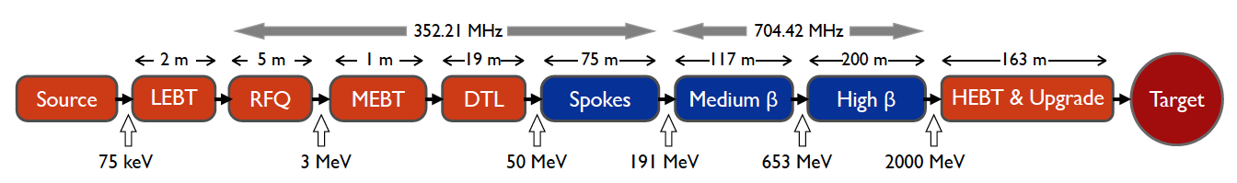
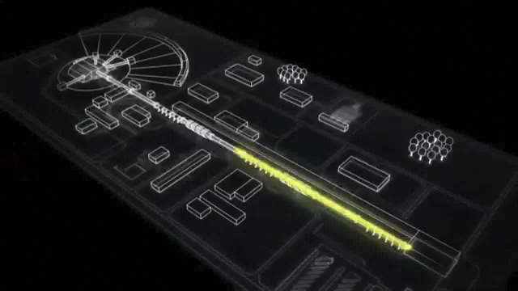
ESS proton linac
The ESS will be a copious source of spallation neutrons.
5 MW average beam power.
125 MW peak power.
14 Hz repetition rate (2.86 ms pulse duration, 10¹⁵ protons).
Duty cycle 4%.
2.0 GeV protons
  up to 3.5 GeV with linac upgrades
>2.7x10²³ p.o.t/year.
Linac ready by 2023 (full power)

Slide 4






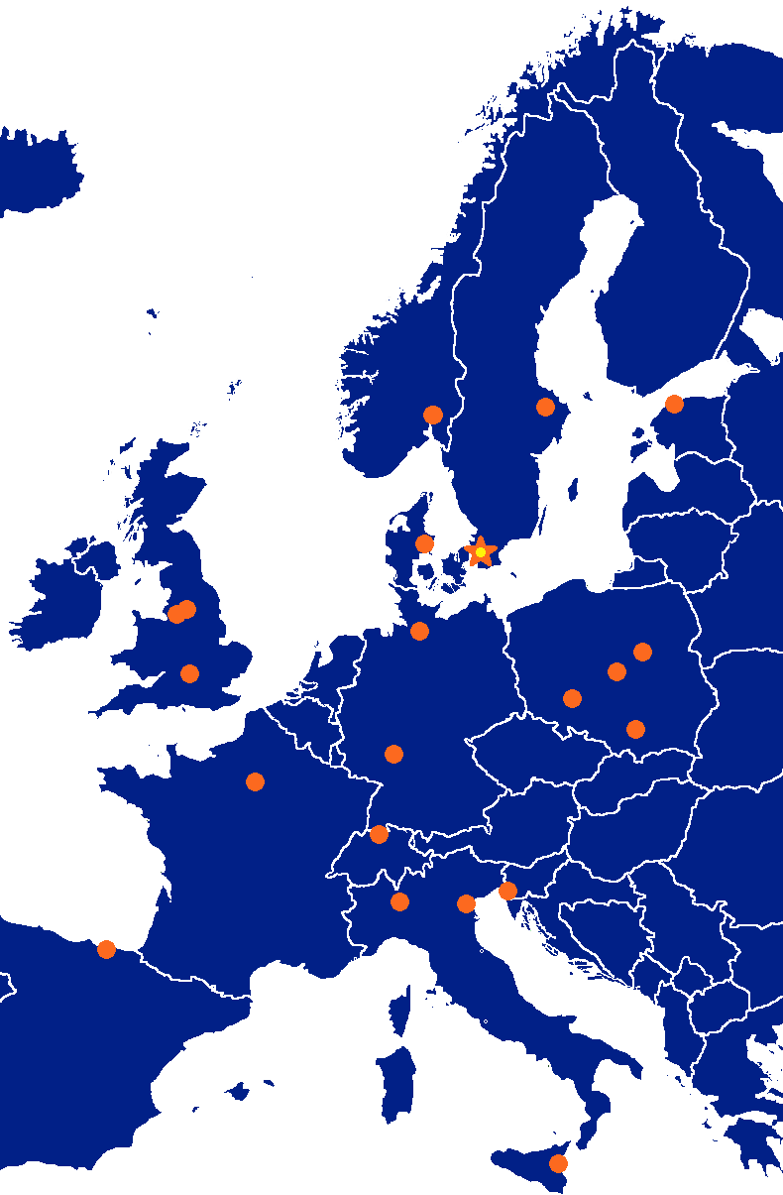













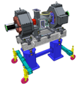




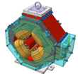




































ESS proton linac
352.21 MHz
704.42 MHz
2.4 m
4.6 m
3.8 m
39 m
56 m
77 m
179 m
Target
Source
LEBT
RFQ
MEBT
DTL
Spokes
Medium β
High β
HEBT & Contingency
75 keV
3.6 MeV
90 MeV
216 MeV
571 MeV
2000 MeV
4

Slide 5
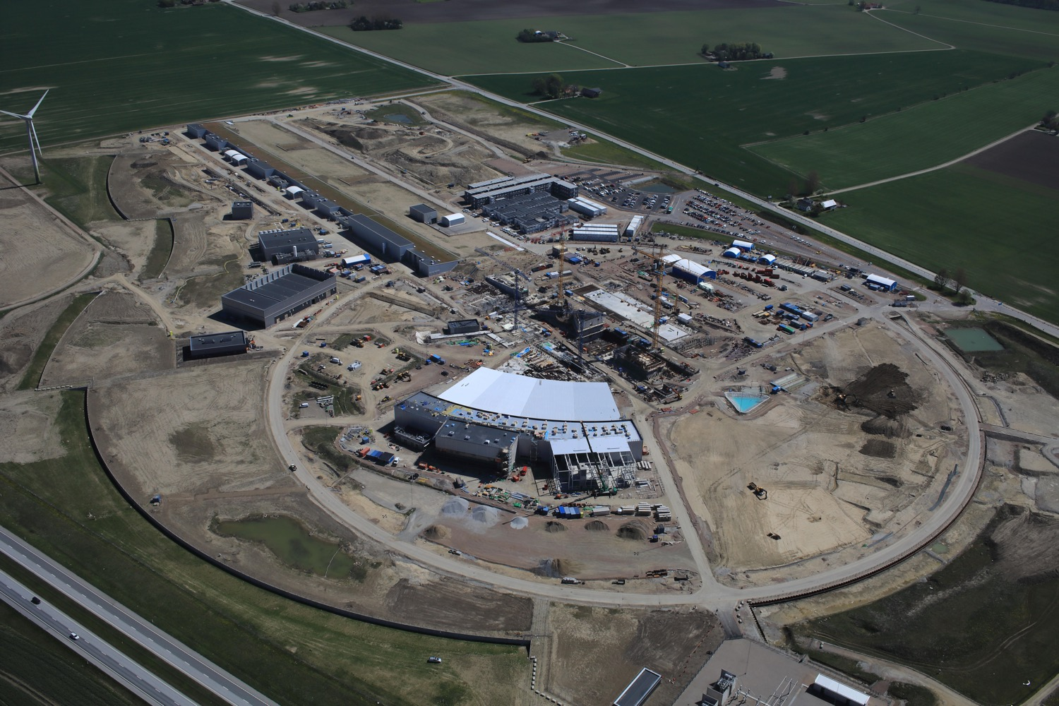
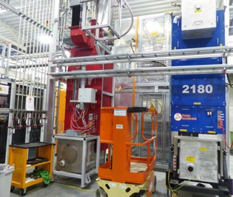
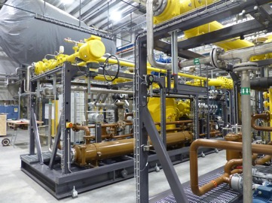
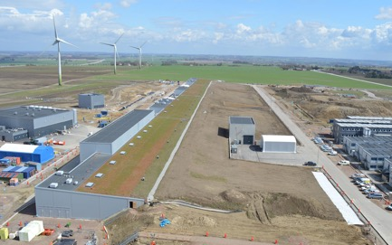
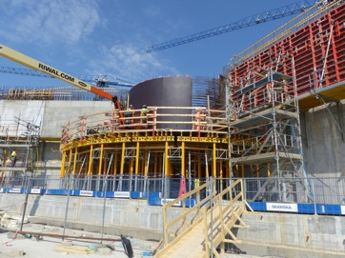
European Spallation Source
May 2018
Target station
klystrons
cryoplants
Proton linac

Slide 6
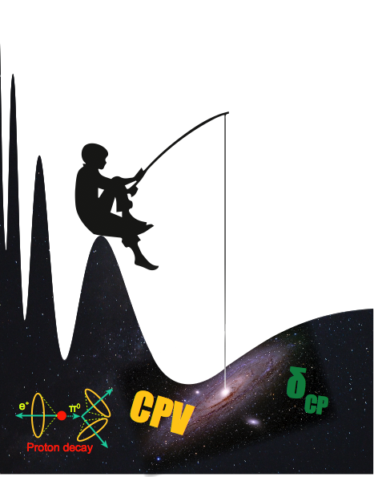
Use all this power to go to the second oscillation maximum
but why?

Slide 7
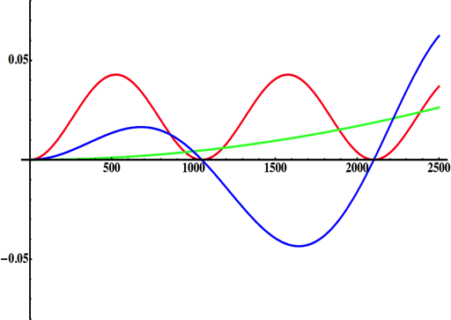
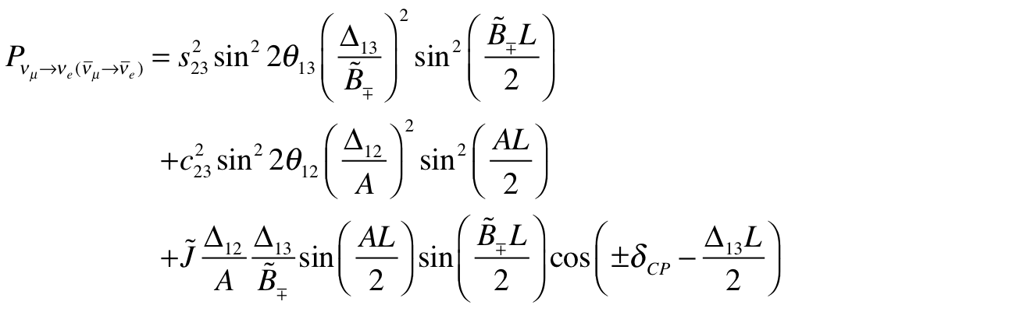
Why to go to the 2nd Oscillation Max.
(arXiv:1110.4583)
atmospheric
atmospheric
solar
Non-CP terms
solar
L/E
interference
CP interference
CP violating
θ₁₃=8.8º
for "large" θ₁₃ 1st oscillation maximum is dominated by atmospheric term
1st oscillation max.: A=0.3sinδ_{CP}
2nd oscillation max.: A=0.75sinδ_{CP}
2nd oscillation maximum
δ_{CP}=-90
δ_{CP}=0
δ_{CP}=+90
(see arXiv:1310.5992 and arXiv:0710.0554)
P(ν_{μ}→ν_{e})
θ₁₃=8.8º
("large" θ₁₃)
more sensitivity at 2nd oscillation max.
very intense neutrino beam needed
L/E

Slide 8
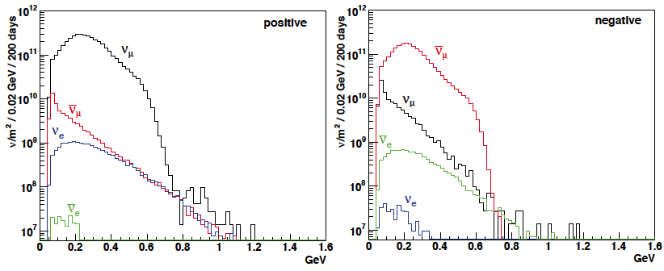
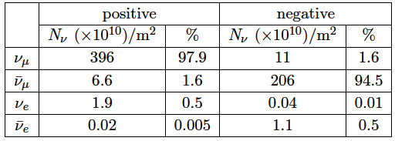
ESSνSB ν energy distribution
(without optimisation)
neutrinos
anti-neutrinos
almost pure ν_{μ} beam
small ν_{e} contamination which could be used to measure ν_{e} cross-sections in a near detector
at 100 km from the target and per year (in absence of oscillations)
(Nucl. Phys. B 885 (2014) 127)

Slide 9
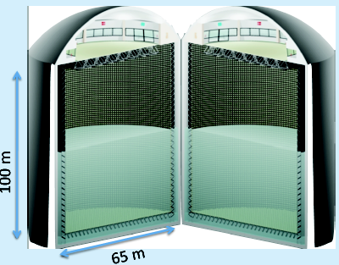
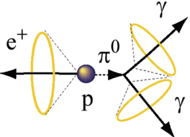
Can we go to the 2nd oscillation maximum using our proton beam?
Yes, if we place our far detector at around 500 km from the neutrino source.
MEMPHYS like Cherenkov detector
(MEgaton Mass PHYSics studied by LAGUNA)
(arXiv: hep-ex/0607026)
Neutrino Oscillations
Proton decay
Astroparticles
Understand the gravitational collapsing: galactic SN ν
  Supernovae "relics"
Solar Neutrinos
Atmospheric Neutrinos
New 20" PMTs with higher QE and cheaper (see JUNO), the detection efficiency will improve the detector performance keeping the price constant, not yet taken into account.
500 kt fiducial volume (~20xSuperK)
Readout: ~240k 8” PMTs
30% optical coverage

Slide 10
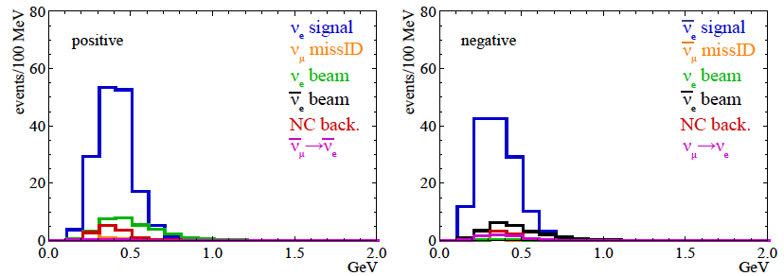
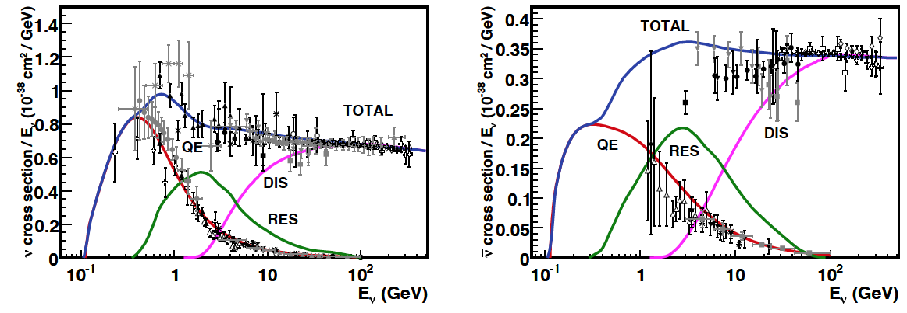
Neutrino spectra
540 km (2 GeV), 10 years
neutrinos
anti-neutrinos
δ_{CP}=0
2 years
8 years
below ν_{τ} production, almost only QE events, not suffering too much by π⁰ background

Slide 11
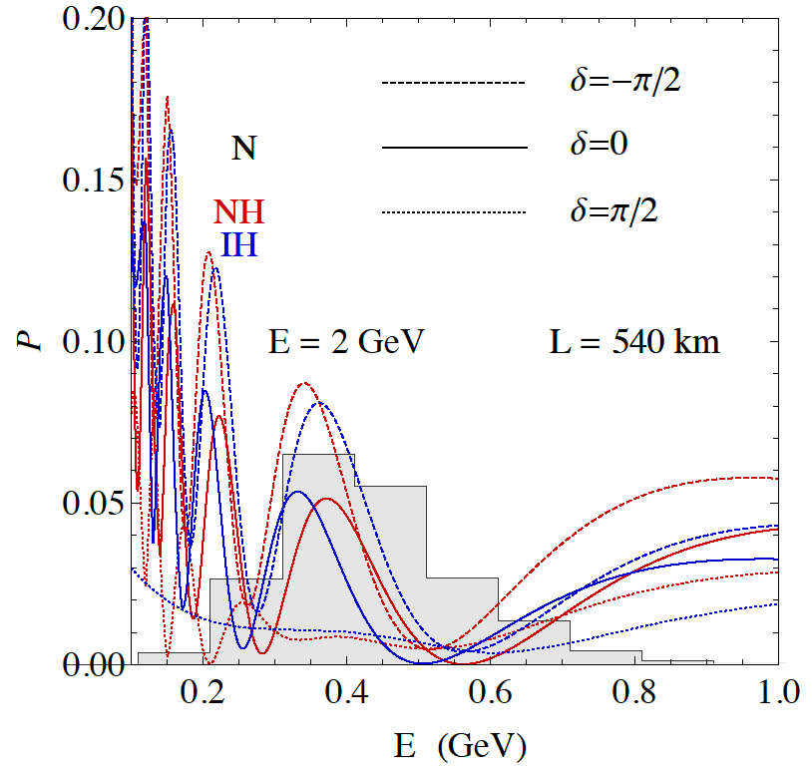
2nd Oscillation max. coverage
2nd oscillation max.
well covered by the ESS neutrino spectrum
1st oscillation max.

Slide 12
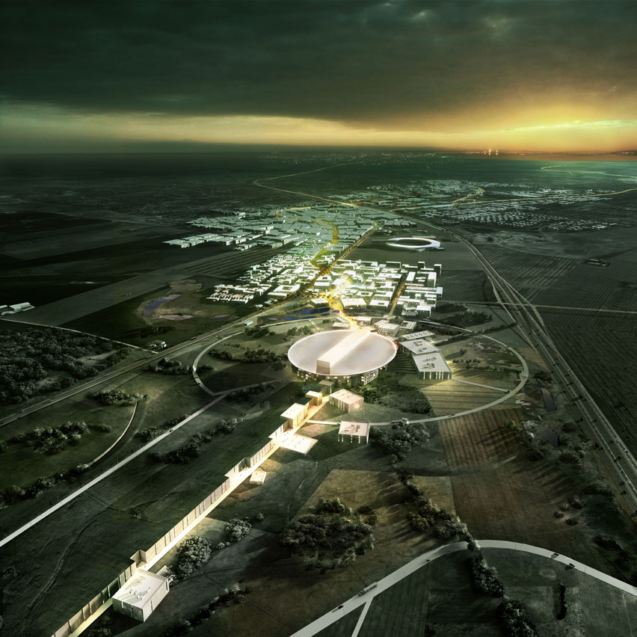
ESS Linac modifications to produce a neutrino Super Beam
European Spallation Source Linac

Slide 13
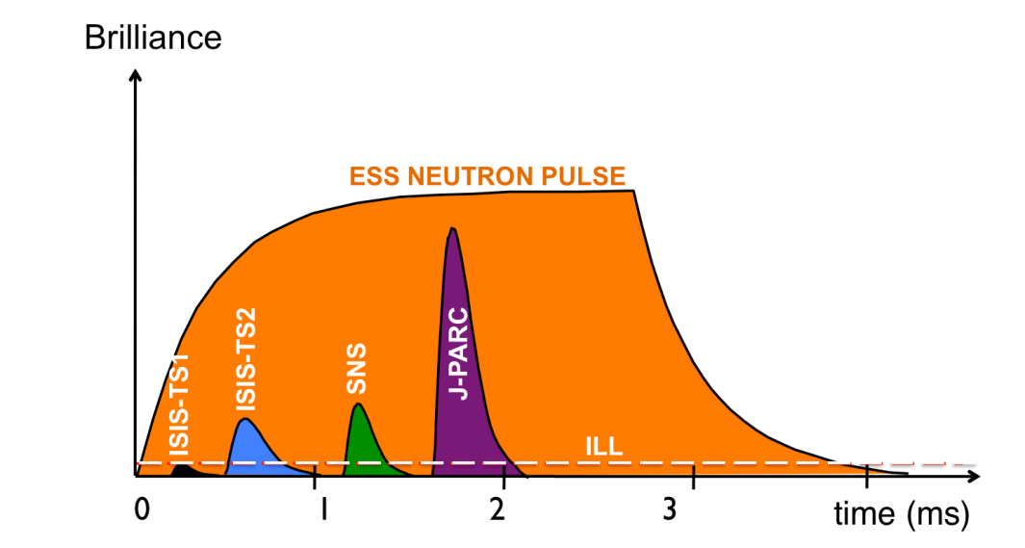
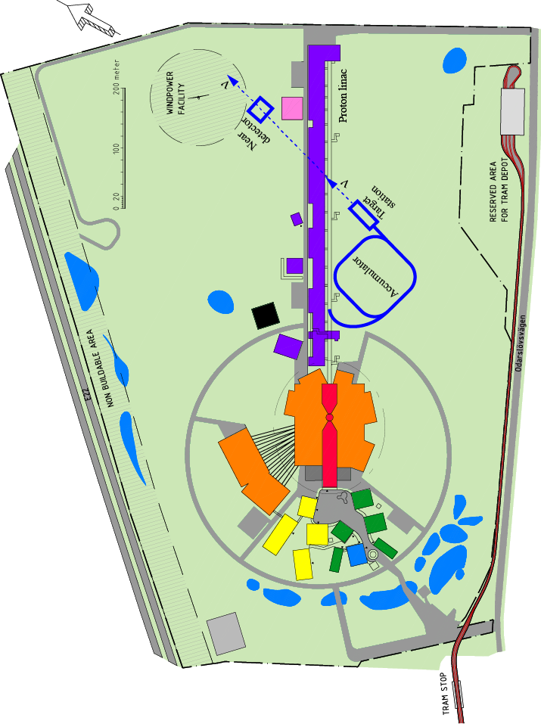
How to add a neutrino facility?
The neutron program must not be affected and if possible synergetic modifications.
Linac modifications: double the rate (14 Hz → 28 Hz), from 4% duty cycle to 8%.
Accumulator (C~400 m) needed to compress to few μs the 2.86 ms proton pulses, affordable by the magnetic horn (350 kA, power consumption, Joule effect)
  H⁻ source (instead of protons),
  space charge problems to be solved.
~300 MeV neutrinos.
Target station (studied in EUROν).
Underground detector (studied in LAGUNA).
Short pulses (~μs) will also allow DAR experiments (as those proposed for SNS) using the neutron target.

Slide 14
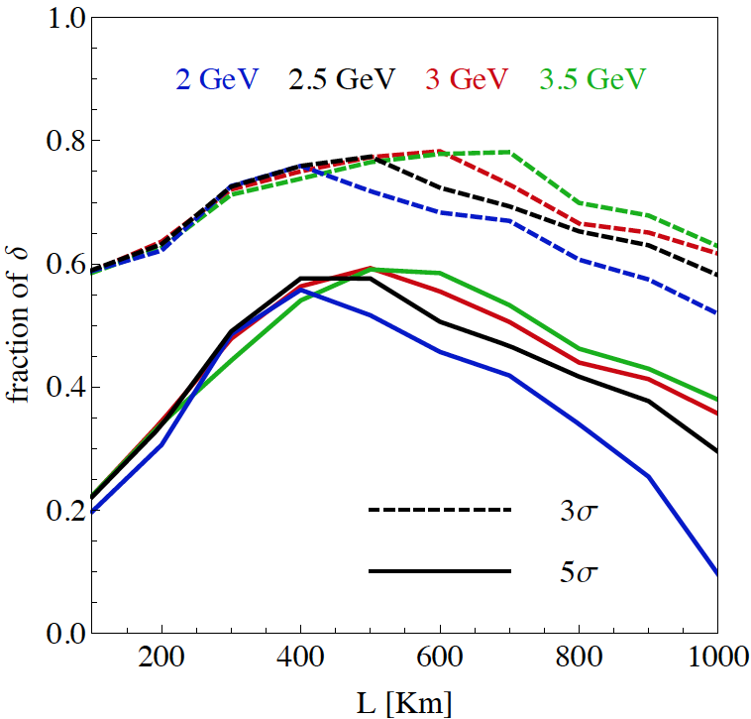
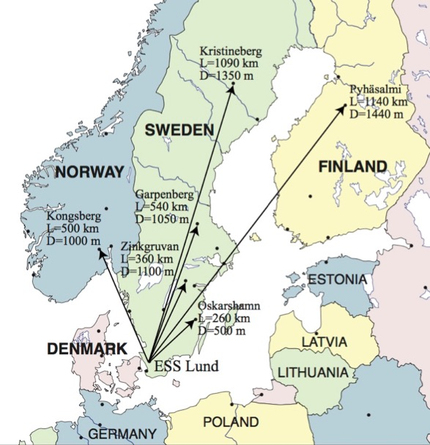
Which baseline?
CPV (Nucl. Phys. B 885 (2014) 127)
Garpenberg
Zinkgruvan
~60% δ_{CP} coverage at 5 σ C.L.
>75% δ_{CP} coverage at 3 σ C.L.
systematic errors: 5%/10% (signal/backg.)
Candidate active mines

Slide 15
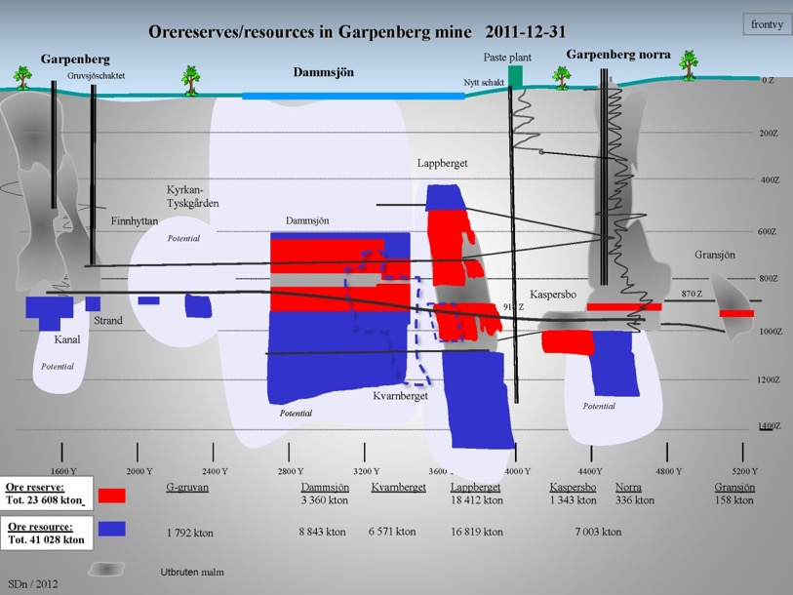
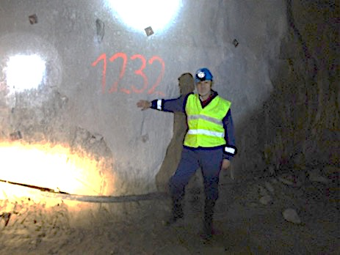
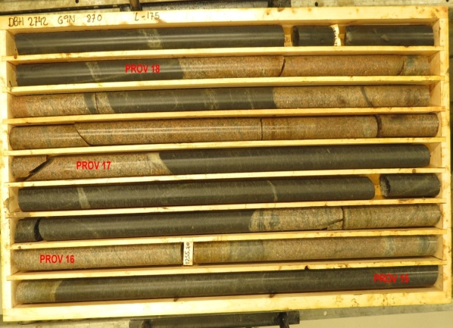
The Garpenberg mine
Distance from ESS Lund 540 km
Depth 1232 m
Truck access tunnel
Hoist shaft free to use by ESSnuSB
Rock-engineering prospection and studies in the Garpenberg-mine granite-zones
Granite drill cores

Slide 16
Garpenberg Research Infrastructure Project for Neutrinos
(GRIPnu)

Slide 17
Physics Performance
540 km
little dependence on mass hierarchy,
δ_{CP} coverage at 5 σ C.L. up to 60%,
δ_{CP} accuracy down to 6° at 0° and 180° (absence of CPV for these two values),
not yet optimized facility,
5/10% systematic errors on signal/background.
See presentation of Salvador Rosauro in WG1 for more details

Slide 18
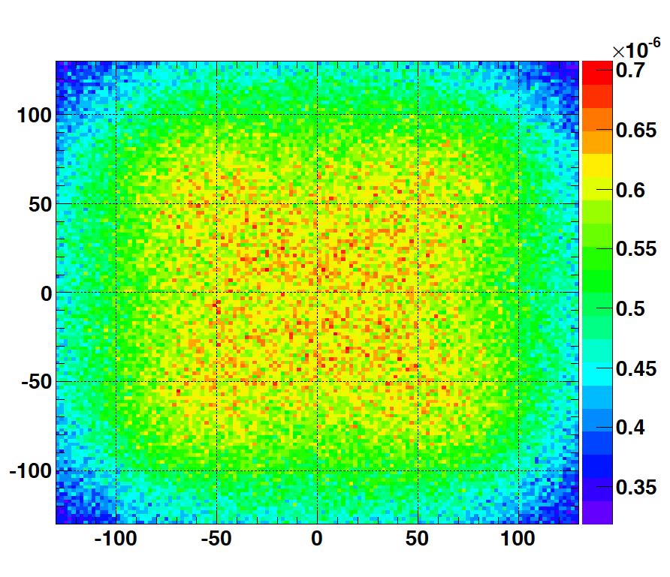
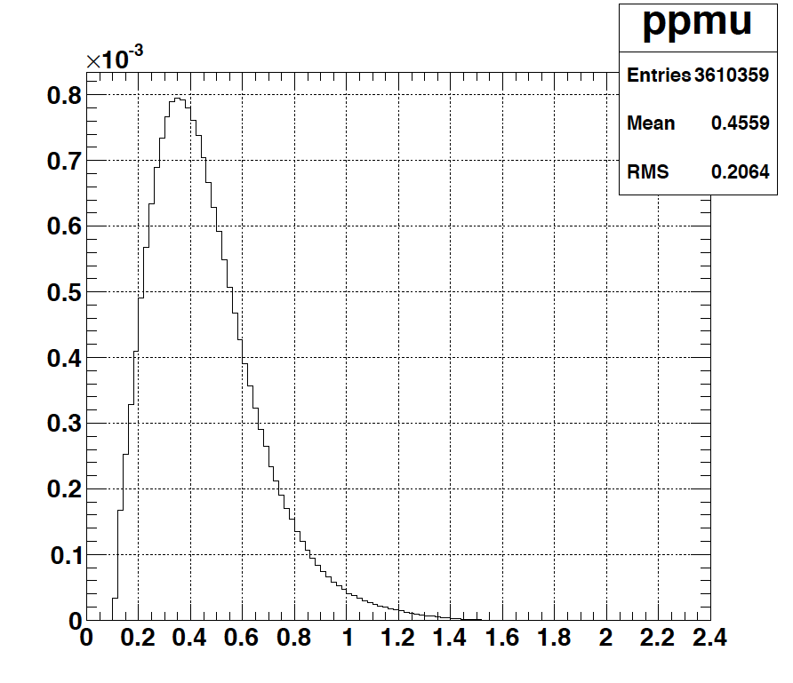
Muons at the level of the beam dump
2.7x10²³ p.o.t/year
y (cm)
muons at the level of the beam dump
(per proton)
more than 4x10²⁰ μ/year from ESSS compared to 10¹⁴ μ used by all experiments up to now (10¹⁸ μ for COMET in the future).
4.2x10²⁰ μ/year
(16.3x10²⁰ for 4 m²)
x (cm)
10⁻³
4.1x10²⁰ μ/year
input beam for future 6D μ cooling experiments (for muon collider),
low energy nuSTORM,
Neutrino Factory,
Muon Collider.
muons/proton
<E_{μ}>~0.46 GeV
<L_{μ}>~2.9 km

Slide 19
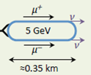
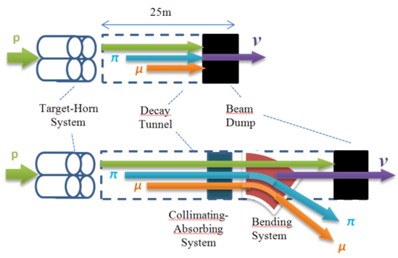
ESS neutrino and muon facility
2.7x10²³ p.o.t/year
Neutrons to ESS
ESS proton driver
Protons dump
ν_{μ} or ‾ν_{μ}
Long
Baseline
Detector
π decay
ESSnuSB
Test Facility
μ⁺ or μ⁻
ν_{μ} + ‾ν_{e}
Short
Baseline
Detector
Short
Baseline
Detector
Accumulator
Decay
channel or ring
nuSTORM
Front end
ν_{e} + ‾ν_{μ}
Muons of average energy ~0.5 GeV at the level of the beam dump
RLA
acceleration
Storage
ring
Cooling
Long
Baseline
Detector
Neutrino
Factory
RCS
acceleration
Collider
ring
Muon Collider
→ ←
μ⁺ μ⁻

Slide 20

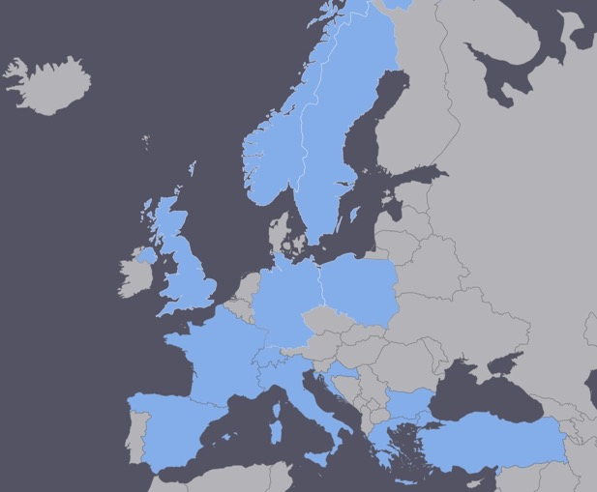
ESSνSB at the European level
COST application for networking: CA15139 (2016-2019)
  EuroNuNet : Combining forces for a novel European facility for neutrino-antineutrino symmetry violation discovery (http://www.cost.eu/COST_Actions/ca/CA15139)
  Major goals of EuroNuNet:
    to aggregate the community of neutrino physics in Europe to study the ESSνSB concept in a spirit of inclusiveness,
    to impact the priority list of High Energy Physics policy makers and of funding agencies to this new approach to the experimental discovery of leptonic CP violation.
  13 participating countries (network still growing).
http://euronunet.in2p3.fr/

Slide 21

ESSνSB at the European level
A H2020 EU Design Study (Call INFRADEV-01-2017)
Title of Proposal: Discovery and measurement of leptonic CP violation using an intensive neutrino Super Beam generated with the exceptionally powerful ESS linear accelerator
Duration: 4 years
Total cost: 4.7 M€
Requested budget: 3 M€
15 participating institutes from
11 European countries including CERN and ESS
6 Work Packages
Approved end of August 2017
ESSνSB
BENE (2004-2008)
ISS (2005-2007)
EUROν (2008-2012)
LAGUNA (2008-2010)
LAGUNA-LBNO (2010-2014)
COST Action CA15139 (2015-2019)

Slide 22
Design Study ESSνSB
(2018-2021)
Kick-off meeting in January 2018.
ESSνSB has already started engaging postdocs.
More information on:
http://essnusb.eu/
partners: IHEP, BNL, SCK•CEN, SNS, PSI, RAL

Slide 23
Required modifications of the ESS accelerator for ESSνSB
See presentation of Björn Gålnander in WG3 for more details

Slide 24
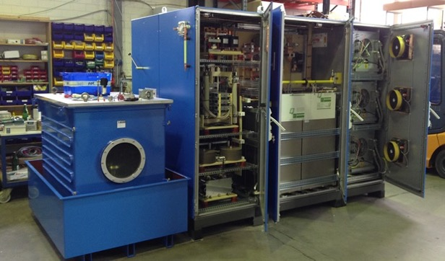
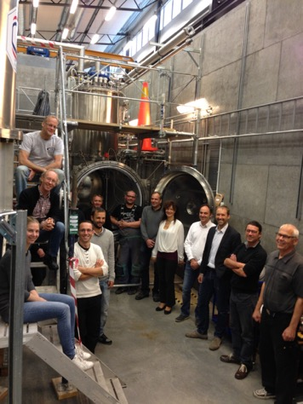
Preparing the ESS linac for operation at 10 MW with a 8% duty cycle and 28 Hz pulsing
For the medium-beta elliptical-cavity part ESS is planning to use tetrodes. Thales has developed a new screen grid with graded wire thickness making operation at 10 % duty cycle possible.
The picture shows the cryostat and test bunker at the FREIA Lab in Uppsala where a first prototype of the ESS 352 MHz spoke accelerating cavity is currently under test at 14 Hz and later on will be tested at 28 Hz.
FREIA Lab, Uppsala

Slide 25
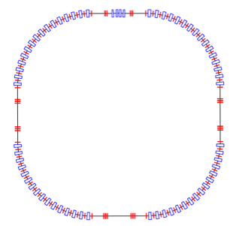
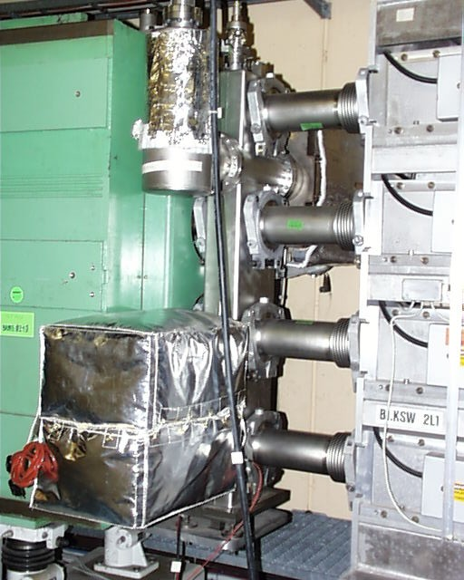
Accumulation Ring
To compress to few μs the 2.86 ms proton pulses, affordable by the magnetic horn (350 kA, power consumption, Joule effect), but also keeping a reasonable size of the ring.
Baseline: single-ring accumulator
  Current studies give a 376 m circumference accumulator ring 1.32μs.
  1 ring leads to a very large space–charge tune–shift of about 0.75.
Injection
Option: 4 superposed rings located in the same tunnel,
  Each ring receives 1/4 of the bunches during the multi–turn injection,
  Reduction of the tune shift to the level of around 0.2 (acceptable for the 2.86 ms storage time),
  Experience already exists from the CERN PS Booster of using 4 superimposed rings with the aim to avoid high space charge effects.
Extraction
Collimation
RF
Lattice
The 4 rings of the CERN PS Booster (1972)
See presentation of Ye Zou in WG3 for more details

Slide 26
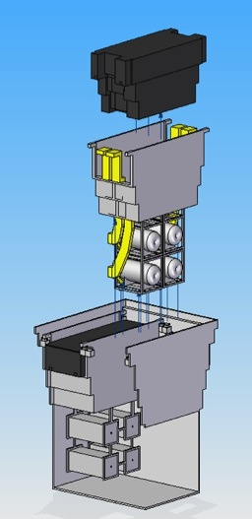
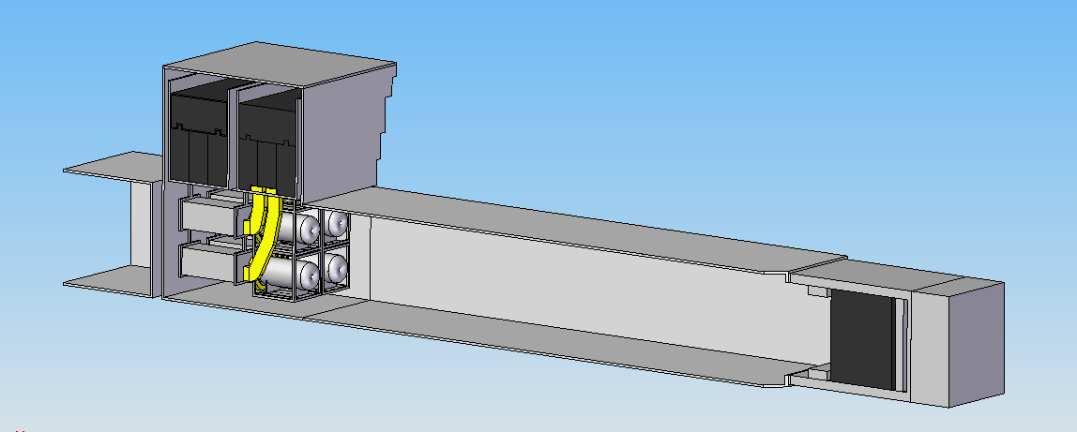
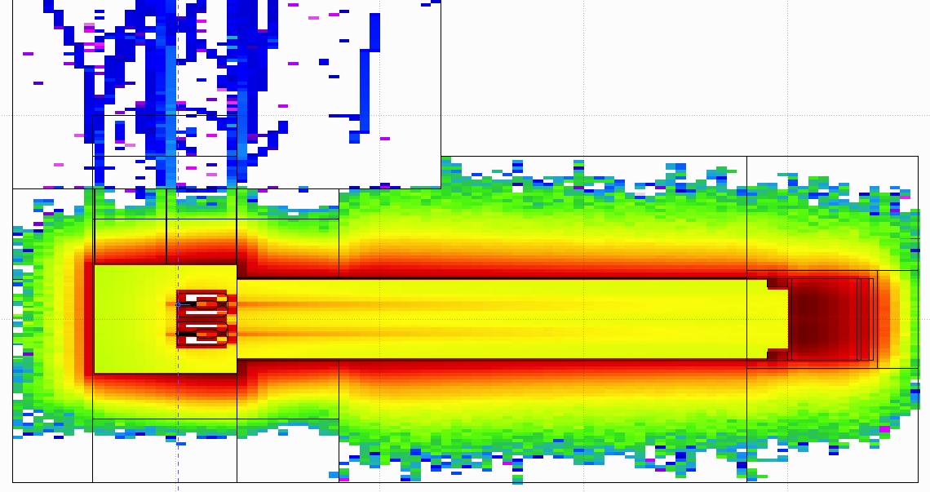
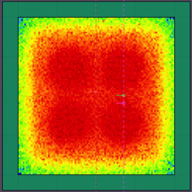
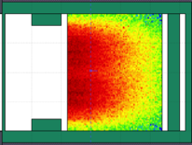
General Layout of the target station
(from EUROν DS)
Shield Blocks
See presentation of M. Dracos in WG3 for more details
Horn Support Module
8 m concrete
Split Proton Beam
Horns and Targets
Collimators
Decay Volume
(He, 4x4x25 m³)
Neutrino Beam Direction
Beam Dump

Slide 27
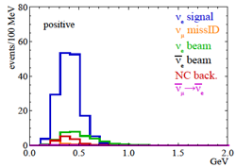
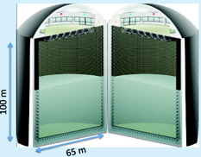
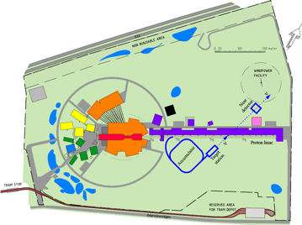
Possible ESSνSB schedule
(2nd generation neutrino Super Beam)
2021: End of ESSνSB Design Study, CDR and preliminary costing
2012: inception of the project
2016-2019: beginning of COST Action EuroNuNet
2018: beginning of ESSνSB Design Study (EU-H2020)
2022-2024: Preparatory Phase, TDR
2025-2026: Preconstruction Phase, International Agreement
2027-2035: Construction of the facility and detectors, including commissioning
2036-: Data taking
Nucl. Phys. B 885 (2014) 127

Slide 28
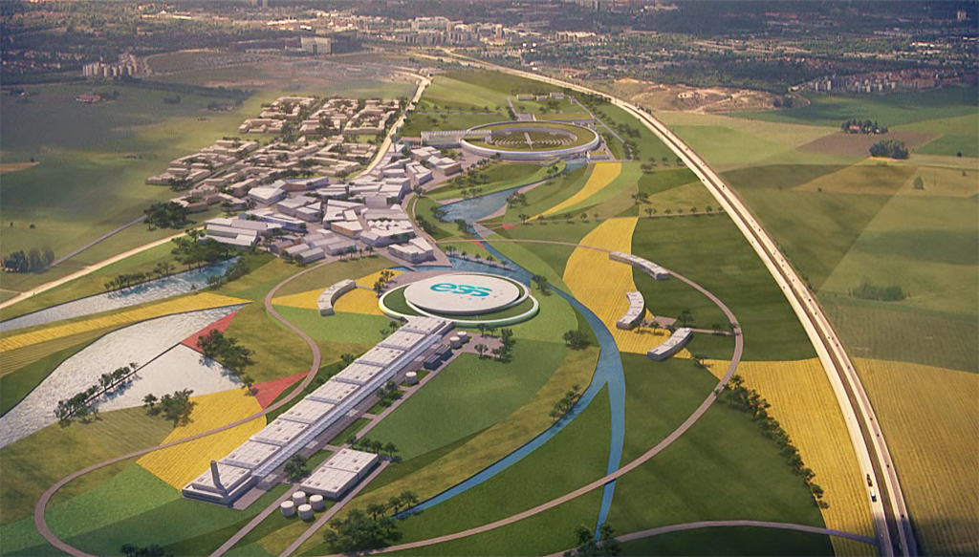
Conclusion
ESS will have enough protons to go to the 2nd oscillation maximum and increase its CPV sensitivity.
CPV: 5 σ could be reached over 60% of δ_{CP} range by ESSνSB with large potentiality.
Large associated detectors have a rich astroparticle physics program.
The European Spallation Source Linac will be ready by 2023, upgrade decisions by this moment.
Rich muon program.
COST network project CA15139 supports this project.
The EU-H2020 Design Study ESSνSB has just started (2018-2021).
Input to the European Strategy Roadmap for particle physics.

Slide 29
Backup

Slide 30
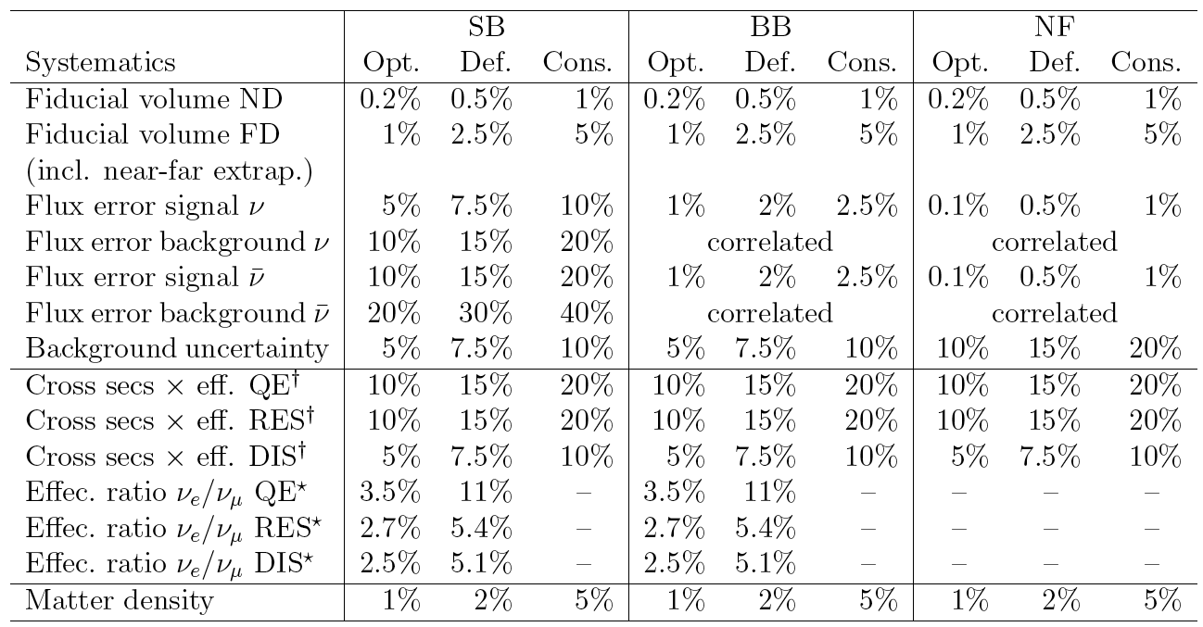
Systematic errors
Phys. Rev. D 87 (2013) 3, 033004 [arXiv:1209.5973 [hep-ph]]

Slide 31
Comparisons
Comparison using the same systematic errors
Phys. Rev. D 87 (2013) 3, 033004 [arXiv:1209.5973 [hep-ph]]

