Slide 1



The European Consortium working on the ESSνSB project

Slide 2
The European Consortium working on the ESSνSB project
The consortium has started being built in 2012 after the end of the EU Projects EUROν and LAGUNA, studying similar projects.
It has been initiated after the publication of new physics results modifying the neutrino physics landscape.
Applications for funding to relevant European Calls:
  COST
  EU-H2020

Slide 3

COST
(European Cooperation in Science and Technology)
https://www.cost.eu

Slide 4
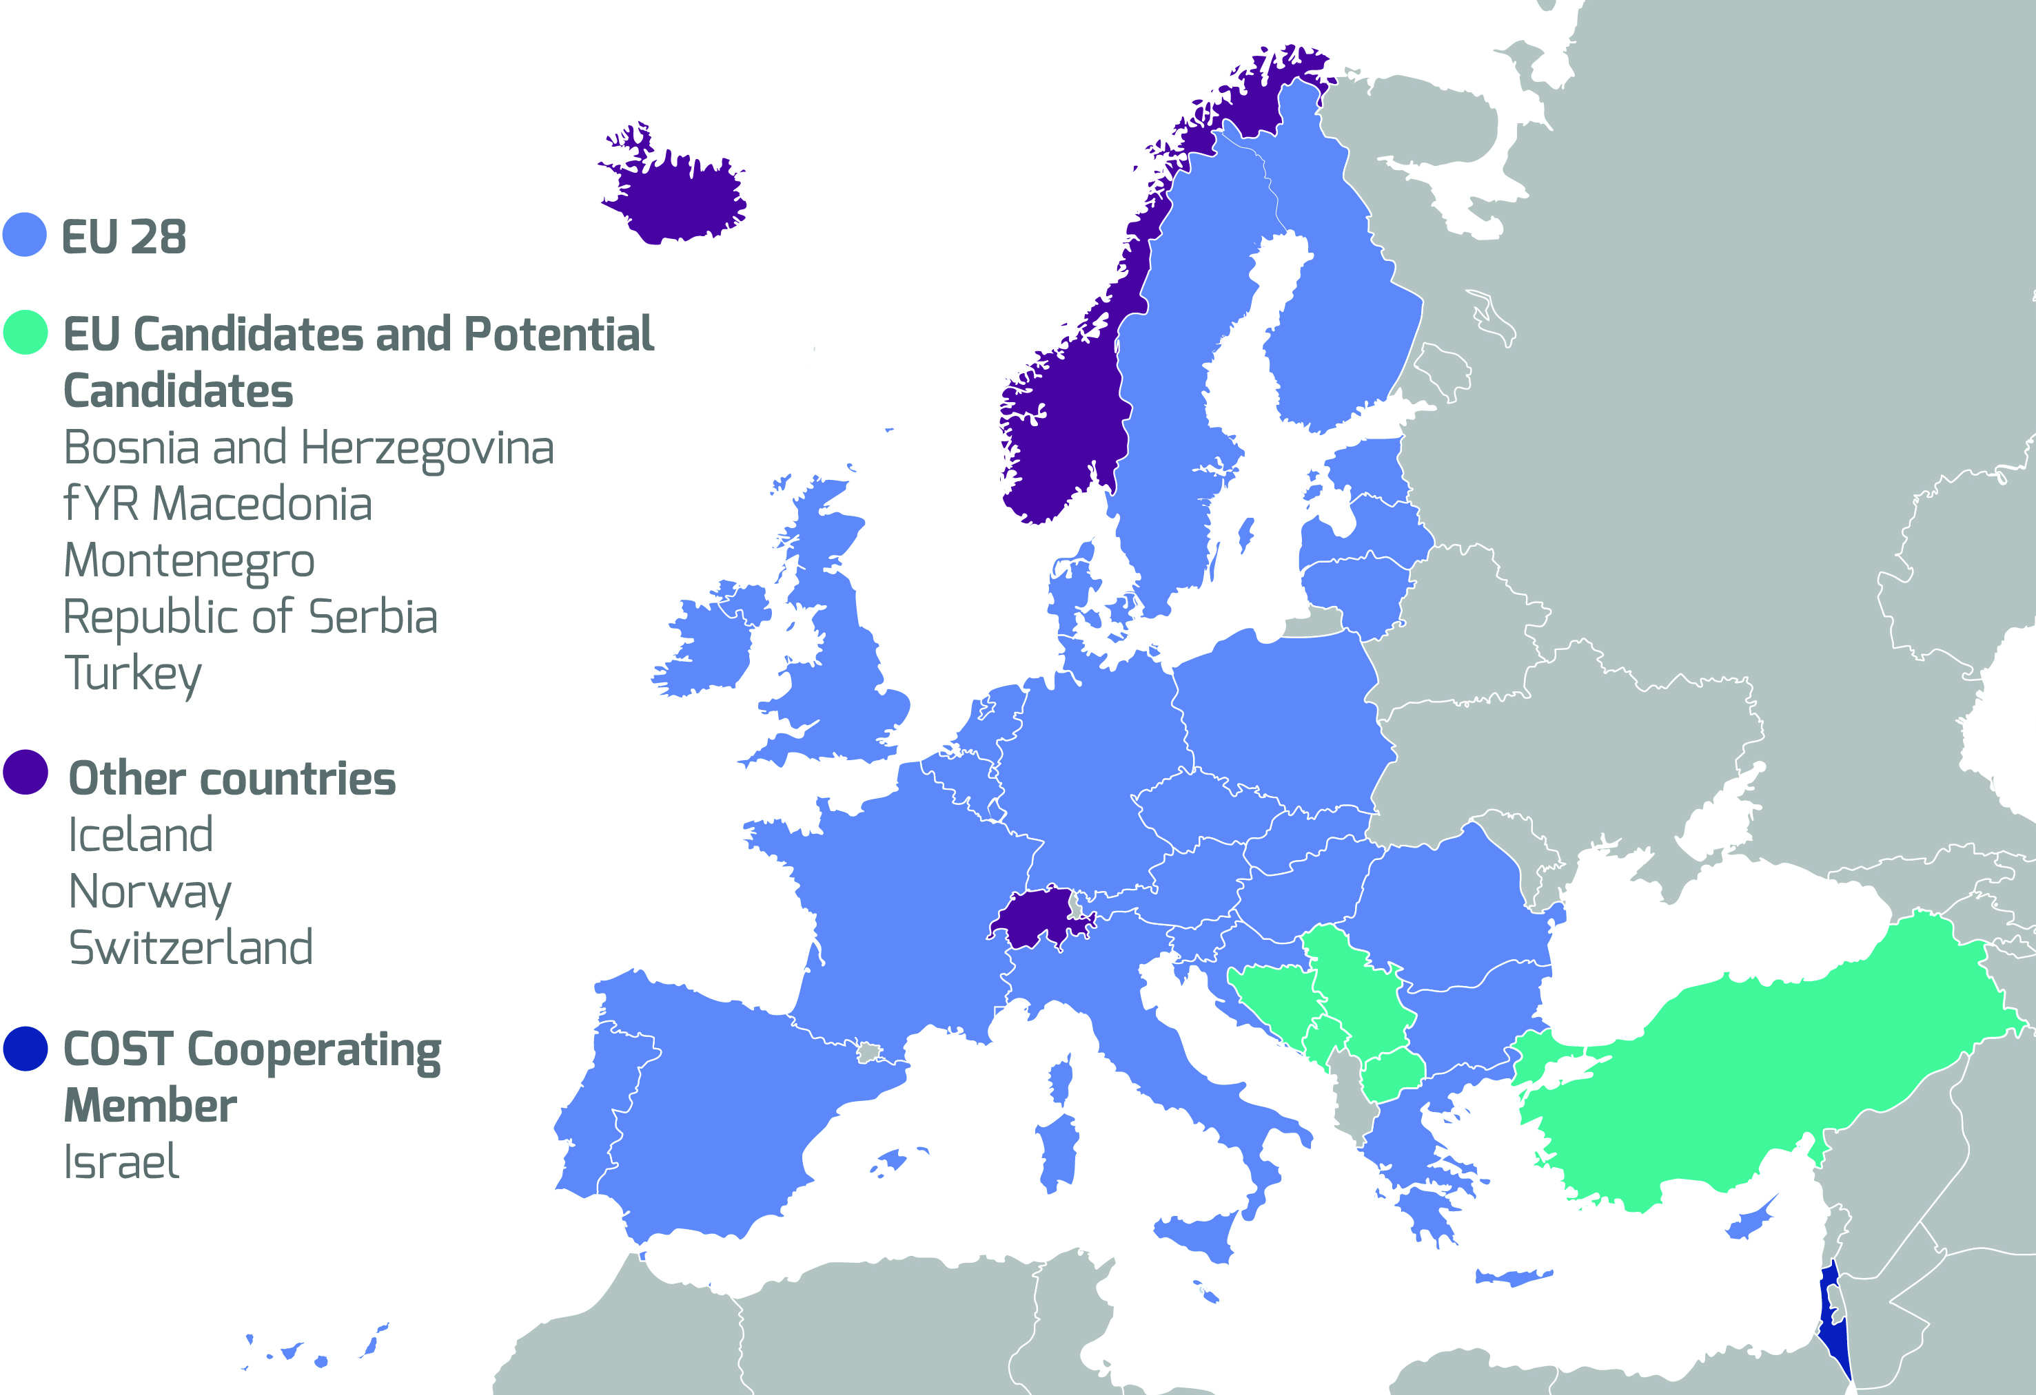
COST Member Countries

Slide 5
COST Politics

Slide 6
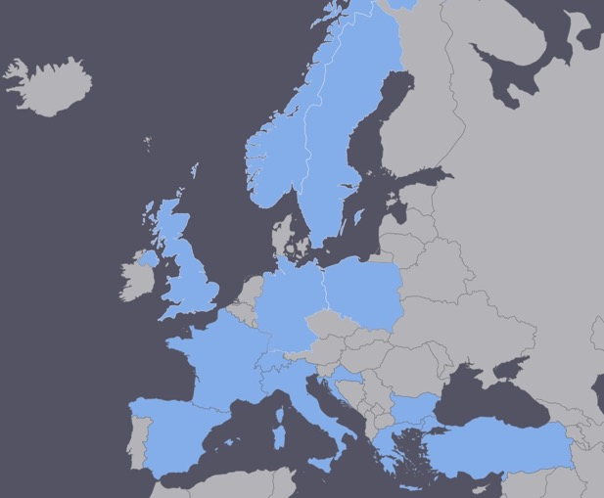
EuroNuNet
COST Action for networking: CA15139 (2016-2020)
  EuroNuNet : Combining forces for a novel European facility for neutrino-antineutrino symmetry violation discovery (http://www.cost.eu/COST_Actions/ca/CA15139)
The members are countries which signed the Action MoU
  Major goals of EuroNuNet:
    to aggregate the community of neutrino physics in Europe to study a neutrino long baseline concept in a spirit of inclusiveness,
    to impact the priority list of High Energy Physics policy makers and of funding agencies to this new approach to the experimental discovery of leptonic CP violation.
  13 participating countries (network still growing).
http://euronunet.in2p3.fr/

Slide 7
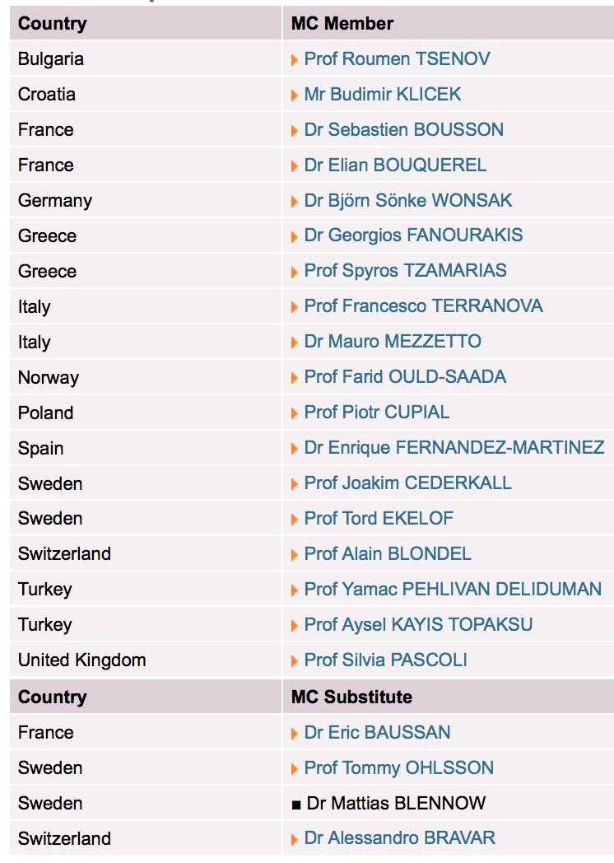
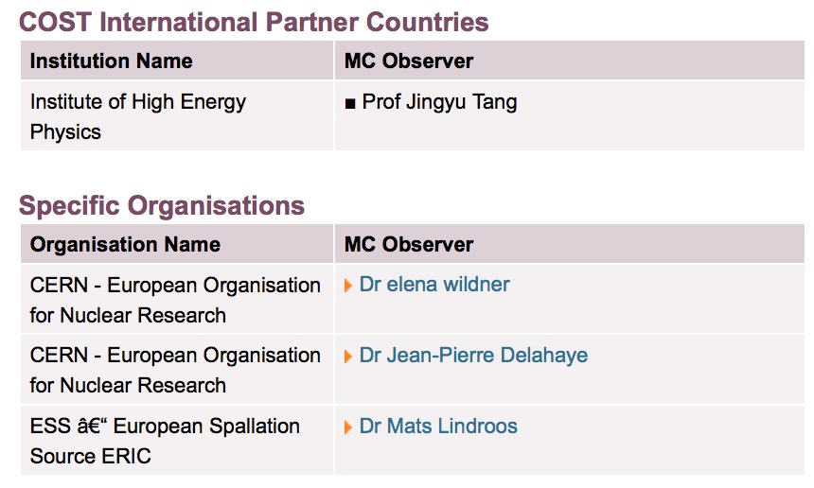
EuroNuNet structure
Chair: Marcos Dracos (FR)
Vice-Chair: Joakim Cederkall (SE)
Ms Mileva Stoyanova

Slide 8
EuroNuNet Working Groups
WG # | WG Title | WG Leader
1 | Neutrino detector and synergies | R. Tsenov (BG)
2 | Neutrino production | P. Cupial (PL)
3 | Accelerators | S. Bousson (FR)
4 | Strategy of implementation and Technological applications | T. Ekelof (SE)
5 | Training, Education and Outreach | F. Terranova (IT)
The main goal of the network was to prepare the ground for a higher level project.

Slide 9
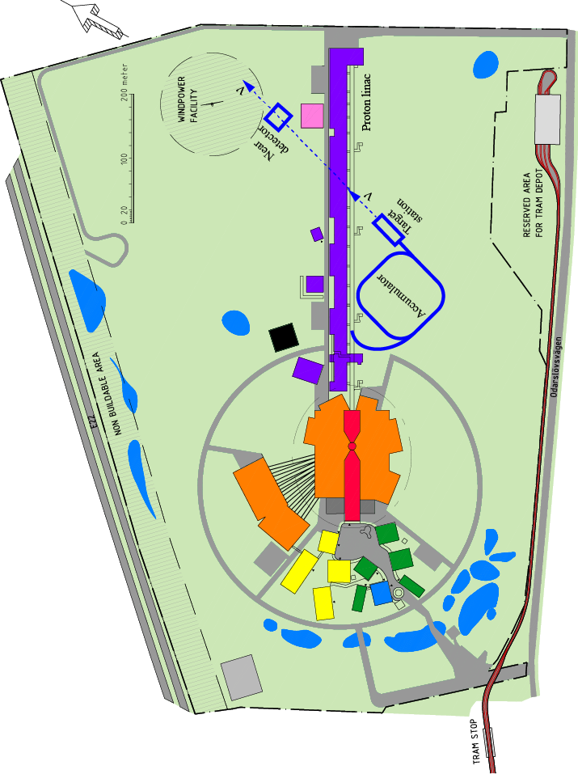
Add a neutrino facility on top of the ESS neutron one
The neutron program must not be affected and if possible synergetic modifications.
Linac modifications: double the rate (14 Hz → 28 Hz), from 4% duty cycle to 8%.
Accumulator (C~400 m) needed to compress to few μs the 2.86 ms proton pulses.
Target station (studied in EUROν).
Underground far detector.

Slide 10
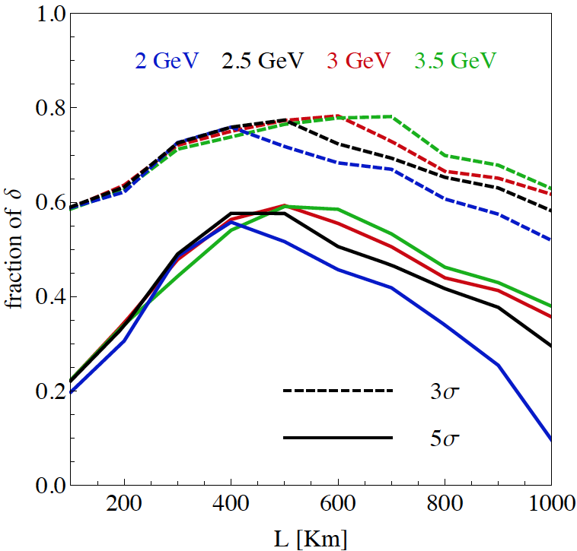
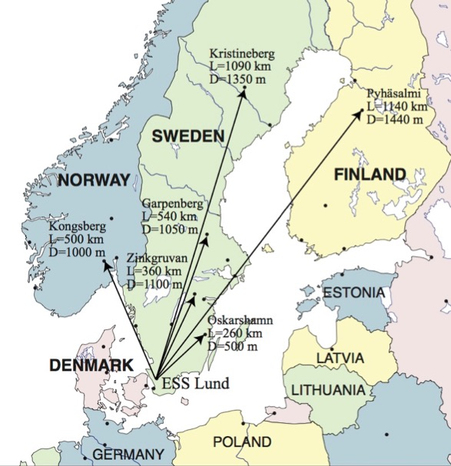
At which distance to place the detector?
discovery potential of matter-antimatter asymmetry
Garpenberg
Zinkgruvan
~60% δ_{CP} coverage at 5 σ C.L.
Candidate active mines

Slide 11
The H2020 ESSνSB Design Study
A H2020 EU Design Study has been submitted March 2017 (Call INFRADEV-01-2017)
Title of Proposal: Discovery and measurement of leptonic CP violation using an intensive neutrino Super Beam generated with the exceptionally powerful ESS linear accelerator.
Duration: 4 years
Total cost: 4.7 M€
Requested budget: 3 M€
15 participating institutions from
11 European countries including CERN and ESS
6 Work Packages
Decision: end of August 2017
ESSνSB
BENE (2004-2008)
ISS (2005-2007)
EUROν (2008-2012)
LAGUNA (2008-2010)
LAGUNA-LBNO (2010-2014)
COST Action CA15139 (2015-2019)

Slide 12
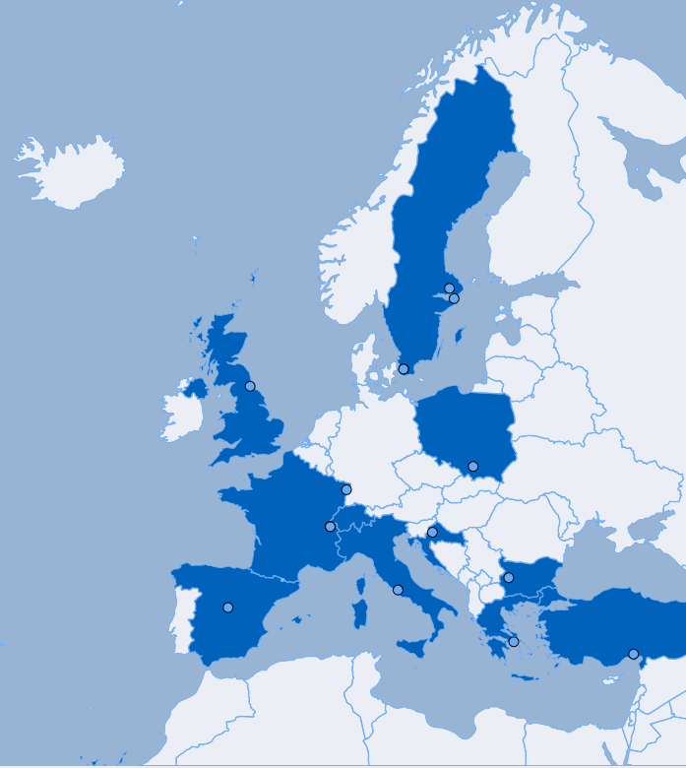
ESSnuSB STRUCTURE: PARTICIPATING INSTITUTIONS/ ORGANISATIONS
15 participating organisations within 11 countries

Slide 13
ESSνSB PROJECT: Grant Agreement

Slide 14
ESSνSB PROJECT: GENERAL INFORMATION
Starting date: 01/01/2018
Ending date: 31/12/2021
Duration: 48 Months
Grant Agreement signature: 22/11/2017
Estimated cost: 4,671,583.68€
Requested EU contribution: 2,999,018.00€
Kick-off meeting: 15 January 2018, Lund (ESS)

Slide 15
ESSnuSB STRUCTURE: ORGANISATION CHART
Governing Board
International Advisory Panel
Management Team (WP1)
Dissemination & Exploitation Board
Executive Committee
WP2: Linac upgrade
WP3: Accumulator
WP4: Target station
WP5: Detector performance
WP6: Physics research

Slide 16
ESSnuSB STRUCTURE: LIST OF PARTICIPANTS
http://essnusb.eu/

Slide 17
ESSνSB and EuroNuNet synergies
EuroNuNet WG | WG Leaders | ESSνSB WP | ESSνSB Coordinators
WG1: Neutrino detector and synergies | R. Tsenov (E. Fernandez) | WP5: Detector performance | R. Tsenov (J. Cederkall)
 |  | WP6: Physics research | E. Martinez-Fernandez (M. Blennow)
WG2: Neutrino production | P. Cupial (E. Bouquerel) | WP4: Target station | P. Cupial (E. Baussan)
WG3: Accelerators | S. Bousson (E. Wildner) | WP2: Linac upgrade | M. Eshraqi (R. Ruber)
 |  | WP3: Accumulator | M. Olvegard (E. Wildner)
WG4: Strategy of implementation and Technological applications | T. Ekelof (J-P. Delahaye) | DEB: Dissemination & Exploitation Board | T. Ekelof
WG5: Training, Education and Outreach | F. Terranova (S. Pascoli)

Slide 18
Postdoc RECRUITMENT – OVERALL VIEW

Slide 19
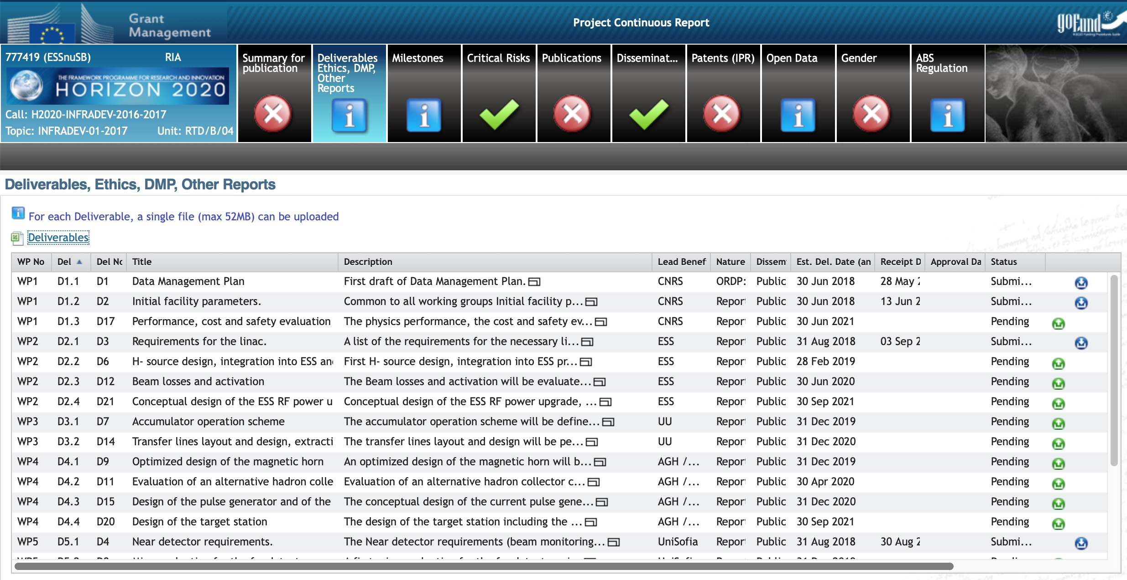
DELIVERABLES

Slide 20
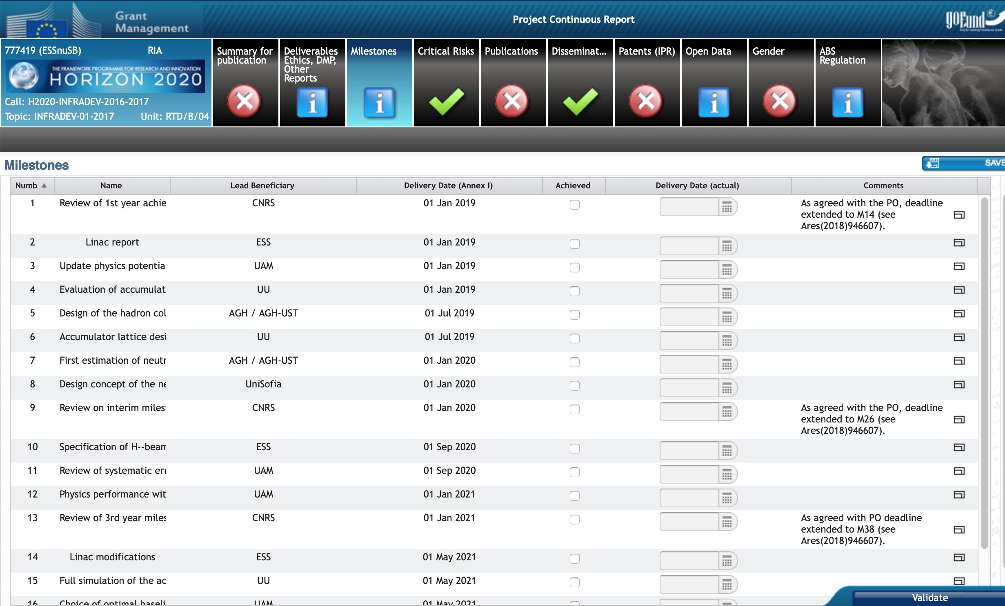
MILESTONES

Slide 21
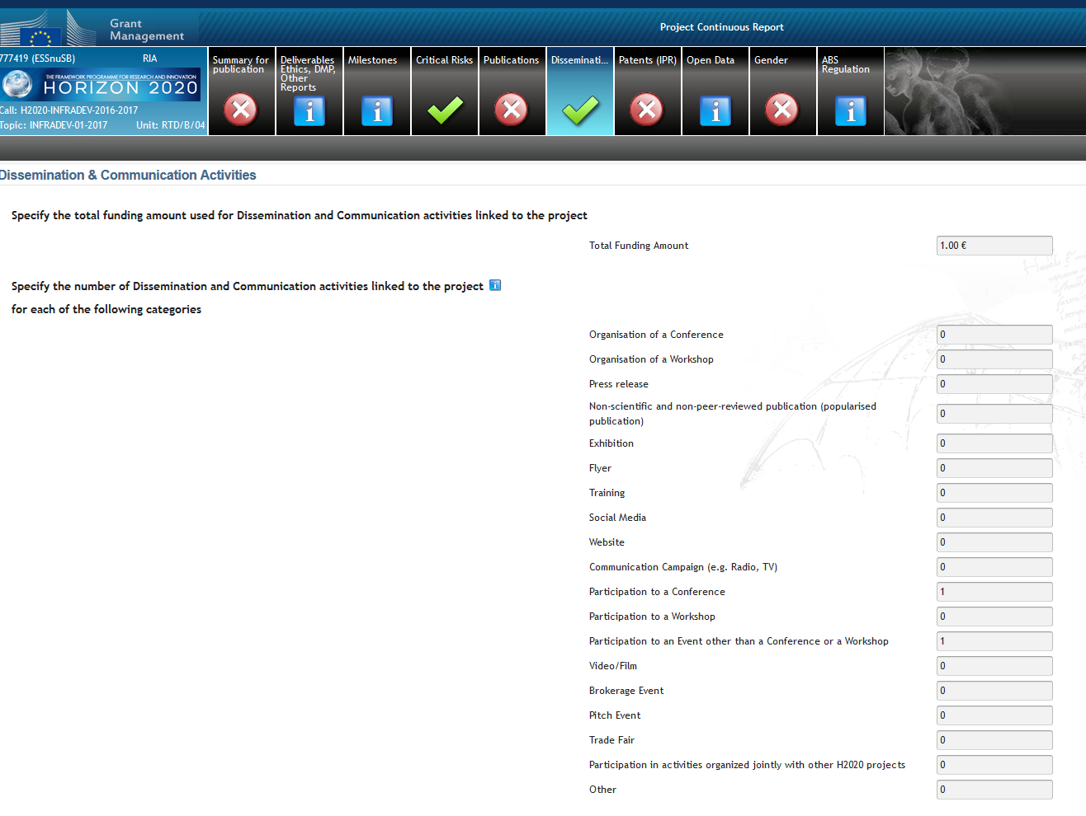
DISSEMINATION ACTIVITIES: Continuous report
Dissemination activities as this one have to be reported

Slide 22
Summary
The ESSνSB Consortium is composed of two entities:
  EuroNuNet
    COST Action for networking
    13 countries
    2016-2020
  ESSνSB Design Study
    EU H2020 INFRADEV project
    15 Institutions
    2018-2021
A Conceptual Design Report will be provided end of 2021
What after?
  R&D
  Technical Design Report

