Slide 1
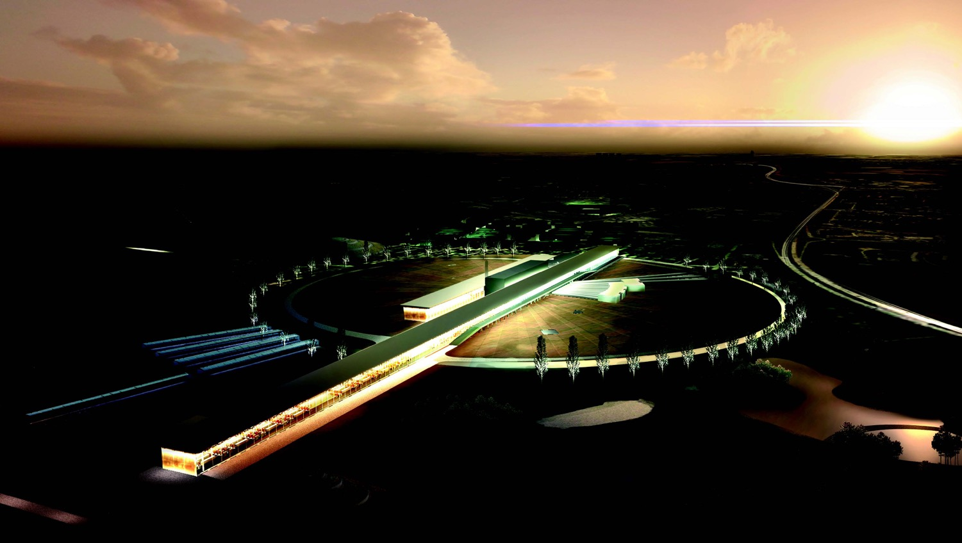


Neutrino CP Violation with the European Spallation Source neutrino Super Beam
Marcos Dracos
IPHC-Strasbourg

Slide 2
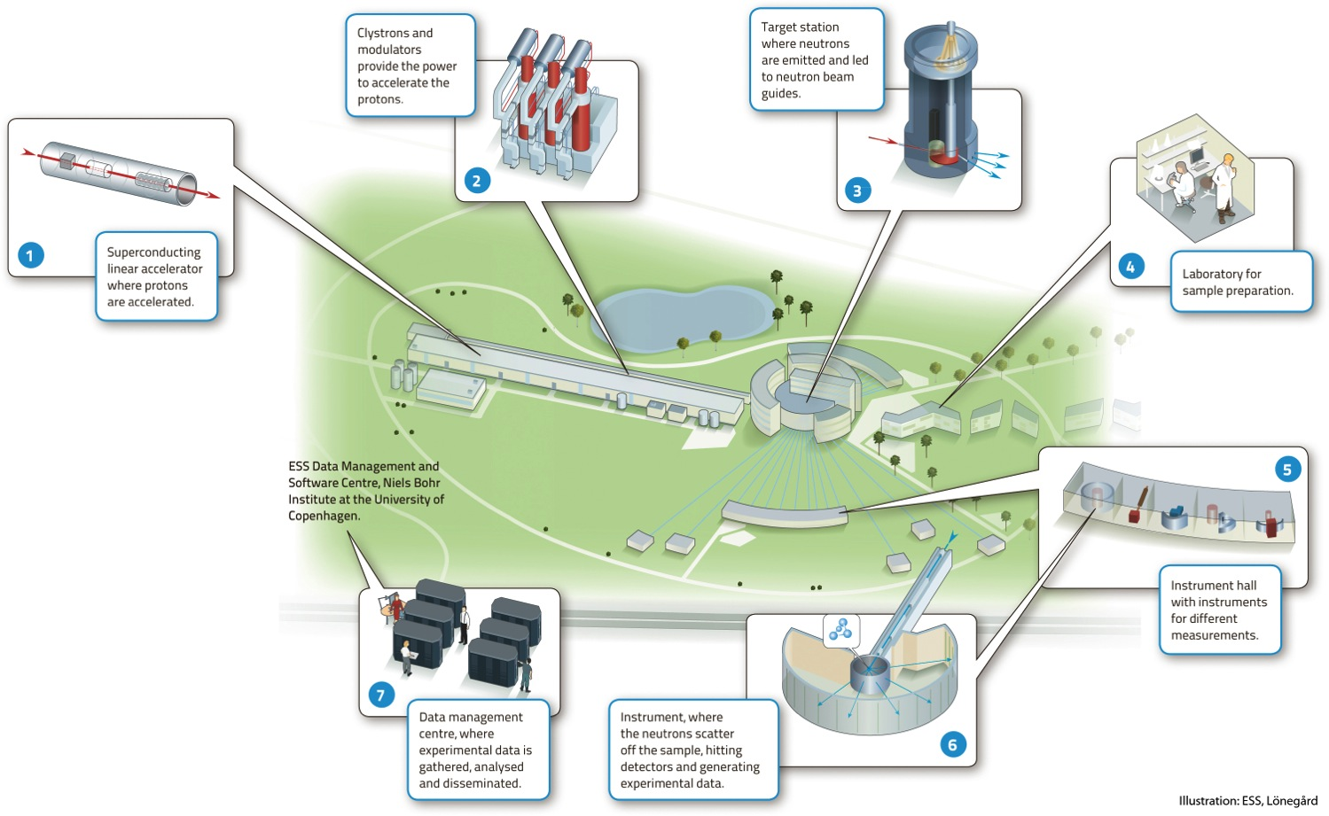

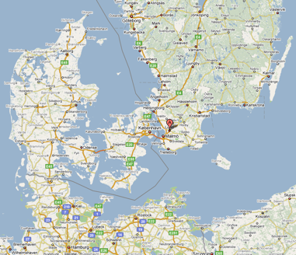
European Spallation Source
Neutron facility
(equivalent to SNS)
under construction phase
(~1.85 B€ facility)

Slide 3
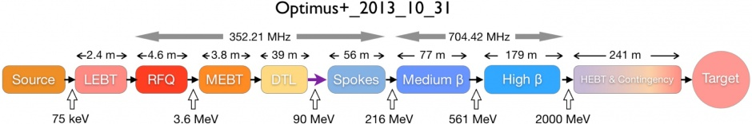
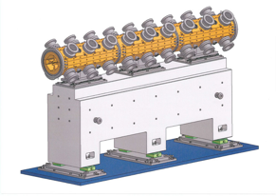
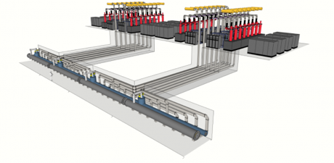
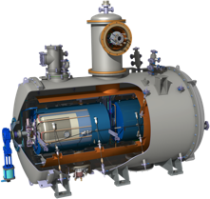
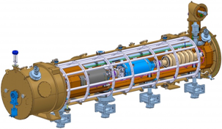
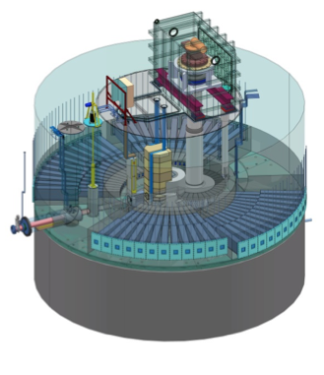
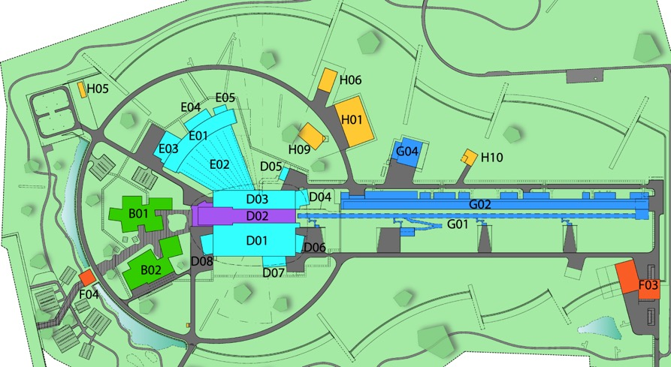
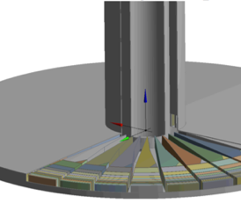
The ESS neutron facility
rotating tungsten target

Slide 4
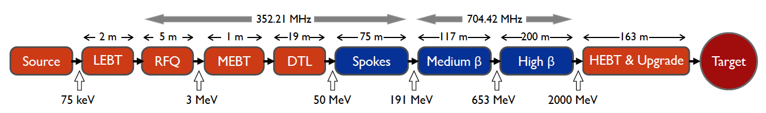
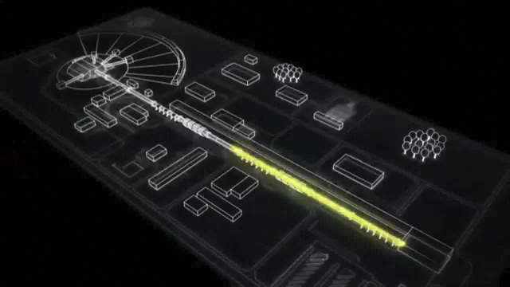
ESS proton linac
empty space for energy upgrades
The ESS will be a copious source of spallation neutrons.
5 MW average beam power.
125 MW peak power.
14 Hz repetition rate (2.86 ms pulse duration, 10¹⁵ protons).
Duty cycle 4%.
2.0 GeV protons
  up to 3.5 GeV with linac upgrades
>2.7x10²³ p.o.t/year.
8
x10¹⁴
ESS 5 MW
2015 design
7
λ = 1.5 Å
6
5
Brightness (n/cm²/s/sr/Å)
4
3
ESS 5 MW
2012 design (TDR)
Linac ready by 2023 (full power)
2
UK TS2
32 kW
SNS
1-2 MW
JPARC
0.3-1 MW
1
UK TS1
128 kW
ILL 57 MW
0
time (ms)
1
2
3
4

Slide 5
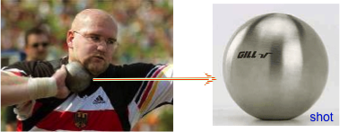
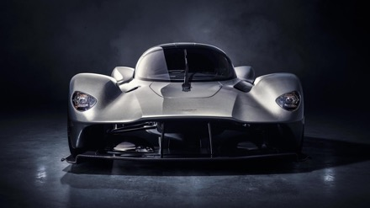
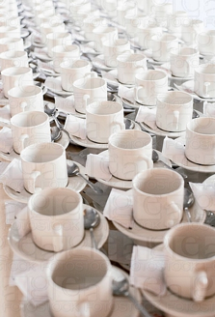
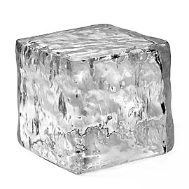
What does it mean 5 MW?
One beam pulse:
    has the same energy as a 16 lb (7.2kg) shot traveling at
    1100 km/hour
    Mach 0.93
  Has the same energy as a 1000 kg car traveling at 96 km/hour
  You boil 1000 kg of ice in 83 seconds
And this for 14 pulses/sec…

Slide 6
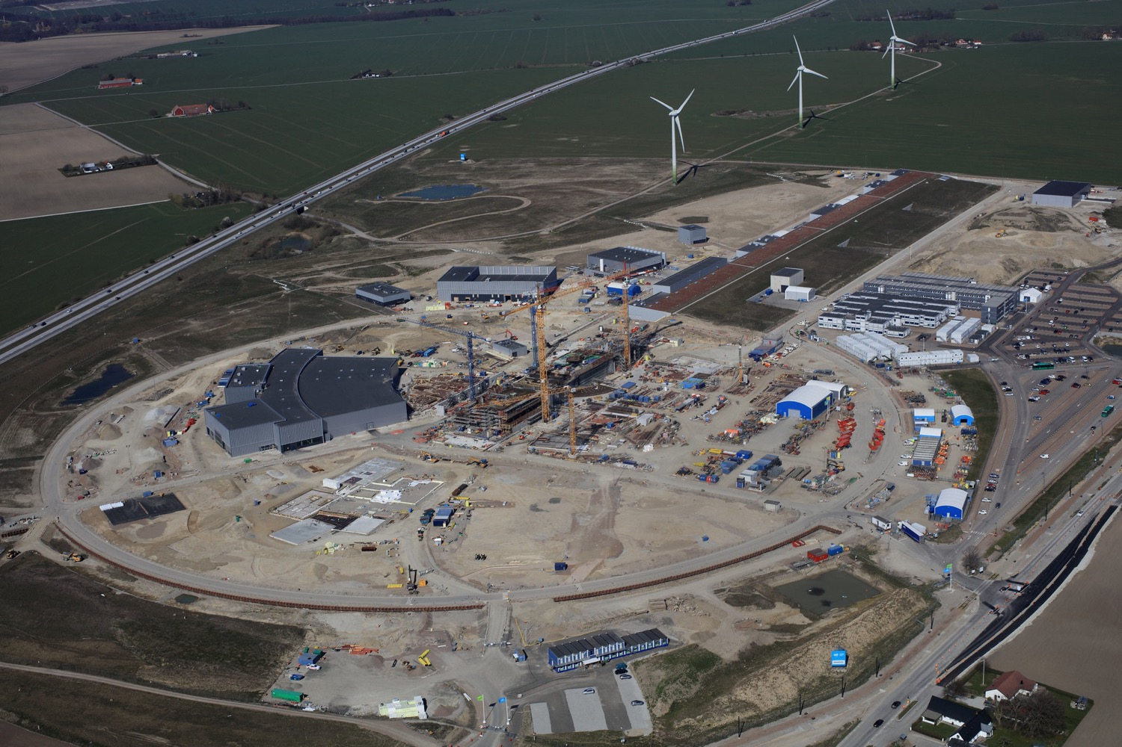

European Spallation Source
Distribution
Substation
Central Utility
Building
Cryo Compressor
Building
Front End
Building
Exp. Hall
E01
Klystron Gallery
High Energy
Loading Bay
Active
Cells
Target
Monolith
April 2019

Slide 7
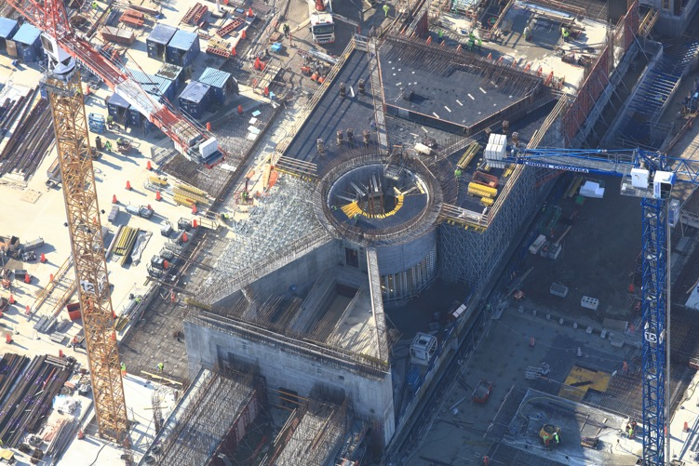
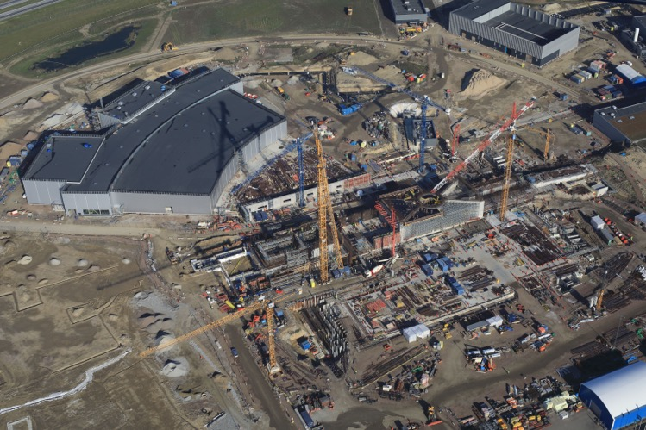
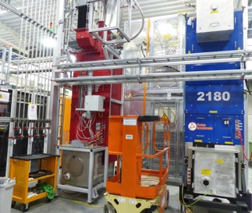
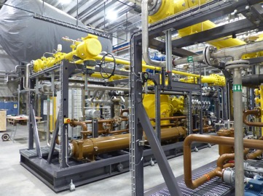
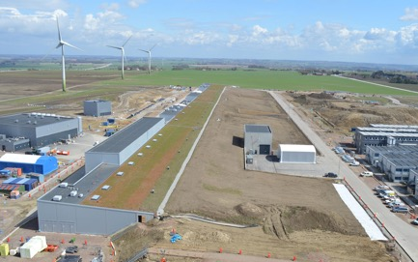
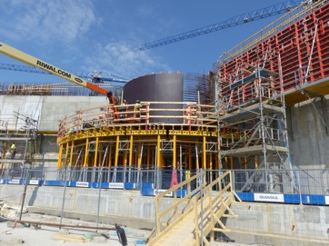
European Spallation Source
Target station
klystrons
cryoplants
Proton linac

Slide 8
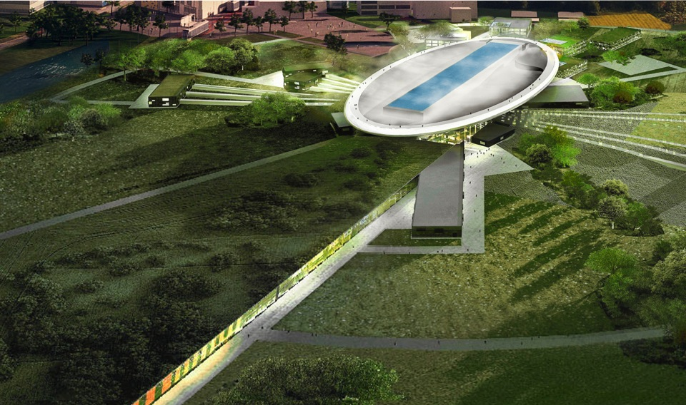
ESS schedule
2025
ESS construction complete
2014
Construction work starts on the site
2023
ESS starts
user program
2009
Decision: ESS will be built in Lund
2019
First neutrons on instruments
2012
ESS Design Update phase complete
2003
First European design effort of ESS completed

Slide 9
European Spallation Source as Neutrino Facility for CP violation observation
(2nd Oscillation maximum)
ν

Slide 10
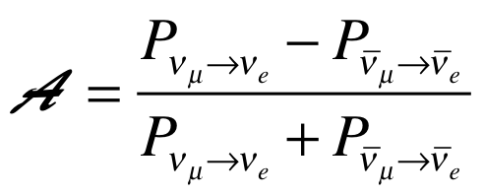
Oscillation probability
(neutrino beams)
"atmospheric"
"interference"
"solar"
matter effect
for antimatter: δ_{CP} →-δ_{CP} and a→-a
fake matter/antimatter asymetry due to matter effect
δ_{CP} dependence,
sizable matter effect for long baselines
Matter-antimatter asymmetry

Slide 11

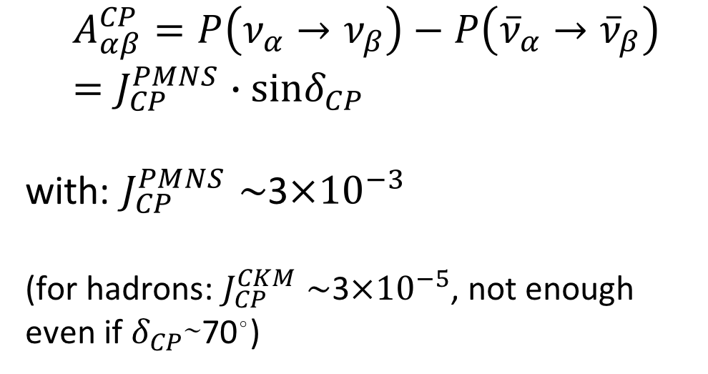
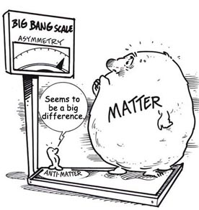
δ_{CP} and Matter-antimatter asymmetry magnitude
(Jarlskog invariant)
(from the already observed CP violation in the hadronic sector)
Theoretical models predict that if |sinδ_{CP}|≳0.7 (45°<δ_{CP}<135° or 225°<δ_{CP}<315°), this could be enough to explain the observed asymmetry.
(Nucl.Phys.B774:1-52,2007, arXiv:hep-ph/0611338)

Slide 12
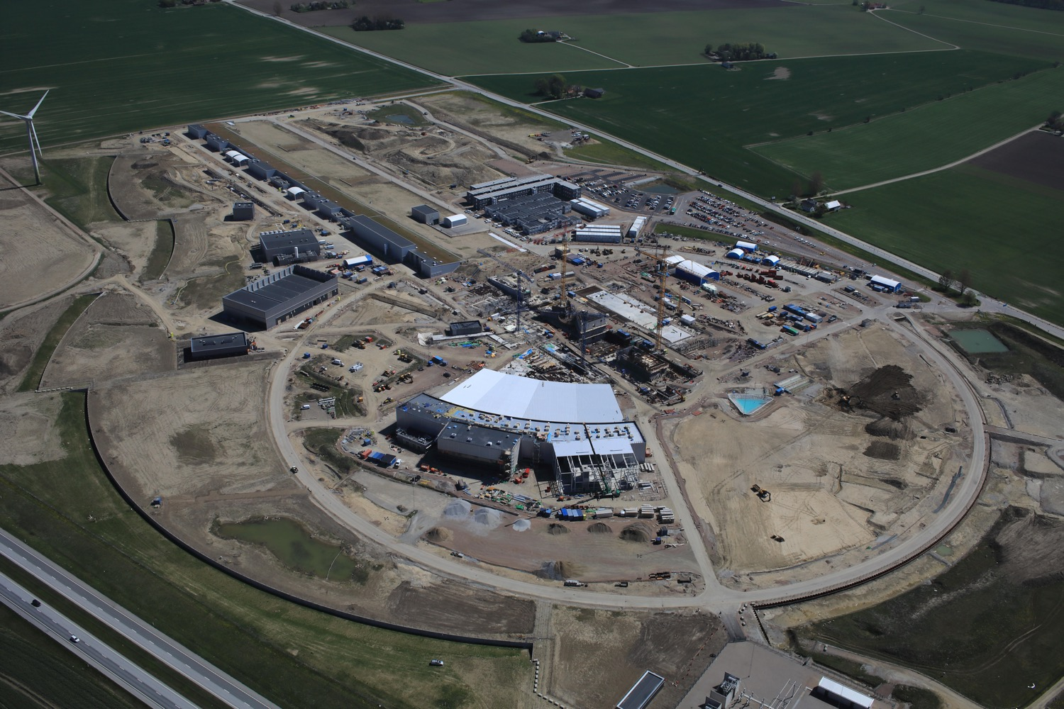
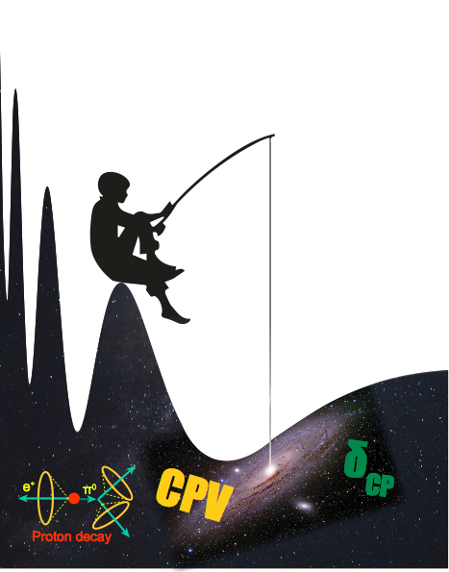
Use all this ESS linac power to go to the second oscillation maximum
but why?

Slide 13
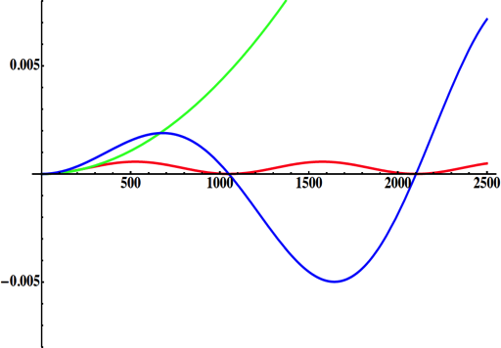
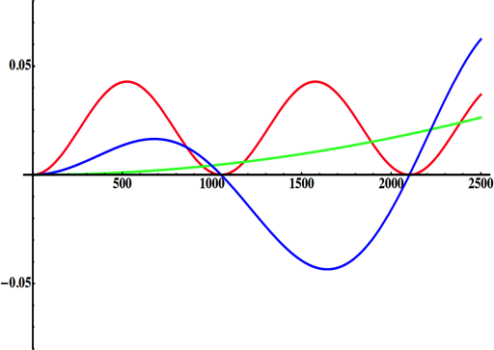
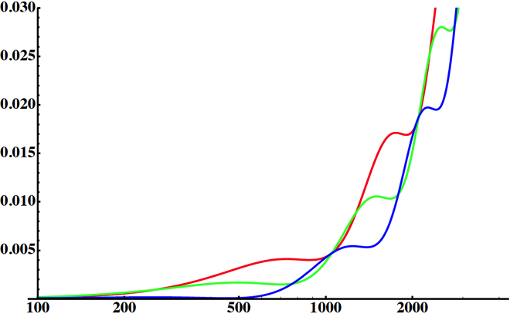
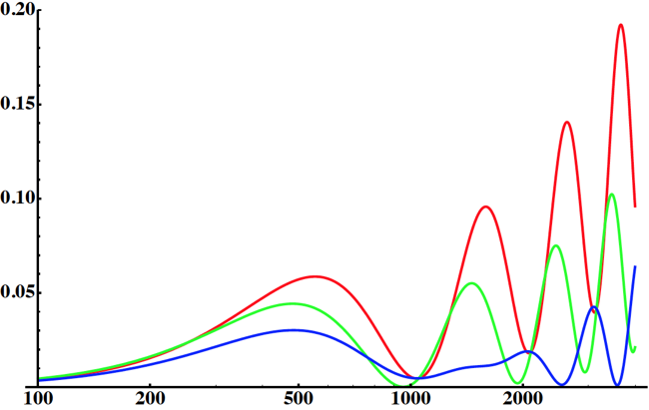
Neutrino Oscillations with "large" θ₁₃
solar
atmospheric
for "large" θ₁₃ 1st oscillation maximum is dominated by atmospheric term
for small θ₁₃ 1st oscillation maximum is better
atmospheric
solar
L/E
L/E
CP interference
(arXiv:1110.4583)
θ₁₃=1º
CP interference
θ₁₃=8.8º
solar
2nd oscillation maximum
P(ν_{μ}→ν_{e})
1st oscillation maximum
θ₁₃=1º
("small" θ₁₃)
δ_{CP}=-90
δ_{CP}=0
δ_{CP}=+90
θ₁₃=8.8º
("large" θ₁₃)
L/E
L/E
1st oscillation max.: A=0.3sinδ_{CP}
2nd oscillation max.: A=0.75sinδ_{CP}
more sensitivity at 2nd oscillation max.
(see arXiv:1310.5992 and arXiv:0710.0554)

Slide 14
Having access to a powerful proton beam…
What can we do with:
5 MW power
2 GeV energy
14 Hz repetition rate
10¹⁵ protons/pulse
>2.7x10²³ protons/year
proton beam
decay tunnel
p
hadrons
physics
π
ν
⨂B
target
hadronic collector
(focusing)
Detector
conventional neutrino (super) beam

Slide 15
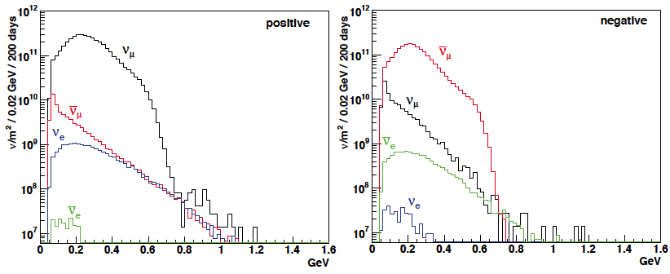
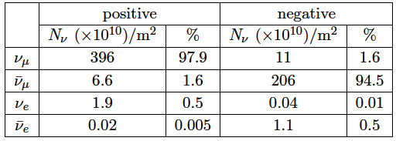
ESSνSB ν energy distribution
(without optimisation)
neutrinos
anti-neutrinos
almost pure ν_{μ} beam
small ν_{e} contamination which could be used to measure ν_{e} cross-sections in a near detector
at 100 km from the target and per year (in absence of oscillations)
(Nucl. Phys. B 885 (2014) 127)

Slide 16
Oscillation to be studied
ν_{μ}→ν_{e}

Slide 17
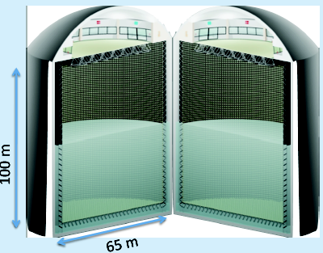
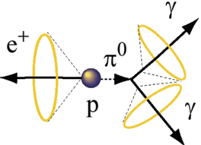
Can we go to the 2nd oscillation maximum using our proton beam?
Yes, if we place our far detector at around 500 km from the neutrino source.
MEMPHYS like Cherenkov detector
(MEgaton Mass PHYSics studied by LAGUNA)
(arXiv: hep-ex/0607026)
Neutrino Oscillations
Proton decay
Astroparticles
Understand the gravitational collapsing: galactic SN ν
  Supernovae "relics"
Solar Neutrinos
Atmospheric Neutrinos
New 20" PMTs with higher QE and cheaper (see JUNO), the detection efficiency will improve the detector performance keeping the price constant, not yet taken into account.
500 kt fiducial volume (~20xSuperK)
Readout: ~240k 8” PMTs
30% optical coverage

Slide 18
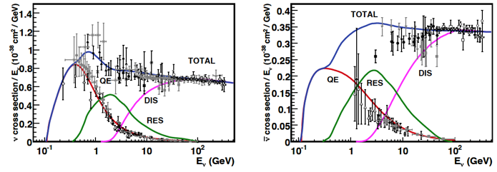
Neutrino Interactions
ν
ν
ν
l
ν
ν
ν
l
π⁰
e
e
n
n
n
n
n
hadrons
Elastic
Quasi-Elastic (QE)
Resonant (RES)
Deep inelastic (DIS)
neutrinos
antineutrinos
According to neutrinos to be detected their interaction cross-section has to be taken into account.

Slide 19
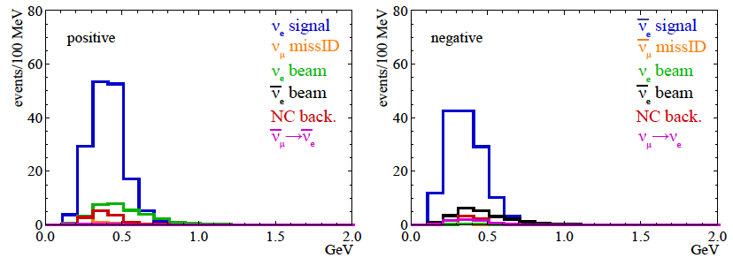
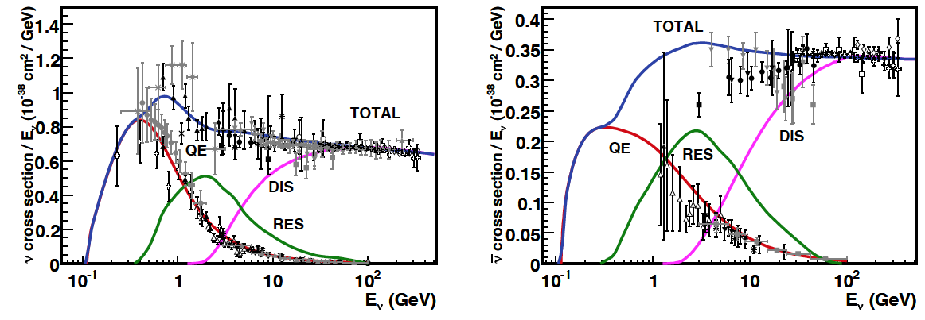
Neutrinos in the far detector
540 km (2 GeV), 10 years
neutrinos
anti-neutrinos
δ_{CP}=0
2 years
8 years
below ν_{τ} production, almost only QE events, not suffering too much by π⁰ background

Slide 20
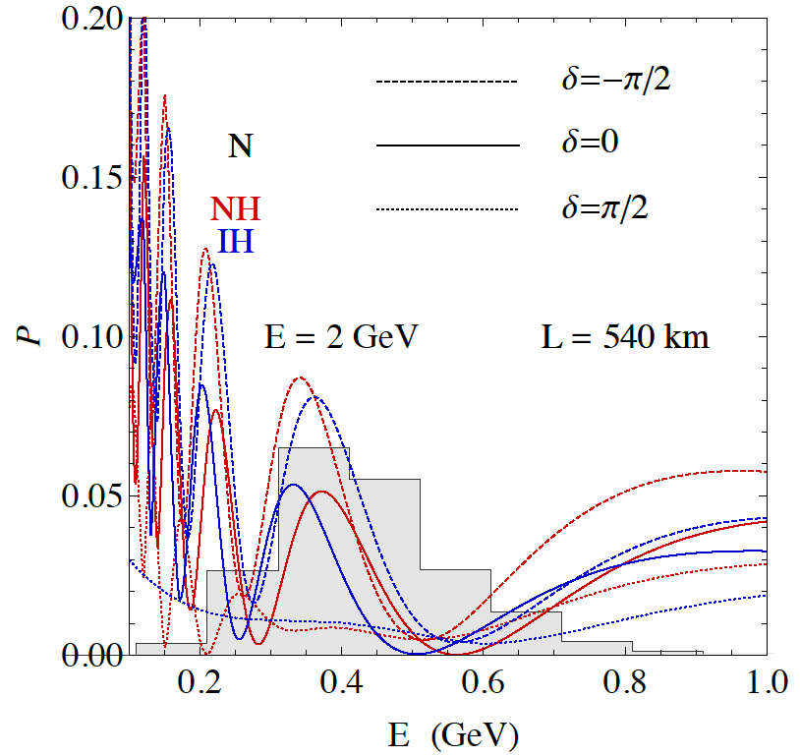
2nd Oscillation max. coverage
2nd oscillation max.
well covered by the ESS neutrino spectrum
1st oscillation max.

Slide 21
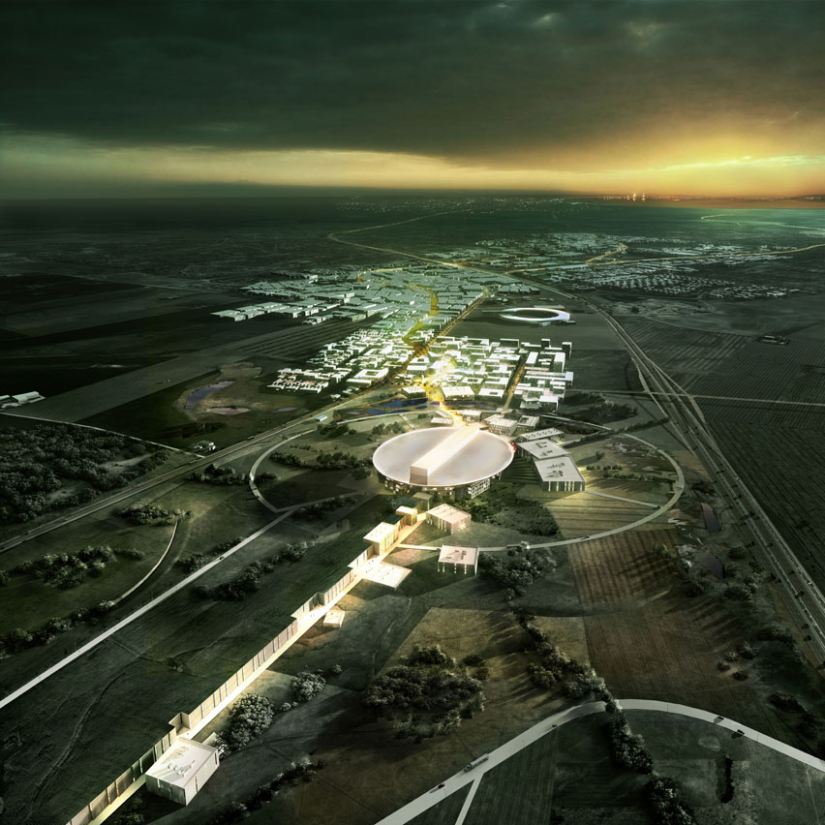
ESS Linac modifications to produce a neutrino Super Beam
European Spallation Source Linac

Slide 22
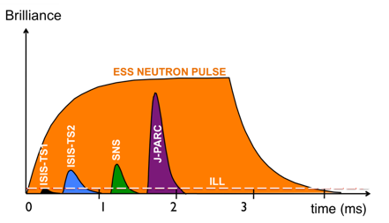
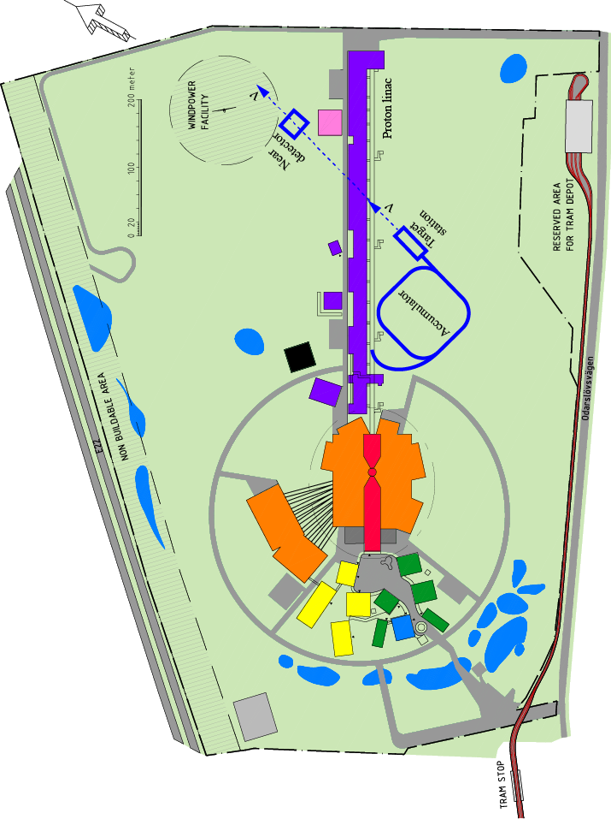
How to add a neutrino facility?
The neutron program must not be affected and if possible synergetic modifications.
Linac modifications: double the rate (14 Hz → 28 Hz), from 4% duty cycle to 8%.
Accumulator (C~400 m) needed to compress to few μs the 2.86 ms proton pulses, affordable by the magnetic horn (350 kA, power consumption, Joule effect)
  H⁻ source (instead of protons),
  space charge problems to be solved.
~300 MeV neutrinos.
Target station (studied in EUROν).
Underground detector (studied in LAGUNA).
Short pulses (~μs) will also allow DAR experiments (as those proposed for SNS) using the neutron target.

Slide 23
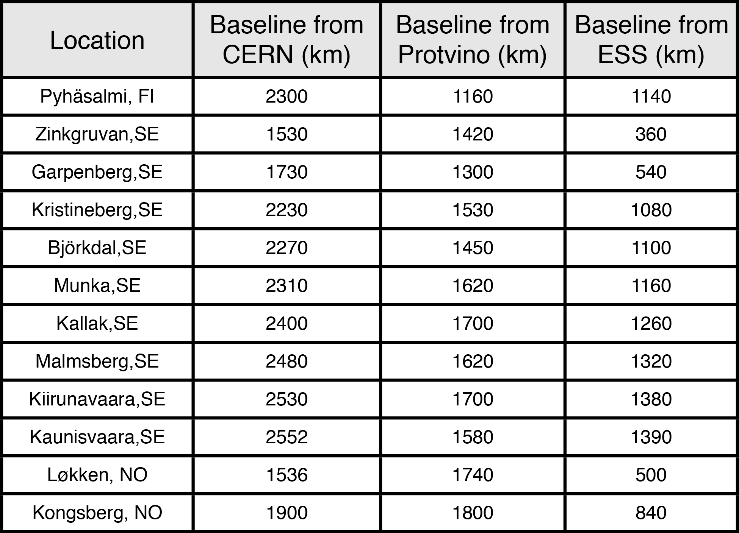
Possible locations for far detector
ESS
Kongsberg
Løkken
CERN
LAGUNA sites

Slide 24
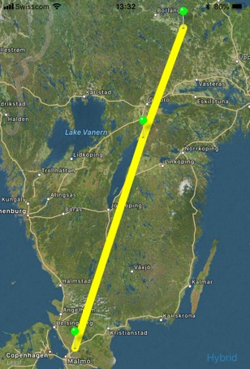
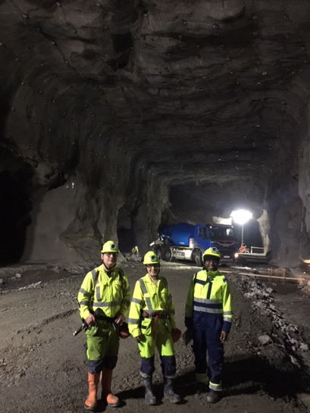
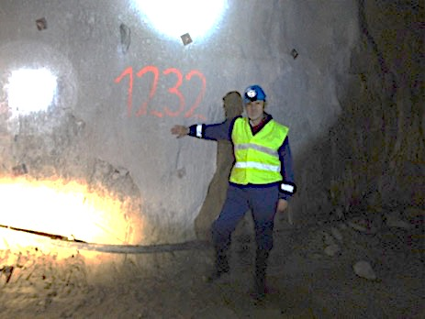
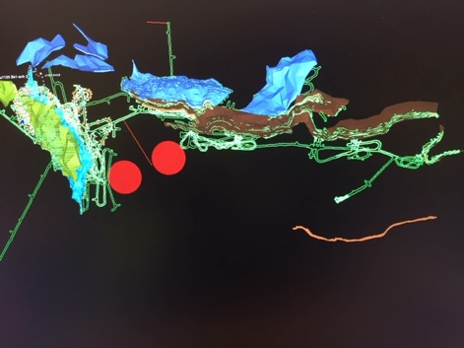

Candidate active mines
Garpenberg mine
  Distance from ESS Lund 540 km
  Depth 1200 m
  Truck access tunnel
Zinkgruvan mine
  Distance from ESS Lund 360 km
  Depth 1500 m
  Truck access tunnel
Garpenberg
(540 km)
Zinkgruvan
Zinkgruvan
(360 km)
Lund
possible location of MEMPHYS in
Zinkgruvan mine
Garpenberg
Granite drill cores

Slide 25


Which baseline?
CPV (Nucl. Phys. B 885 (2014) 127)
Garpenberg
Zinkgruvan
~60% δ_{CP} coverage at 5 σ C.L.
>75% δ_{CP} coverage at 3 σ C.L.
systematic errors: 5%/10% (signal/backg.)
Candidate active mines

Slide 26
Physics Performance
540 km
little dependence on mass hierarchy,
δ_{CP} coverage at 5 σ C.L. up to 60%,
δ_{CP} accuracy down to 6° at 0° and 180° (absence of CPV for these two values),
not yet optimized facility,
5/10% systematic errors on signal/background.
5/5 yrs

Slide 27
Required modifications of the ESS accelerator for ESSνSB
Better to go to 2.5 GeV

Slide 28






General Layout of the target station
Shield Blocks
Horn Support Module
8 m concrete
Split Proton Beam
Horns and Targets
Collimators
Decay Volume
(He, 4x4x25 m³)
Neutrino Beam Direction
Beam Dump

Slide 29


Muons at the level of the beam dump
2.7x10²³ p.o.t/year
y (cm)
muons at the level of the beam dump
(per proton)
more than 4x10²⁰ μ/year from ESSS compared to 10¹⁴ μ used by all experiments up to now (10¹⁸ μ for COMET in the future).
4.2x10²⁰ μ/year
(16.3x10²⁰ for 4 m²)
x (cm)
10⁻³
4.1x10²⁰ μ/year
input beam for future 6D μ cooling experiments (for muon collider),
low energy nuSTORM,
Neutrino Factory,
Muon Collider.
muons/proton
<E_{μ}>~0.46 GeV
<L_{μ}>~2.9 km

Slide 30


ESS neutrino and muon facility
2.7x10²³ p.o.t/year
Neutrons to ESS
ESS proton driver
Protons dump
ν_{μ} or ‾ν_{μ}
Long
Baseline
Detector
π decay
ESSnuSB
Test Facility
μ⁺ or μ⁻
ν_{μ} + ‾ν_{e}
Short
Baseline
Detector
Short
Baseline
Detector
Accumulator
Decay
channel or ring
nuSTORM
Front end
ν_{e} + ‾ν_{μ}
Muons of average energy ~0.5 GeV at the level of the beam dump
RLA
acceleration
Storage
ring
Cooling
Long
Baseline
Detector
Neutrino
Factory
RCS
acceleration
Collider
ring
Muon Collider
→ ←
μ⁺ μ⁻

Slide 31


Muons at ESS (ESSμSB)
Carlo Rubbia
Venice, March 2019
on arXiv since this week: arXiv:1908.05664

Slide 32


Muons at ESS (ESSμSB)
Carlo Rubbia
SM Higgs rate is ≈ 10⁵ ev/year (10⁷ s)
in each detector.

Slide 33


EuroNuNet
COST application for networking: CA15139 (2016-2020)
  EuroNuNet : Combining forces for a novel European facility for neutrino-antineutrino symmetry violation discovery (http://www.cost.eu/COST_Actions/ca/CA15139)
The members are countries which signed the Action MoU
  Major goals of EuroNuNet:
    to aggregate the community of neutrino physics in Europe to study a neutrino long baseline concept in a spirit of inclusiveness,
    to impact the priority list of High Energy Physics policy makers and of funding agencies to this new approach to the experimental discovery of leptonic CP violation.
  13 participating countries (know at the last year)
http://euronunet.in2p3.fr/

Slide 34
ESSνSB at the European level
A H2020 EU Design Study (Call INFRADEV-01-2017)
Title of Proposal: Discovery and measurement of leptonic CP violation using an intensive neutrino Super Beam generated with the exceptionally powerful ESS linear accelerator
Duration: 4 years
Total cost: 4.7 M€
Requested budget: 3 M€
15 participating institutes from
11 European countries including CERN and ESS
6 Work Packages
Approved end of August 2017
ESSνSB
BENE (2004-2008)
ISS (2005-2007)
EUROν (2008-2012)
LAGUNA (2008-2010)
LAGUNA-LBNO (2010-2014)
COST Action CA15139 (2015-2019)

Slide 35
Design Study ESSνSB
(2018-2021)
More information on:
http://essnusb.eu/
CDR end of 2021
partners: IHEP, BNL, SCK•CEN, SNS, PSI, RAL

Slide 36



Possible ESSνSB schedule
(2nd generation neutrino Super Beam)
2021: End of ESSνSB Design Study, CDR and preliminary costing
2012: inception of the project
2016-2019: beginning of COST Action EuroNuNet
2018: beginning of ESSνSB Design Study (EU-H2020)
2022-2024: Preparatory Phase, TDR
2025-2026: Preconstruction Phase, International Agreement
2027-2034: Construction of the facility and detectors, including commissioning
2035-: Data taking
Nucl. Phys. B 885 (2014) 127

Slide 37

Conclusion
ESS will be the most powerful neutron facility for many applications.
ESS can also become a neutrino facility with enough protons to go to the 2nd oscillation maximum and increase the CPV sensitivity.
CPV: 5 σ could be reached over 60% of δ_{CP} range by ESSνSB with large physics potential.
Large associated detectors have a rich astroparticle physics program.
The European Spallation Source Linac will be ready by 2025, upgrade decisions by this moment.
Rich muon program for future ESS upgrades.
COST network project CA15139 and a EU-H2020 Design Study supports this project.

Slide 38
Backup

Slide 39
How the CPV coverage and resolution curves have been produced
T2HK:
  Same curves that Hyper-K has showed at the Neutrino Town Meeting at CERN and the one that was showed at Neutrino 2018.
  Systematics are said by T2HK to be between 3% to 4%.
  sin² 2θ₁₃ =0.1 and θ₂₃= π /2.
DUNE:
  Public globes file released by the DUNE collaboration with the CDR, the only change is to increase the number of years from 7 to 10.
  sin²2θ₁₃ =0.1 and θ₂₃=π/2, to be compatible with the T2HK line.
ESSnuSB:
  Instead of considering as usual “Opt. Snowmass errors" it is only assumed an overall 3% systematic error in the different signal and background channels, more in line with T2HK assumptions.
  sin²2θ₁₃ =0.1 and θ₂₃= π /2, to be compatible with the T2HK line.

Slide 40

Beyond DUNE, JUNO, HyperK:
ESSνSB, P2O and Neutrino factory
European Neutrino "Town" meeting and ESPP 2019 discussion, CERN, 24.10.2018
Roumen Tsenov
Department of Atomic Physics, University of Sofia

Slide 41


CPV performance comparison between ESSnuSB, DUNE and Hyper-K
assuming 3% systematic errors for ESSnuSB in line with the other two.
ESSνSB 500 kt tank at 540 km.
ESSνSB 500 kt tank at 360 km.
(degrees)
ESSνSB 250 kt tank at 540 km
and 250 kt tank at 360 km.

Slide 42
Fraction of δ_{CP}
Garpenberg
(540 km)
(E. Martinez-Fernandez)
Zinkgruvan
(360 km)
Lund
2 active mines aligned…
My personal opinion:
these scenarios are too optimistic for all facilities

Slide 43


Preparing the ESS linac for operation at 10 MW with a 8% duty cycle and 28 Hz pulsing
For the medium-beta elliptical-cavity part ESS is planning to use tetrodes. Thales has developed a new screen grid with graded wire thickness making operation at 10 % duty cycle possible.
The picture shows the cryostat and test bunker at the FREIA Lab in Uppsala where a first prototype of the ESS 352 MHz spoke accelerating cavity is currently under test at 14 Hz and later on will be tested at 28 Hz.
FREIA Lab, Uppsala

Slide 44


Accumulation Ring
To compress to few μs the 2.86 ms proton pulses, affordable by the magnetic horn (350 kA, power consumption, Joule effect), but also keeping a reasonable size of the ring.
Baseline: single-ring accumulator
  Current studies give a 376 m circumference accumulator ring 1.32μs.
  1 ring leads to a very large space–charge tune–shift of about 0.75.
Injection
Option: 4 superposed rings located in the same tunnel,
  Each ring receives 1/4 of the bunches during the multi–turn injection,
  Reduction of the tune shift to the level of around 0.2 (acceptable for the 2.86 ms storage time),
  Experience already exists from the CERN PS Booster of using 4 superimposed rings with the aim to avoid high space charge effects.
Extraction
Collimation
RF
Lattice
The 4 rings of the CERN PS Booster (1972)

Slide 45





Mitigation of high power effects
(4-Target/Horn system for EUROnu Super Beam)
Packed bed canister in symmetrical transverse flow configuration (titanium alloy spheres)
4-target/horn system to mitigate the high proton beam power (4 MW) and rate (50 Hz)
target inside the horn
Helium Flow
proton beam switchyard

Slide 46

Systematic errors
Phys. Rev. D 87 (2013) 3, 033004 [arXiv:1209.5973 [hep-ph]]

Slide 47
Comparisons
Comparison using the same systematic errors
Phys. Rev. D 87 (2013) 3, 033004 [arXiv:1209.5973 [hep-ph]]

Slide 48

Sakharov conditions
In order to generate the needed baryon asymmetry the following conditions must be satisfied:
Baryon number violation
  If not, no baryon number can be generated (o.k. in SM considering Sphalerons @ ~140 GeV)
C and CP violation
  Γ(A→B+C)=Γ(A-bar→B-bar+C-bar)
  CP violation already observed in the quark sector, but not enough
Departure from thermal equilibrium
  production/destruction rates of baryons are equal if thermal equilibrium Γ(A→B+C)=Γ(B+C→A)
  expansion of the universe

Slide 49


The MEMPHYS Detector
(Proton decay)
(arXiv: hep-ex/0607026)

Slide 50


The MEMPHYS Detector
(Supernova explosion)
MEMPHYS
SUPERK
Diffuse Supernova Neutrinos
(10 years, 440 kt)
For 10 kpc: ~10⁵ events

Slide 51

DAR experiments
(ESS/SNS)
using the massive neutron target
(stopping all π and μ)
(from SN)
(from μ decays at rest)
(from π decays at rest)
(from μ decays at rest)
Typical expected supernova neutrino spectrum for different flavours (solid lines) and SNS/ESS neutrino spectrum (dashed and dotted lines)

Slide 52

Matter/antimatter asymmetry in the Universe
At the very beginning of the Universe:
10,000,000,001
10,000,000,000
matter
antimatter

Slide 53

Matter/antimatter asymmetry in the Universe
After annihilation:
+ radiation
matter
what we see around us today…
Baryon Asymmetry in the Universe (BAU)

