Slide 1


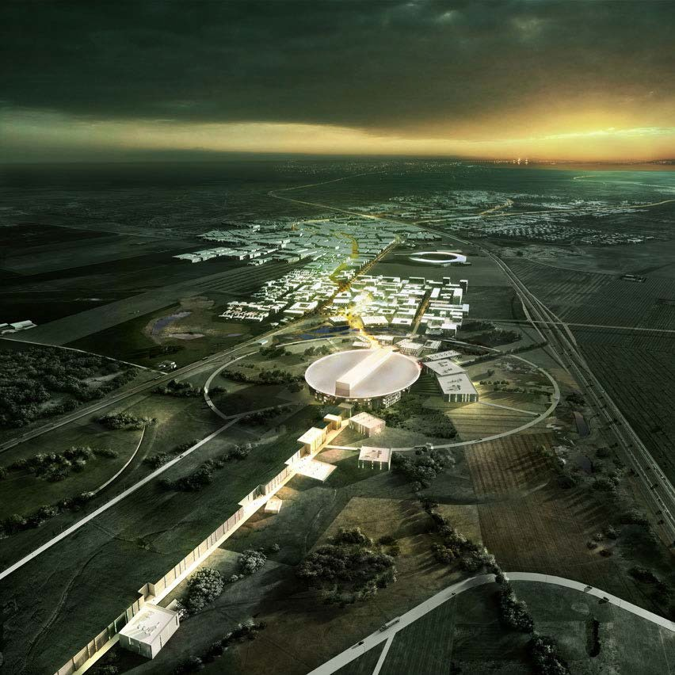

Status of the ESSnuSB neutrino beam and detector project
Particle Physics with Neutrino Telescopes
Uppsala 7 October 2019
Tord Ekelöf
Uppsala University

Slide 2
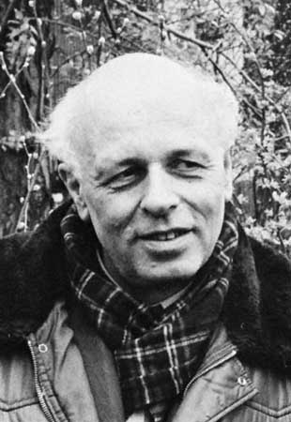
The Sakharov conditions (necessary but not sufficient) to explain the Baryon Asymmetry of the Universe (BAU):
1. At least one B-number violating process.
2. C- and CP-violation
3. Interactions outside of thermal equilibrium
Grand Unified Theories can fulfill the Sakharov conditions. However, in each m³ of the Universe there are on average ca 10⁹ photons, one proton and no antiproton. The CP violation measured in the quark sector is far too small (by a factor 10⁹) to explain this 10⁹ photon to baryon ratio.
Now, neutrino CP-violation, so far not observed, may very well be large enough to permit an explanation of BAU through the leptogenesis mechanism which relates the matter-antimatter asymmetry of the universe to neutrino properties: decays of heavy Majorana neutrinos generate a lepton asymmetry which is partly converted to a baryon asymmetry via sphaleron processes.
.
Why is there only matter and
no antimatter in Universe?

Slide 3
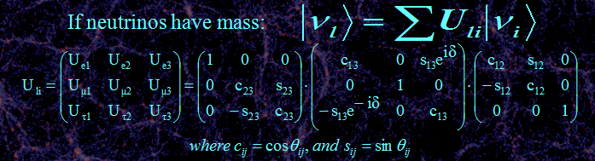
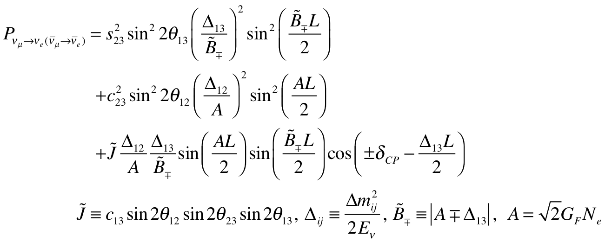
Three neutrino mixing
atmospheric
Non-CP terms
solar
interference
CP violating

Slide 4
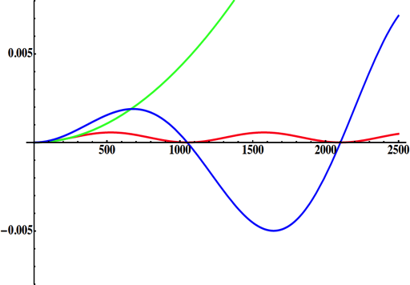
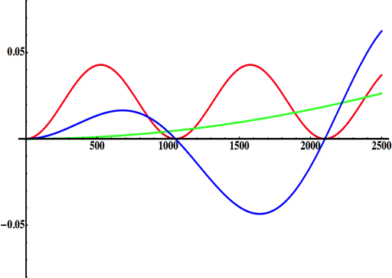
Neutrino Oscillations with "large" θ₁₃
solar
atmospheric
for "large" θ₁₃ 1st oscillation maximum is dominated by atmospheric term
for small θ₁₃ 1st oscillation maximum is better
atmospheric
solar
L/E
L/E
CP interference
(arXiv:1110.4583)
θ₁₃=1º
CP interference
θ₁₃=8.8º
2nd oscillation maximum
δ_{CP}=-90
δ_{CP}=0
δ_{CP}=+90
P(ν_{μ}→ν_{e})
1st oscillation max.: A=0.3sinδ_{CP}
2nd oscillation max.: A=0.75sinδ_{CP}
θ₁₃=8.8º
("large" θ₁₃)
(see arXiv:1310.5992 and arXiv:0710.0554)
L/E
more sensitivity at 2nd oscillation max.

Slide 5
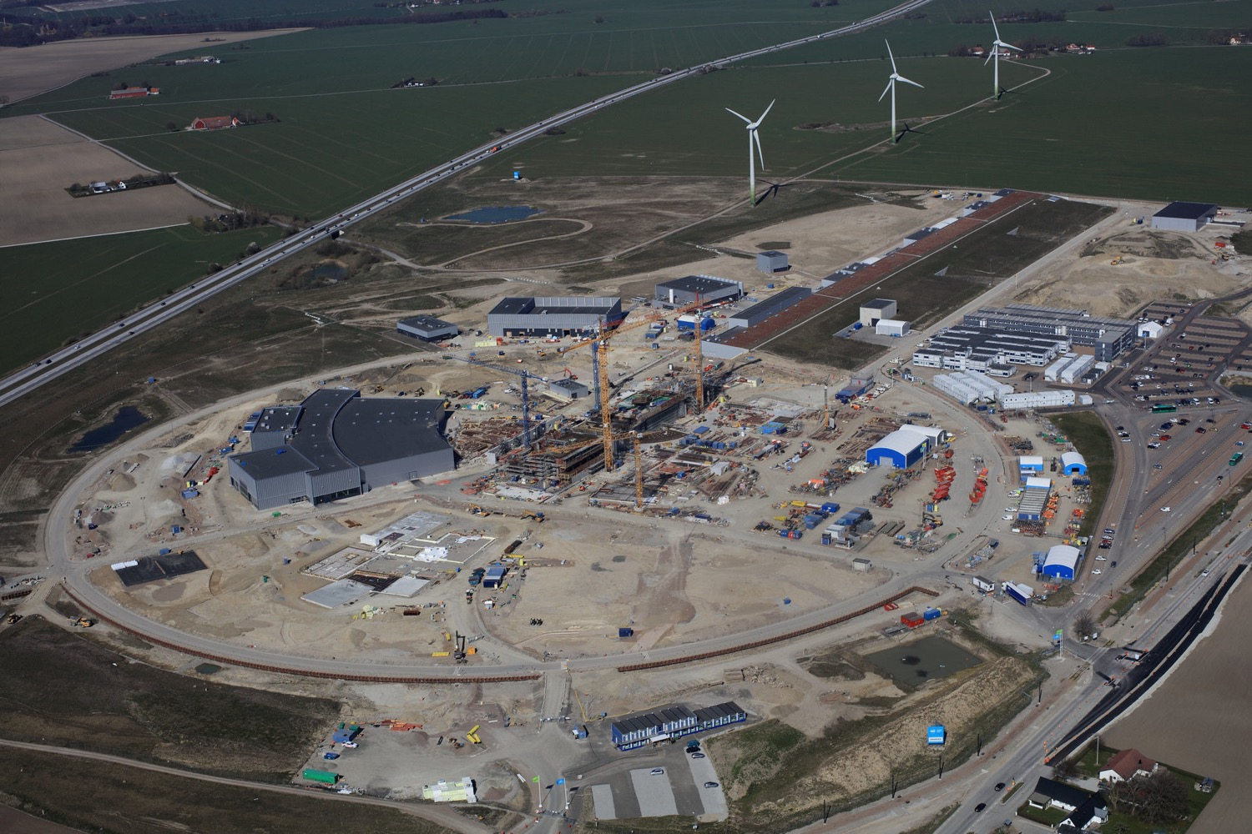

ESS ν Super Beam
To Far Detector
located at second
ν oscillation max.
Near Detector
Target Station
5 MW p
n
Accumulator
5 MW H⁻
April 2019

Slide 6
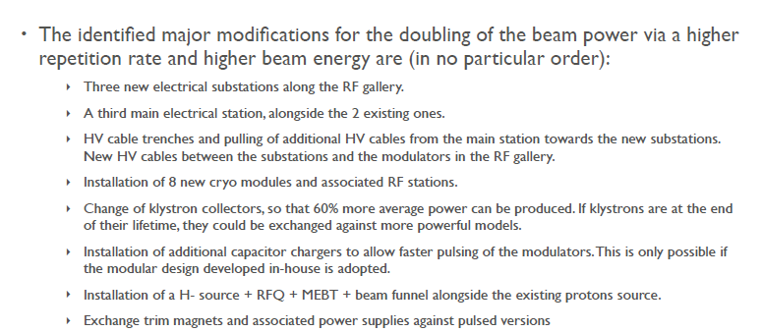
Required modifications of the ESS accelerator architecture for ESSnuSB
F. Gerigk and E. Montesinos CERN-ACC-NOTE-2016-0050 8 July 2016
to accelerate to 2.5 GeV
“No show stoppers have been identified for a possible future addition of the capability of a 5 MW H- beam to the 5 MW H+ beam of the ESS linac built as presently foreseen. Its additional cost is roughly estimated at 250 MEuros.”
Cf total cost of the ESS 5 MW linac of ca 1000 MEuros

Slide 7
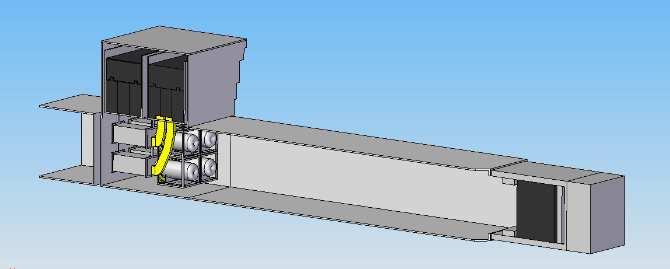
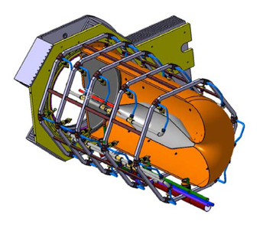
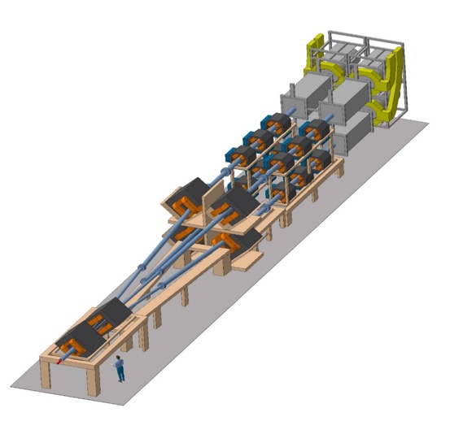
General Layout of the 5 MW target station
The proton beam is split up om 4 targets, each receiving a 1.25 MW beam
6
8 m concrete
Split Proton Beam
Horns and Targets
Neutrino Beam Direction
Collimators
Decay Volume
(He, 4x4x25 m³)
Beam Dump
Granular Ti target with He gas
cooling for a 1.25 MW beam
Beam
switchyard
Horn excided with
350 kA pulses, each
having a 1.3 flat top

Slide 8
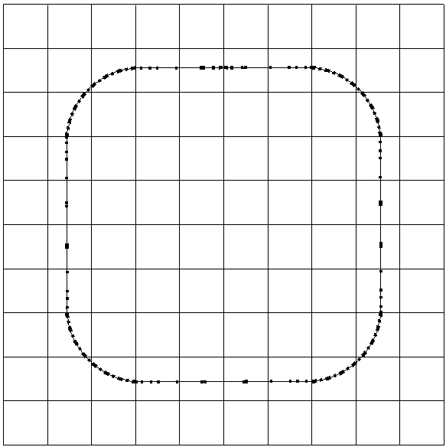
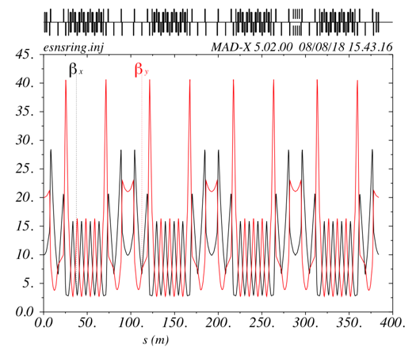
The Accumulator Ring which compresses each 0.65 ms pulse of 2.5*10¹⁴ protons from the ESS linac to 1.3 µs
To inject such a high charge in the accumulator ring, H⁻ injection with stripping is required
injection
4 superperiods
RF
extraction
FODO cells
collimation
Dispersion-free straight sections

Slide 9
The Linac modifications and operation
H⁻ source options
Into linac
P
_{H}⁻
_{H}⁻
_{H}⁻
_{H}⁻
P
_{H}⁻
_{H}⁻
_{H}⁻
_{H}⁻
14 Hz
100 µs
0.65 ms
Into ring
H⁻
H⁻
H⁻
H⁻
H⁻
H⁻
H⁻
H⁻
14 Hz
~1.4 kHz
~1 µs
~0.75 ms
Out of ring
into horn
_{H}⁻
_{H}⁻
_{H}⁻
_{H}⁻
_{H}⁻
_{H}⁻
_{H}⁻
_{H}⁻
14 Hz
Horn 1
Horn 4
Horn 2
Horn 3

Slide 10
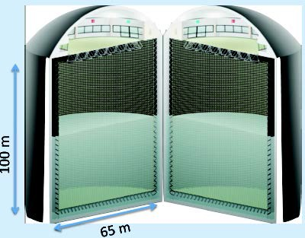
The Megaton Water Cherenkov neutrino detector
MEMPHYS like Cherenkov detector(MEgaton Mass PHYSics studied by LAGUNA
Two cylindrical tanks
Total fiducial volume 500 kt (~20xSuperK)
Readout: ~240k 8” PMTs
30% optical coverage
(arXiv: hep-ex/0607026)

Slide 11
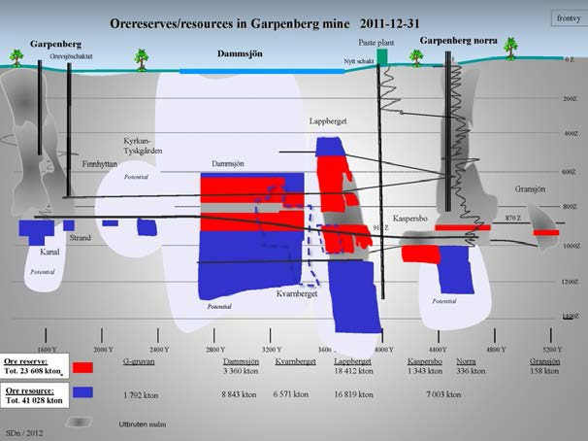
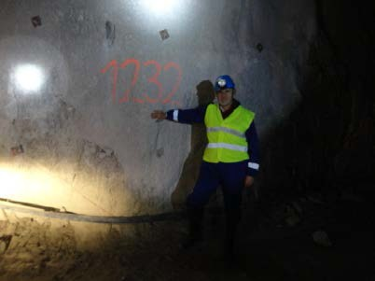
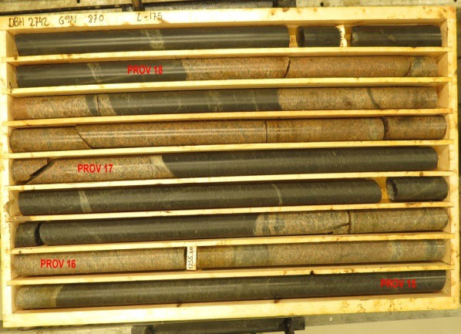
Garpenberg Mine 540 km from ESS
The MEMPHYS type detector to be located 1000 m down in a mine
Garpenberg mine depth 1200 m
Truck access tunnel
A new ore-hoist shaft has been taken into operation,
leaving an older shaft free to use for transport of ESSnuSB-detector cavern excavation-debris
Granite drill cores

Slide 12
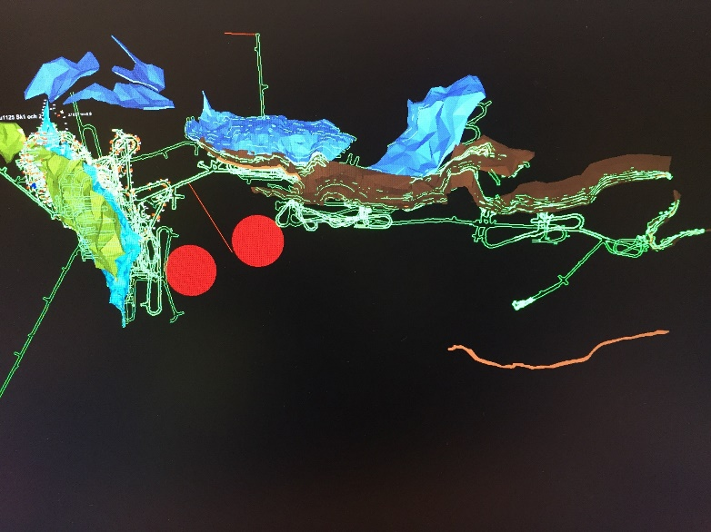
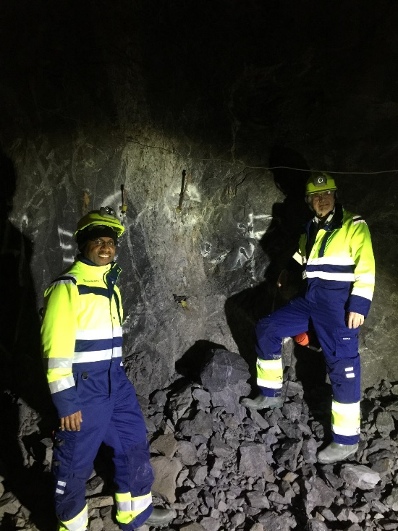
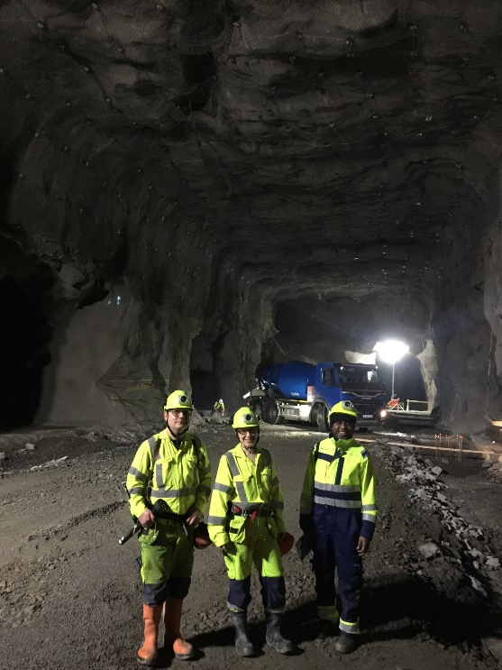
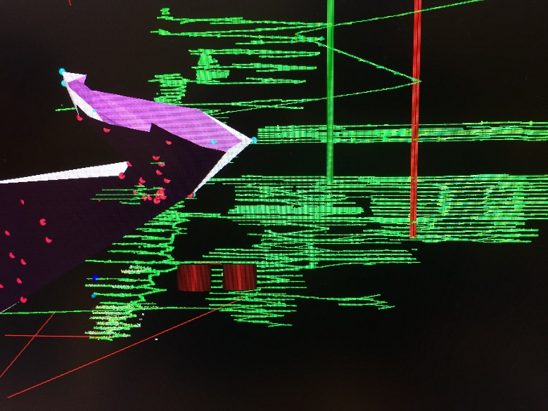
Zinkgruvan Mine 360 km from ESS
Zinggruvan mine depth 1500 m
Truck access tunnel
The main ore transport-shaft hoist has a capacity of 6000 tons per 24 hours of which only 2/3 is used. To bring up the 2.5 Mton of cruched rock will take order 3 years.

Slide 13
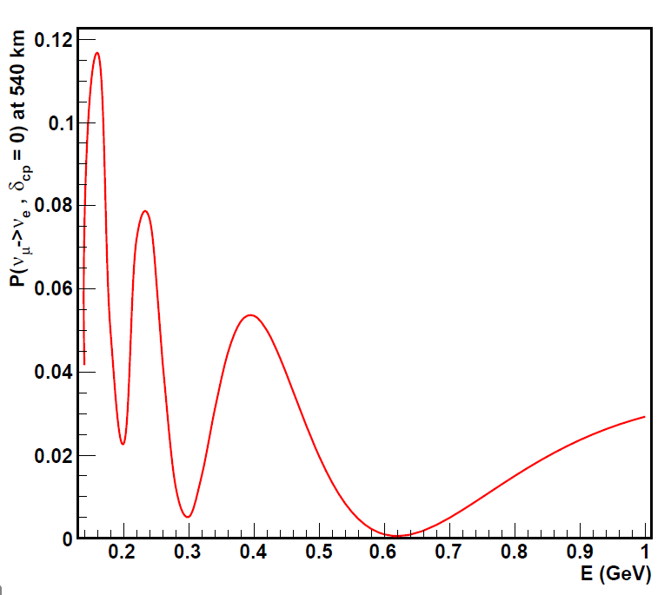
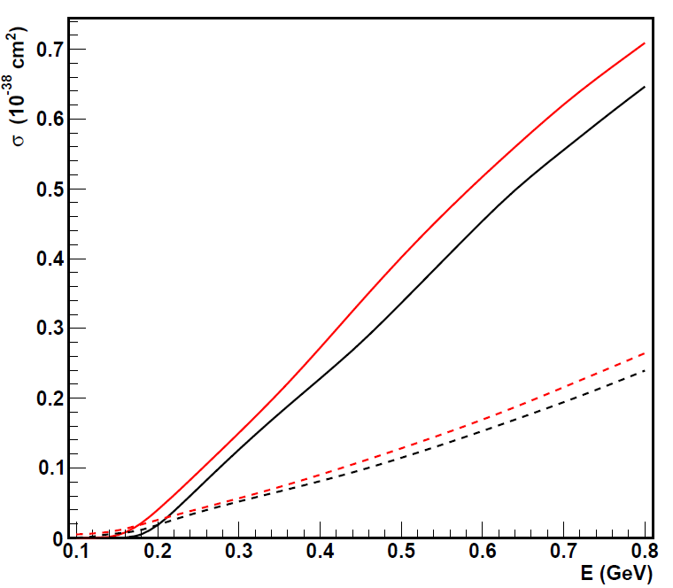
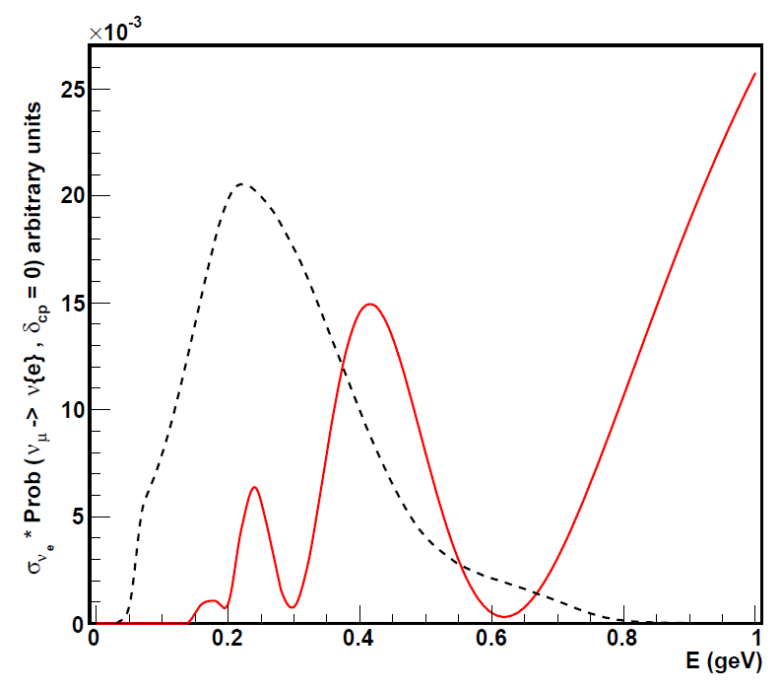
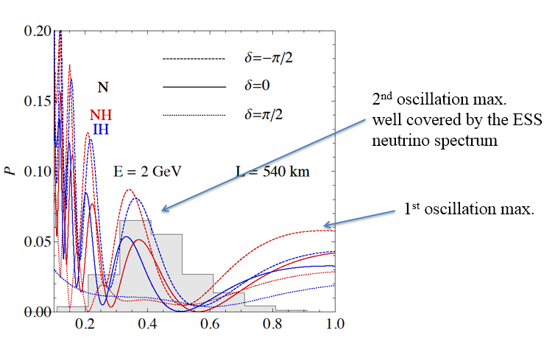
The effect of the sharply decreasing
ν detection cross-section
xs CC, wat.dat file (Enrique)
nue
anue
numu
anumu
flux(E)
2.5 GeV
(prob*xs)(E)
dcp=0, NH

Slide 14
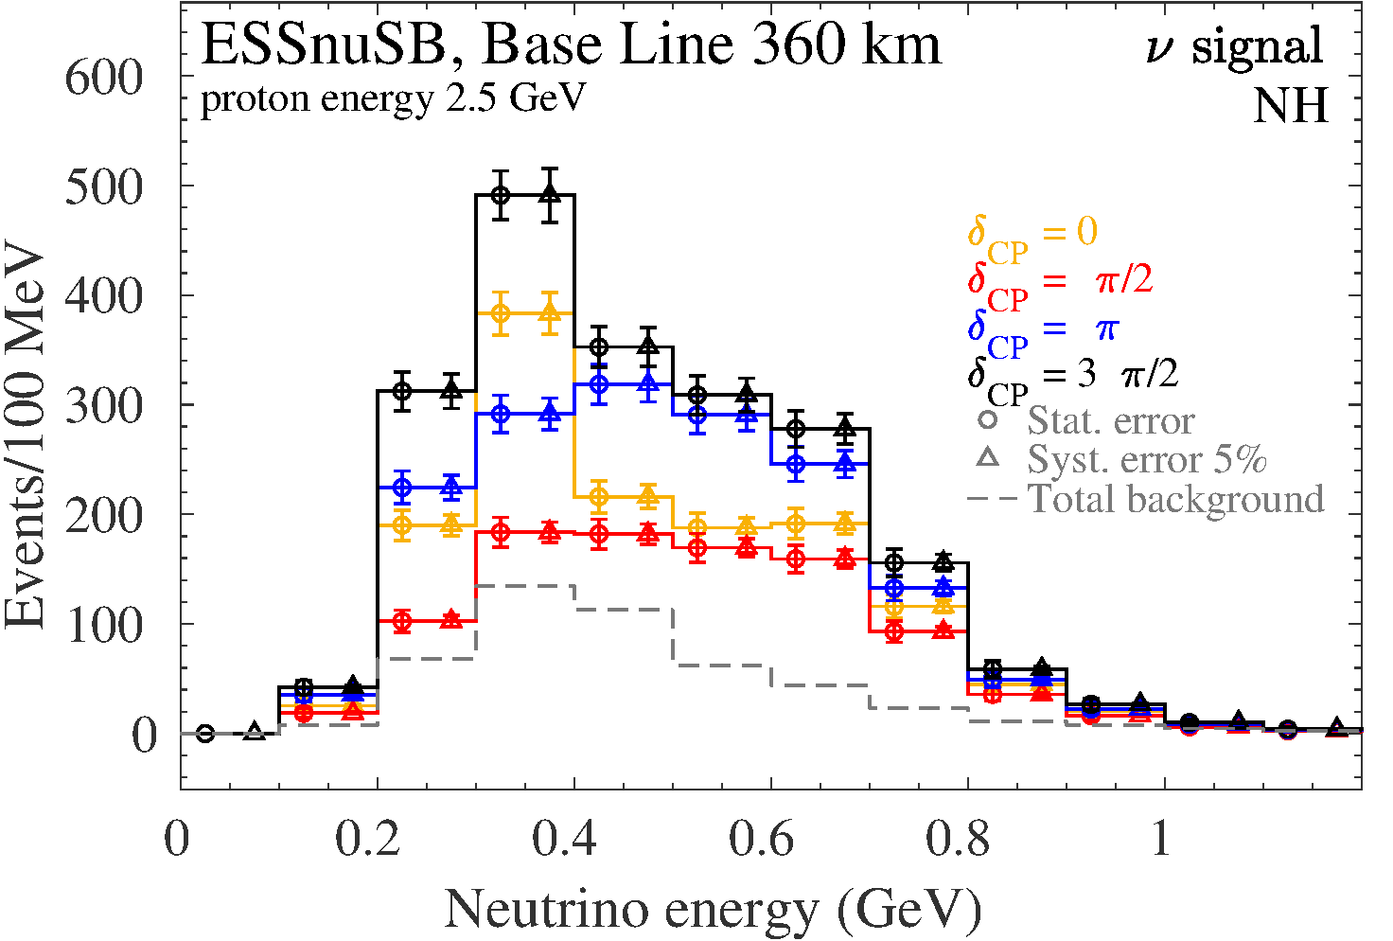
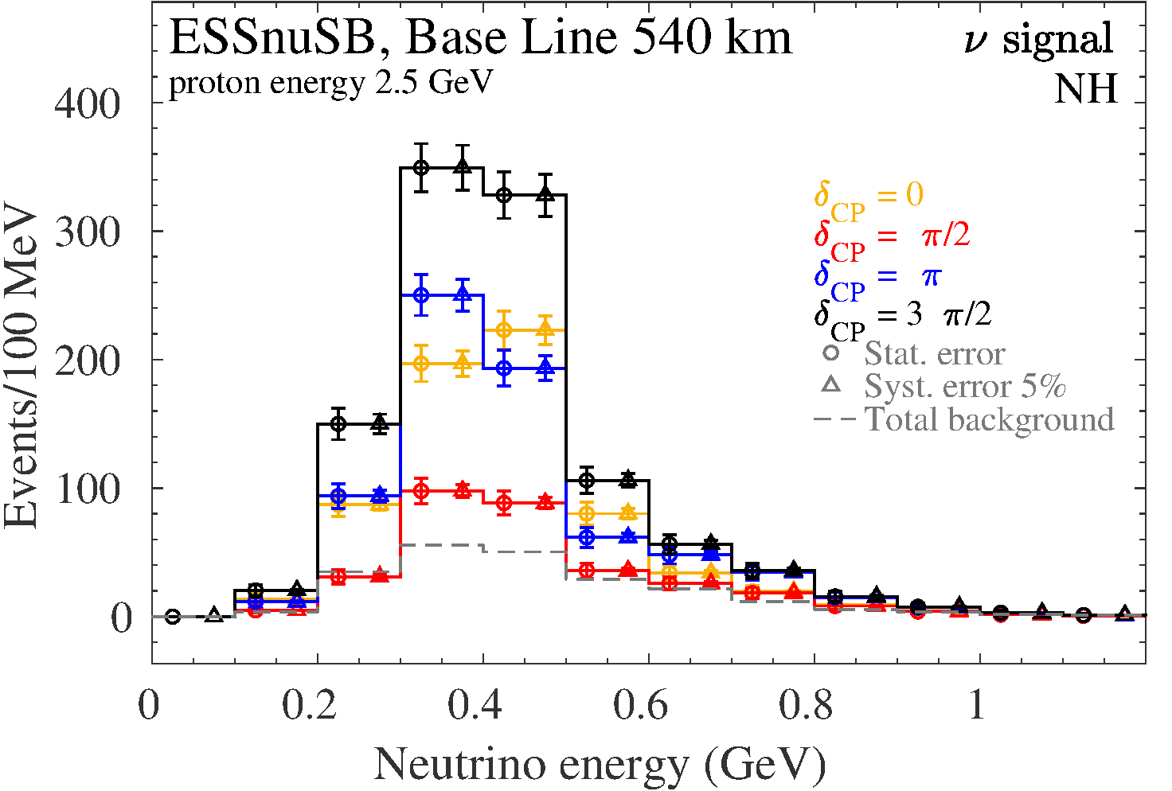
Comparison of the two mines
Garpenberg Zinkgruvan

Slide 15
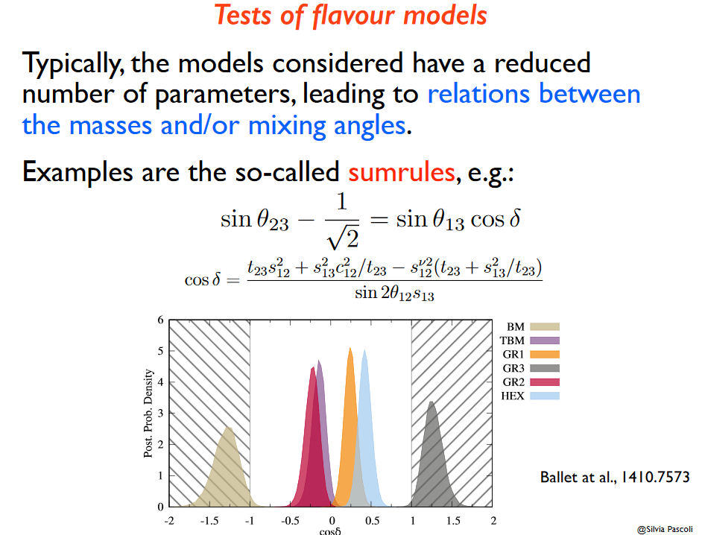
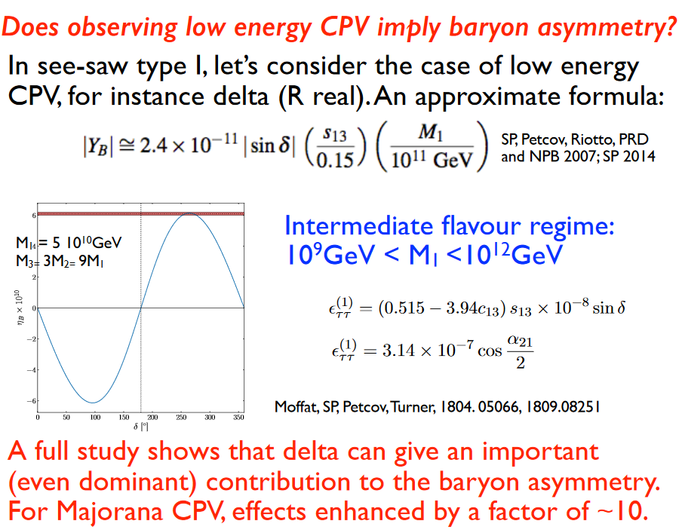
The interest of measuring δ_{CP} precisely
Test of flavor models
Baryon Asymmetry of the Universe
See Silvia Pascoli’s talk at this workshop from which these two slides are taken

Slide 16


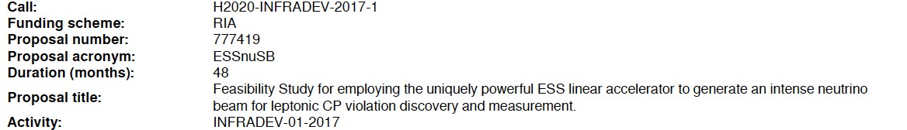
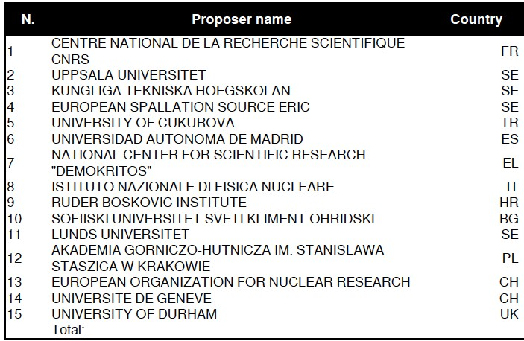
ESSnuSB organization and time plan
EU grant 3 MEUR/4 years
Kick-off meeting in January 2018.
ESSνSB has about 60 members of which 10 are full-time EU-financed postdocs.
Next ESSnuSB and EuroNuNet annual meeting to be held in Zagreb 21-24 October 2019 – newcomers are most welcome to attend
Partners: Oslo U, IHEP, BNL, SCK•CEN, SNS, PSI, RAL
More information at: http://essnusb.eu/

Slide 17
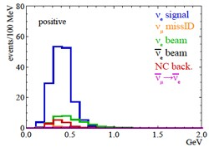
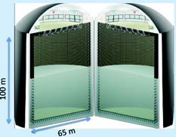














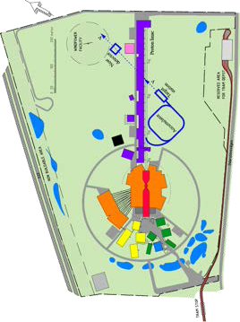

ESSnuSB organization and time plan
A 2nd generation neutrino Super Beam
2033-2036:
Start Data taking
7 years
Construction of the facility and detectors, including commissioning
2-5 years, International Agreement
2021: End
of ESSνSB Design Study, CDR and preliminary costing
2024:End
Preparatory Phase, TDR
2018:
beginnin g of ESSνSB
Design Study
(EU- H2020)
2016-
2019:
beginnin g of COST
Action
EuroNuN et
2012:
^{Θ}13
measurement
published - inception of the ESSnuSB project
Nucl. Phys. B 885 (2014) 127

Slide 18
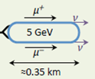
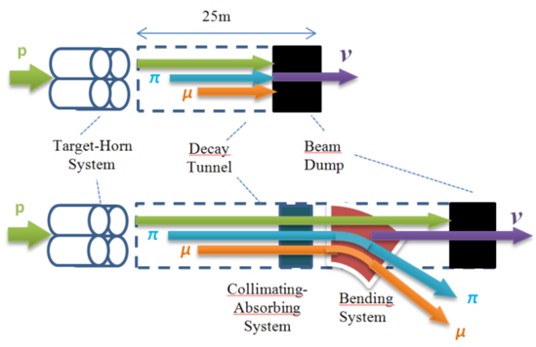
Future further option form a
ESS neutrino and muon facility
Neutrons to ESS
ESS proton driver
Protons dump
ν_{μ} or ‾ν_{μ}
Long
Baseline
Detector
π decay
ESSnuSB
2.7x10²³ p.o.t/year
Test Facility
μ⁺ or μ⁻
ν_{μ} + ‾ν_{e}
Short
Baseline
Detector
Short
Baseline
Detector
Accumulator
Decay
channel or ring
nuSTORM
Front end
ν_{e} + ‾ν_{μ}
Muons of average energy ~0.5 GeV at the level of the beam dump (per proton)
RLA
acceleration
Storage
ring
Cooling
Long
Baseline
Detector
Neutrino
Factory
RCS
acceleration
Collider
ring
Muon Collider
→ ←
μ⁺ μ⁻
See Carlo Rubbias talk at the NeuTel2019 workshop
more than 4x10²⁰ μ/year from ESS

Slide 19
Workshop ‘Prospects for Intensity Frontier Physics with Compresses Pulses from the ESS Linac’ to be held at the Ångström Laboratory at Uppsala University, Sweden 2-3 March 2020.
Monday 2 March 2020
14:00–14:05 Welcome & Introduction to the Workshop/ Tord Ekelof
14:05–14:45 The use of the ESS linac to create a Muon Collider/ Carlo Rubbia
14:45–15:15 The ESS neutrino Super Beam Design Study/ Marcos Dracos
15:15–15:30 Discussion
15:30–16:00 Coffee break
16:00–16:30 The prospects for nuSTORM at ESS/ Alan Bross
16:30–17:00 The prospects for an ESS based Neutrino Factory/ Jaroslaw Pasternak
17:00–17:30 The possibilities of Decay-at-Rest experiments at ESS/ Janet Conrad
19:00–23:00 Conference dinner
Tuesday 3 March 2020
09:00–09:30 Coherent scattering experiments possible at ESS/Kate Scholberg
09:30–10:00 Short Pulses for neutron Physics at ESS/ Ken Andersen
10 :00–10:30 The ESS Linac Modifications required for the Different Proposals/ Natalia Milas
10:30–11:00 Coffee break
11:00–11:30 Design of the ESSnuSB accumulator/ Ye Zou
11:30–12:00 Accumulator Synergies and Differences for the Different Proposals/ Maja Olvegard
12:00–12:30 Discussion
12:30–14:00 Lunch
14:00–14:30 Target Synergies and Differences for the Different Proposals/ Eric Baussan
14:30–15:00 Space available at the ESS site for the new installations/ Karin Wennerholm
15:00–15:30 Discussion & Closing

Slide 20

Sponsors of this project
This project has received funding from the European Union’s Horizon 2020 research and innovation programme under grant agreement No 777419.
This project is supported by the COST Action CA15139 ``Combining forces for a novel European facility for neutrino-antineutrino symmetry-violation discovery'' (EuroNuNet).

Slide 21
Concluding remarks
ESSnuSB, the design of which is currently being studied, is complementary to other existing and planned super beam experiments by the fact
that it focusses at the second maximum where the sensitivity to systematic errors is 3 times lower than at the first maximum,
the correlation with other parameter of the ν mixing matrix is different and
that the neutrino energy is low enough for the resonant and deep inelastic backgrounds to be strongly suppressed.
If and when the current experimental hints of CP violation will have been confirmed on the level of 5σ, the next important step will be to make an accurate measurement of the CP violating angle δ_{CP} , which will require the CP violation signal to maximized. Accurate measurement of δ_{CP} has the potential to provide decisive information on flavour models and on the baryon asymmetry.
The use of the ESS linac for the producing a world-uniquely intense neutrino beam can pave the way for making use of the concurrent production of an equally intense muon beam to realize the Muon Collider or Neutrino Factory project.

Slide 22
Thank you

