Slide 1

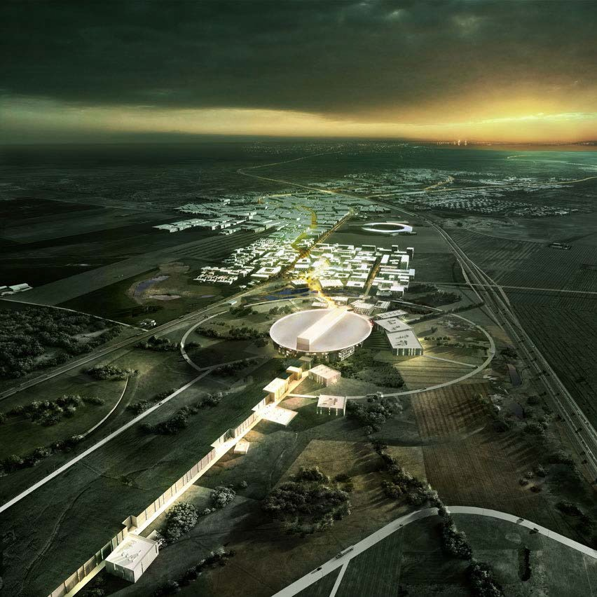


Status of the ESSnuSB
Design Study
J-PARC Symposium in Tsukuba
26 September 2019
Tord Ekelöf
Uppsala University

Slide 2


Many congratulations to
J-PARC
and wishes for at great future
from Uppsala University

Slide 3
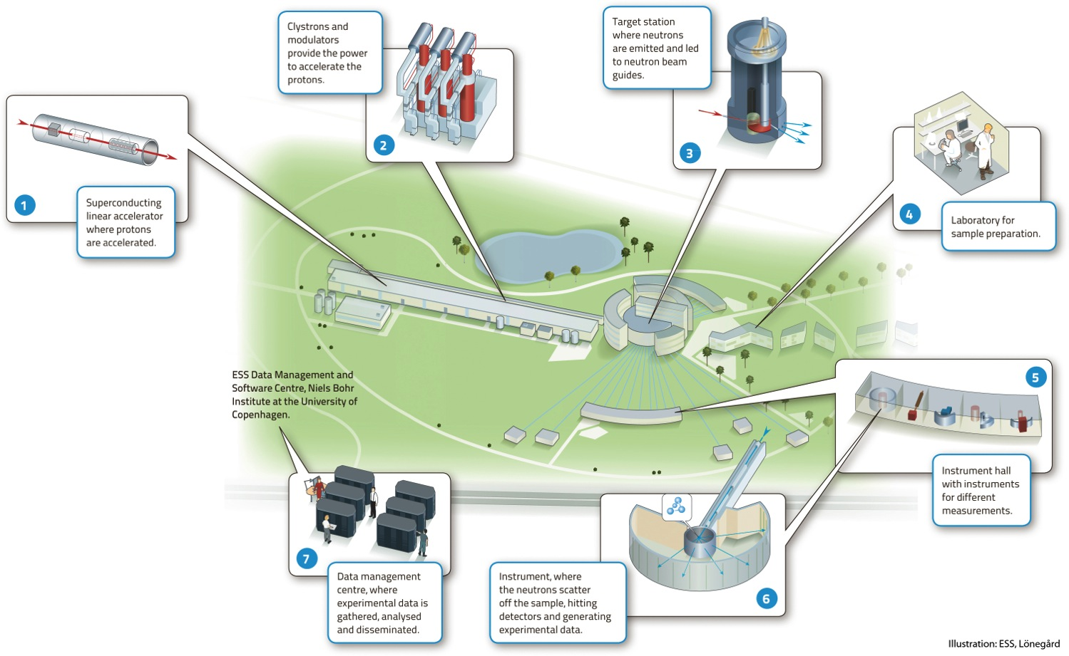

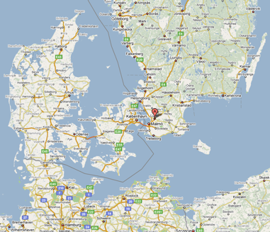
European Spallation Source
Neutron facility
(equivalent to SNS)
under construction phase
(~1.85 B€ facility)

Slide 4

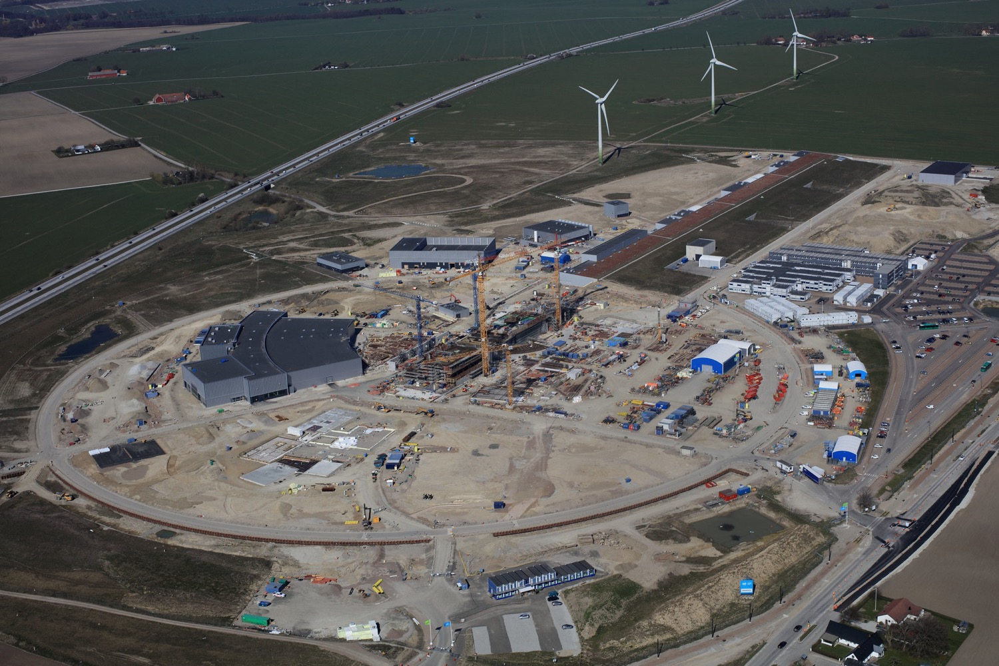
European Spallation Source
Distribution
Substation
Central Utility
Building
Cryo Compressor
Building
Front End
Building
Exp. Hall
E01
Linac and
Klystron Gallery
Target
Monolith
April 2019

Slide 5
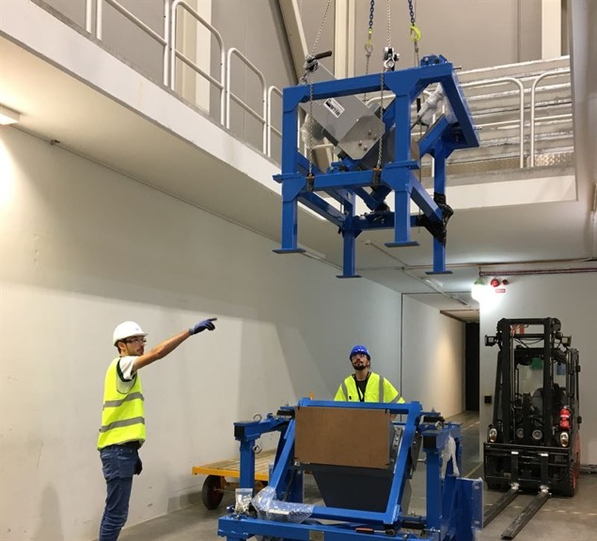
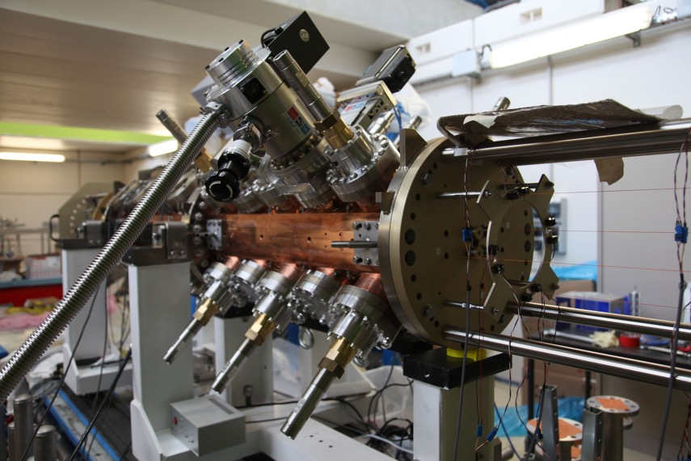
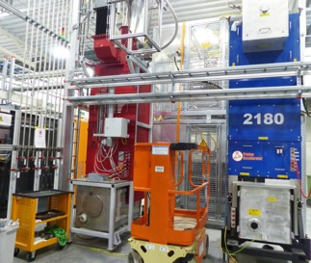
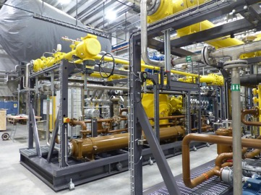
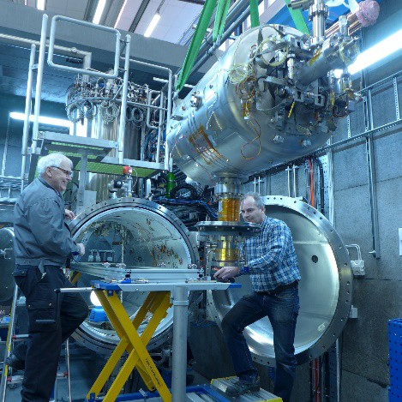
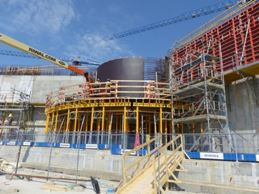
European Spallation Source
RFQ deliverd in August
RFQ
g
Target station
Accelerating modules
Klystrons
Cryoplants

Slide 6
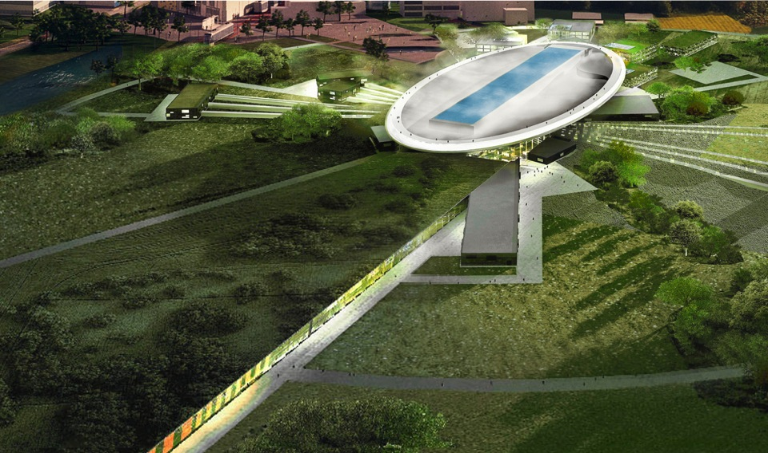
ESS schedule
2025
ESS construction complete
2014
Construction work starts on the site
2023
ESS starts
user program
2009
Decision: ESS will be built in Lund
2021
First neutrons on instruments
2012
ESS Design Update phase complete
2003
First European design effort of ESS completed

Slide 7
ESS ν Super Beam
To Far Detector
located at second
ν oscillation max.
Near Detector
Target Station
5 MW p
n
Accumulator
5 MW H⁻
April 2019

Slide 8
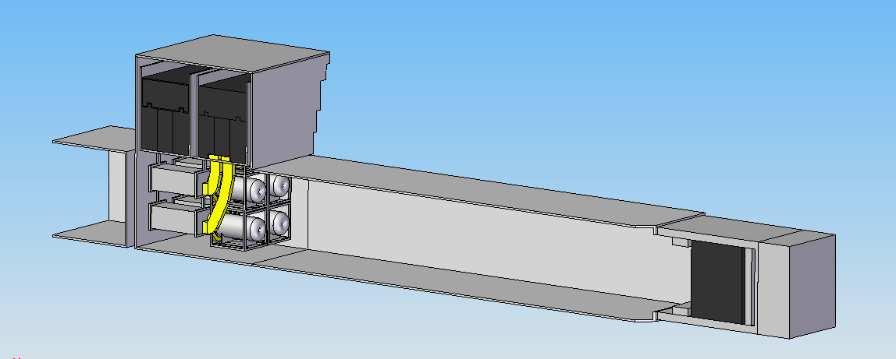
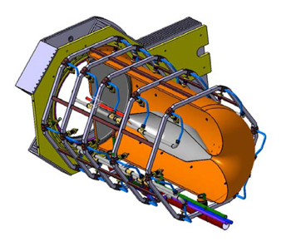
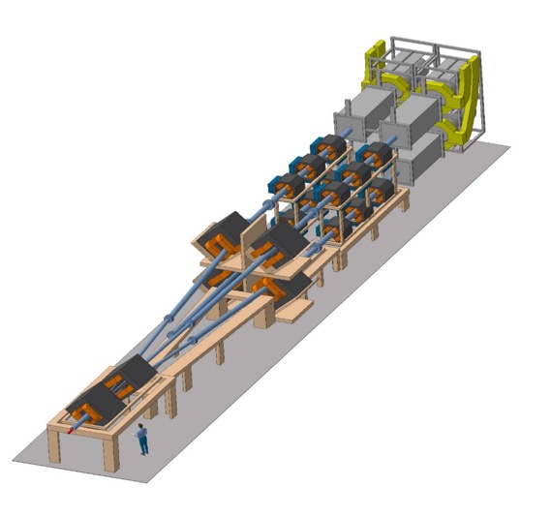
General Layout of the 5 MW target station
The proton beam is split up om 4 targets, each receiving a 1.25 MW beam
6
8 m concrete
Split Proton Beam
Horns and Targets
Neutrino Beam Direction
Collimators
Decay Volume
(He, 4x4x25 m³)
Beam Dump
Granular Ti target with He gas
cooling for a 1.25 MW beam
Beam
switchyard
Horn excided with
350 kA pulses, each
having a 1.3 flat top

Slide 9
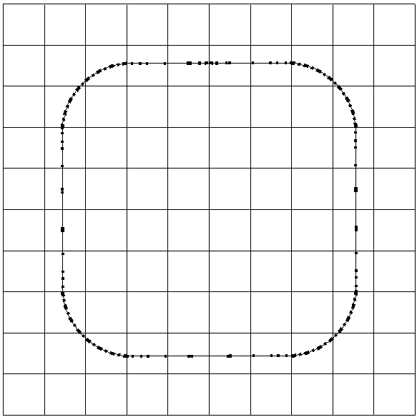
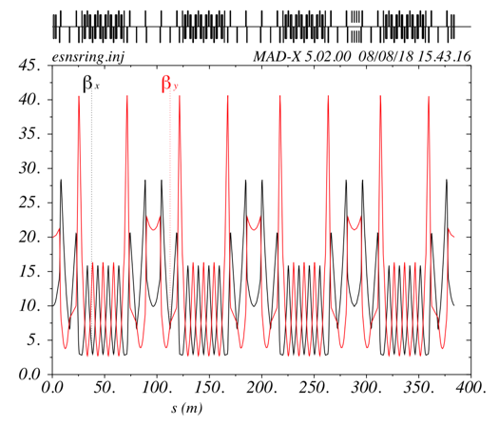
The Accumulator Ring which compresses each 0.65 ms pulse of 2.5*10¹⁴ protons from the ESS linac to 1.3 µs
To inject such a high charge in the accumulator ring, H⁻ injection with stripping is required
injection
4 superperiods
RF
extraction
FODO cells
collimation
Dispersion-free straight sections

Slide 10
The Linac modifications and operation
H⁻ source options
Into linac
P
_{H}⁻
_{H}⁻
_{H}⁻
_{H}⁻
P
_{H}⁻
_{H}⁻
_{H}⁻
_{H}⁻
14 Hz
100 µs
0.65 ms
Into ring
H⁻
H⁻
H⁻
H⁻
H⁻
H⁻
H⁻
H⁻
14 Hz
~1.4 kHz
~1 µs
~0.75 ms
Out of ring
into horn
_{H}⁻
_{H}⁻
_{H}⁻
_{H}⁻
_{H}⁻
_{H}⁻
_{H}⁻
_{H}⁻
14 Hz
Horn 1
Horn 4
Horn 2
Horn 3

Slide 11
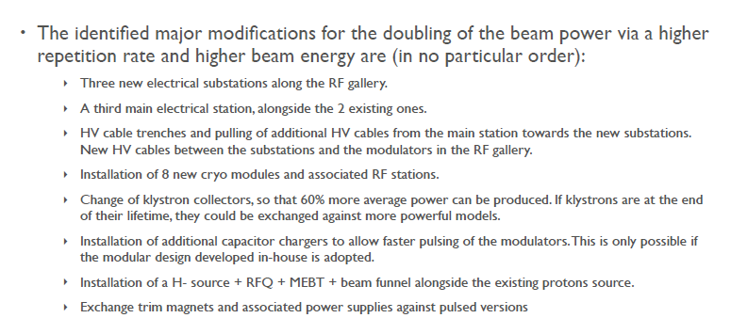
Required modifications of the ESS accelerator for adding a 5 MW H⁻ beam for ESSnuSB
F. Gerigk and E. Montesinos CERN-ACC-NOTE-2016-0050 8 July 2016
To accelerate to 2.5 GeV.
“No show stoppers have been identified for a possible future addition of the capability of a 5 MW H- beam to the 5 MW H+ beam of the ESS linac built as presently foreseen. Its additional cost is roughly estimated at 250 MEuros.”
Cf total cost of the ESS 5 MW linac of ca 1000 MEuros

Slide 12
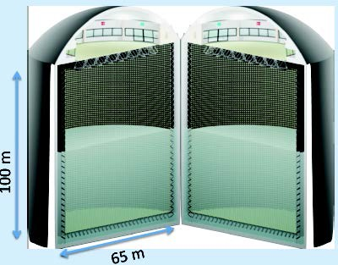
The Megaton Water Cherenkov neutrino detector
MEMPHYS-like Cherenkov detector (MEgaton Mass PHYSics) studied the EUROν and LAGUNA EU Design Studies
Two cylindrical tanks
Total fiducial volume 500 kt (~20xSuperK)
Readout: latest type of high efficiency PMTs
(arXiv: hep-ex/0607026)

Slide 13
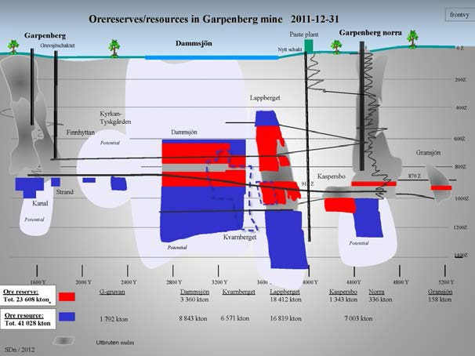
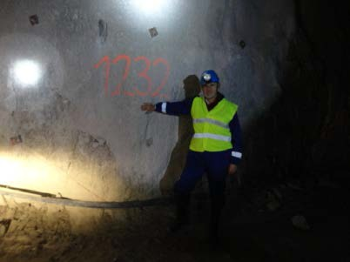
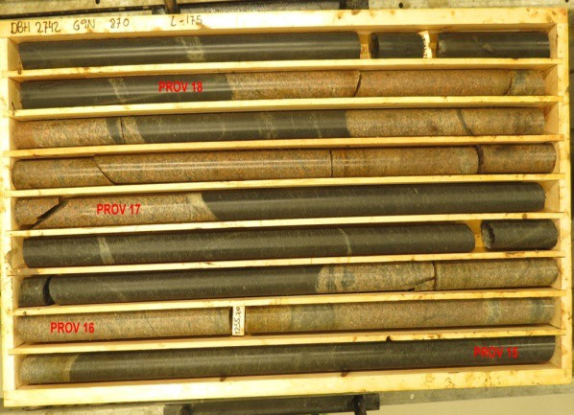
Garpenberg Mine 540 km from ESS
The MEMPHYS type detector to be located 1000 m down in a mine
Garpenberg mine depth 1200 m
Truck access tunnel
A new ore-hoist shaft has been taken into operation,
leaving an older shaft free to use for transport of ESSnuSB-detector cavern excavation-debris
Granite drill cores

Slide 14
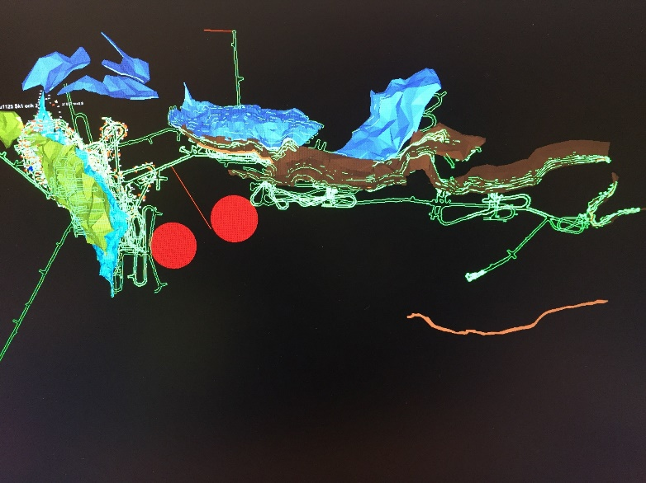
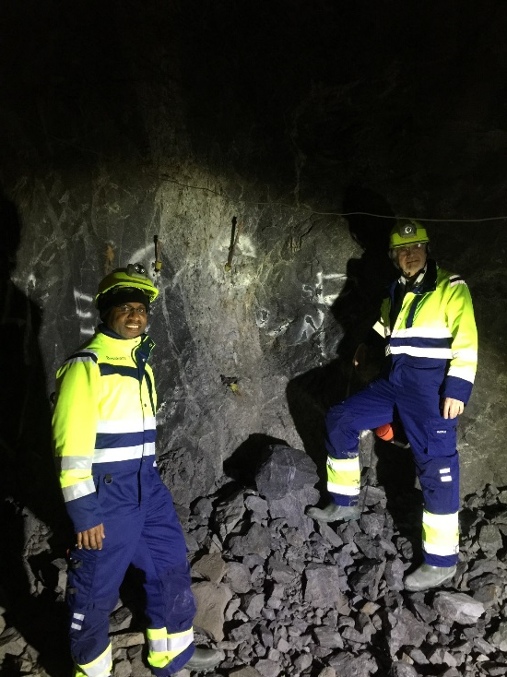
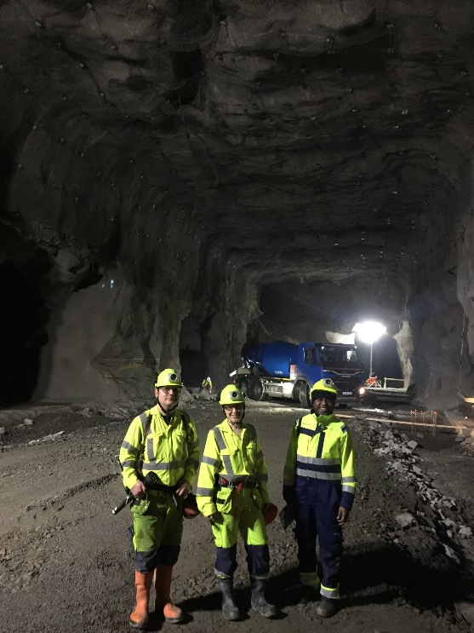
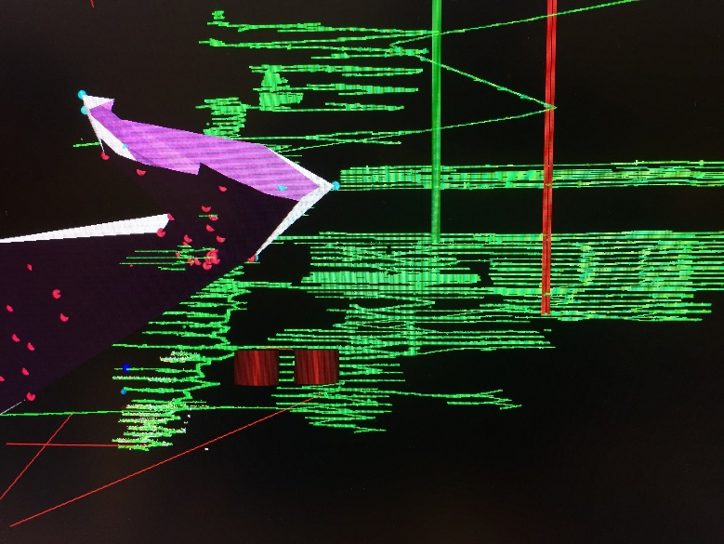
Zinkgruvan Mine 360 km from ESS
Zinggruvan mine depth 1500 m
Truck access tunnel
The main ore transport-shaft hoist has a capacity of 6000 tons per 24 hours of which only 2/3 is used. To bring up the 2.5 Mton of cruched rock will take order 3 years.

Slide 15
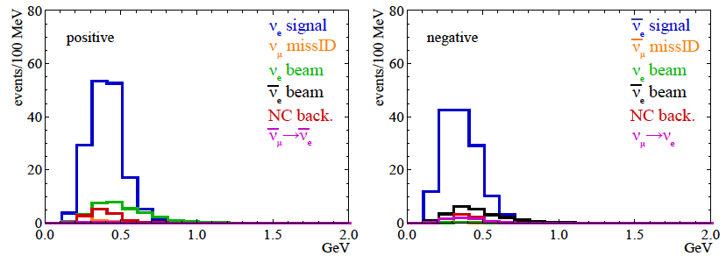
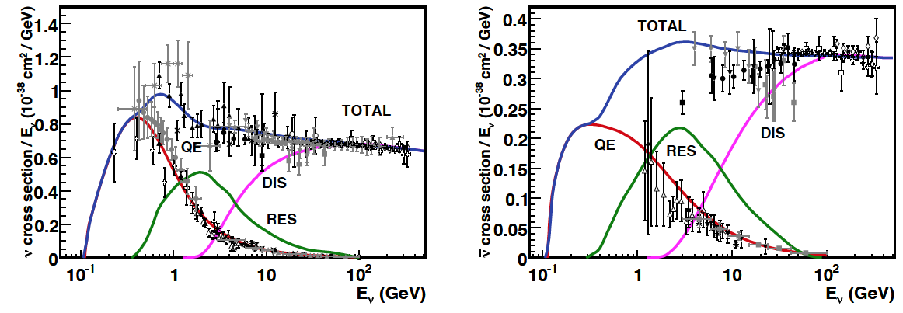
Neutrinos in the far detector
neutrinos
anti-neutrinos
540 km, 2 GeV, 2 years
540 km, 2 GeV, 8 years
δ_{CP}=0
Almost only QE events, very little RES background and no DIS background

Slide 16
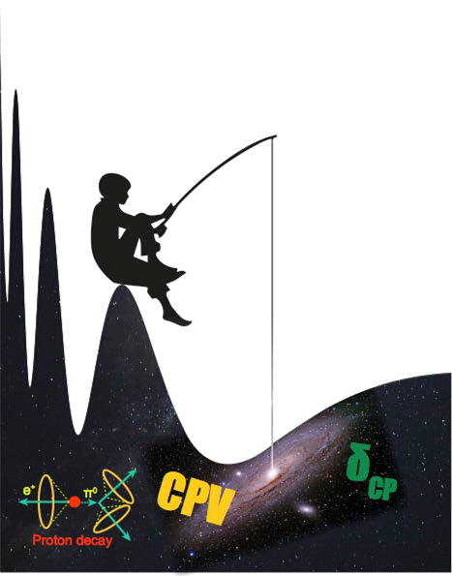



The second ν oscillation maximum
The ultimate precision in the determination of the leptonic CP violating angle δ_{CP} from
neutrinos oscillation measurements will be set by systematic errors.
The motivation for the effort to generate a world-uniquely intense neutrino beam using the ESS 5 MW linac is to have enough statistics to reach the second maximum where the CP signal is 3 times higher than at
the first maximum, thus reducing the uncertainty in δ_{CP} due to systematic errors by a factor 3.

Slide 17
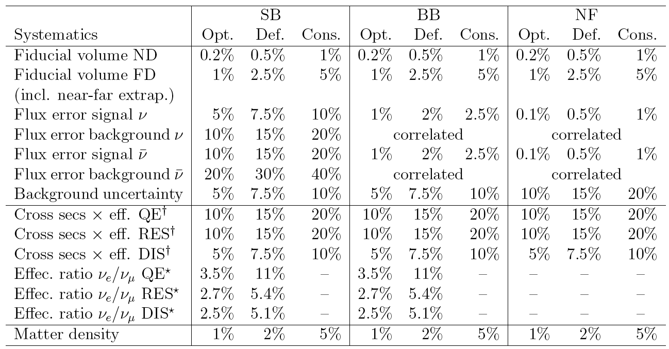
Systematic errors
Systematic uncertainties in long-baseline neutrino oscillations for large θ₁₃
Pilar Coloma, Patrick Huber, Joachim Kopp, and Walter Winter
Phys. Rev. D 87, 033004 – Published 11 February 2013

Slide 18
Sensitivity to the different error types
Fraction of values of δCP for which a 5σ discovery would be possible is shown when each of the systematic errors from table is varied individually between one half of the "optimistic" values and twice the "pessimistic" ones. A 540 km baseline and 5 yrs in neutrino and antineutrino mode have been assumed. The different systematics studied in the plot are the far and near detector fiducial volumes (FD and ND), the signal and background components of the beam running in neutrino and antineutrino modes (S v , B v , S v , and B v ), the cross section uncertainties for neutrinos and antineutrinos (X v and X v ) as well as for the NC interactions (NC v and NC v ) and the ratio of the muon to electron neutrino cross sections (RX v and RX v ).

Slide 19
Copmarison of different baselines

Slide 20
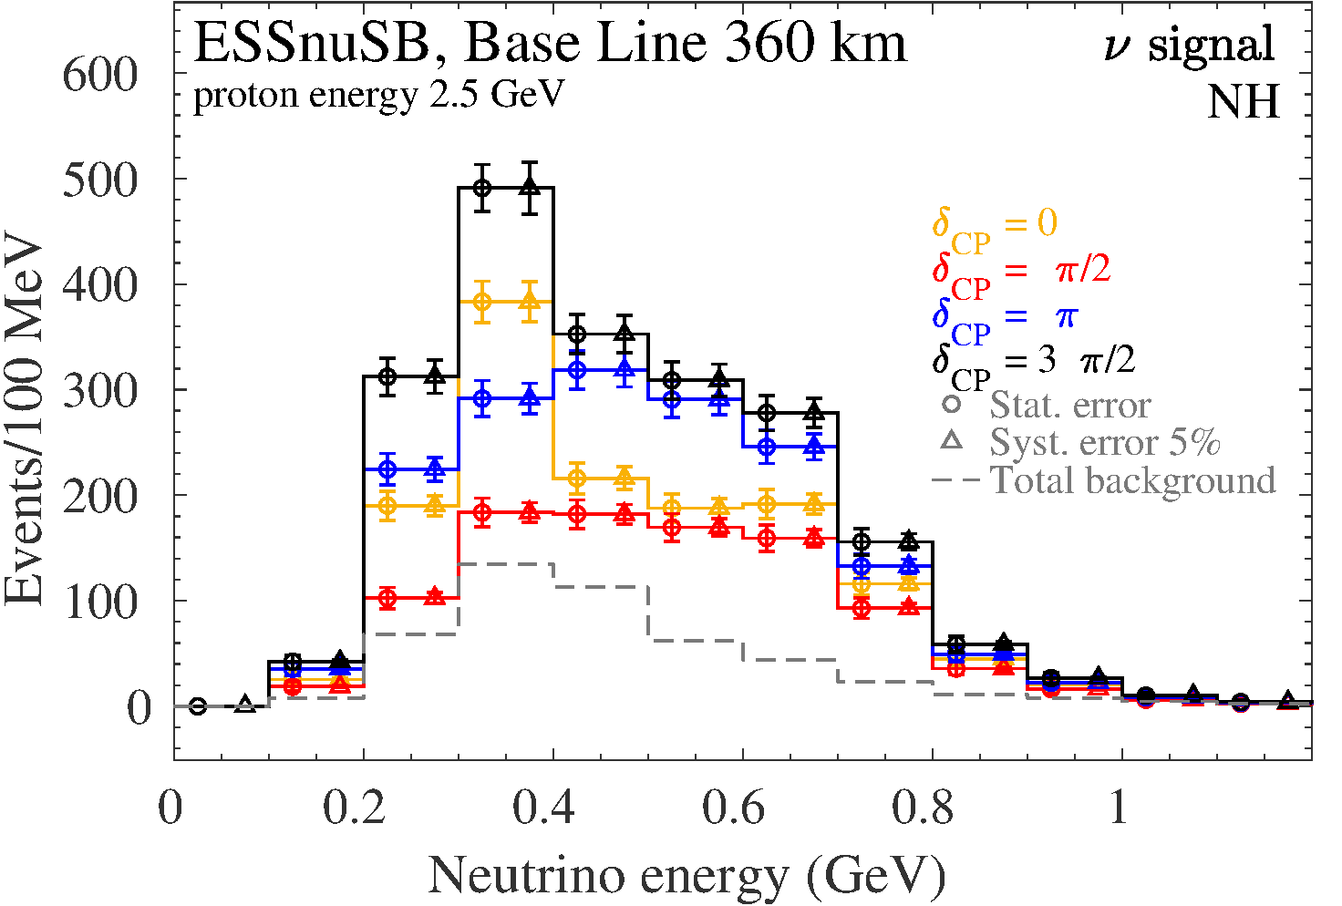
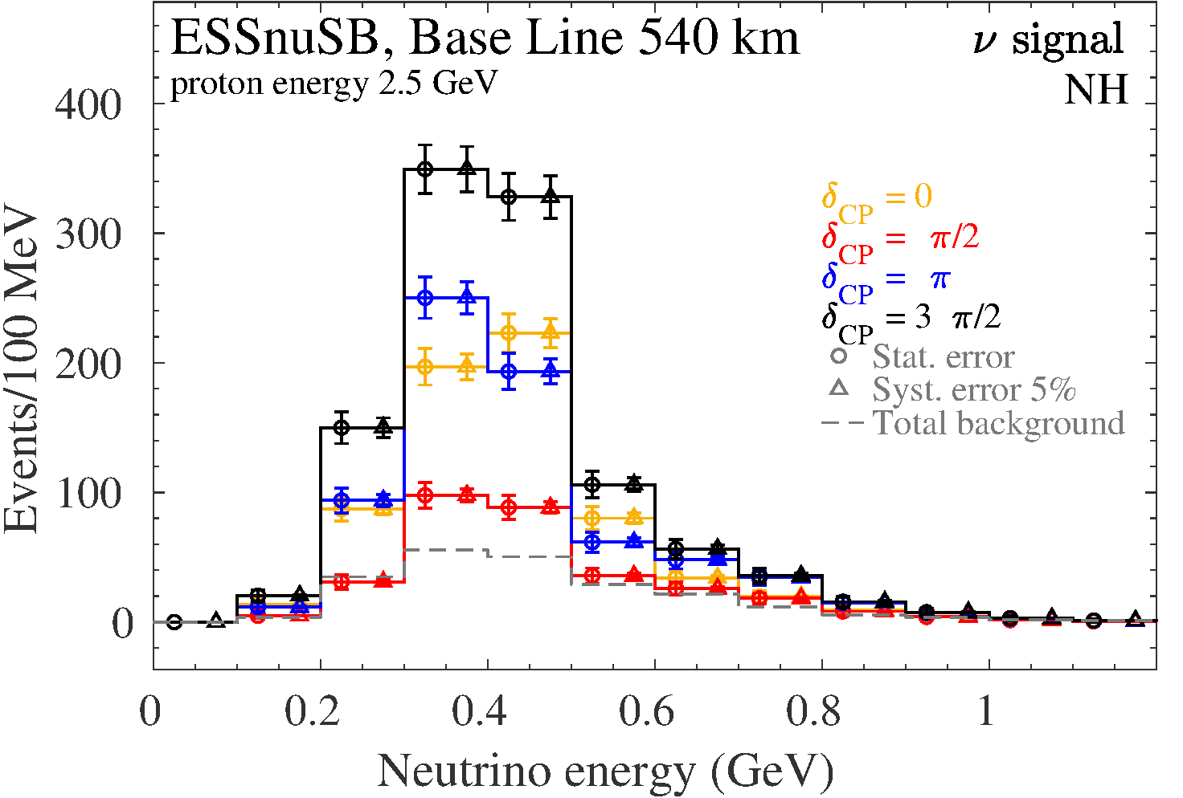
Comparison of the two mines
Garpenberg 540 km Zinkgruvan 360 km

Slide 21
ESSnuSB performance at Garpenberg (blue) and Zinkgruvan (red) and the two error sets
‘Def.’ and ‘ Opt’

Slide 22
The performances of
ESSnuSB, DUNE and Hyper-K
The performance of ESSnuSB, DUNE and Hyper-K
assuming the same systematic error 3% for all
three experiments to compare them on the same footing
(detailed explanation on the next slide)
73%
Courtesy Enrique F. Martinez

Slide 23
Explanation of the figures in slide 18
In these figures are shown results for two 250 kt detectors in the Garpenberg mine (540 km baseline, blue curves), two 250 kt detectors in the Zinkgruvan mine (360 km baseline, green curves) and one 250 kt detector in the Garpenberg mine and one in the Zinkgruvan mine (black curves).
The Hyper-K curve in the middle and right plots and the two resolution values in the left plot for δ_{CP} = 0 and δ_{CP} = π/2, indicated by the two dotted horizontal lines, are those presented by Hyper-K at the Neutrino 2018 conference.
The DUNE curves have been derived using the public GLoBES file released by the DUNE collaboration with its Conceptual Design Report in 2016. Performance predictions for DUNE, assuming 7 years of data taking, were shown by the DUNE collaboration at the Neutrino 2018 conference. For the comparison, in this plot the same simulations were repeated, assuming 10 years of data taking to be in line with the assumptions made for the Hyper-K simulations.
The ESSνSB curves have been derived setting the systematic errors to 3% to be in line with the systematic error levels set by DUNE and Hyper-K. The θ₁₃ and θ₂₃ values for DUNE and ESSνSS have been set to the same values as those used by Hyper-K, again to compare the three experiments on the same footing.

Slide 24
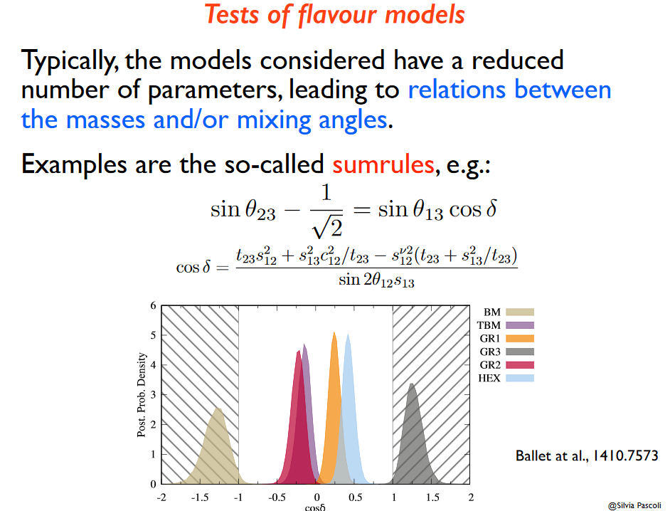
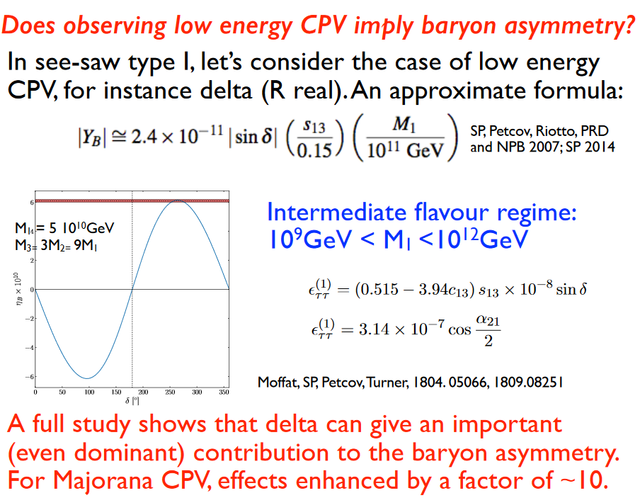
The interest of measuring δ_{CP} precisly
Test of flavor models
Baryon Asymmetry of the Universe

Slide 25


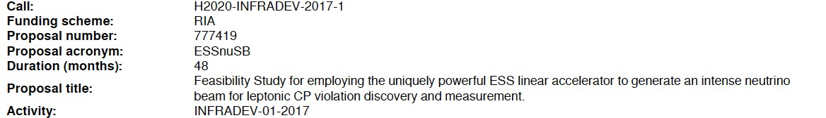
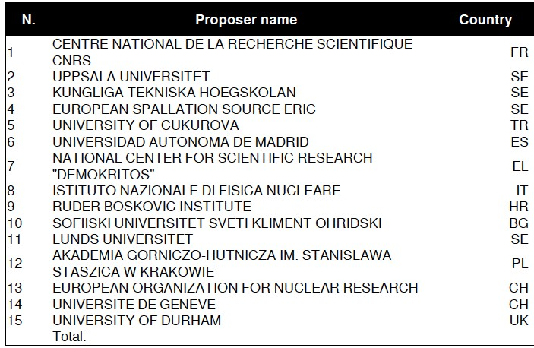
ESSnuSB organization and time plan
EU grant 3 MEUR/4 years
Kick-off meeting in January 2018.
ESSνSB has about 60 members of which 10 are full-time EU-financed postdocs.
Next ESSnuSB and EuroNuNet annual meeting to be held in Zagreb 21-24 October 2019 – newcomers are most welcome to attend
Partners: Oslo U, IHEP, BNL, SCK•CEN, SNS, PSI, RAL
More information at: http://essnusb.eu/

Slide 26
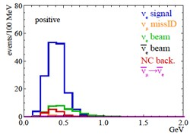
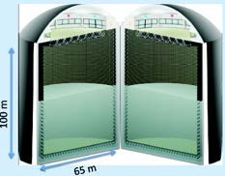














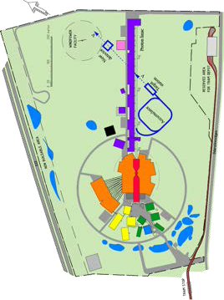

ESSnuSB organization and time plan
A 2nd generation neutrino Super Beam
2033-2036:
Start Data taking
7 years
Construction of the facility and detectors, including commissioning
2-5 years, International Agreement
2021: End
of ESSνSB Design Study, CDR and preliminary costing
2024:End
Preparatory Phase, TDR
2018:
beginnin g of ESSνSB
Design Study
(EU- H2020)
2016-
2019:
beginnin g of COST
Action
EuroNuN et
2012:
^{Θ}13
measurement
published - inception of the ESSnuSB project
Nucl. Phys. B 885 (2014) 127

Slide 27
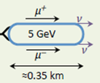
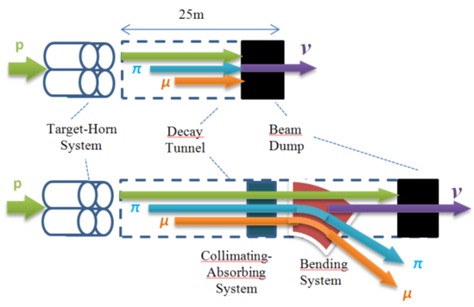
Open workshop on “Prospects for Intensity Frontier Physics with Compressed Pulses from the ESS Linac" in Uppsala 2-3 March 2020
ESS proton driver
Neutrons to ESS
ν_{μ} or ‾ν_{μ}
Long
Baseline
Detector
ESSnuSB
2.7x10²³ p.o.t/year
π decay
μ⁺ or μ⁻
ν_{μ} + ‾ν_{e}
Short
Baseline
Detector
Short
Baseline
Detector
Accumulator
Decay
channel or ring
nuSTORM
Front end
ν_{e} + ‾ν_{μ}
Muons of average energy ~0.5 GeV at the level of the beam dump (per proton)
RLA
acceleration
Storage
ring
Cooling
Long
Baseline
Detector
Neutrino
Factory
RCS
acceleration
Collider
ring
Muon Collider
→ ←
μ⁺ μ⁻
more than 4x10²⁰ μ/year from ESS
Decay At Rest and Coherent ν scattering also need Compressed pulse and will be included

Slide 28

Sponsors of this project
This project has received funding from the European Union’s Horizon 2020 research and innovation programme under grant agreement No 777419.
This project is supported by the COST Action CA15139 ``Combining forces for a novel European facility for neutrino-antineutrino symmetry-violation discovery'' (EuroNuNet).

Slide 29
A few concluding remarks
ESSnuSB, the design of which is currently being studied, is complementary to other existing and planned super beam experiments by the fact
that it focusses at the second maximum where the sensitivity to systematic errors is 3 times lower than at the first maximum and also
that the neutrino energy is low enough for the resonant and deep inelastic backgrounds to be strongly suppressed.
If and when the current experimental hints of CP violation will have been confirmed on the level of 5σ, the next important step will be to make an accurate measurement of the CP violating angle δ_{CP} , which will require the CP violation signal to maximized. Accurate measurement of δ_{CP} has the potential to provide decisive information on flavour models and on the baryon asymmetry.
The use of the ESS linac for the producing a world-uniquely intense neutrino beam can pave the way for making use of the concurrent production of an equally intense muon beam to realize the Muon Collider and/or Neutrino Factory project.

Slide 30
Thank you

