Slide 1
The accumulator ring for the ESSnuSB project: Foil Stripping Injection of 4 Batches at 14 Hz
Present scenario:
2018 a Cycle with Linac Pulsing at 14 Hz and Injection of 4 Batches per Pulse, separated by 100 µsec, was chosen.
Straightforward foil stripping injection of 4 batches in one ring at 14 Hz would lead to evaporation of the foil.
This implied the definitive decision for Laser Stripping, expected to be available at the time of realization of the Ring. Otherwise one would have to consider a fall-back solution of pulsing at 56 Hz.
H. Schönauer, CERN

Slide 2
Is there a way out?
Not considered so far:
The Tilted Foil, together with moving the injection point along the foil edge.
Past attempts to exploit the performance of tilted foils gave rather deceiving results. Moving the injection point makes no sense in a corner foil .
The displacement of the injection area along the foil edge from batch to batch
The entire injection process with all the painting bumps is displaced. This way each foil zone is heated only once.

Slide 3
Recently Crucial Parameters have been modified :
Parameter List (M. Olvegård), to be verified: https://docs.google.com/spreadsheets/d/1huFRX6mdcrh-LdoEtf70MeGtKTlG-cHJa7Kec4nygfk/edit#gid=0https://docs.google.com/spreadsheets/d/1huFRX6mdcrh-LdoEtf70MeGtKTlG-cHJa7Kec4nygfk/edit#gid=0
Final emittances = acceptance of 1st collimator: 120 π “100%” geometrical
These final emittances values allow more efficient painting,
Together with the Linac emittances: 0.35 π rms geometrical
These final emittances considerably reduce the space-charge tune shifts
This allows to use optimization codes
without space charge like MISHIF

Slide 4
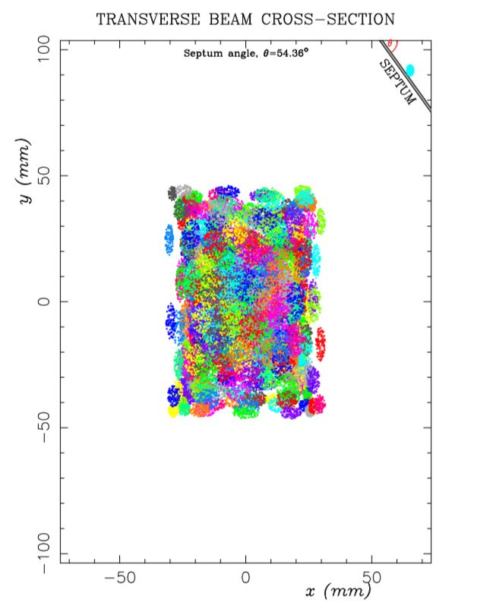
Example: The MISHIF Code (C. Prior)
Conceived for a Liouville environment, i.e. a single type of charge particle, Protons, Heavy Ions etc.
e.g. Multiturn Injection of Heavy Ions for Inertial Fusion using an inclined septum
It succeeds finding painting strategies without any septum hits – for reasonable parameters
One can use it as well for charge exchange injection, representing the foil edge as the septum
Results with about 1% hits are useful
It produces rectangular beam cross sections – as all other painting methods do

Slide 5
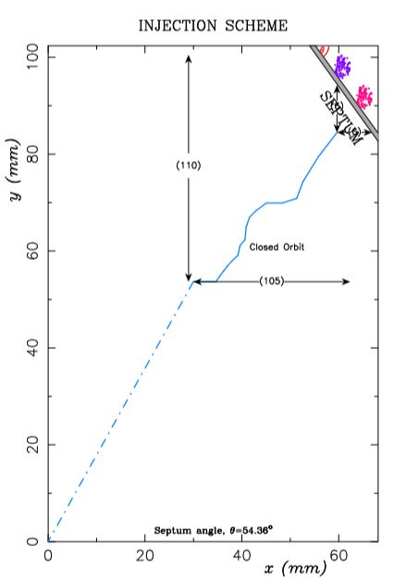
MISHIF is independent of the lattice!
It just requires:
The tunes and the lattice parameters at the injection point
Linac and final emittances
Number of injected turns
One can chose fixed values or values varying along the painting
The figure shows the closed orbit due to the painting bumps for the preceding figure
It shows the septum and the linac beam at its initial and final positions
The final c.o. positions are not in the centre; one can re-center the solution for further calculations

Slide 6
Displacement: The 4 Batches in x – y Space:
You can see the inclined foil at about 45deg and the Linac spot moving along its edge.
The inclined foil has only one free edge contrary to the usual corner foils. This could improve the stability of the foil.
The graph shows for 4 Batches:
The Foil
X0 Linac: The injection point moving continuously along the foil during all 4 batches
XCO: Painting c.o. bumps: between the batches all orbits are displaced
This displacement is effectuated by a ‘Base Bump’ moving in steps

Slide 7
The sequence for H and V Linac steering, C.O. bumps and Base Bumps in time :
X0, Y0: Linac steering moves steadily
XCO, YCO: The bumpers have to pulse 4 times (would have to pulse 4 times for a constant injection point too)
The Base Bumps displace the C.O. bumps between the batches (within 100 µs)
At the end of the 4th injection the C.O. is not at zero; needs perhaps larger local apertures

Slide 8
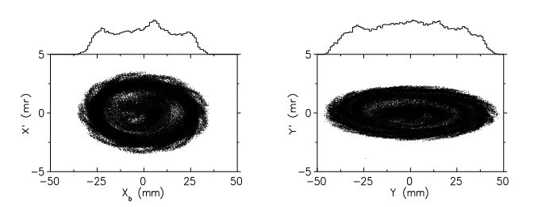
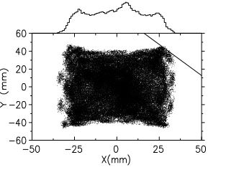
Tracking with ACCSIM (F. Jones, TRIUMF)
The painting orbits found with MISHIF were transferred to the ACCSIM code. This program allows inclined foils, moving injection points, includes space charge and provides the final particle distributions. It counts in the number of foil hits by H- and p beams on a grid of 1 mm bin size. Note that ORBIT was conceived on the base of ACCSIM…
Four runs were effectuated for the four different batch positions and produced as expected nearly identical results.
p Distributions after 480 Turns: Phase spaces x, y, Real Space x-y
Final emittances: ε_{x} = 118 π, ε_{y} = 108 π

Slide 9
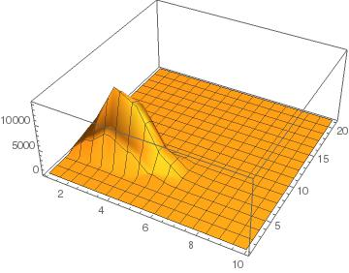
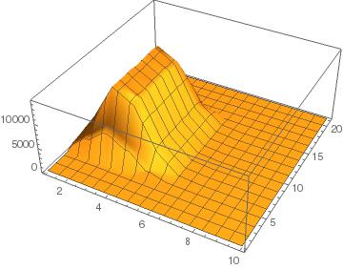
Foil Hits for 100k and 400k Macroparticles
Foil Hits for the Linac H- Beam : First Batch (left) and four Batches (right)

Slide 10
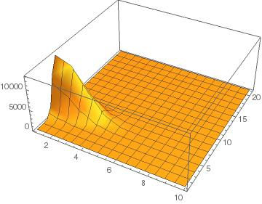
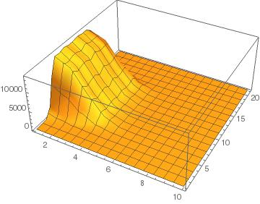
Foil Hits for Circulating p Beam: First Batch (left) and four Batches (right)

Slide 11
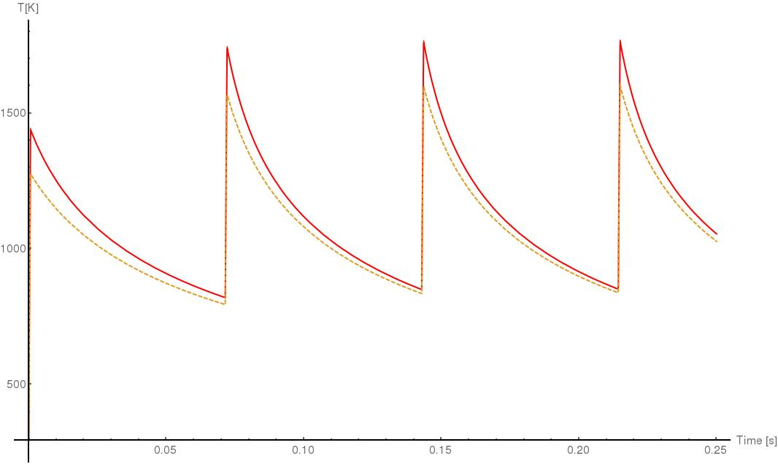
Foil Temperatures for 4 Batches (400k Macroparticles)
Peak Foil Temperatures
Full Line: Combined Effect of Linac- and Circulating Beam, Maximum 1765 K
Dashed Line: Linac Beam, Maximum 1602 K
Foil Stripping
Proton Liouville Injection
This implies that all ring elements must allow for emittances in the corners.
$∈r= ∈$x + $∈$y

Slide 12
Some conclusions:
Present Status: Foil Stripping is limited to 56Hz pulsing
This is still valid for the corner foil, used at the SNS and in all calculations so far
The MISHIF approach to foil stripping:
In all given examples an inclined foil is used – this suggests trials with the ESSnuSB accumulator parameters where space charge forces are rather weak. The final emittances of 120 π made painting easier too.
The inclined foil: Allows injection to drift along the edge to distribute the foil hits
Perhaps it renders 4-Batch injection possible. Hence my trial!
Four batches entail more or less important hardware requirements: The c.o. bumpers have to pulse 4 times with a reset time of only 100 µsec, as the extraction kickers (they would have to do it in any 4-batch solution)
An additional base bump, has to be added or implemented in the painting bump power supplies. This may entail locally larger apertures.
It may be worthwhile to check the problems of the additional
hardware and to continue further studies of the scenario.

