Slide 1
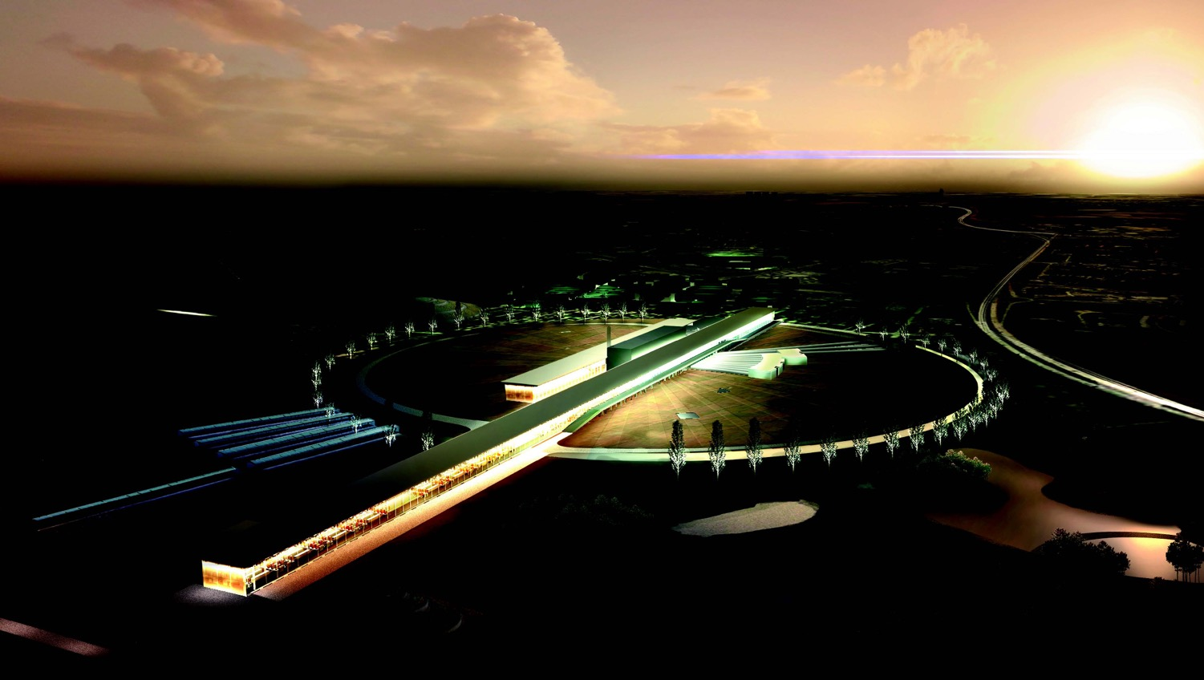


The neutron European Spallation Source and the proposed neutrino Super Beam for CP Violation discovery
Marcos Dracos
IPHC-Strasbourg

Slide 2
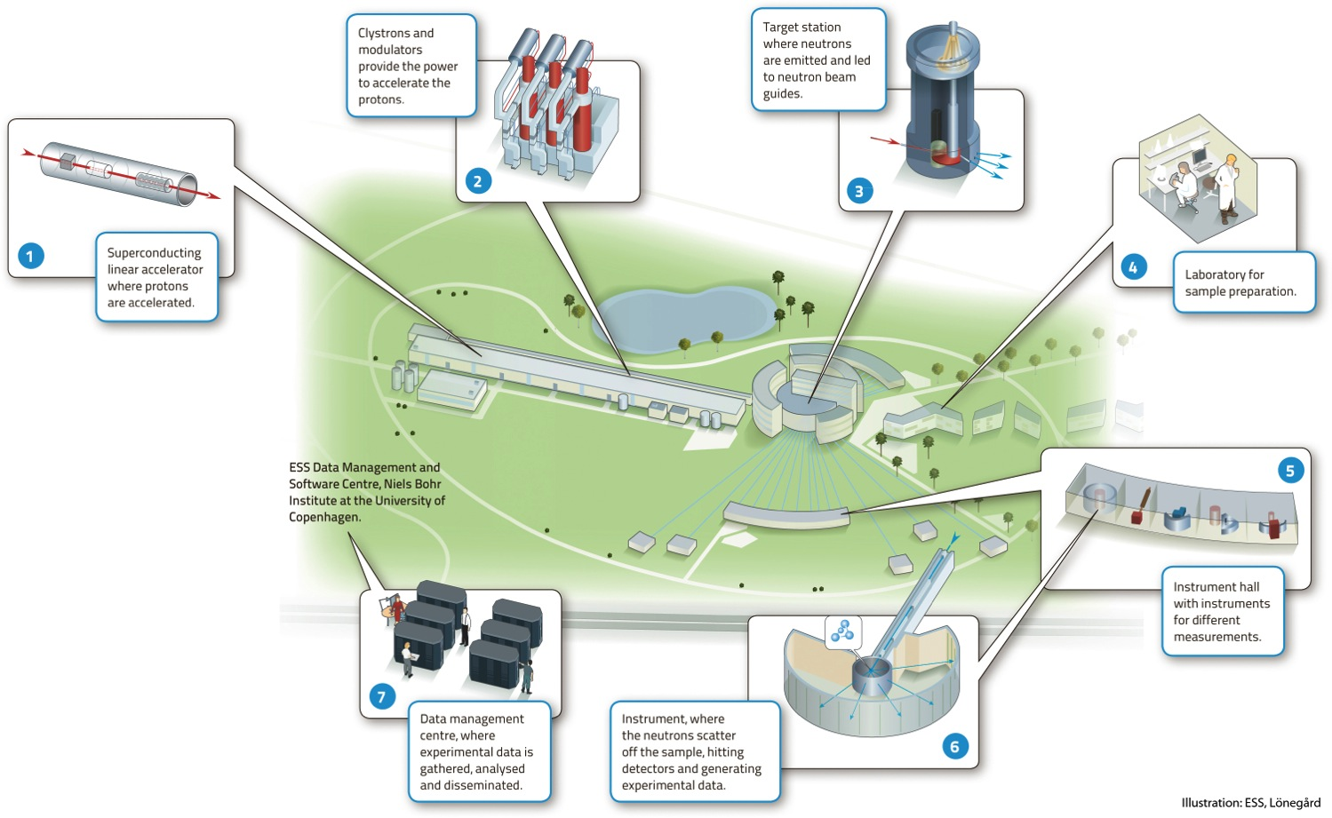

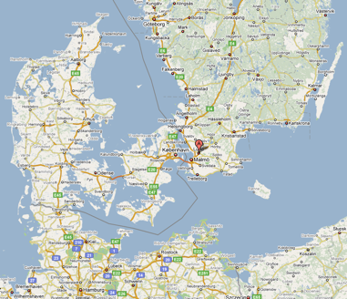
European Spallation Source
Neutron facility
under construction phase
(~1.85 B€ facility)

Slide 3







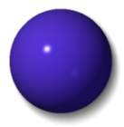




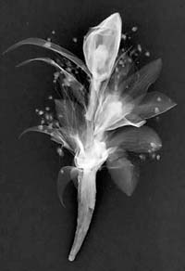
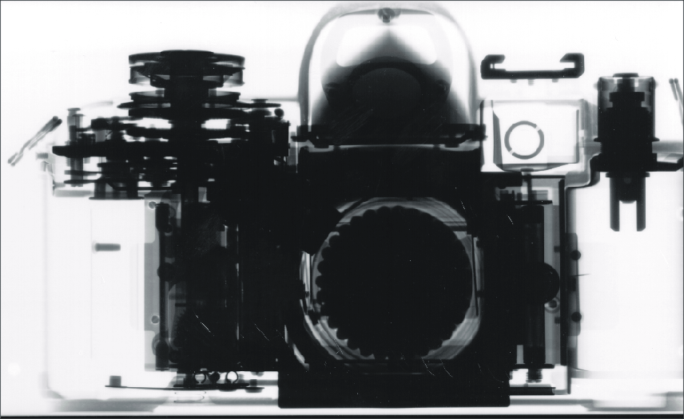
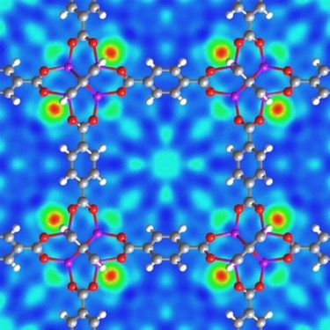
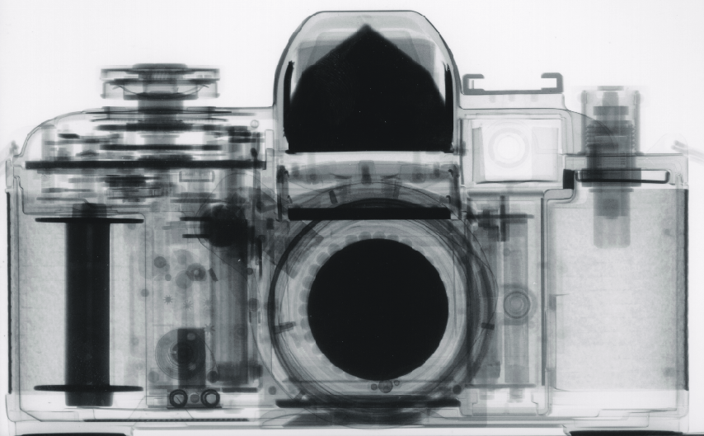
Neutron Scattering
H
Li
C
O
S
Mn
Zr
Cs
X-rays
neutrons
X-Ray Image
Neutron scattering of hydrogen in a metal organic framework
Neutron radiograph of a flower corsage
Neutron radiograph

Slide 4
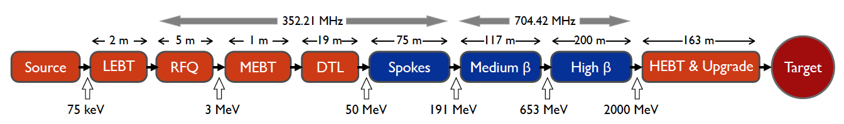
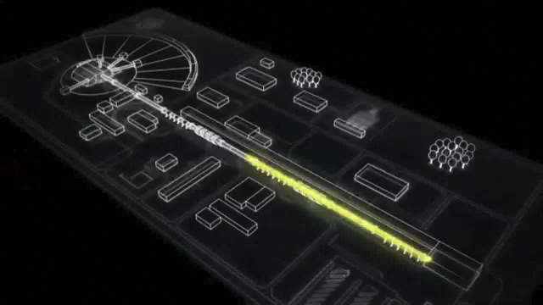
ESS proton linac
The ESS will be a copious source of spallation neutrons.
5 MW average beam power.
125 MW peak power.
14 Hz repetition rate (2.86 ms pulse duration, 10¹⁵ protons).
Duty cycle 4%.
2.0 GeV protons
  up to 3.5 GeV with linac upgrades
>2.7x10²³ p.o.t/year.
Linac ready by 2023 (full power)

Slide 5
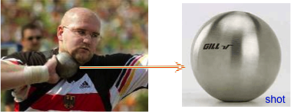
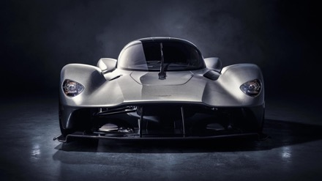
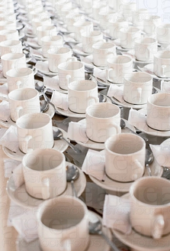
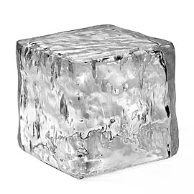
What does it mean 5 MW?
One beam pulse:
    has the same energy as a 16 lb (7.2kg) shot traveling at:
    1100 km/hour
    Mach 0.93
  Has the same energy as a 1000 kg car traveling at 96 km/hour
  You boil 1000 kg of ice in 83 seconds
And this for 14 pulses/sec…

Slide 6

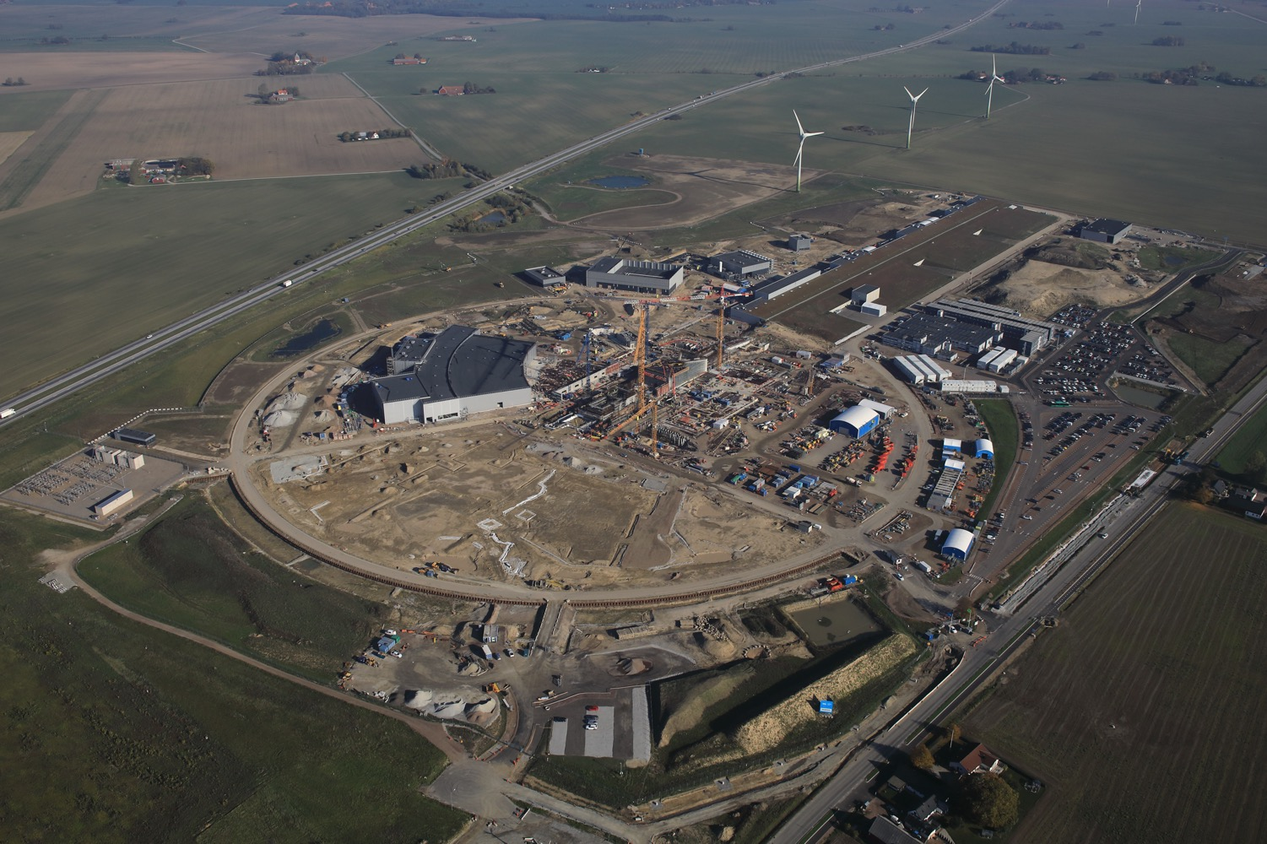
European Spallation Source
Distribution
Substation
Central Utility
Building
Cryo Compressor
Building
Primary
Substation
Front End
Building
Exp. Hall
E01
Klystron Gallery
High Energy
Loading Bay
Active
Cells
Target
Monolith
Oct. 2018

Slide 7
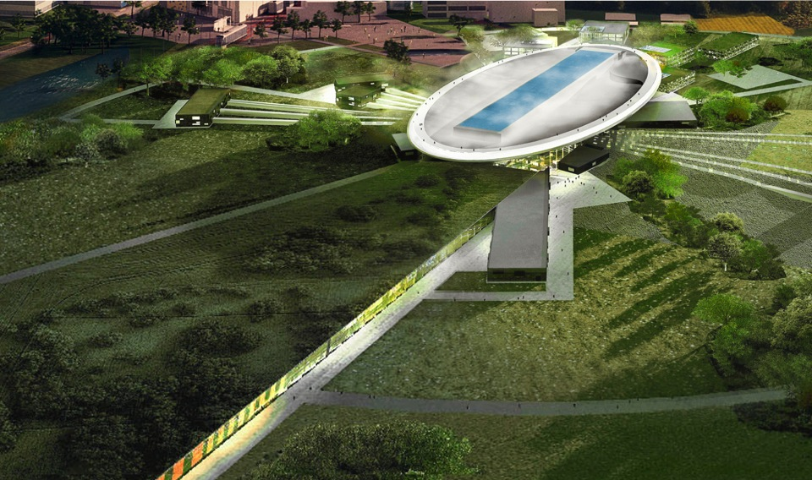
ESS schedule
2025
ESS construction complete
2014
Construction work starts on the site
2023
ESS starts
user program
2009
Decision: ESS will be built in Lund
2019
First neutrons on instruments
2012
ESS Design Update phase complete
2003
First European design effort of ESS completed

Slide 8
European Spallation Source as Neutrino Facility
ν

Slide 9
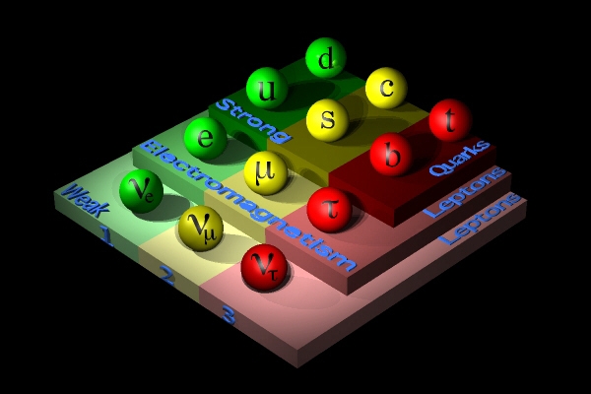

But, what a neutrino is?
elementary particles,
neutral (electrical charge=0)
interacting only through weak interaction,
they have massive and charged partners,
massless up to 90’s (this is what was assumed by the Standard Model of elementary particles)
fermions (spin 1/2)
+bosons currying the interactions (spin integer)
strong
weak
electromagnetic
the fermions’ anti-particles
the Higgs boson

Slide 10
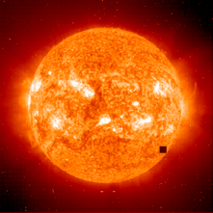
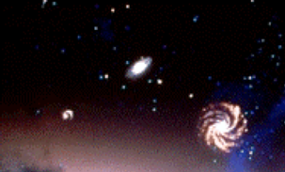


Where can we find neutrinos?
Solar Neutrinos : 2 10³⁸ ν/s → 40 billions ν/s/cm² on the earth → 400000 billion ν/s/human.
Universe :
Big-Bang : 330 ν/cm³.
Stars : 0.000006 ν/cm³.
Supernovae : 0.0002 ν/cm³.
Earth radioactivity : 50 billion ν/s human.
Nuclear Plants:10-100 billion ν/s/human.
Human body: 340 million ν/day (20 mg of ⁴⁰K, β decay).

Slide 11
Quantum Mechanics and lepton mixing
The "known" neutrinos are combinations of neutrino mass eigen states, e.g., for the electron neutrino:
Propagation in time:
For all neutrinos, we can write:
ν₂
ν₃
ν₁
ν_{e}
or
ν_{μ}
or
Pontecorvo-Maki-Nakagawa-Sakata Matrix
Weak interaction
ν_{τ}
Unitarity: UU⁺=I
(U⁺=(U*)^{t})

Slide 12
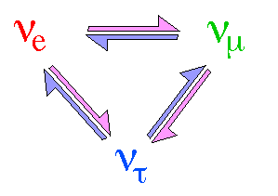
Neutrino Oscillations
Pontecorvo-Maki-Nakagawa-Sakata matrix
ν₃
well established now
θ₁₃
ν_{μ}
ν_{τ}
θ₂₃
θ₂₃
θ₁₂
ν₂
Usual parametrization
ν_{e}
ν₁
θ₁₂
θ₁₃
atmospheric,
accelerators
reactors,
accelerators
CP violation
solar,
reactors
δCP for neutrinos
-δCP for anti-neutrinos

Slide 13
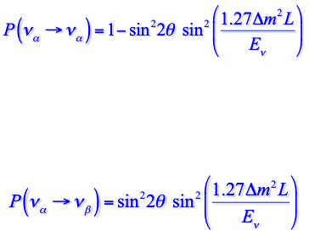

Appearance/disappearance experiments
In disappearance experiments we count how many initial neutrinos ν_{α} survive after traveling over a distance L (case of 2 flavours):
4π/Δm²
probability
sin²2θ
10¹
10²
10³
10⁴
L/E_{ν}
km/GeV
In appearance experiments we look for neutrinos ν_{β} in a ν_{α} neutrino beam:
1.0
Δm² = 3x10⁻³ eV²
probability
0.5
0.0
10¹
10²
10³
10⁴
L/E_{ν}
km/GeV

Slide 14
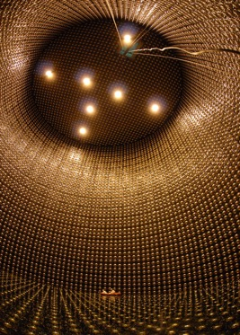
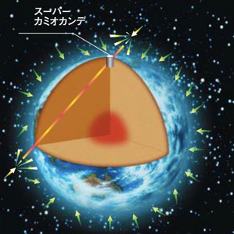
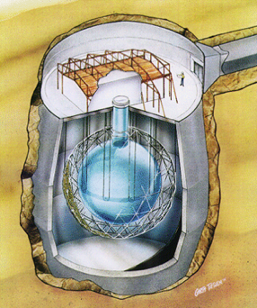
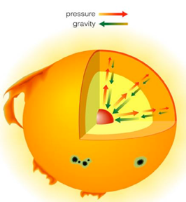
Confirmation of neutrino oscillations
Using SuperK and SNO experiments
atmospheric ν
SuperK
solar ν
SNO

Slide 15

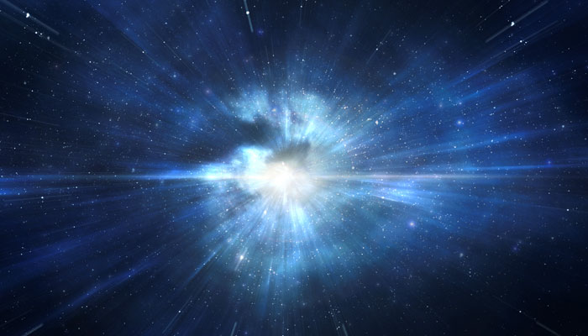
Matter/antimatter asymmetry in the Universe and ν oscillations
At the very beginning of the Universe:
10,000,000,001
10,000,000,000
matter
antimatter

Slide 16
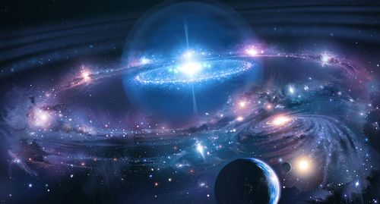
Matter/antimatter asymmetry in the Universe
After annihilation:
+ radiation
matter
what we see around us today…
Baryon Asymmetry in the Universe (BAU)

Slide 17
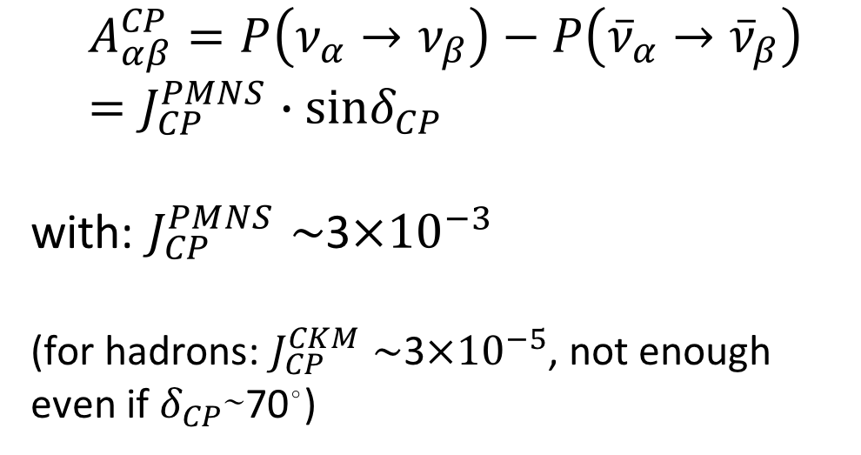
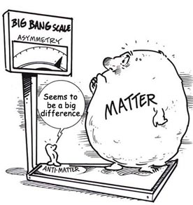
δ_{CP} and Matter-antimatter asymmetry magnitude
(Jarlskog invariant)
(from the already observed CP violation in the hadronic sector)
Theoretical models predict that if |sinδ_{CP}|≳0.7 (45°<δ_{CP}<135° or 225°<δ_{CP}<315°), this could be enough to explain the observed asymmetry.
(Nucl.Phys.B774:1-52,2007, arXiv:hep-ph/0611338)

Slide 18
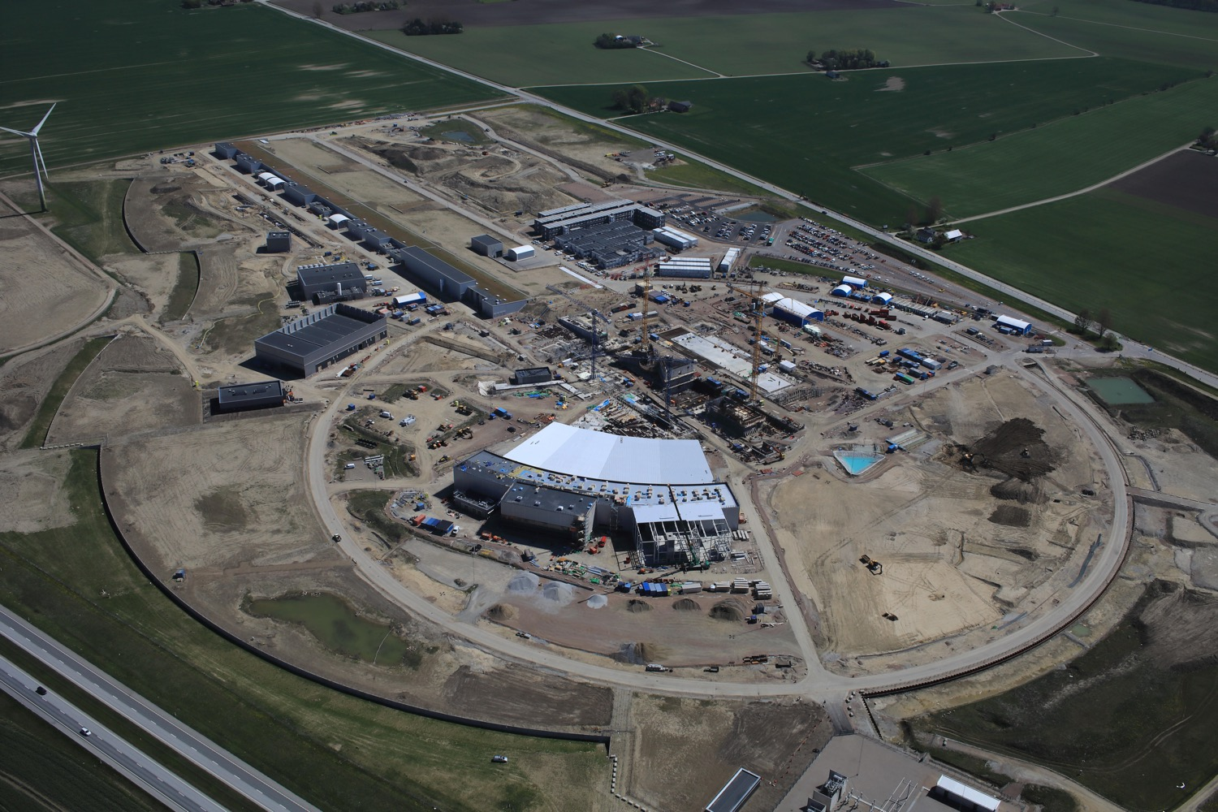

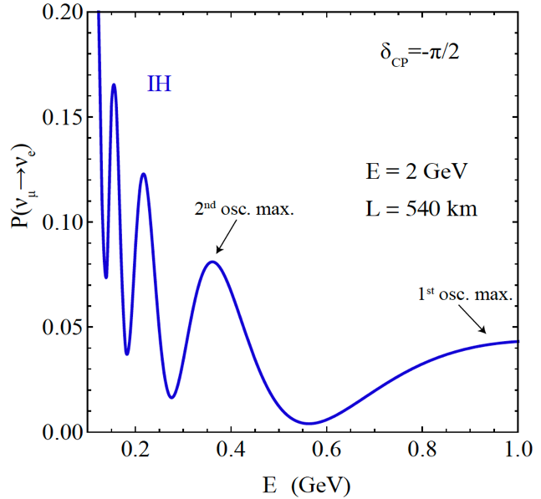
Use all this ESS linac power to go to the second oscillation maximum
More sensitive to matter-antimatter asymmetry

Slide 19
Having access to a powerful proton beam…
What can we do with:
5 MW power
2 GeV energy
14 Hz repetition rate
10¹⁵ protons/pulse
>2.7x10²³ protons/year
proton beam
decay tunnel
p
hadrons
physics
π
ν
⨂B
target
hadronic collector
(focusing)
Detector
conventional neutrino (super) beam

Slide 20
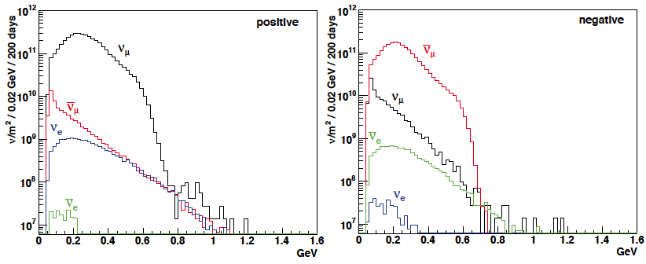
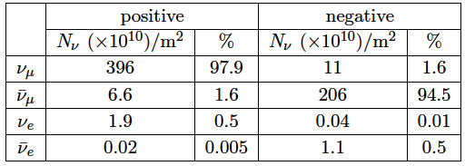
ESSνSB ν energy distribution
neutrinos
anti-neutrinos
almost pure ν_{μ} beam
small ν_{e} contamination which could be used to measure ν_{e} cross-sections in a near detector
at 100 km from the target and per year (in absence of oscillations)
(Nucl. Phys. B 885 (2014) 127)

Slide 21
Oscillation to be studied
ν_{μ}→ν_{e}

Slide 22
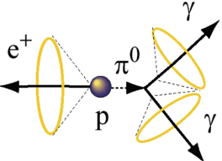
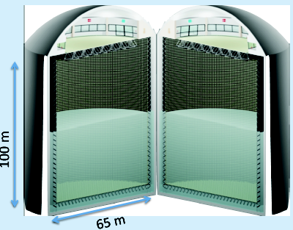
Can we go to the 2nd oscillation maximum using our proton beam?
Yes, if we place our far detector at around 500 km from the neutrino source.
MEMPHYS like Cherenkov detector
(MEgaton Mass PHYSics studied by LAGUNA)
Neutrino Oscillations
Proton decay
Astroparticles
Understand the gravitational collapsing: galactic SN ν
  Supernovae "relics"
Solar Neutrinos
Atmospheric Neutrinos
(arXiv: hep-ex/0607026)
500 kt fiducial volume (~20xSuperK)
Readout: ~240k 8” PMTs
30% optical coverage

Slide 23
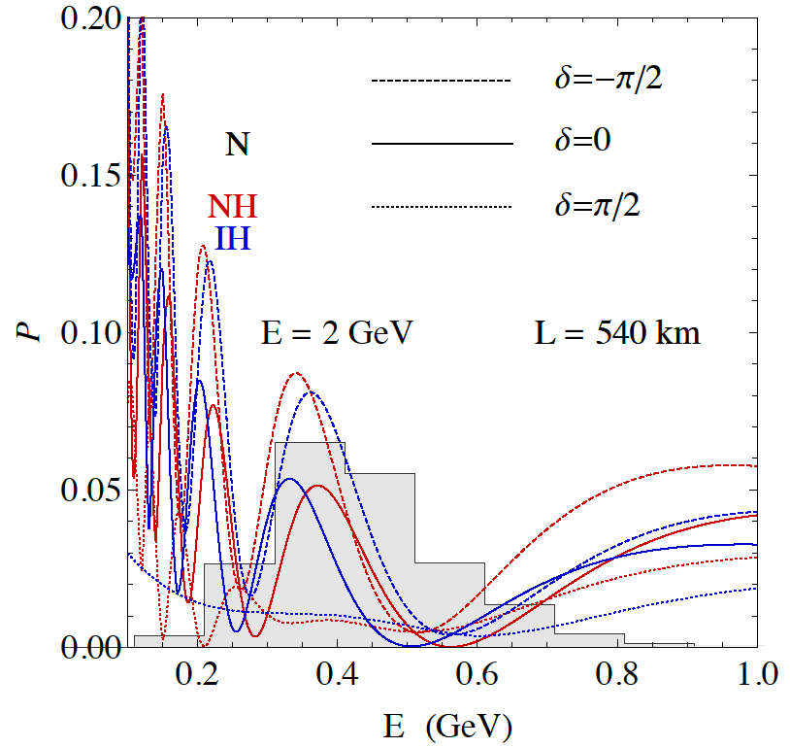
2nd Oscillation max. coverage
2nd oscillation max.
well covered by the ESS neutrino spectrum
1st oscillation max.

Slide 24
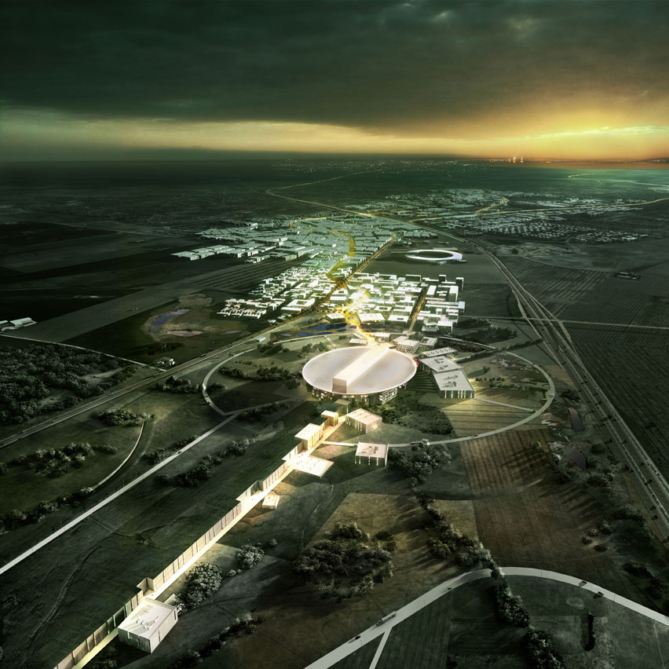
ESS Linac modifications to produce a neutrino Super Beam
European Spallation Source Linac

Slide 25
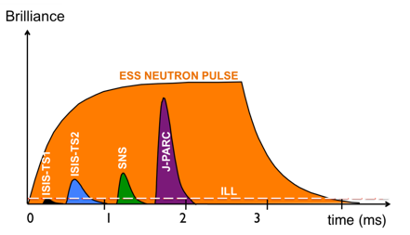
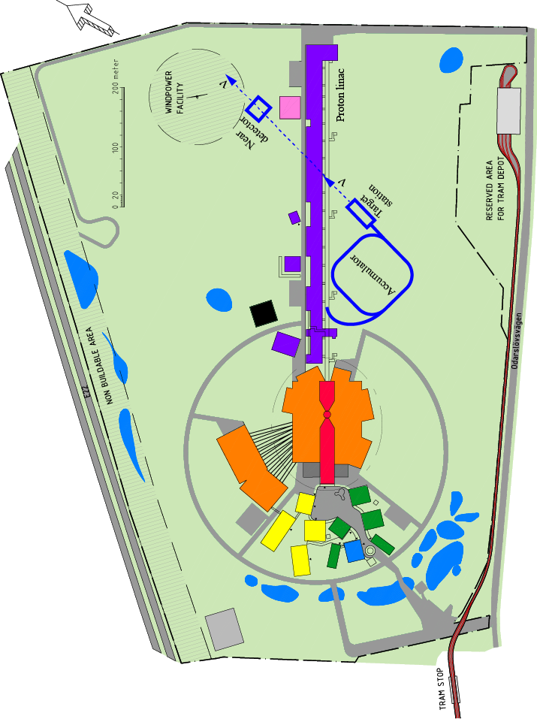
How to add a neutrino facility?
The neutron program must not be affected and if possible synergetic modifications.
Linac modifications: double the rate (14 Hz → 28 Hz), from 4% duty cycle to 8%.
Accumulator (C~400 m) needed to compress to few μs the 2.86 ms proton pulses, affordable by the magnetic horn (350 kA, power consumption, Joule effect)
  H⁻ source (instead of protons).
Target station (studied in EUROν).
Underground detector (studied in LAGUNA).

Slide 26
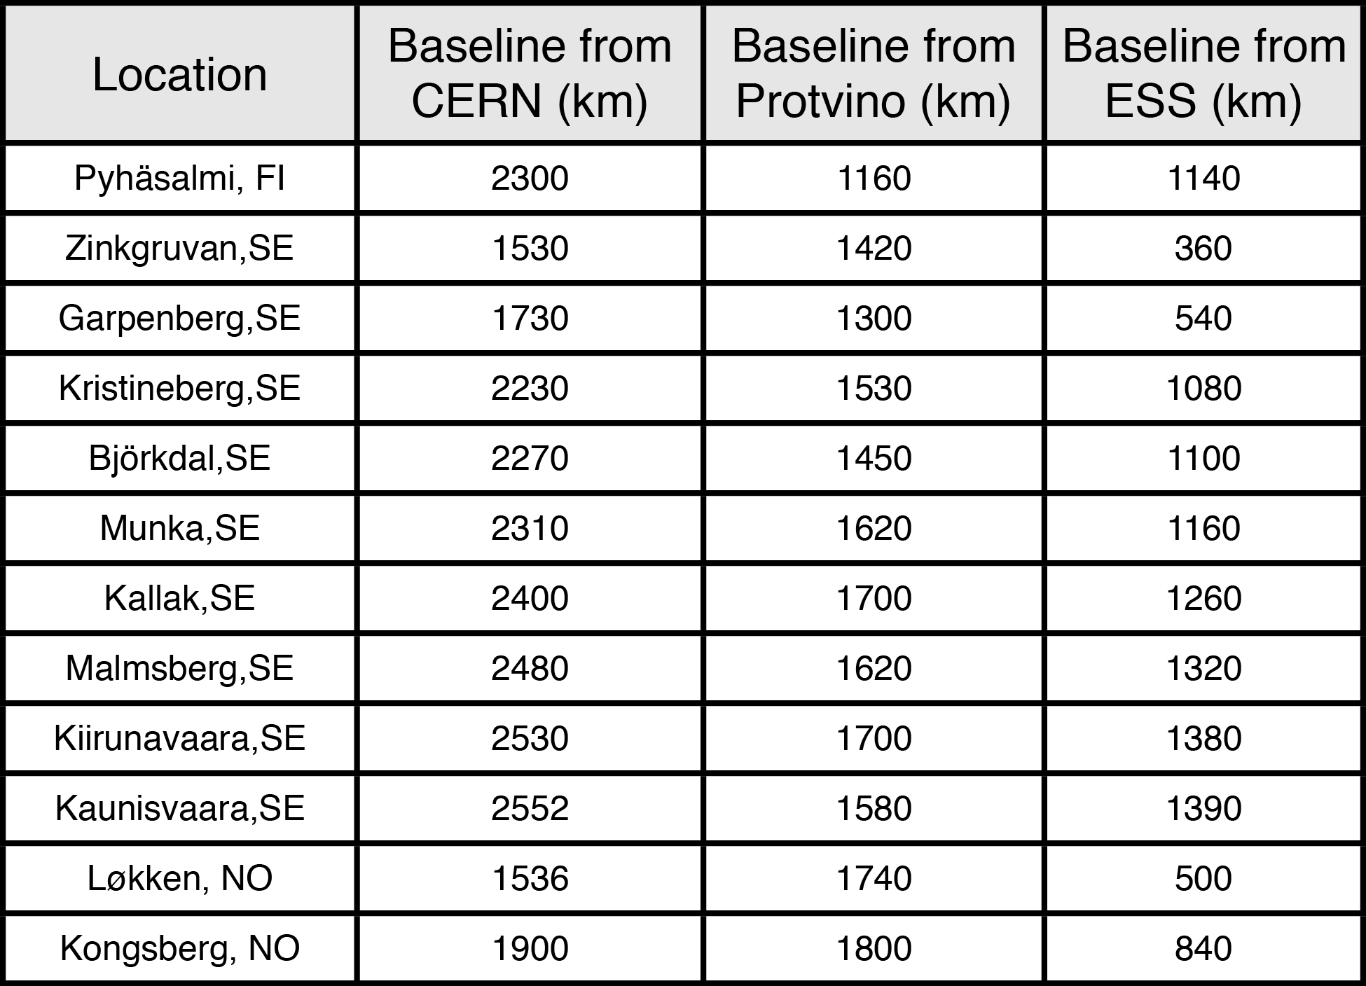
Possible locations for far detector
ESS
Kongsberg
Løkken
CERN
LAGUNA sites

Slide 27
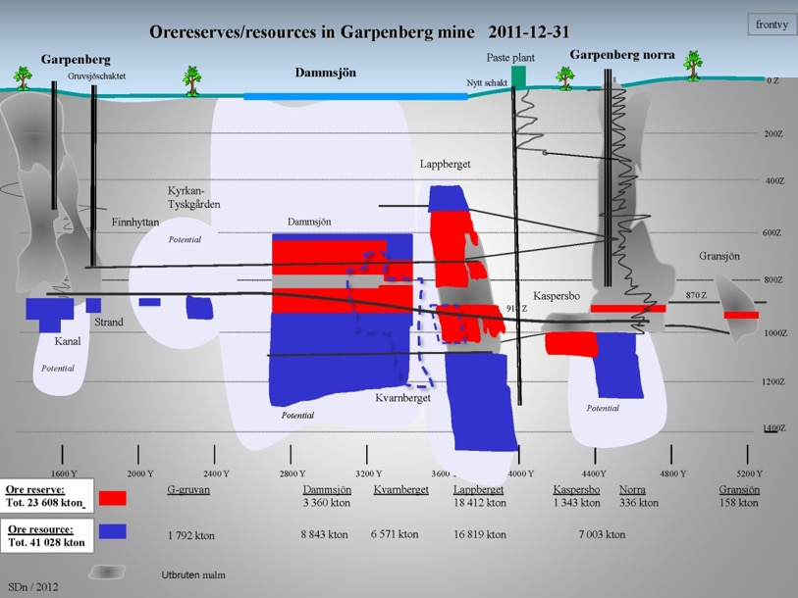
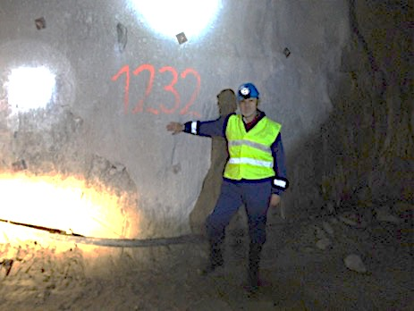
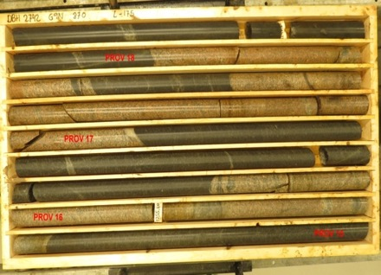
The Garpenberg mine
Distance from ESS Lund 540 km
Depth 1232 m
Truck access tunnel
Hoist shaft free to use by ESSnuSB
Rock-engineering prospection and studies in the Garpenberg-mine granite-zones
Granite drill cores

Slide 28
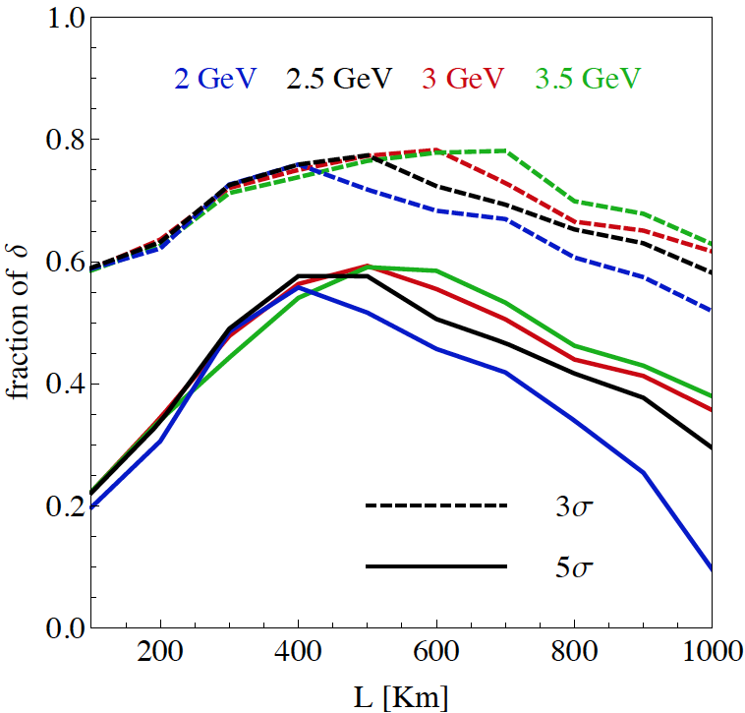
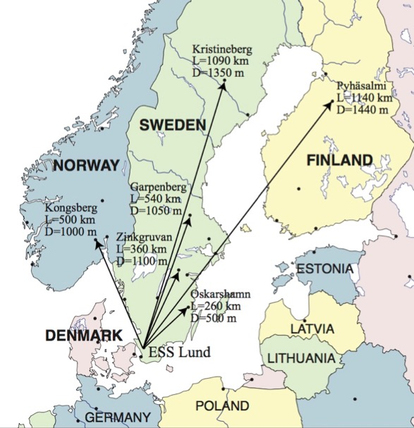
Which baseline?
discovery potential of matter-antimatter asymmetry
Garpenberg
Zinkgruvan
~60% δ_{CP} coverage at 5 σ C.L.
>75% δ_{CP} coverage at 3 σ C.L.
systematic errors: 5%/10% (signal/backg.)
Candidate active mines

Slide 29
Physics Performance
540 km
little dependence on mass hierarchy,
δ_{CP} coverage at 5 σ C.L. up to 60%,
δ_{CP} accuracy down to 6° at 0° and 180° (absence of CPV for these two values),
not yet optimized facility,
5/10% systematic errors on signal/background.
5/5 yrs

Slide 30

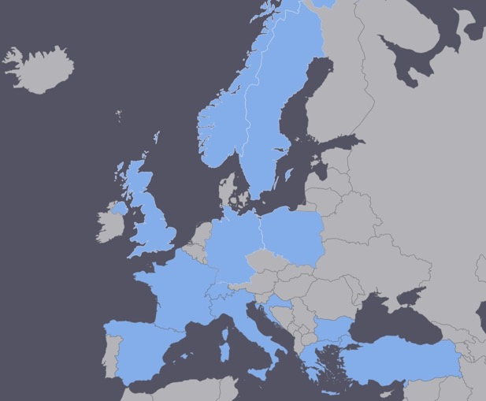
EuroNuNet
COST application for networking: CA15139 (2016-2020)
  EuroNuNet : Combining forces for a novel European facility for neutrino-antineutrino symmetry violation discovery (http://www.cost.eu/COST_Actions/ca/CA15139)
The members are countries which signed the Action MoU
  Major goals of EuroNuNet:
    to aggregate the community of neutrino physics in Europe to study a neutrino long baseline concept in a spirit of inclusiveness,
    to impact the priority list of High Energy Physics policy makers and of funding agencies to this new approach to the experimental discovery of leptonic CP violation.
  13 participating countries (network still growing).
http://euronunet.in2p3.fr/

Slide 31
ESSνSB at the European level
A H2020 EU Design Study (Call INFRADEV-01-2017)
Title of Proposal: Discovery and measurement of leptonic CP violation using an intensive neutrino Super Beam generated with the exceptionally powerful ESS linear accelerator
Duration: 4 years
Total cost: 4.7 M€
Requested budget: 3 M€
15 participating institutes from
11 European countries including CERN and ESS
6 Work Packages
Approved end of August 2017
ESSνSB
BENE (2004-2008)
ISS (2005-2007)
EUROν (2008-2012)
LAGUNA (2008-2010)
LAGUNA-LBNO (2010-2014)
COST Action CA15139 (2015-2019)

Slide 32
Design Study ESSνSB
(2018-2021)
More information on:
http://essnusb.eu/
partners: IHEP, BNL, SCK•CEN, SNS, PSI, RAL

Slide 33
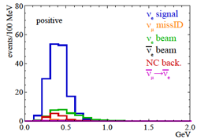
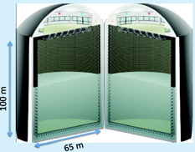
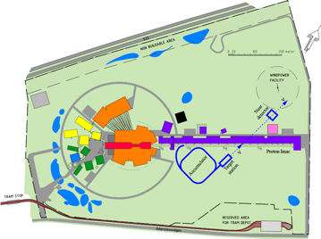
Possible ESSνSB schedule
(2nd generation neutrino Super Beam)
2021: End of ESSνSB Design Study, CDR and preliminary costing
2012: inception of the project
2016-2019: beginning of COST Action EuroNuNet
2018: beginning of ESSνSB Design Study (EU-H2020)
2022-2024: Preparatory Phase, TDR
2025-2026: Preconstruction Phase, International Agreement
2027-2034: Construction of the facility and detectors, including commissioning
2035-: Data taking
Nucl. Phys. B 885 (2014) 127

Slide 34
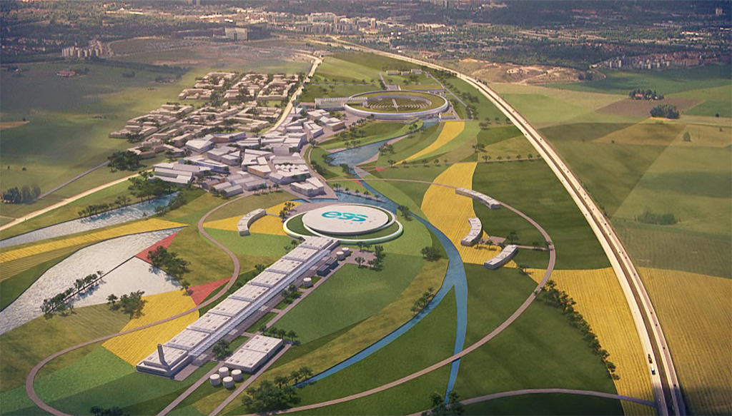
Conclusion
ESS will be the most powerful neutron facility for many applications.
ESS can also become a neutrino facility with enough protons to go to the 2nd oscillation maximum and increase the CPV sensitivity.
CPV: 5 σ could be reached over 60% of δ_{CP} range by ESSνSB with large physics potential.
Large associated detectors have a rich astroparticle physics program.
The European Spallation Source Linac will be ready by 2025, upgrade decisions by this moment.
Rich muon program for future ESS upgrades.
COST network project CA15139 and a EU-H2020 Design Study supports this project.

