Slide 1
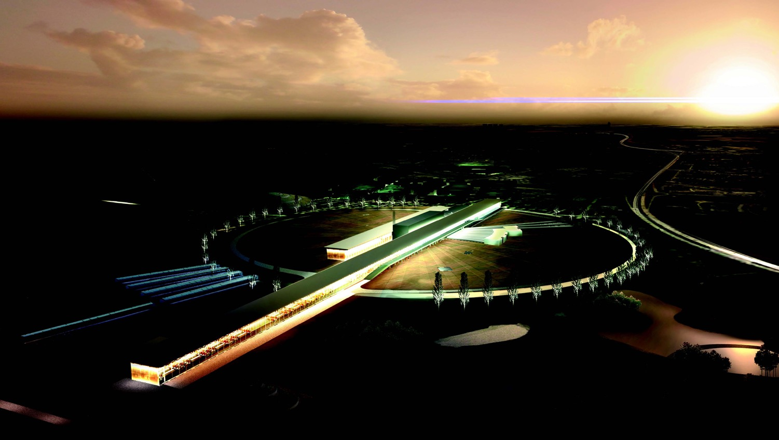

Neutrino CP Violation with the European Spallation Source neutrino Super Beam
Marcos Dracos
IPHC-Strasbourg

Slide 2
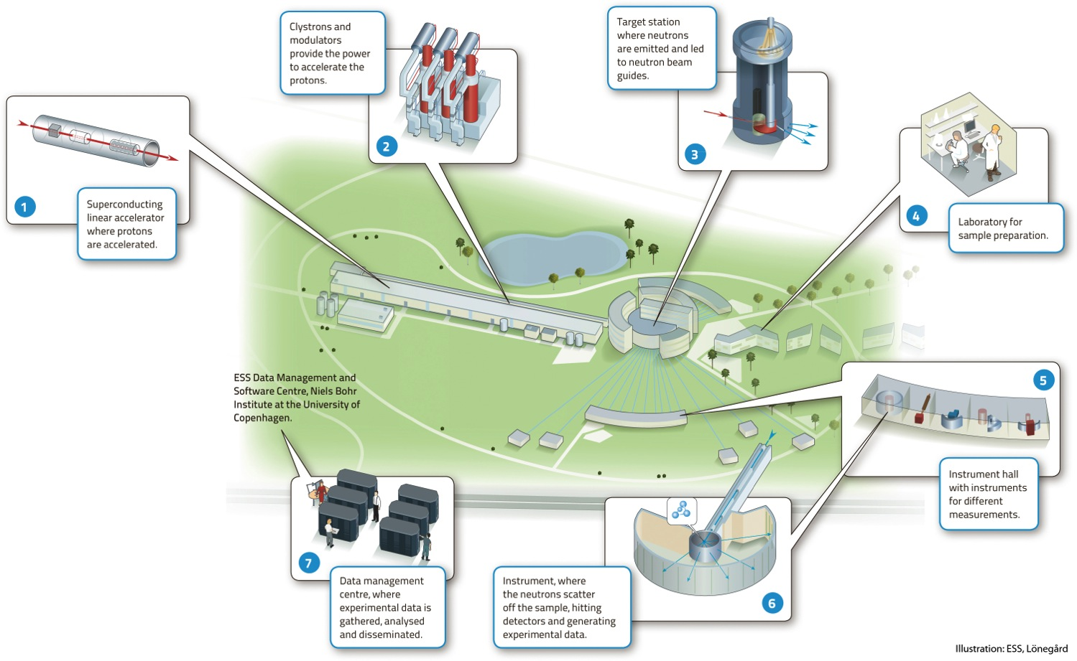

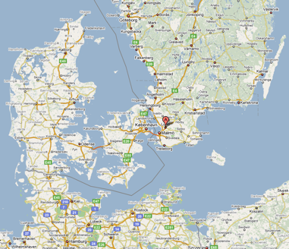
European Spallation Source
Neutron facility
(equivalent to SNS in the USA)
under construction phase
(~1.85 B€ facility)

Slide 3
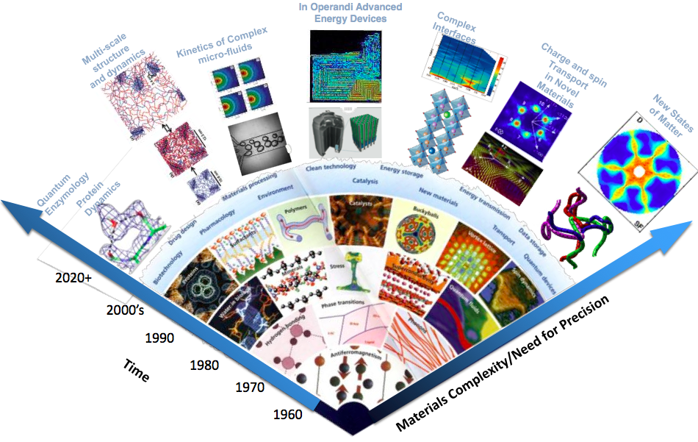
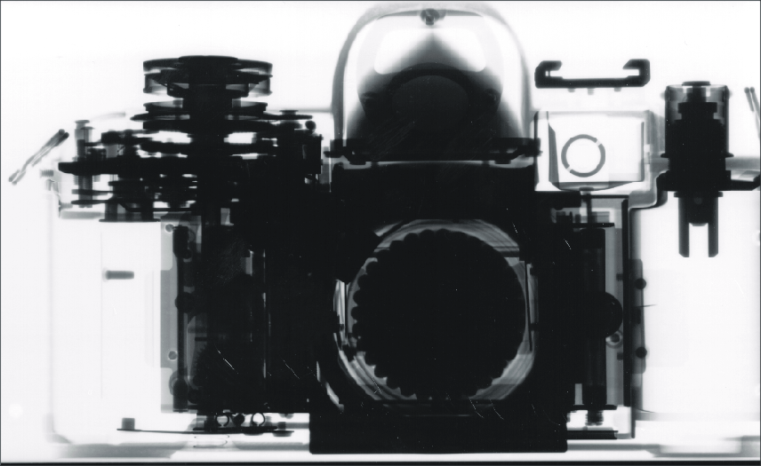
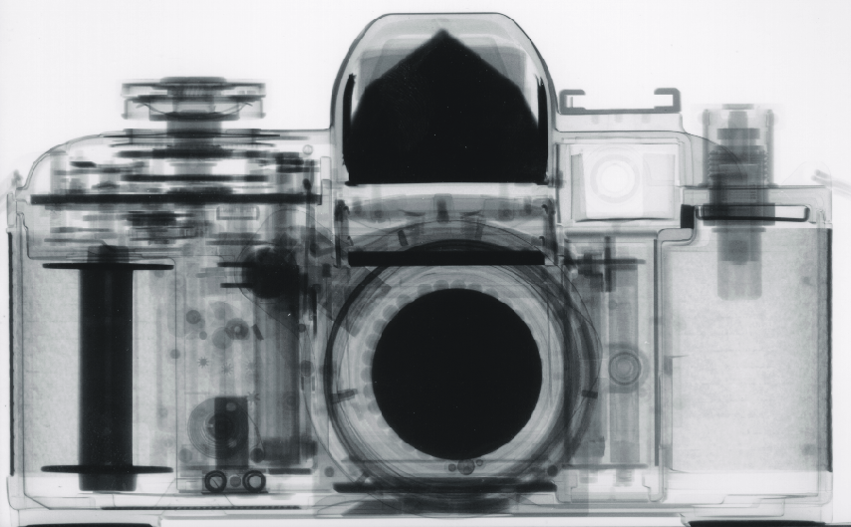
Applications of neutrons
Multi-disciplinary science applications
Transmutation of radioactive (waste) material
  Accelerator-driven Systems
Industrial applications:
  materials analysis and non-destructive testing tools in many industries
    heavy mechanical production
    art conservancy
    Medicine
    …
X-Ray Image
Neutron radiograph

Slide 4
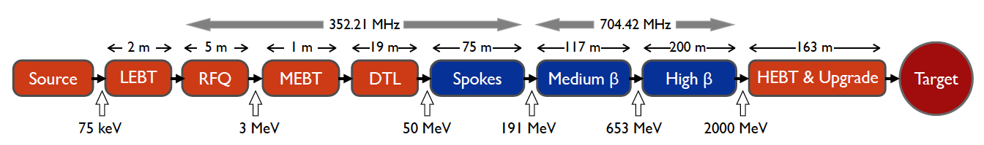
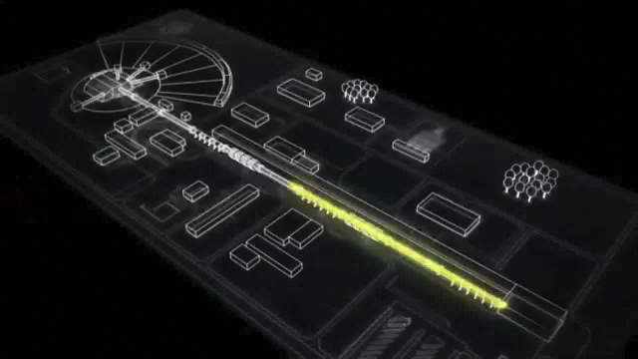
ESS proton linac
empty space for energy upgrades
The ESS will be a copious source of spallation neutrons.
5 MW average beam power.
125 MW peak power.
14 Hz repetition rate (2.86 ms pulse duration, 10¹⁵ protons).
Duty cycle 4%.
2.0 GeV protons
  up to 3.5 GeV with linac upgrades
>2.7x10²³ p.o.t/year.
8
x10¹⁴
ESS 5 MW
2015 design
7
λ = 1.5 Å
6
5
Brightness (n/cm²/s/sr/Å)
4
3
ESS 5 MW
2012 design (TDR)
Linac ready by 2025 (full power)
2
UK TS2
32 kW
SNS
1-2 MW
JPARC
0.3-1 MW
1
UK TS1
128 kW
ILL 57 MW
0
time (ms)
1
2
3
4

Slide 5
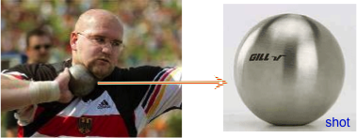
What does it mean 5 MW?
One beam pulse:
    has the same energy as a 16 lb (7.2kg) shot traveling at
    1100 km/hour
    Mach 0.93
And this for 14 pulses/sec…
Many challenging problems to solve.
neutron beam exraction port
proton beam
target wheel absorping all hadrons and muons

Slide 6
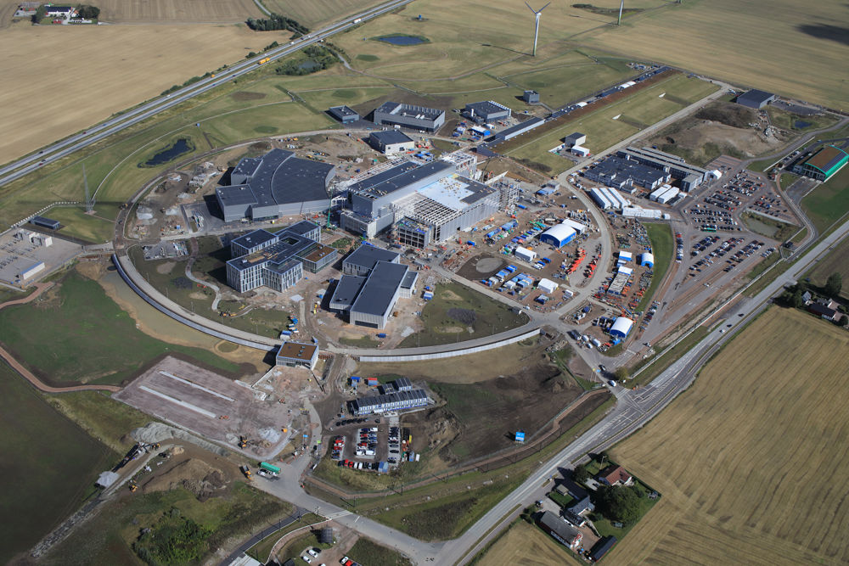

European Spallation Source
Distribution
Substation
Central Utility
Building
Cryo Compressor
Building
Exp. Hall
E01
Front End
Building
Klystron Gallery
Target
Monolith
High Energy
Loading Bay
Active
Cells
European Research Infrastructure Consortium (ERIC) since 2015
Oct. 2020

Slide 7
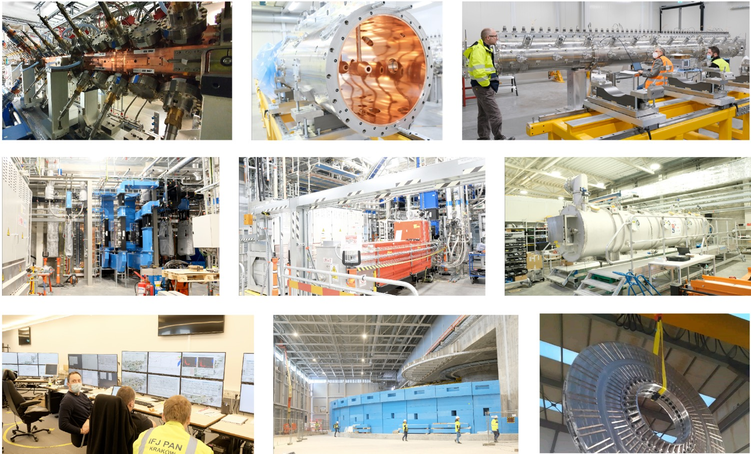
European Spallation Source
(courtesy M. Eshraqi)

Slide 8
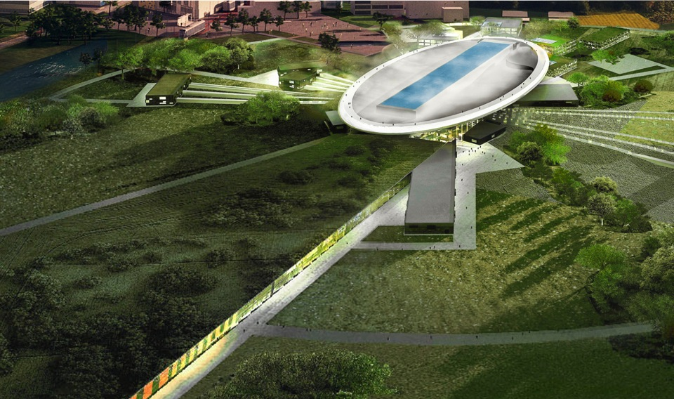
ESS schedule
2025
ESS construction complete
2014
Construction work starts on the site
2023
ESS starts
user program
2009
Decision: ESS will be built in Lund
2019
First neutrons on instruments
2012
ESS Design Update phase complete
2003
First European design effort of ESS completed

Slide 9
European Spallation Source as Neutrino Facility for CP violation observation
(2nd Oscillation maximum)
or, what else can we do with 5 MW proton beam?
ν_{μ}→ν_{e}

Slide 10
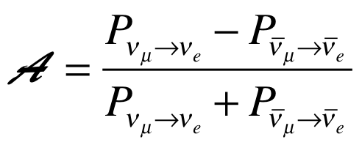
Oscillation probability
(neutrino beams)
"atmospheric"
"interference"
"solar"
matter effect
for antimatter: δ_{CP} →-δ_{CP} and a→-a
fake matter/antimatter asymetry due to matter effect
δ_{CP} dependence,
sizable matter effect for long baselines
Matter-antimatter asymmetry

Slide 11

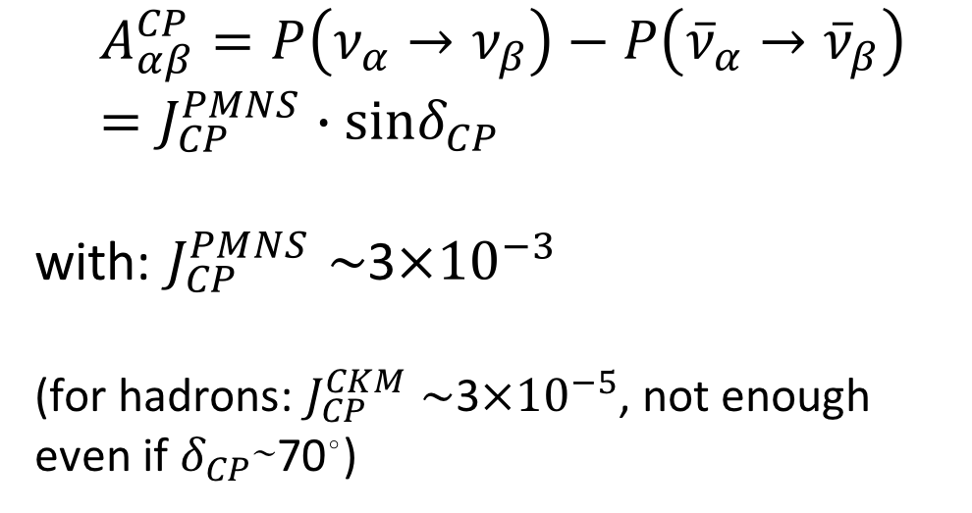
δ_{CP} and matter-antimatter asymmetry magnitude
(Jarlskog invariant)
(from the already observed CP violation in the hadronic sector)
Theoretical models predict that if |sinδ_{CP}|≳0.7 (45°<δ_{CP}<135° or 225°<δ_{CP}<315°), this could be enough, under assumptions, to explain the observed asymmetry.
(Nucl.Phys.B774:1-52,2007, arXiv:hep-ph/0611338)

Slide 12
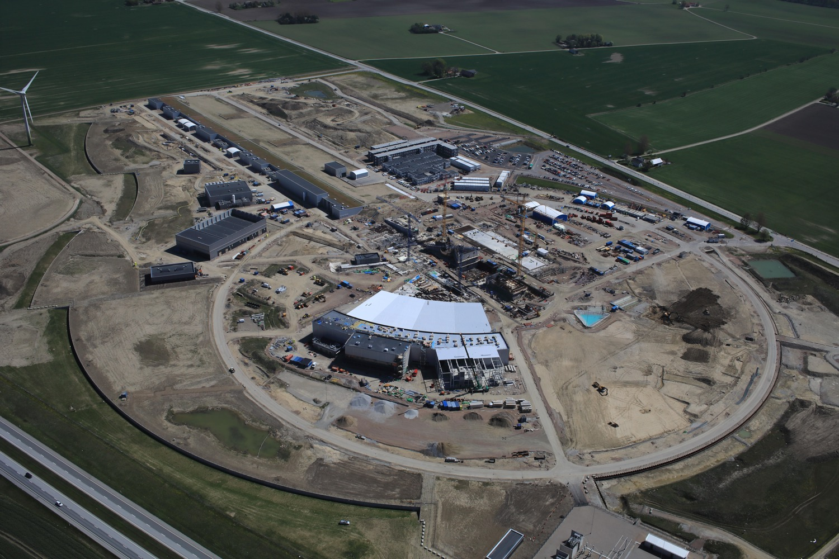
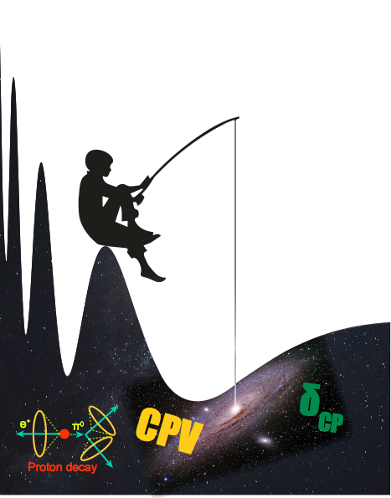
Use all this ESS linac power to go to the second oscillation maximum
but why?

Slide 13
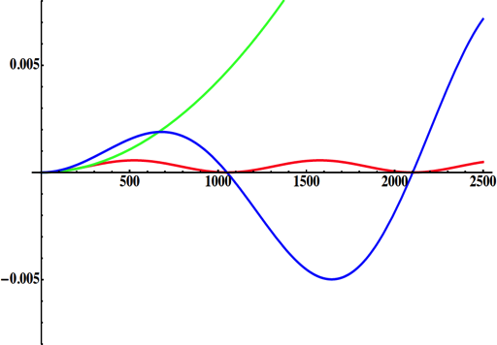
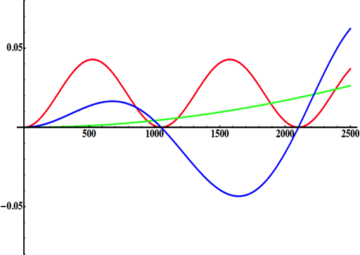
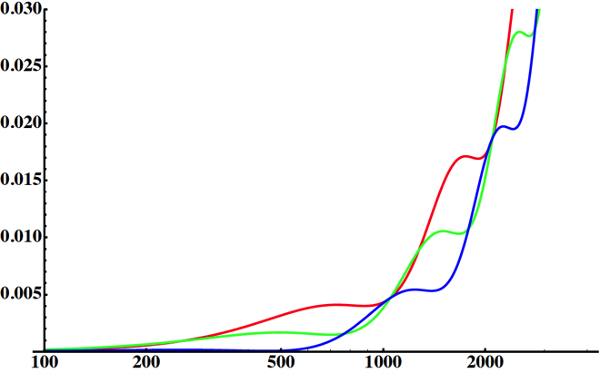
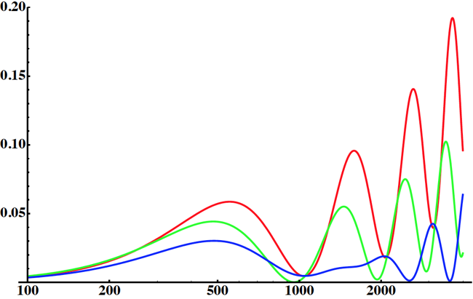
Neutrino Oscillations with "large" θ₁₃
solar
(after 2012)
(before 2012)
atmospheric
for "large" θ₁₃ 1st oscillation maximum is dominated by atmospheric term
for small θ₁₃ 1st oscillation maximum is better
atmospheric
solar
L/E
L/E
CP interference
(arXiv:1110.4583)
θ₁₃=1º
CP interference
θ₁₃=8.8º
solar
2nd oscillation maximum
P(ν_{μ}→ν_{e})
1st oscillation maximum
θ₁₃=1º
("small" θ₁₃)
δ_{CP}=-90
δ_{CP}=0
δ_{CP}=+90
θ₁₃=8.8º
("large" θ₁₃)
L/E
L/E
1st oscillation max.: A=0.3sinδ_{CP}
2nd oscillation max.: A=0.75sinδ_{CP}
more sensitivity at 2nd oscillation max.
(see arXiv:1310.5992 and arXiv:0710.0554)

Slide 14
Having access to a powerful proton beam…
What can we do with:
5 MW power
2 GeV energy
14 Hz repetition rate
10¹⁵ protons/pulse
>2.7x10²³ protons/year
proton beam
decay tunnel
p
hadrons
physics
π
ν
⨂B
target
hadronic collector
(focusing)
Detector
conventional neutrino (super) beam

Slide 15
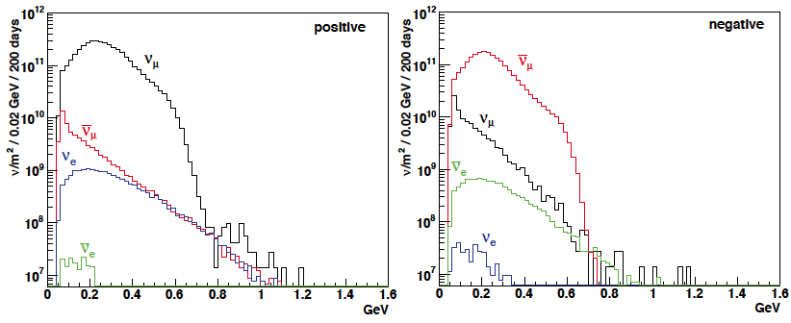
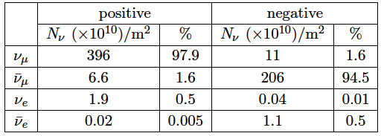
ESSνSB ν energy distribution
neutrinos
anti-neutrinos
almost pure ν_{μ} beam
small ν_{e} contamination which could be used to measure ν_{e} cross-sections in a near detector
at 100 km from the target, per year (in absence of oscillations)
(Nucl. Phys. B 885 (2014) 127)

Slide 16
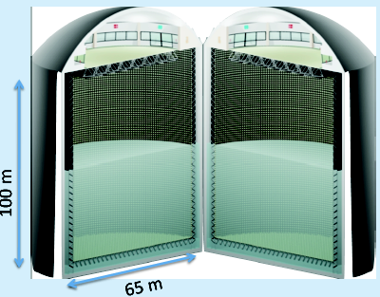
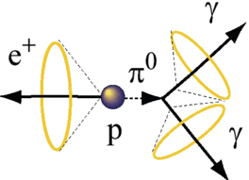
Can we go to the 2nd oscillation maximum using our proton beam?
Yes, if we place our far detector at around 500 km from the neutrino source.
MEMPHYS like Cherenkov detector
(MEgaton Mass PHYSics studied by LAGUNA)
(arXiv: hep-ex/0607026)
Neutrino Oscillations
Proton decay
Astroparticles
Understand the gravitational collapsing: galactic SN ν
  Supernovae "relics"
Solar Neutrinos
Atmospheric Neutrinos
500 kt fiducial volume (~20xSuperK)
Readout: ~240k 8” PMTs
30% optical coverage
New 20" PMTs with higher QE and cheaper (see JUNO), the detection efficiency will improve the detector performance keeping the price constant, not yet taken into account.

Slide 17
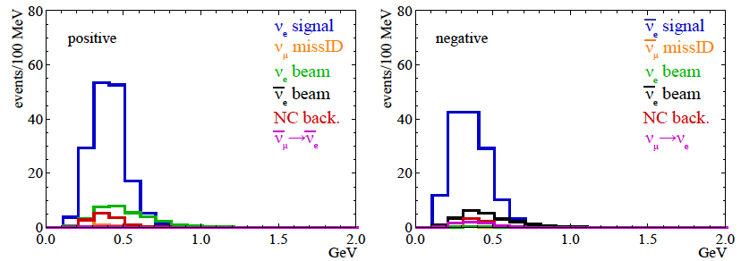
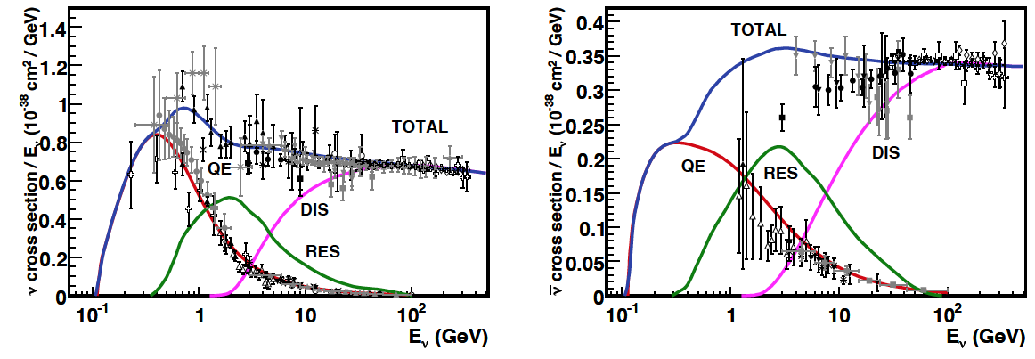
Neutrinos in the far detector
540 km (2 GeV), 10 years
neutrinos
anti-neutrinos
δ_{CP}=0
2 years
8 years
Below ν_{τ} production, almost only QE events, not suffering too much by π⁰ background.

Slide 18
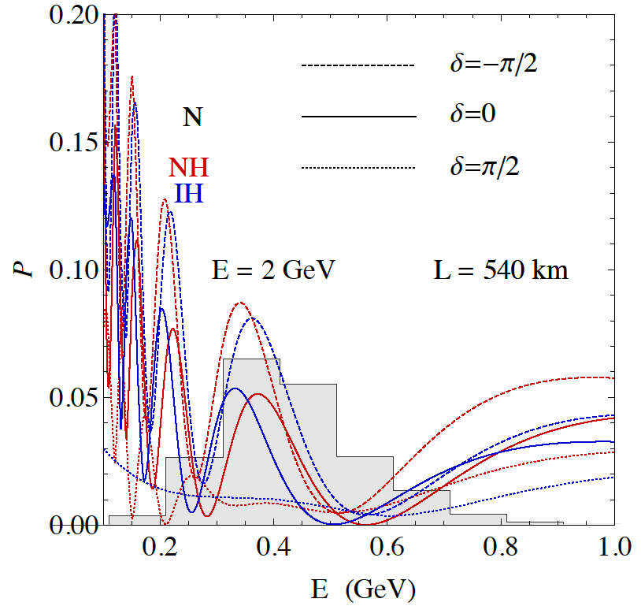
2nd Oscillation max. coverage
2nd oscillation max.
well covered by the ESS neutrino spectrum
1st oscillation max.
full coverage of the 2nd oscillation max.

Slide 19
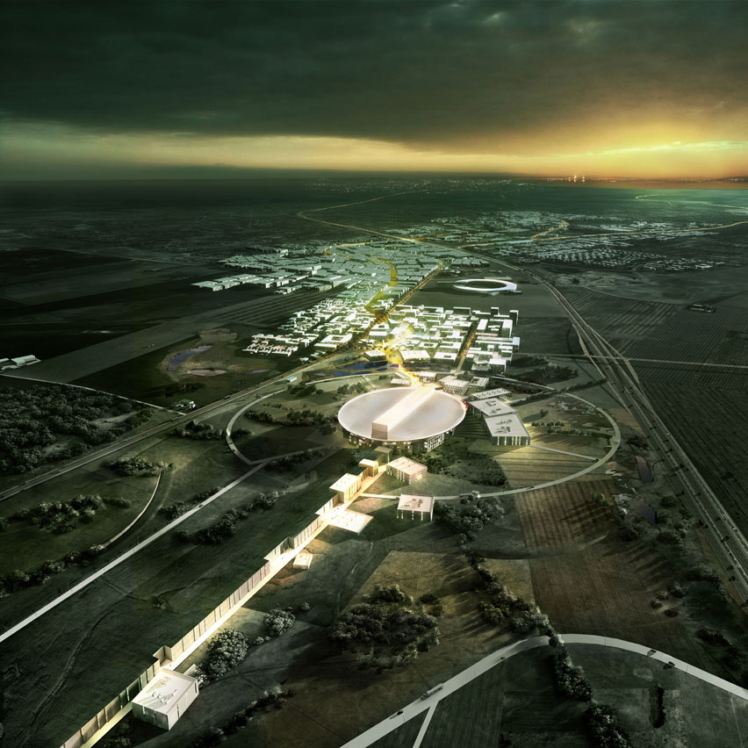
ESS Linac modifications to produce a neutrino Super Beam
European Spallation Source Linac

Slide 20
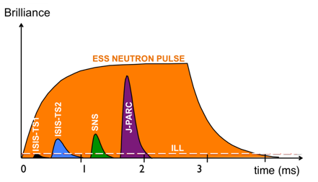
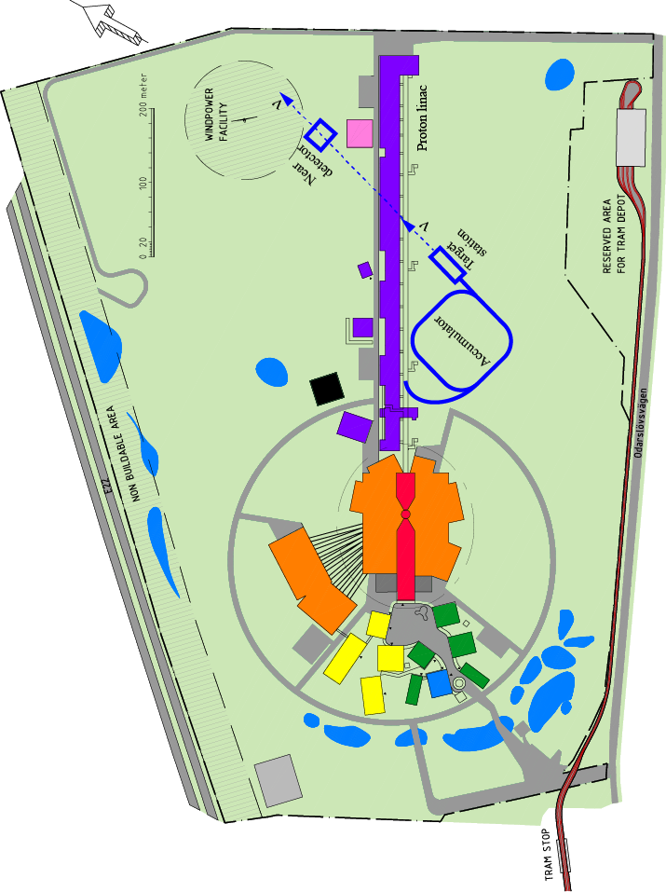
How to add a neutrino facility?
The neutron program must not be affected and if possible synergetic modifications.
Linac modifications: double the rate (14 Hz → 28 Hz), from 4% duty cycle to 8%.
Accumulator (C~400 m) needed to compress to few μs the 2.86 ms proton pulses, affordable by the magnetic horn (350 kA, power consumption, Joule effect)
  H⁻ source (instead of protons),
  space charge problems to be solved.
~300 MeV neutrinos.
Target station.
Underground detector.
Short pulses (~μs) will also allow DAR experiments (as those proposed for SNS) using the neutron target.

Slide 21
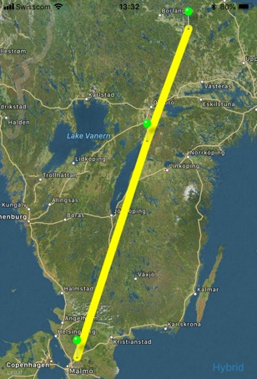
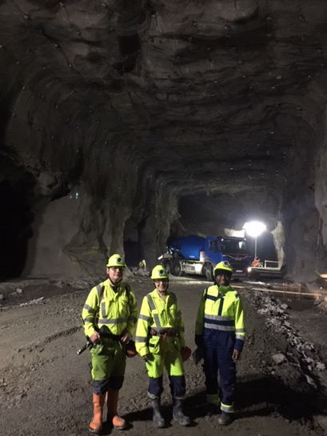
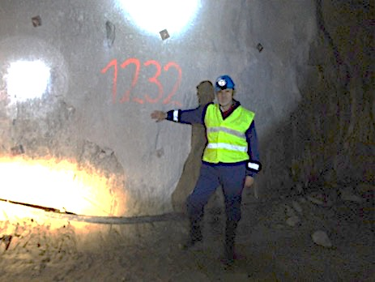
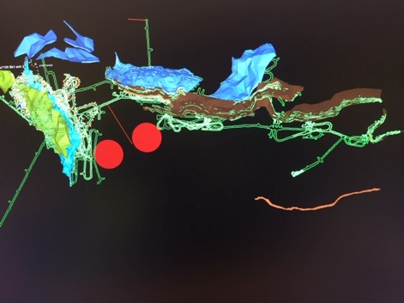
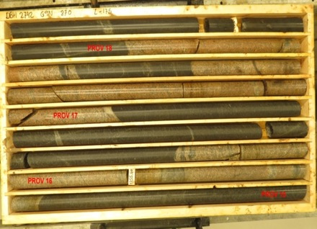
Candidate active mines
Garpenberg mine
  Distance from ESS Lund 540 km
  Depth 1200 m
  Truck access tunnel
Zinkgruvan mine
  Distance from ESS Lund 360 km
  Depth 1500 m
  Truck access tunnel
Garpenberg
(540 km)
Zinkgruvan
Zinkgruvan
(360 km)
Lund
possible location of MEMPHYS in
Zinkgruvan mine
Garpenberg
Granite drill cores

Slide 22
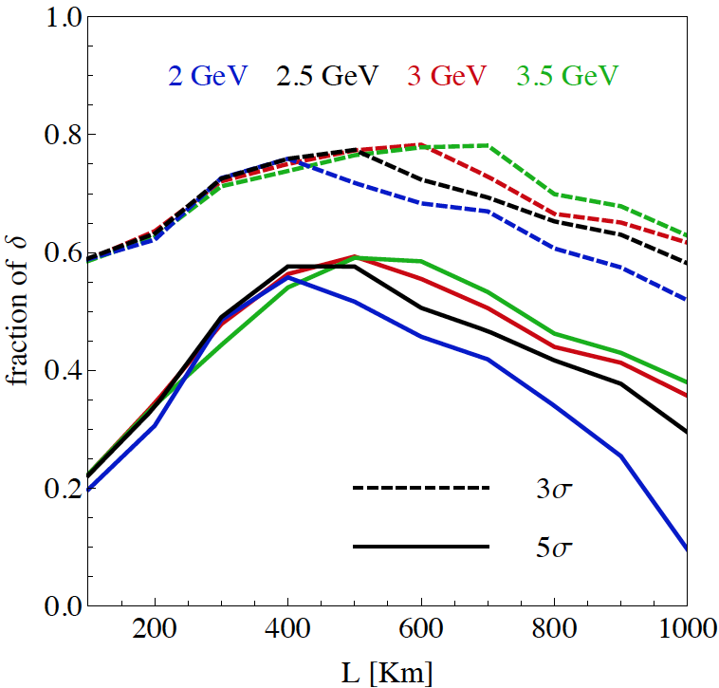
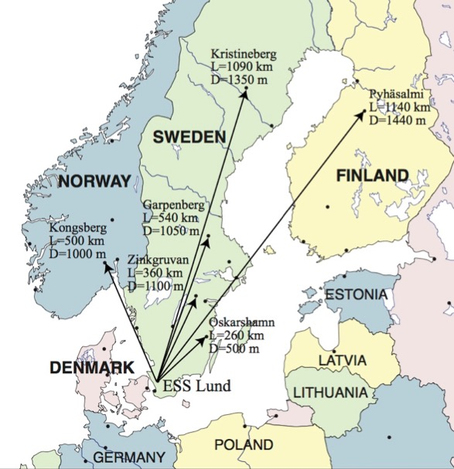
Which baseline?
CPV (Nucl. Phys. B 885 (2014) 127)
Garpenberg
Zinkgruvan
~60% δ_{CP} coverage at 5 σ C.L.
>75% δ_{CP} coverage at 3 σ C.L.
systematic errors: 5%/10% (signal/backg.)
Candidate active mines

Slide 23
Physics Performance
(CPV discovery)
540 km
little dependence on mass hierarchy,
δ_{CP} coverage at 5 σ C.L. up to 60%,
δ_{CP} accuracy down to 6° at 0° and 180° (absence of CPV for these two values),
not yet optimized facility,
5/10% systematic errors on signal/background.

Slide 24
Physics Performance
(accuracy)
5/5 yrs
δ_{CP} accuracy down to 6° at 0° and 180°
12° accuracy at δ_{CP}= -90° and 10° at δ_{CP}= 90°
5/10% systematic errors on signal/background.

Slide 25
Required modifications of the ESS accelerator for ESSνSB
Better to go to 2.5 GeV

Slide 26
The Linac modifications and operation
H⁻ source options
Into linac
P
_{H}⁻
_{H}⁻
_{H}⁻
_{H}⁻
P
_{H}⁻
_{H}⁻
_{H}⁻
_{H}⁻
14 Hz
100 µs
0.65 ms
Into ring
H⁻
H⁻
H⁻
H⁻
H⁻
H⁻
H⁻
H⁻
14 Hz
~1.4 kHz
~1 µs
~0.75 ms
Into horn
_{H}⁻
_{H}⁻
_{H}⁻
_{H}⁻
_{H}⁻
_{H}⁻
_{H}⁻
_{H}⁻
14 Hz
time operation option
Horn 1
Horn 4
Horn 2
Horn 3

Slide 27
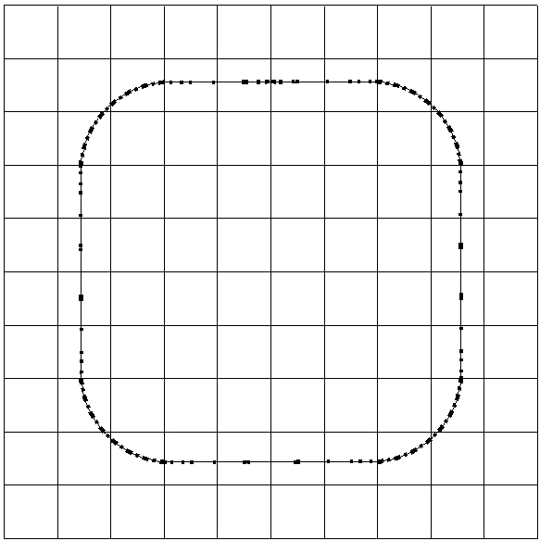
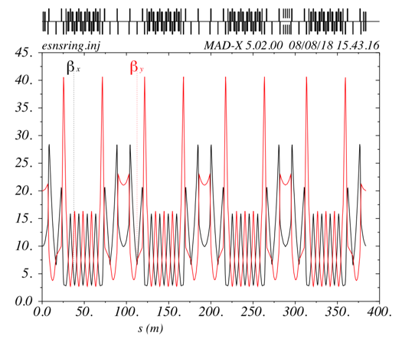
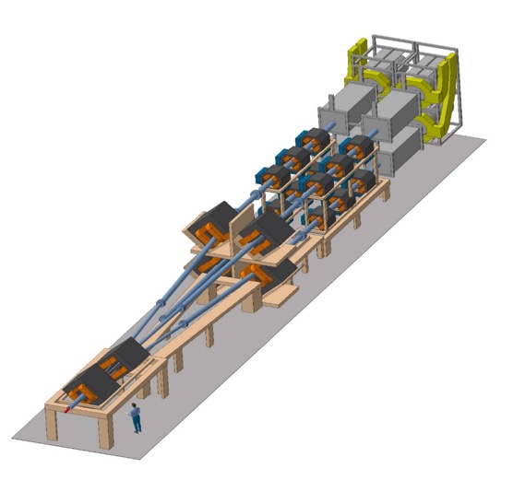
The Accumulator
lattice development
injection
4 superperiods
RF
extraction
FODO cells
H⁻ stripping
collimation
Dispersion-free straight sections
Switchyard

Slide 28
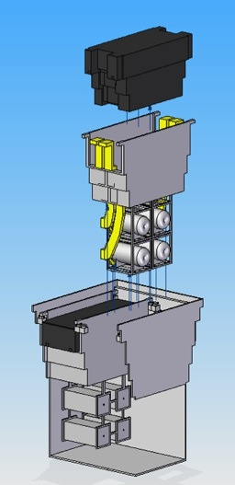
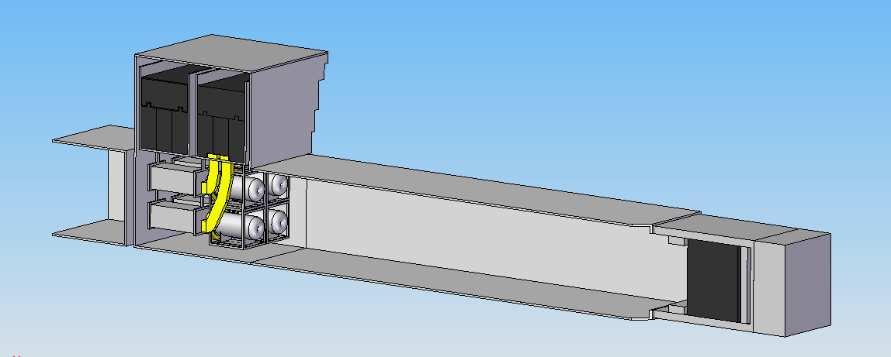
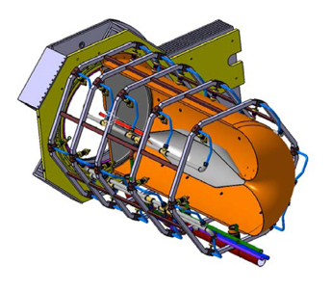
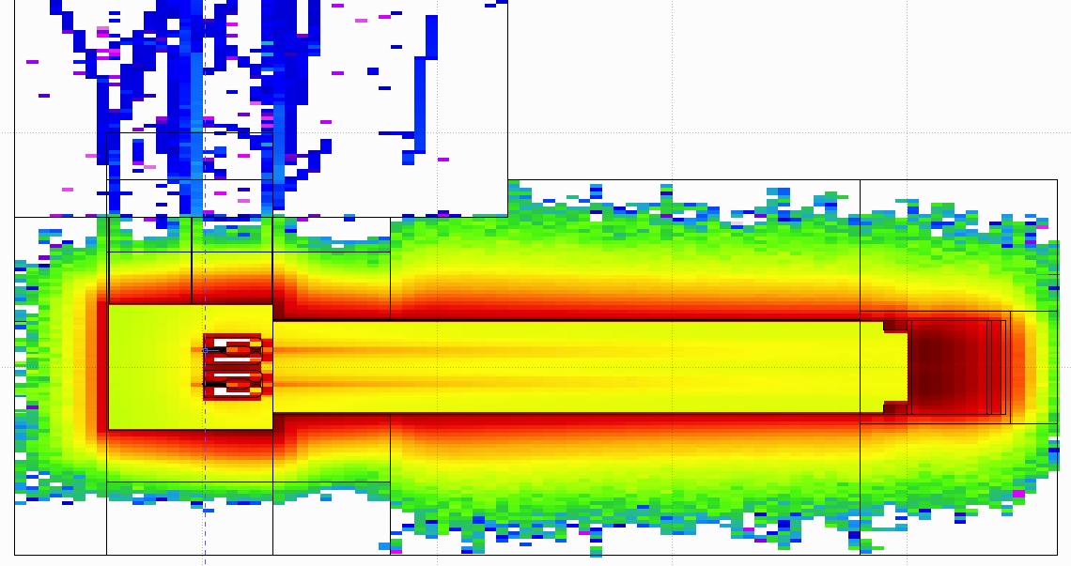
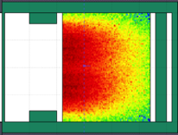
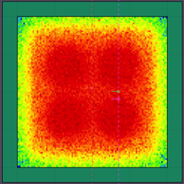
General Layout of the target station
Shield Blocks
Horn Support Module
8 m concrete
Split Proton Beam
Horns and Targets
Collimators
Decay Volume
(He, 4x4x25 m³)
Neutrino Beam Direction
Beam Dump

Slide 29
Latest Improvements
New Magriation Matrices for the far detector compared to those of MEMPHYS
Genetic Algorithm for Target Station optimisation
MEMPHYS WC detector
new far detector reconstruction algorithm
(publication is coming)
Phys. Rev. ST Accel. Beams 16, 061001 (2013)
DEMOKRITOS contribution
horn optimisation
~500 kt

Slide 30
Improvements
very preliminary
(to be confirmed)
very preliminary
(to be confirmed)
540 km
360 km
ESSnuSB
θ₁₂ = 33.44°
θ₁₃ = 8.57°
θ₂₃ = 49.2°
Δm²₂₁ = 7.42e-5
Δm²₃₁ = +2.517e-3
2nd osc. max.
507 ktons far detector
best version of NF
EUROnu
θ₁₂ = 33.2°
θ₁₃ = 9.2°
θ₂₃ = 45°
Δm²₂₁ = 7.64e-5
Δm²₃₁ = +2.45e-3
1st osc. max.
10 years
(publication in preparation)

Slide 31
Improvements (discovery potential)
very preliminary
540 km
360 km
75% after 10 years
discovery potential at the level of the Neutrino Factory!
EUROnu performance
10 years

Slide 32
Improvements
(precision measurements)
very preliminary
540 km
360 km
Precision measurements
ESSnuSB
10 years
EUROnu performance
Neutrino Factory

Slide 33
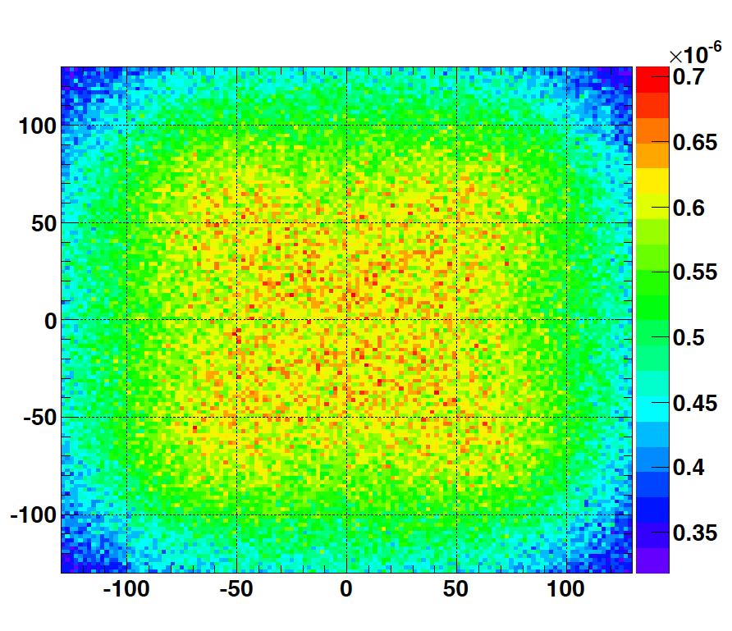
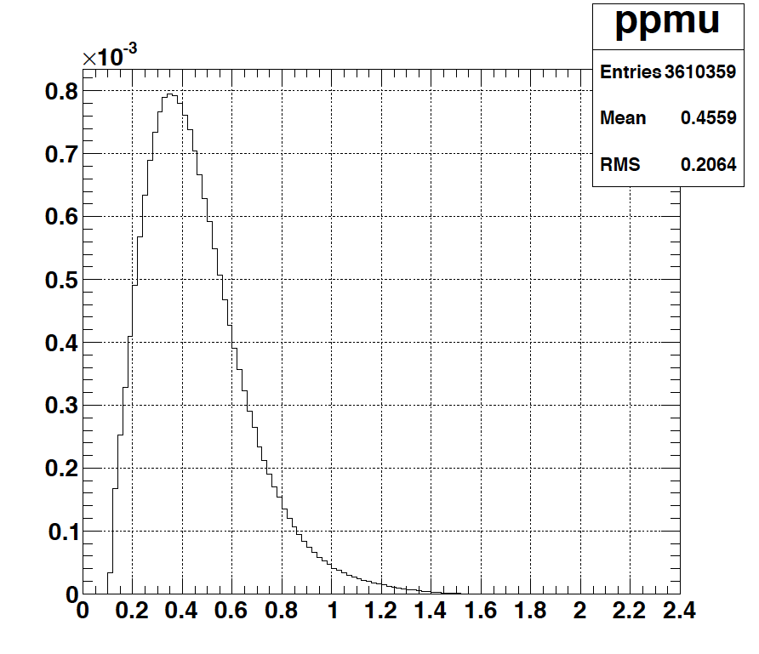
Muons at the level of the beam dump
2.7x10²³ p.o.t/year
y (cm)
muons at the level of the beam dump
(per proton)
more than 4x10²⁰ μ/year from ESS compared to 10¹⁴ μ used by all experiments up to now (10¹⁸ μ for COMET in the future).
4.2x10²⁰ μ/year
(16.3x10²⁰ for 4 m²)
x (cm)
10⁻³
4.1x10²⁰ μ/year
input beam for future 6D μ cooling experiments (for muon collider),
low energy nuSTORM,
Neutrino Factory,
Muon Collider.
muons/proton
<E_{μ}>~0.46 GeV
<L_{μ}>~2.9 km

Slide 34
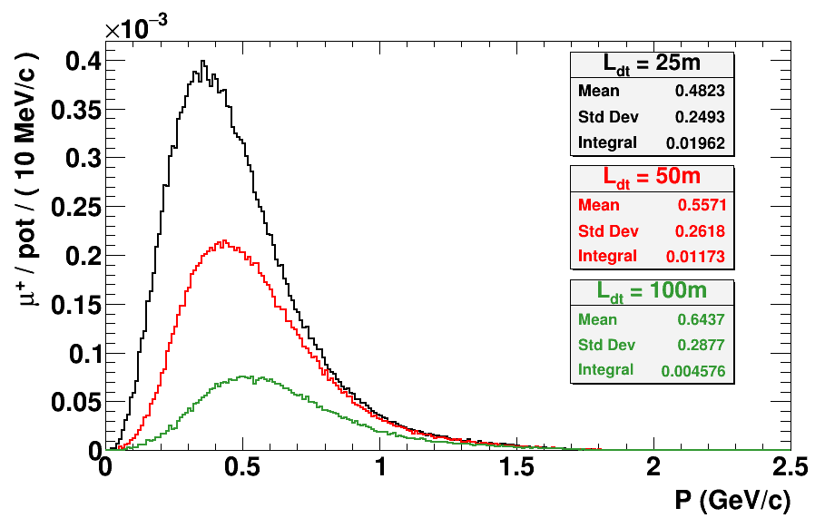
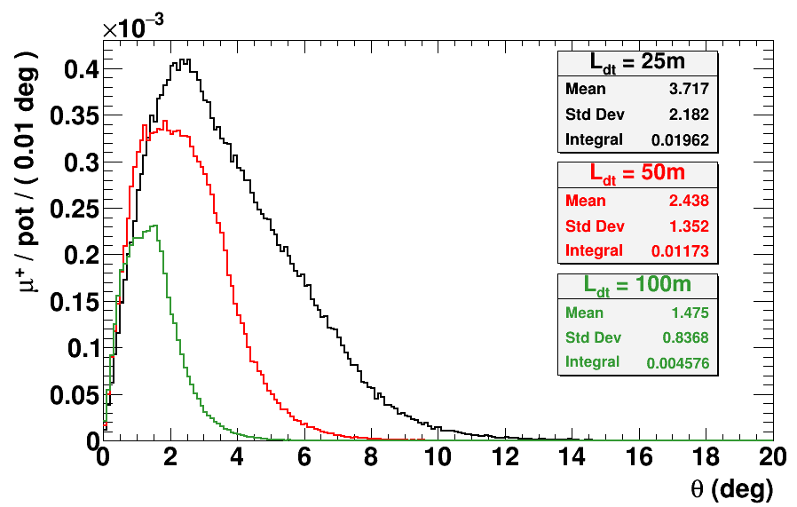

Muons at the level of the beam dump
<E_{μ}>~0.5 GeV
<L_{μ}>~3 km
$L_{dt}$ ($m$) | $N_{μ}$ ( ${μ^{+}}/{pot}$ ) | $N_{μ}$ ( ${μ^{+}}/s$ ) | $N_{μ}$ ( ${μ^{+}}/{200d}$) | $\left\langle P_{μ}\right\rangle$ ($GeV/c$)
$$25$$ | $$0.02$$ | $$2.5×{10}^{14}$$ | $$4.3×{10}^{21}$$ | $$0.48$$
$$50$$ | $$0.01$$ | $$1.2×{10}^{14}$$ | $$2.1×{10}^{21}$$ | $$0.56$$
$$100$$ | $$4.5×{10}^{−3}$$ | $$0.6×{10}^{14}$$ | $$1.0×{10}^{21}$$ | $$0.64$$
decay tunnel length

Slide 35
ESSνSB and (R&D) synergies
2.7x10²³ p.o.t/year
ν_{μ} + ‾ν_{e}
ν_{μ} or ‾ν_{μ}
ν_{e} + ‾ν_{μ}
Super Beam
nuSTORM
+Decay At Rest and Coherent scat.
(with short pulses)
Neutrino Factory
Muon Collider

Slide 36



Muon Collider as Higgs Factory
Carlo Rubbia
arXiv:1908.05664
HIFI Uppsala Workshop 2-3 March 2020

Slide 37

Muons at ESS (ESSμSB)

Slide 38

Muons at ESS (ESSμSB)

Slide 39

Muons at ESS (ESSμSB)

Slide 40
Low Energy nuSTORM at ESS
Sterile Neutrino searches
Neutrino cross sections measurements with unprecedented precision
LBL performance improvement by systematic error mitigation
To be adapted for lower muon energies (~0.5 GeV)
Proposed at FERMILAB and CERN (~3.8 GeV muons)
preliminar studies for ESS
sterile neutrino searches

Slide 41

Decay At Rest at ESS
Possible if short pulses (~μs)
π⁻
~99%
capture
ν_{e}
Well known neutrino spectra (DAR).
Very high neutrino intensities ~ 5x10¹⁵ ν/s.
Separate neutrinos of different flavors by time cut.
Role that neutrino-nucleus interactions play in the supernova explosion process and subsequent nucleosynthesis.
Accurate knowledge of neutrino-nucleus cross sections is important (almost no data exist).
This lack of knowledge significantly limits our understanding of supernovae and of terrestrial observations of cosmic neutrinos to probe the deepest layer of these powerful explosions.
p
A
μ⁺
τ ≈ 2.2 μs
DAR
e⁺
π⁺
τ ≈ 26 ns
ν_{μ}
Fragments
ν_{μ}

Slide 42

Coherent Scattering at ESS
SNS
sterile neutrinos,
neutrino magnetic moment,
non-standard interactions (NSI) mediated by new particles,
probes of nuclear structure,
improved constraints on the value of the weak nuclear charge,
reduction in neutrino detector mass may lead to a number of technological applications as non-intrusive nuclear reactor monitoring.
CEνNS is also expected to dominate neutrino transport in neutron stars, and during stellar collapse.
…

Slide 43


Coherent Scattering at ESS
JHEP 02 (2020) 123
ESS can generate the largest pulsed neutrino flux suitable for the detection of Coherent Elastic Neutrino-Nucleus Scattering (CEνNS ).
Innovative detector technologies able to profit from the order-of-magnitude increase in neutrino flux provided by the ESS, along with their sensitivity to a rich particle physics phenomenology accessible through high-statistics, precision CEνNS measurements, are under study.

Slide 44


Current ESSνSB status
COST Action EuroNuNet (CA15139): ended March 2020
  https://euronunet.in2p3.fr
  video for scientists: https://www.youtube.com/watch?v=PwzNzLQh-Dw
EU-H2020 Design Study ESSνSB: on going up to March 2021 (3 months extension due to COVID19)
  https://essnusb.eu
  video for general public: https://www.youtube.com/watch?v=qAnvft0nAlg

Slide 45
Design Study ESSνSB
(2018-2021)
15 participating organisations within 11 countries
Starting date: 01/01/2018
Ending date: 31/12/2021 → 31/03/2022
Duration: 48 Months
Grant Agreement signature: 22/11/2017
Estimated cost: 4,671,583.68€
Requested EU contribution: 2,999,018.00€
Kick-off meeting: 15 January 2018, Lund (ESS)
90% of the budget already received
3 months extension due to COVID19 have been requested and obtained
All deliverables ready on time
All milestones achieved on time
CDR end of 2021

Slide 46



Possible ESSνSB schedule
(2nd generation neutrino Super Beam)
2021: End of ESSνSB Design Study, CDR and preliminary costing
2012: inception of the project
2016-2019: beginning of COST Action EuroNuNet
2018: beginning of ESSνSB Design Study (EU-H2020)
2022-2024: Preparatory Phase, TDR
2025-2026: Preconstruction Phase, International Agreement
2027-2034: Construction of the facility and detectors, including commissioning
2035-: Data taking
Nucl. Phys. B 885 (2014) 127

Slide 47
Near future possibilities for continuation
  Destination 1: INFRADEV-01 : Developing, consolidating and optimizing European RIs landscape by reinforcing RI capacities in Europe. Here we need to make the application to the Horizon Europe Destination #1 significantly different from our previous Horizon 2020 Design Study application, and include implementation studies of ESSνSB on the ESS and Garpenberg sites and a HIFI conceptual study, primarily for low energy nuSTORM and a muon-cooling test-bed for a Neutrino Factory and possibly Muon Collider.
    Deadline: 24 March 2022
    Preparation of the application will start soon
  ERC-Synergy (extensive R&D is allowed): A group of two to maximum four Principal Investigators (PIs) – of which one will be designated as the corresponding PI (cPI) – working together and bringing different skills and resources to tackle ambitious research problems. No Synergy Grant call announced before summer 2021 but foreseen afterwards. Here the first step will have to be to designate at least two PIs. A prerequisite for an ERC Synergy grant is that the PIs have an outstanding track record in scientific research.
    Deadlines not yet clear

Slide 48
Possible scenario for new near future applications
Possible WPs:
Civil engineering (onsite and offsite) abd safety.
Linac accumulator and race-track.
Target Station, hadron/muon production and muon extraction.
Low Energy nuSTORM.
Detectors and physics performance (synergy between ESSnuSB and LEnuSTORM).
Muons for future. applications, including 6D cooling tests (several locations are possible).

Slide 49

Conclusion
The ESS proton linac will be soon the most powerful linac in the world.
ESS can also become a neutrino facility (ESSνSB ) with enough protons to go to the 2nd oscillation maximum and increase significantly the CPV sensitivity and precise measurement of δ_{CP}.
Large associated detectors have a rich astroparticle physics program.
The European Spallation Source will be ready by 2025, upgrade decisions by this moment.
Rich muon program for future ESS upgrades
  Low energy nuSTORM
  Muon Collider R&D
Excellent conditions for DAR and Coherent Scattering experiments
New applications under preparation

Slide 50
Backup

Slide 51


EuroNuNet
COST application for networking: CA15139 (2016-2020)
  EuroNuNet : Combining forces for a novel European facility for neutrino-antineutrino symmetry violation discovery (http://www.cost.eu/COST_Actions/ca/CA15139)
The members are countries which signed the Action MoU
  Major goals of EuroNuNet:
    to aggregate the community of neutrino physics in Europe to study a neutrino long baseline concept in a spirit of inclusiveness,
    to impact the priority list of High Energy Physics policy makers and of funding agencies to this new approach to the experimental discovery of leptonic CP violation.
  13 participating countries
http://euronunet.in2p3.fr/

Slide 52
ESSνSB at the European level
A H2020 EU Design Study (Call INFRADEV-01-2017)
Title of Proposal: Discovery and measurement of leptonic CP violation using an intensive neutrino Super Beam generated with the exceptionally powerful ESS linear accelerator
Duration: 4 years
Total cost: 4.7 M€
Requested budget: 3 M€
15 participating institutes from
11 European countries including CERN and ESS
6 Work Packages
Approved end of August 2017
ESSνSB
BENE (2004-2008)
ISS (2005-2007)
EUROν (2008-2012)
LAGUNA (2008-2010)
LAGUNA-LBNO (2010-2014)
COST Action CA15139 (2015-2019)

Slide 53
How the CPV coverage and resolution curves have been produced
T2HK:
  Same curves that Hyper-K has showed at the Neutrino Town Meeting at CERN and the one that was showed at Neutrino 2018.
  Systematics are said by T2HK to be between 3% to 4%.
  sin² 2θ₁₃ =0.1 and θ₂₃= π /2.
DUNE:
  Public globes file released by the DUNE collaboration with the CDR, the only change is to increase the number of years from 7 to 10.
  sin²2θ₁₃ =0.1 and θ₂₃=π/2, to be compatible with the T2HK line.
ESSnuSB:
  Instead of considering as usual “Opt. Snowmass errors" it is only assumed an overall 3% systematic error in the different signal and background channels, more in line with T2HK assumptions.
  sin²2θ₁₃ =0.1 and θ₂₃= π /2, to be compatible with the T2HK line.

Slide 54

Beyond DUNE, JUNO, HyperK:
ESSνSB, P2O and Neutrino factory
European Neutrino "Town" meeting and ESPP 2019 discussion, CERN, 24.10.2018
Roumen Tsenov
Department of Atomic Physics, University of Sofia

Slide 55

Systematic errors
Phys. Rev. D 87 (2013) 3, 033004 [arXiv:1209.5973 [hep-ph]]

Slide 56


CPV performance comparison between ESSnuSB, DUNE and Hyper-K
assuming 3% systematic errors for ESSnuSB in line with the other two.
ESSνSB 500 kt tank at 540 km.
ESSνSB 500 kt tank at 360 km.
(degrees)
ESSνSB 250 kt tank at 540 km
and 250 kt tank at 360 km.

Slide 57
Fraction of δ_{CP}
Garpenberg
(540 km)
(E. Martinez-Fernandez)
Zinkgruvan
(360 km)
Lund
2 active mines aligned…
My personal opinion:
these scenarios are too optimistic for all facilities

Slide 58
Comparisons
Comparison using the same systematic errors
Phys. Rev. D 87 (2013) 3, 033004 [arXiv:1209.5973 [hep-ph]]

Slide 59








The ESS neutron facility
rotating tungsten target

Slide 60

Possible locations for far detector
ESS
Kongsberg
Løkken
CERN
LAGUNA sites

Slide 61
nuSTORM
sterile neutrino searches
Proposed at FERMILAB and CERN (~3.8 GeV muons)

