Slide 1



The ESS based neutrino Super Beam Experiment (ESS𝜈SB)
Tamer Tolba (on behalf of the ESSnuSB collaboration)
Institut für Experimentalphysik, Universität Hamburg
30th International Symposium on Lepton Photon Interactions at High Energies
Manchester, UK, 10 – 14 Jan. 2022

Slide 2
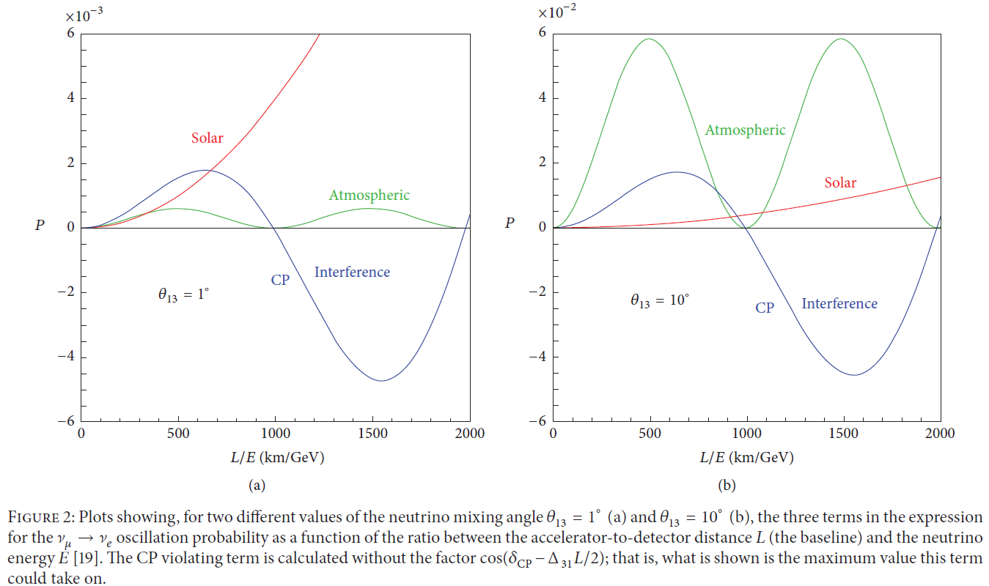
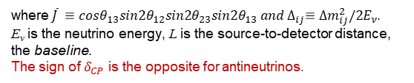

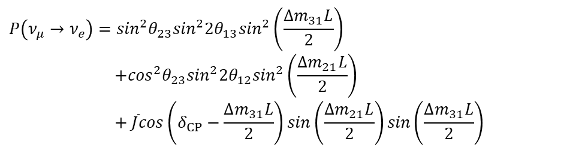
Neutrino oscillations (Leptonic CP-Violation)
$ν_{μ}→ν_{e}$ oscillation probability:
$$P\left(ν_{μ}→ν_{e}\right)=\sin^{2}θ_{23}\sin^{2}{2θ}_{13}\sin^{2}\left(\frac{{∆m}_{31}L}{2}\right)$$
$$+\cos^{2}θ_{23}\sin^{2}{2θ}_{12}\sin^{2}\left(\frac{{∆m}_{21}L}{2}\right)$$
$$+ \overline{J}cos\left(δ_{CP}−\frac{{∆m}_{31}L}{2}\right)sin\left(\frac{{∆m}_{21}L}{2}\right)sin\left(\frac{{∆m}_{31}L}{2}\right)$$
where$\overline{J} ≡cosθ_{13}sin{2θ}_{12}sin2θ_{23}sin{2θ}_{13} and ∆_{ij}≡{∆m_{ij}^{2}/2E}_{ν}$.
E_{ν} is the neutrino energy, L is the source-to-detector distance, the baseline.
The sign of $δ_{CP}$ is the opposite for antineutrinos.
θ₁₃ plays a significant role in evaluating the performance when planning “future” long baseline neutrino experiments
Important for CPV in leptonic sector
@ 1st oscillation max.
@ 1st oscillation max.
CP-interference dominates
Atm. term dominates
@ 2nd oscillation max.
@ 2nd oscillation max.
Solar term dominates
for small θ₁₃
for large θ₁₃
CP-interference dominates
arXiv:1110.4583v2 (2012)

Slide 3
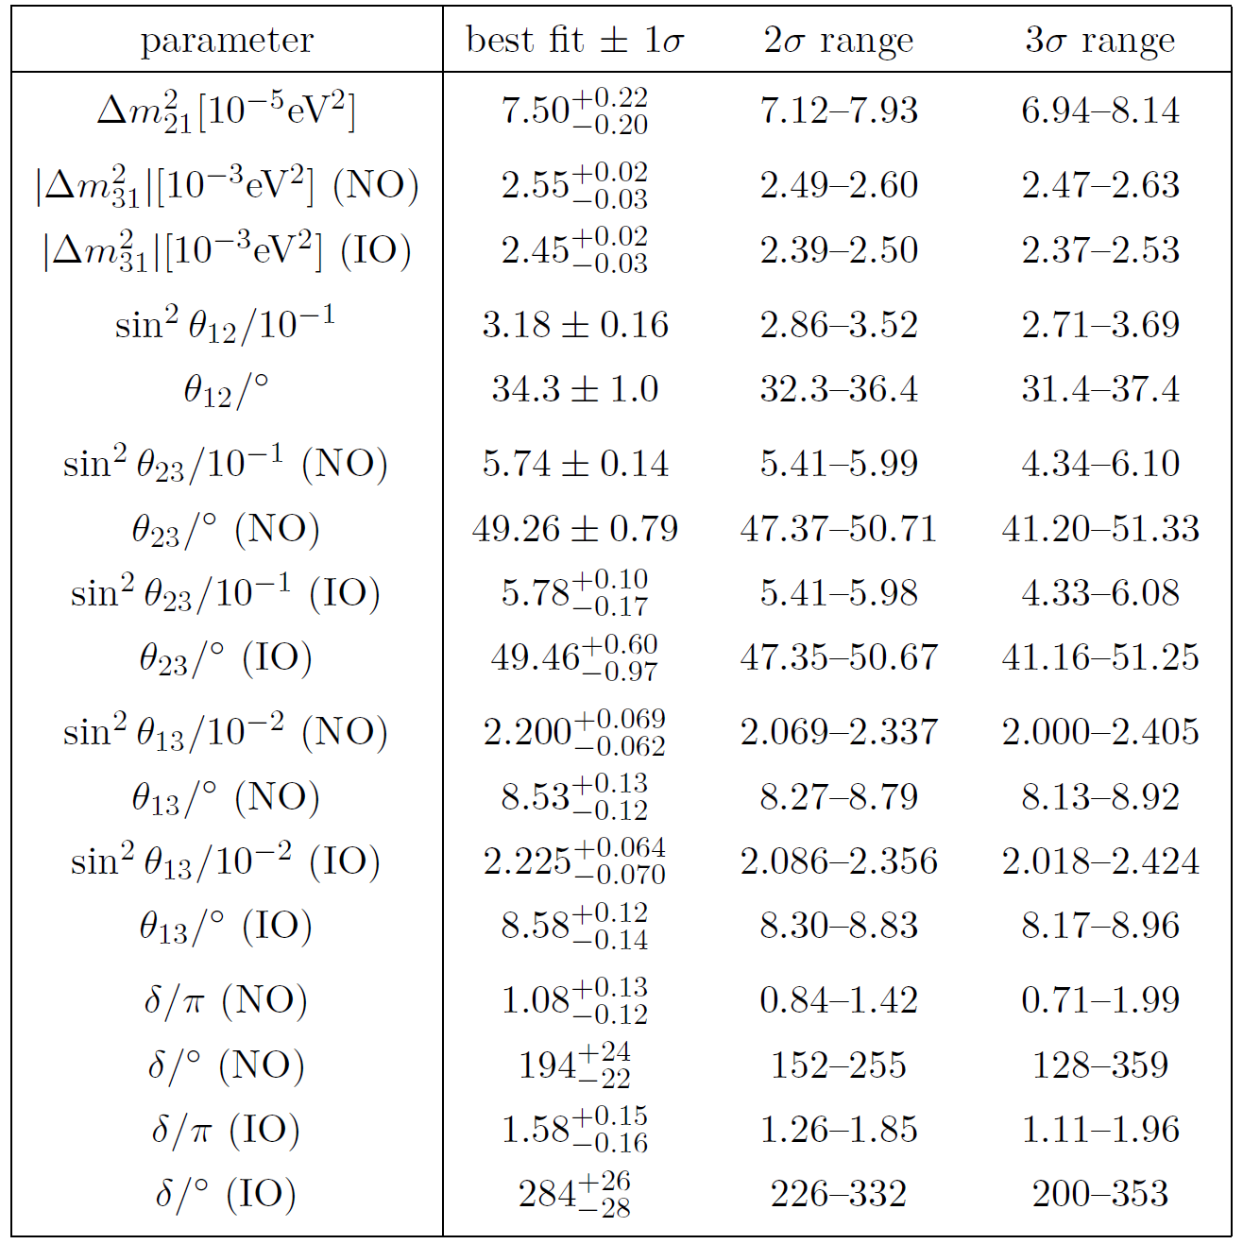
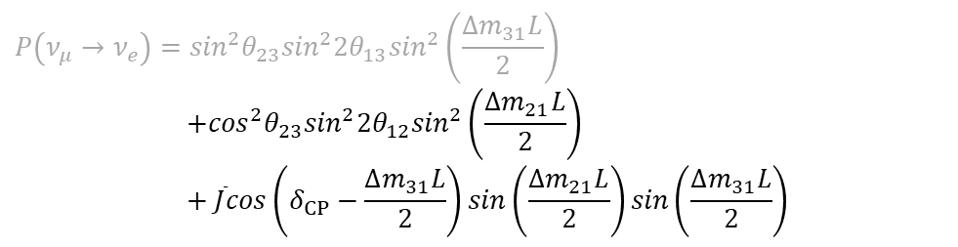
Neutrino oscillations (Leptonic CP-Violation)
$$P\left(ν_{μ}→ν_{e}\right)=\sin^{2}θ_{23}\sin^{2}{2θ}_{13}\sin^{2}\left(\frac{{∆m}_{31}L}{2}\right)$$
$$+\cos^{2}θ_{23}\sin^{2}{2θ}_{12}\sin^{2}\left(\frac{{∆m}_{21}L}{2}\right)$$
$$+ \overline{J}cos\left(δ_{CP}−\frac{{∆m}_{31}L}{2}\right)sin\left(\frac{{∆m}_{21}L}{2}\right)sin\left(\frac{{∆m}_{31}L}{2}\right)$$
P.F. de Salas et al., 2020 global reassessment of the neutrino oscillation Picture, JHEP 02 (2021) 071
θ₁₃ found to be at higher values
CPV is best studied at 2nd
Oscillation maximum
@ 1st oscillation max.
@ 1st oscillation max.
CP-interference dominates
Atm. term dominates
@ 2nd oscillation max.
@ 2nd oscillation max.
Solar term dominates
for small θ₁₃
for large θ₁₃
CP-interference dominates
arXiv:1110.4583v2 (2012)

Slide 4
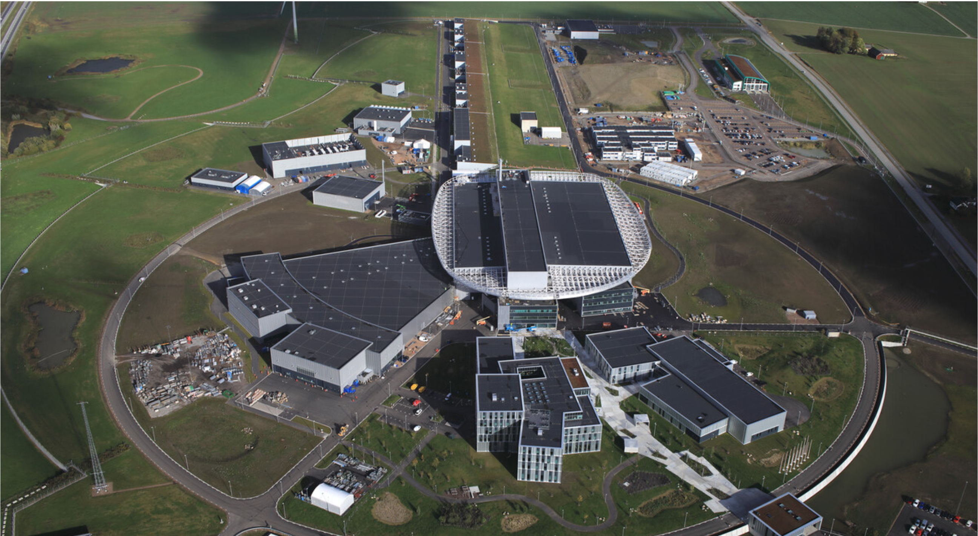

The European Spallation Source (ESS)
Front End
Building
Oct. 2021
Linac and
Klystron Gallery
Cryo Compressor
Building
Central Utility
Building
602.5 m
Distribution
Substation
Target
Monolith
Exp. Hall
E01
The ESS facility is under construction in Lund, Sweden
The most powerful proton linear accelerator ever built, with beam kinetic energy of 2 GeV and power of 5 MW.
The world’s most powerful neutron source (~ 40x10¹⁵ n·cm⁻²·s⁻¹).
Tungsten rotating-target-wheel of 2.5 m diameter/4.9 tonne.
An aerial short of the ESS construction site. Credit: SKANSKA

Slide 5

ESSνSB at the European level
A H2020 EU Design Study (Call INFRADEV-01-2017)
Title of Proposal: Discovery and measurement of leptonic CP violation using an intensive neutrino
Super Beam generated with the exceptionally powerful ESS linear accelerator
Duration: 4 years
Total cost: 4.7 M€
Requested budget: 3 M€
15 participating institutes from
11 European countries including CERN and ESS
6 Work Packages
Approved end of August 2017
ESSνSB
BENE (2004-2008)
ISS (2005-2007)
EUROν (2008-2012)
LAGUNA (2008-2010)
LAGUNA-LBNO (2010-2014)
COST Action CA15139 (2015-2019)

Slide 6
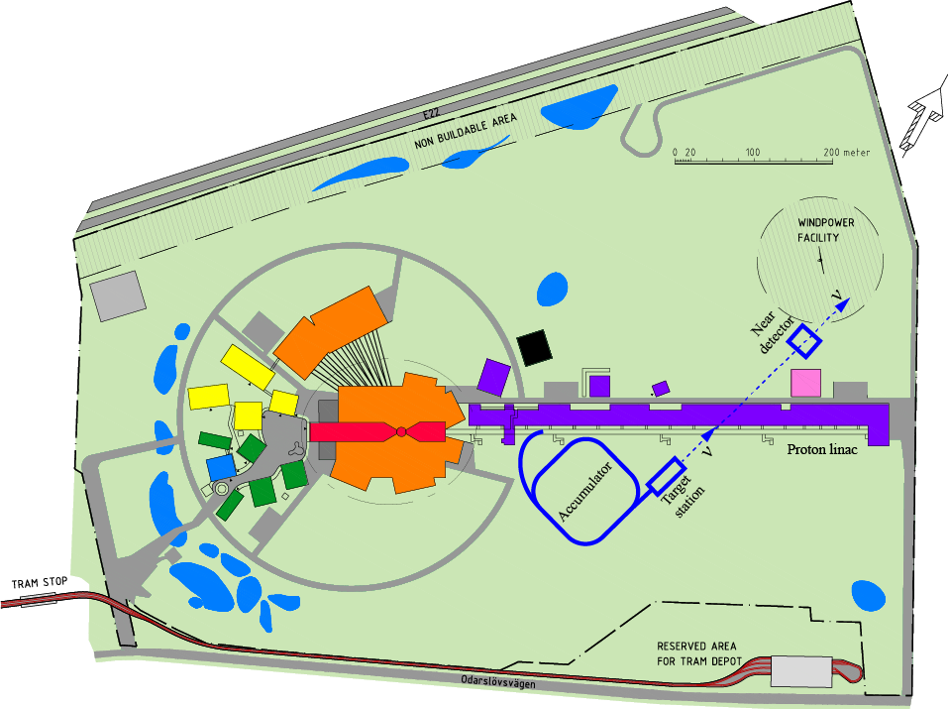
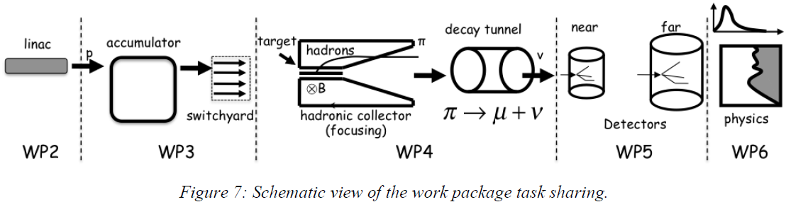
The European Spallation Source neutrino Super Beam (ESSνSB)
To Far Detector
located at second
ν oscillation max.
It will benefit from the powerful proton beam of the ESS LINAC to produce intense neutrino beam.
Aims at searching and measuring, with precision, for CP-violation in the leptonic sector, at 5σ significance level in more than 70% of the leptonic Dirac CP violating phase range,
The neutrino source-to-detector distance, the baseline, is set at the second oscillation maximum.
Linac
Upgrade
Accumulator
Target Station
Detector
Performance
Physics
Reach
A schematic overview of the main work packages (WP) within the ESSνSB project
April 2019
April 2019

Slide 7
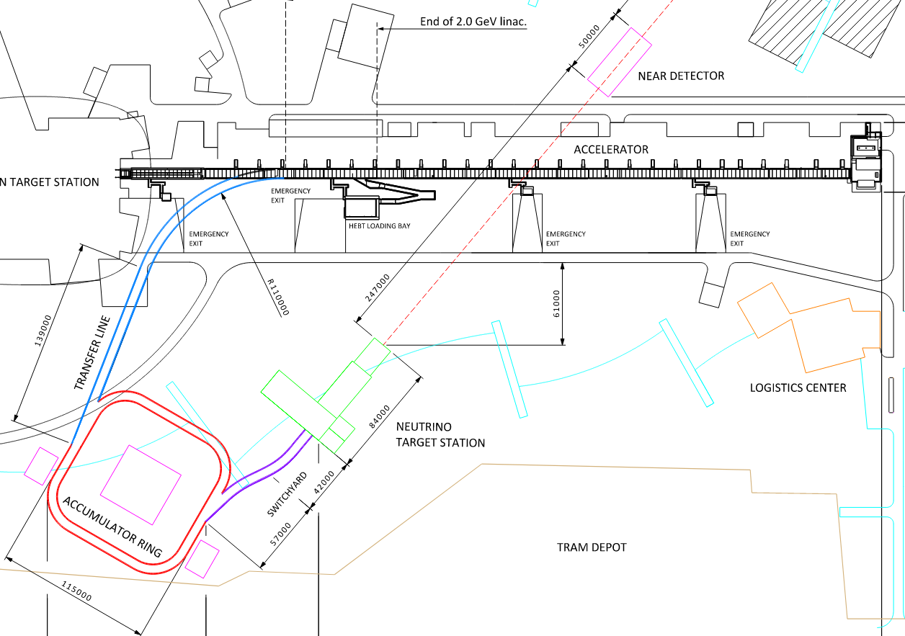
Adding a neutrino facility on ESS

Slide 8
Adding a neutrino facility on ESS
Upgrade of the accelerator
14 Hz to 28 Hz
use H⁻ instead of protons in ESSNuSB cycles
increase energy to 2.5 GeV kinetic

Slide 9
Adding a neutrino facility on ESS
Upgrade of the accelerator
14 Hz to 28 Hz
use H⁻ instead of protons in ESSNuSB cycles
increase energy to 2.5 GeV kinetic
Build an accumulator ring
shorten ESS pulses from 2.86 ms to ≈ 1 μs

Slide 10
Adding a neutrino facility on ESS
Upgrade of the accelerator
14 Hz to 28 Hz
use H⁻ instead of protons in ESSNuSB cycles
increase energy to 2.5 GeV kinetic
Build an accumulator ring
shorten ESS pulses from 2.86 ms to ≈ 1 μs
Build a neutrino target station
4 identical targets and horns
need switchyard

Slide 11
Adding a neutrino facility on ESS
Upgrade of the accelerator
14 Hz to 28 Hz
use H⁻ instead of protons in ESSNuSB cycles
increase energy to 2.5 GeV kinetic
Build an accumulator ring
shorten ESS pulses from 2.86 ms to ≈ 1 μs
Build a near detector site
water Cherenkov detector
fine grained scintillator
emulsion detector
Build a neutrino target station
4 identical targets and horns
need switchyard

Slide 12
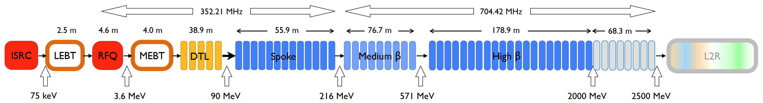
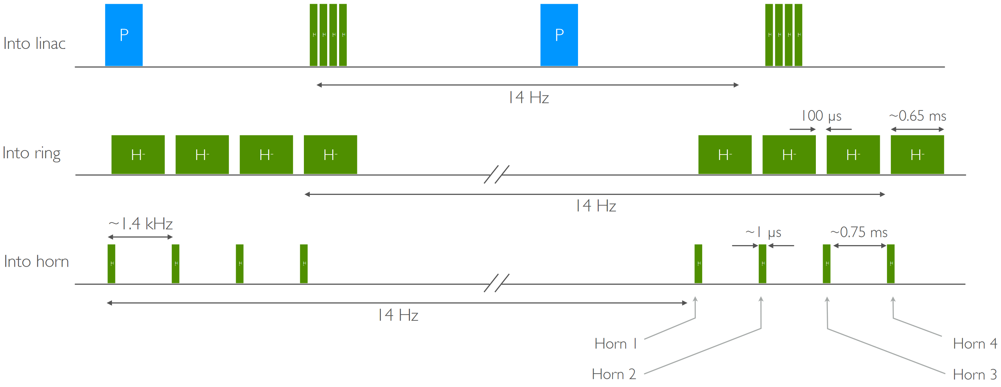
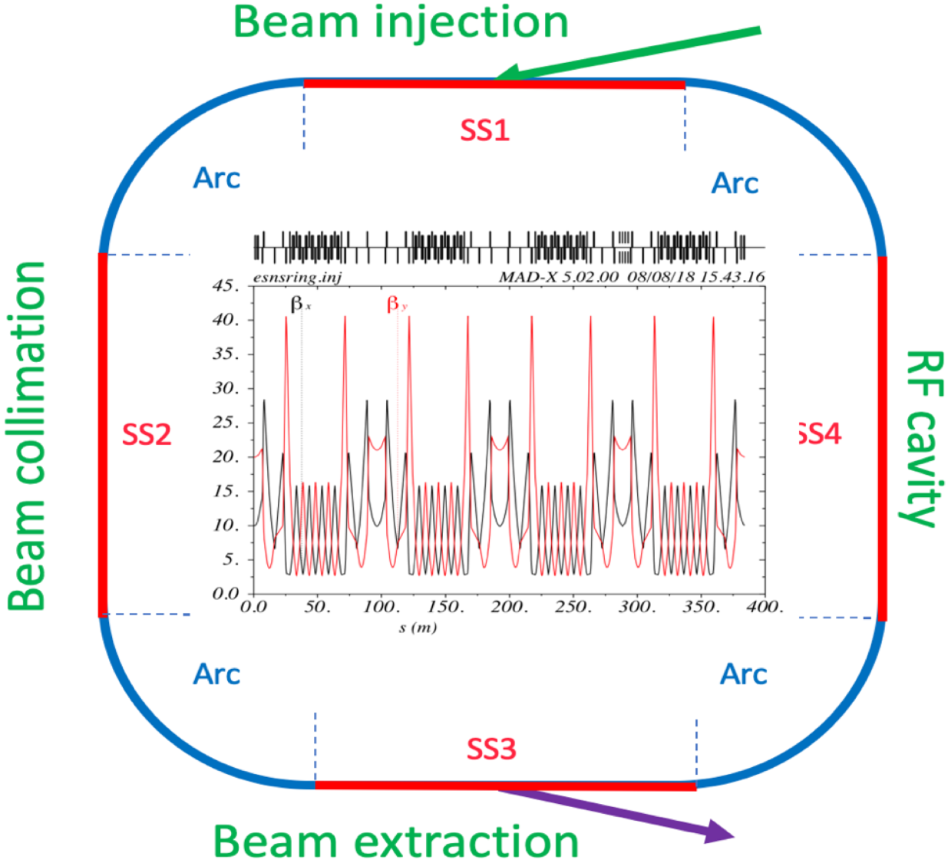
ESS Proton Linac upgrade and the accumulator ring
Pulsing scheme
ESSνSB proposes to increase the ESS LINAC power from 5 MW to 10 MW.
The dedicated proton beam will be shortened to 1.3 μs:
With the help of the accumulator ring.
Will be split in four (batches) already in the LINAC.
Each batch is accumulated and then extracted before the next batch enters the ring.
Each batch hits a different target thanks to the switching in the switchyard.
To avoid excessive injection losses, H⁻ ions are injected into the LINAC and stripped by a foil before entering the accumulator.
Ring-to-switchyard, L2R, transfer-line extract the proton pulses from the ring to the beam switchyard and distribute the resulting four beam batches over four targets.
Accumulator
Ring
● Accumulation and storage, no acceleration.
● 384 m circumference, 1.33 μs revolution period

Slide 13
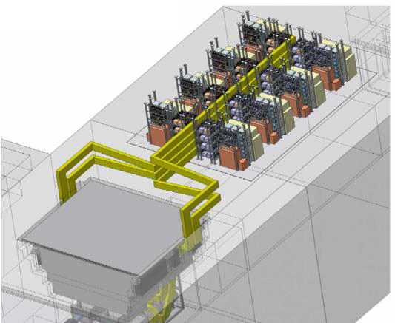
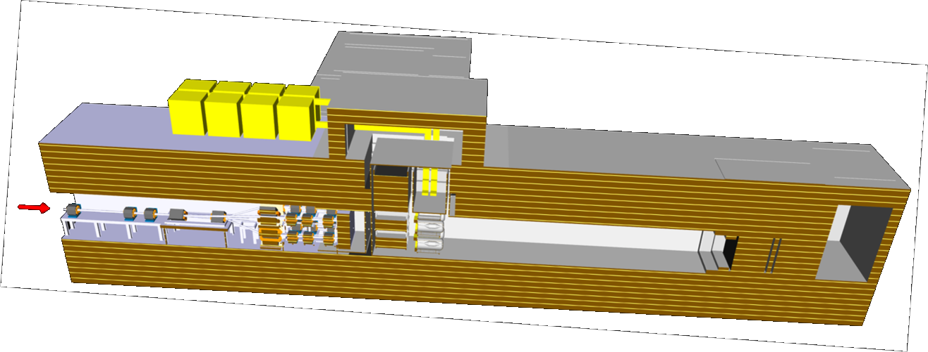
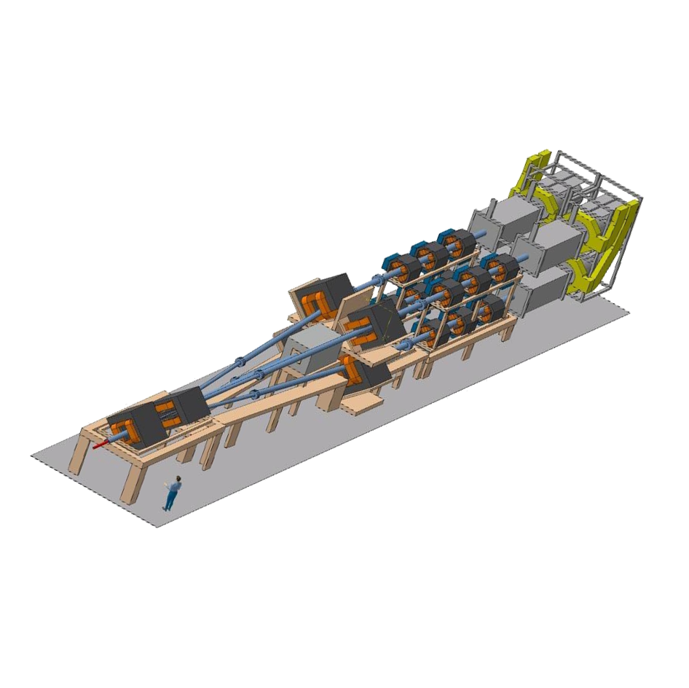
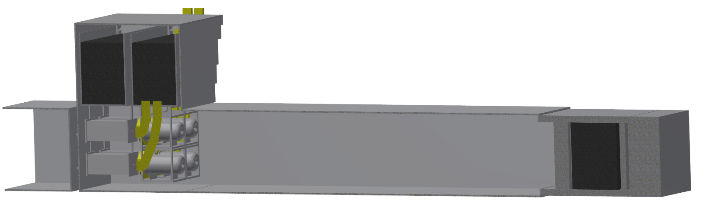
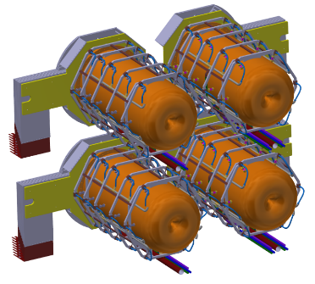
Layout of the Target Station Facility
Power Supply
8 m of concrete shielding
Beam
concrete
shield
Not Target-station
Accumulator ring
Switch yard system
Target-station
beam dump
P_{beam}
decay tunnel
4-horn system

Slide 14
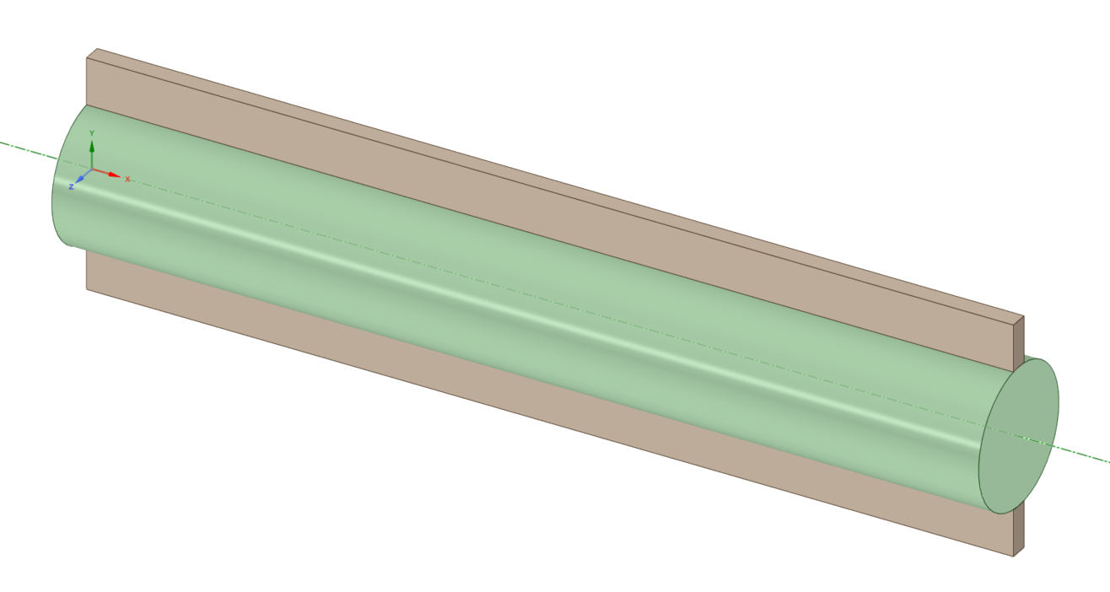
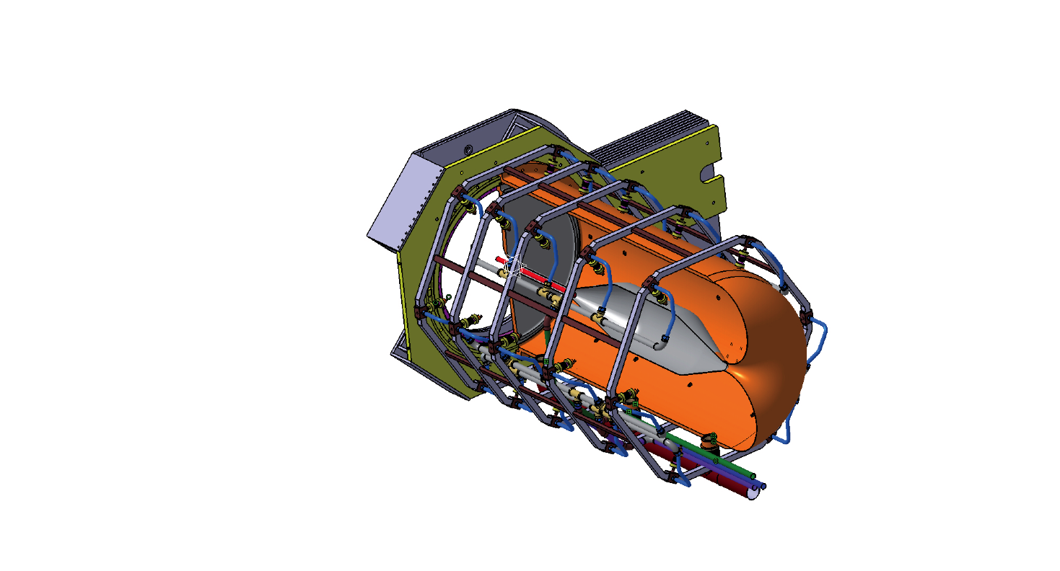
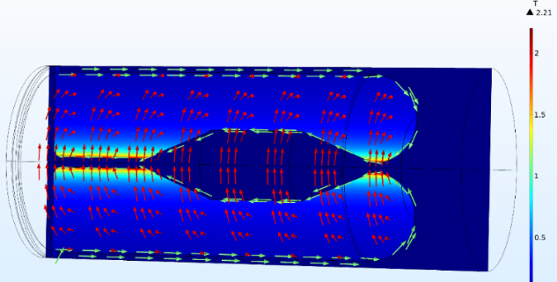

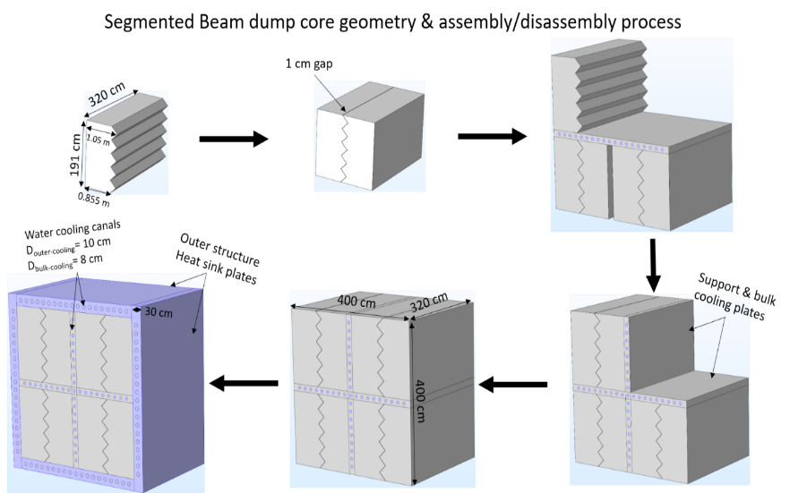
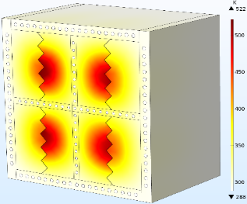

Target Station
2.21 T
4Horn focusing system
Four separated horns, target canister in the horn middle.
Aluminum conductor with outer (10 mm)/inner (3 mm) thickness and water cooled.
Horn current 350 kA/14 Hz/100 µs-pulse.
Toroidal $\vec{B}$ field inside the cavity, with max. B-value of 2.21 T.
Current polarity depends on the π± focusing operation mode.
Has a very low inductance of 0.9 μH and a low resistance value of 0.235 mΩ.
Packed-bed target
Four solid packed-bed, 1.5 mm radius Ti spheres, contained in a 15 mm-radius, 780 mm-long canister.
1.25 MW @ of 14 Hz ESS proton beam on target.
Cooled based on longitudinal He flow in the bulk of the canister
Disadvantage: drastic reduction in cooling the spheres at the canister back.
New multi-entries transverse cooling system is under study
Advantage: homogenous cooling of the spheres in the canister bulk.
Beam dump (Segmented-blocks core)
Protects the site behind the decay tunnel from radio-activation.
Different graphite core designs, with outer layout 4 x 4 x 3.2 m³.
Interior view of one horn (left). $\vec{B}$,$\left|\vec{B}\right|$ and current direction in the horn (right).
Cooling by transverse flow – Temperature
Target canister with cooling bars.
Cooling by transverse flow – superficial velocity
522 K

Slide 15
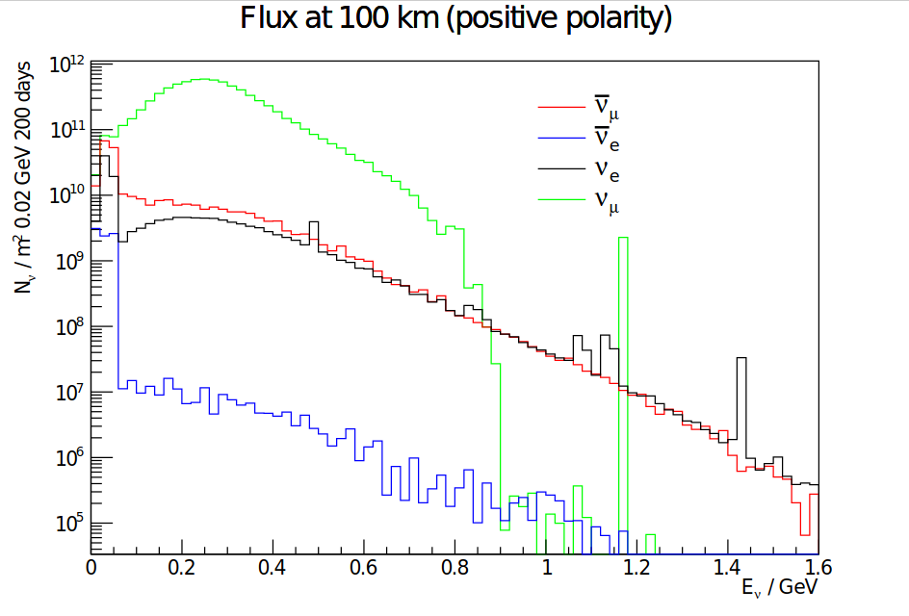
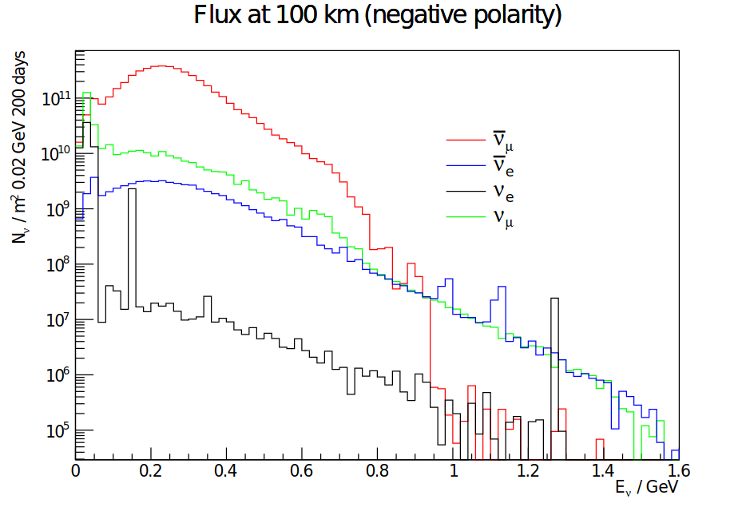
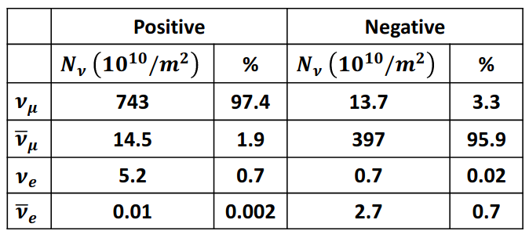
ESSνSB neutrino energy distribution
(after optimisation)
at 100 km from the target per year
(in absence of oscillations)
Almost pure ν_{μ} beam
Small ν_{e} contamination which could be used to measure ν_{e} cross-sections in a near detector

Slide 16
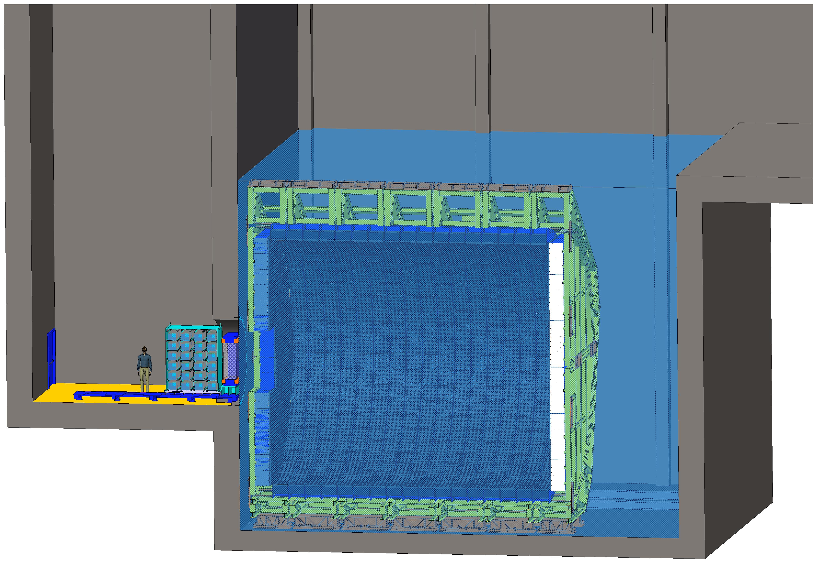
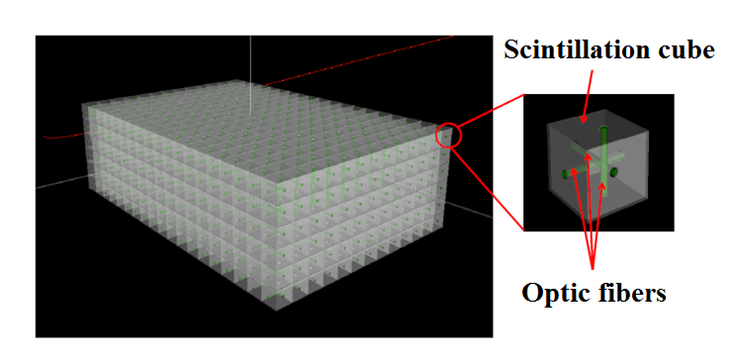
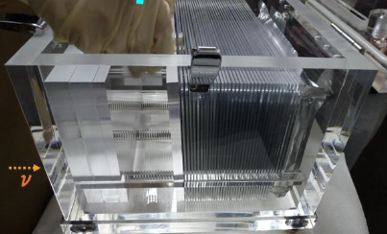
Near Detector
The Near Detector is based on:
Baseline ~ 250 m
A 0.5 kt “fiducial volume” Water Cherenkov detector, for event rate measurements, flux normalization and event reconstruction
A 1t Super Fine-grained (SFGD) Scintillator Tracker inside a magnetic field for cross-section measurements
Water-Emulsion neutrino detector for flux and cross sections measurements.
NINJA-like water-emulsion detector (1 t)
Super-FGD like detector
(1t)
ν Beam
Water Cherenkov
(0.5 kt “fiducial”
0.8 kt “total”)

Slide 17
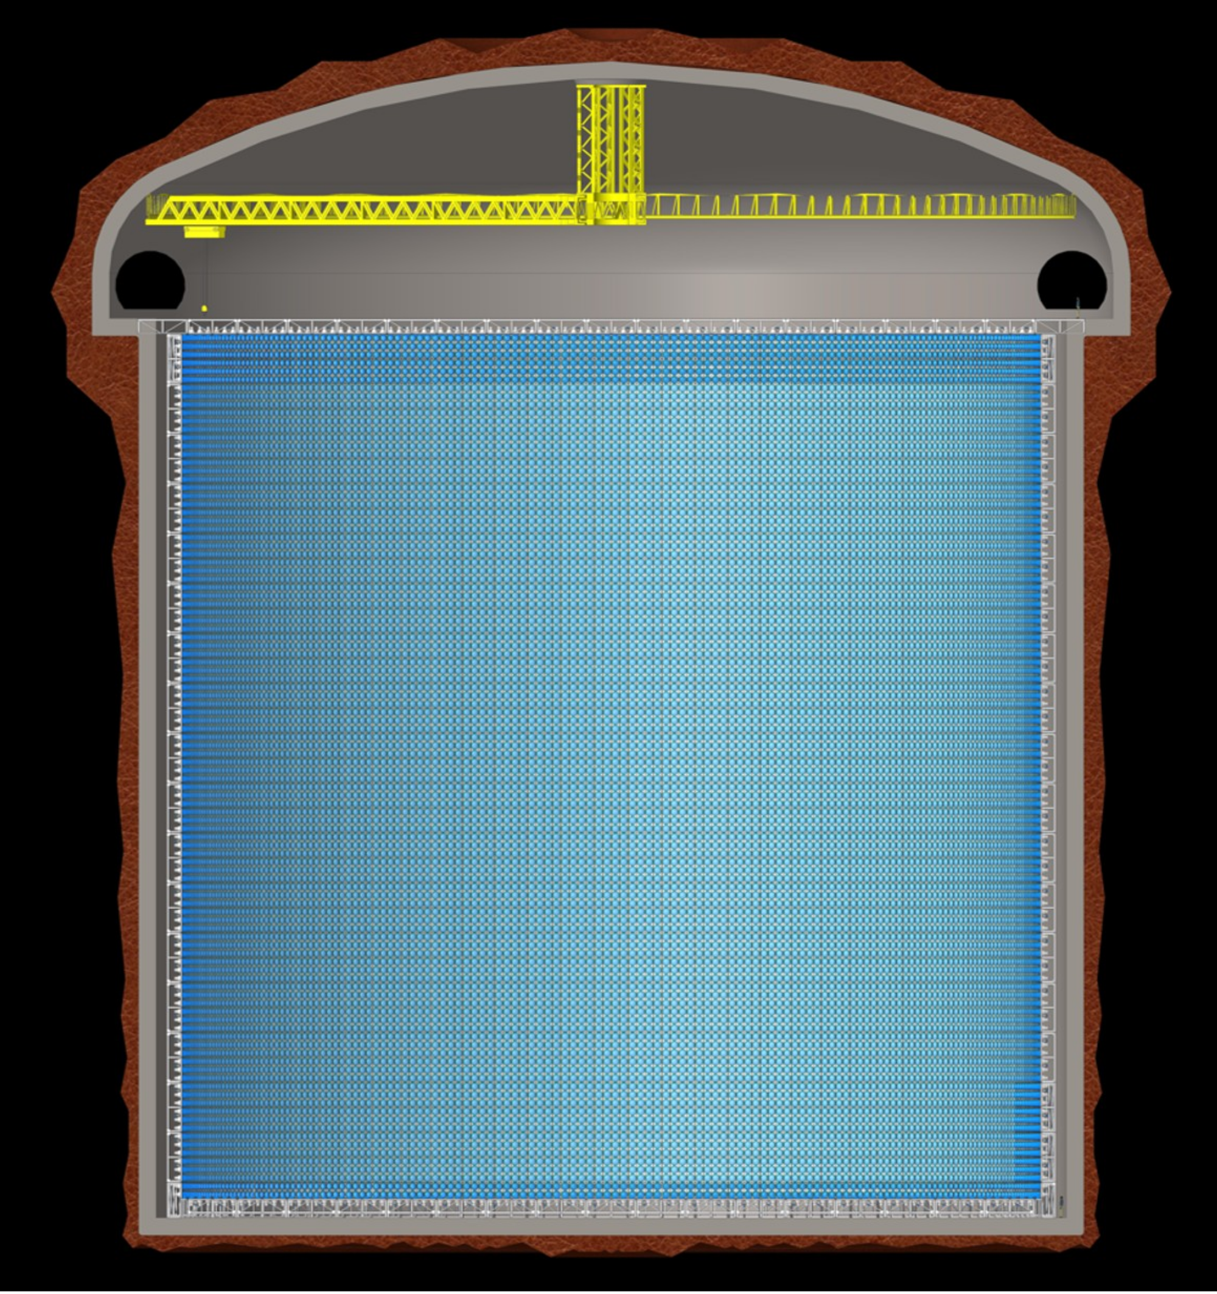
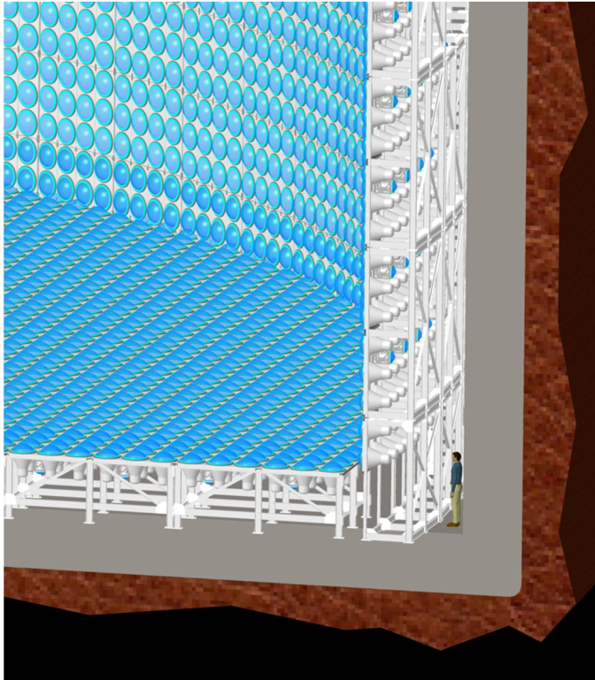
Far detector
(Design)
Memphis-like Water Cherenkov detector
2 x 270 kt fiducial volume (~20xSuperK)
Readout: 2 x 38k 20” PMTs
➔ 40% optical coverage
Can also be used for :
Proton decay, astroparticles,
Galactic SN, Supernovae "relics”,
Solar Neutrinos and Atmospheric Neutrinos

Slide 18
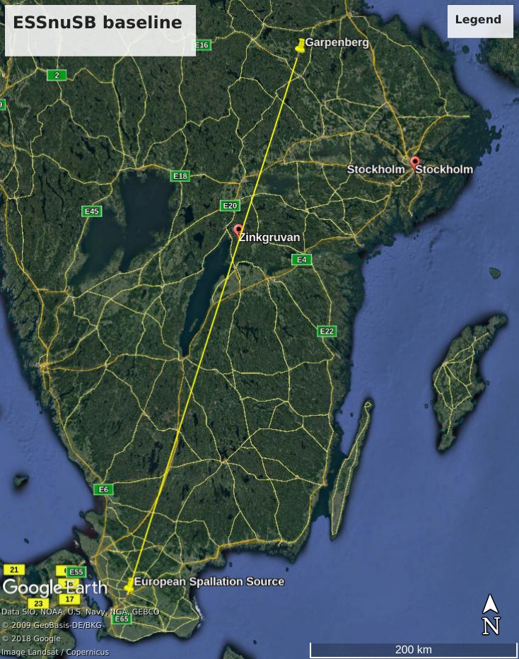
Far Detector
(location)
Most probable baseline:
Zinkgruvan mine, 340 km from the source
➔ covernig 1st and 2nd maximum
Alternative:
Garpenberg mine, 540 km from the neutrino source
➔ covering 2nd oscillation maximum.

Slide 19
Updated physics performance
Updated horn design [1,2]
A Genetic Algorithm optimization study has been carried out using FLUKA for different
horn and decay tunnel geometries
Resulted in bigger horn (1.5x) and longer decay tunnel (25 m to 50 m)
➔ Obtained higher statistics in the neutrino, hence better performance of the experiment
➔ On-going studies to verify the feasibility of the new horn in terms of thermomechanical stresses.
Distance from neutrino source (baseline)
  ➔ 540 km (Garpenberg) and 360 km (Zinkgruvan)
Experiment run time
  ➔ 5 years neutrino mode and 5 years anti-neutrino mode
Assumed systematic error
  ➔ 5% on signal normalization and 10% on background normalization
[1] L. D’Alessi et al. [ESSvSB], "Optimization of the Target Station for the ESSnSB Project Using the Genetic Algorithm", NeuTel Conference 2021.
[2] L. D’Alessi et al. [ESSvSB], “Neutrino Beam Optimization for the ESSnSB Experiment”, International Research Network - Neutrino 2021

Slide 20
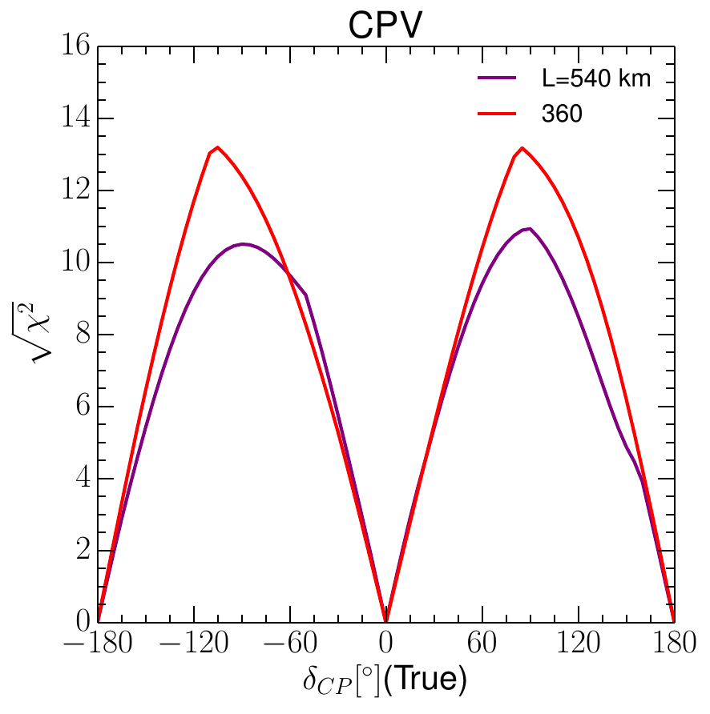
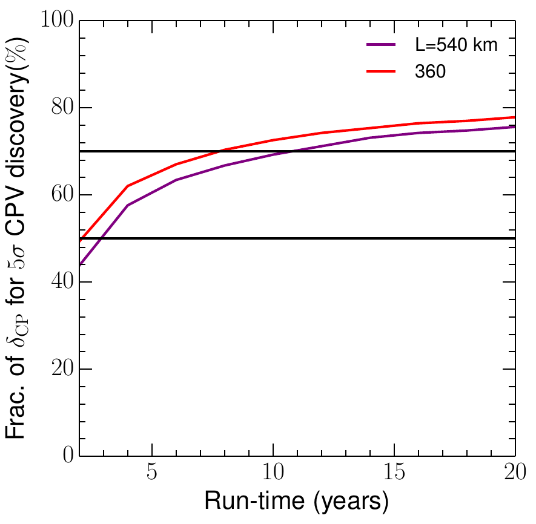
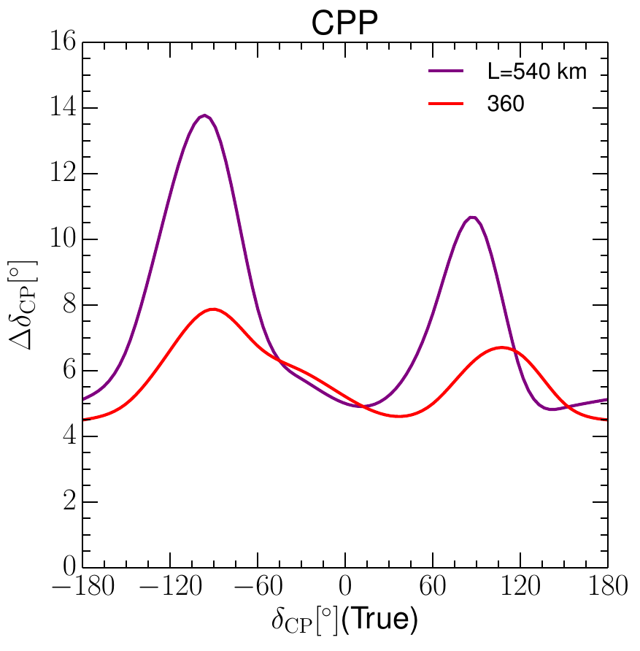
Updated physics performance
(Sensitivity and Precision)
70%
50%
Sensitivity for δ_{CP} = ± π/2:
11 σ (540 km)
13 σ (360 km)
70% δ_{CP} coverage @ 5 σ:
11 years (540 km)
8 years (360 km)
High precision of δ_{CP} measurement
A. Alekou et al., “Updated physics performance of the ESSnuSB experiment” Eu. Phys. J. C 81, (2021) 1130

Slide 21
ESSνSB Other Opportunities
Super Beam
nuSTORM
+Decay At Rest and Coherent scat.
(with short pulses)
Neutrino Factory
Muon Collider

Slide 22
Conclusion
Studies financed by EU are running to design the ESSvSB experiment and its sub-detectors in order to produce the most intense neutrino beam
Optimisations of the Target Station, based on a Genetic Algorithm, and of the detectors allowed to considerably increase the physics performance of the facility.
ESSnuSB, using reasonable systematic error assumptions, can cover more than 70% of δ_{CP} with 5 σ significance, and can measure δ_{CP} with a precision better than 8˚.
Conceptual Design Report (CDR) is foreseen to be produced by March 2022
This facility offers great opportunity for the community and it is an ideal platform to house R&D activities and other neutrino and muon experiments

Slide 23






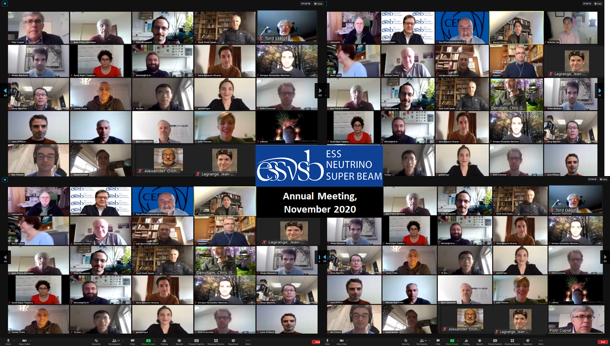









Slide 24
spares

Slide 25
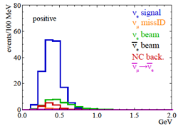
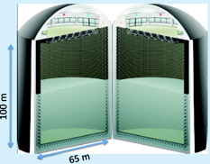

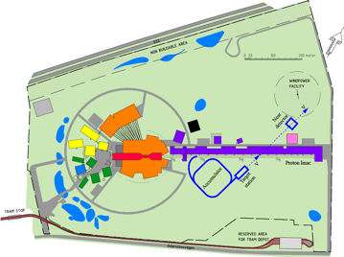
Possible ESSνSB schedule (optimistic?)
(2nd generation neutrino Super Beam)
2021: End of ESSνSB Design Study, CDR and preliminary costing
2012: inception of the project
2016-2019: beginning of COST Action EuroNuNet
2018: beginning of ESSνSB Design Study (EU-H2020)
2022-2025: Preparatory Phase, TDR
2025-2028: Preconstruction Phase, International Agreement
2028-2034: Construction of the facility and detectors, including commissioning
2035-: Data taking
Eu. Phys. J. C 81,
(2021) 1130
Nucl. Phys. B 885 (2014) 127

