Slide 1





Measuring leptonic CP violation at the second neutrino oscillation maximum with ESSnuSB
Budimir Kliček
On behalf of the ESSnuSB project
Ruđer Bošković Institute, Zagreb, Croatia
CERN EP Seminar
12 April 2022

Slide 2
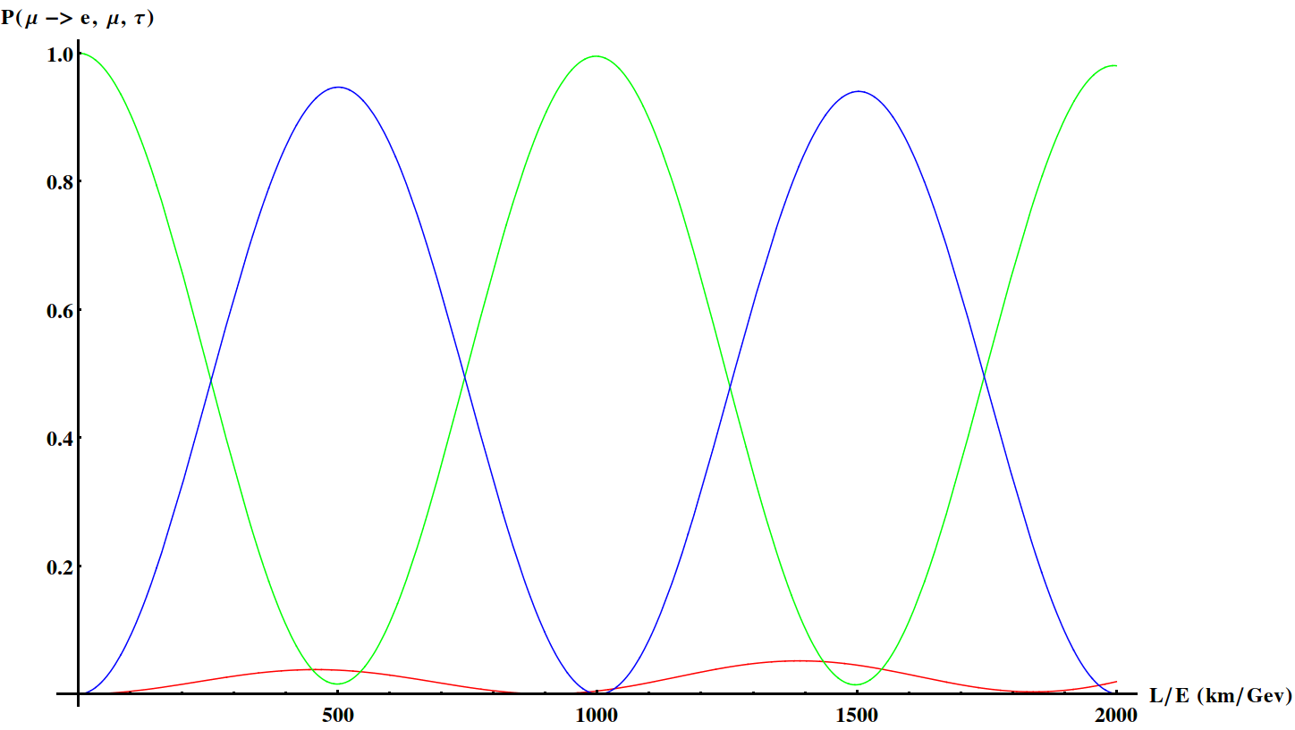



ESSnuSB
A design study for an experiment to measure CP violation at 2nd neutrino oscillation maximum.
HyperK, DUNE
ESSnuSB

Slide 3

CP violation in neutrino oscillations
Oscillation probability for neutrinos is different than oscillation probability for anti-neutrinos in vaccum.
probability of oscillation
neutrino flavour at production
neutrino flavour at detection

Slide 4

CP violation in ESSnuSB
We will study ν_{e} and ν_{e} appearance in ν_{μ} and ν_{μ} beam, respectively
The plan:
Run with ν_{μ} and look at ν_{e} appearance, then
Run with ν_{μ} and look at ν_{e} appearance

Slide 5
Why 2nd maximum?
Large signal and small matter effects

Slide 6
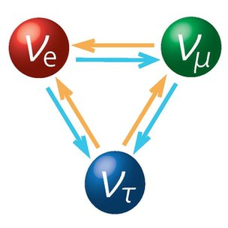
Neutrino oscillations
Neutrino flavour can effectively change between its creation and interaction.

Slide 7
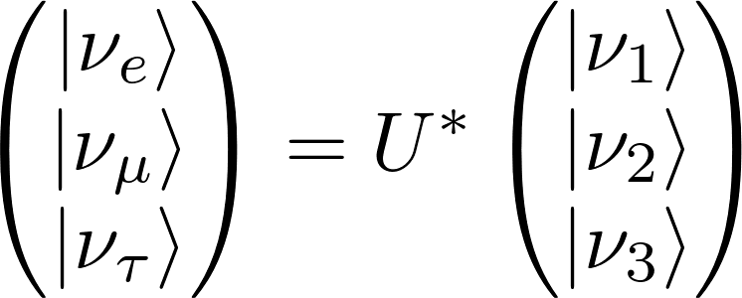
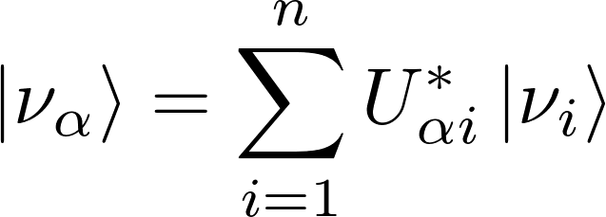

Neutrino oscillations
Neutrino flavor eigenstate
is not a mass eigenstate
flavour eigenstate
mixing matrix
mass eigenstates
U_{αi} is called the PMNS (Pontecorvo-Maki-Nakagawa-Sakata) matrix
U_{αi} must be unitary for probability conservation
    for n generations of neutrinos it is a n x n complex matrix
    here we focus on standard 3 neutrino generations

Slide 8
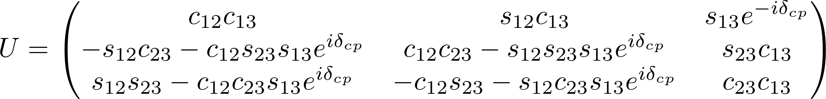
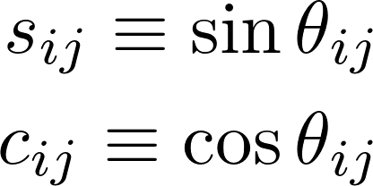
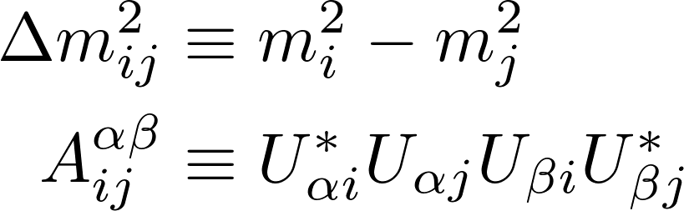

Neutrino oscillations (3 generations)
e
μ
τ
1
2
3
Six parameters in total:

Slide 9
Neutrino oscillations

Slide 10


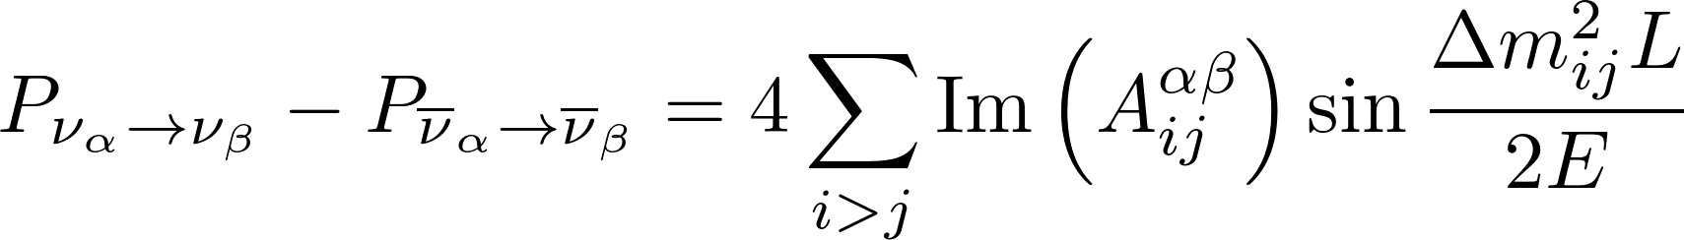
CP violation in vacuum
CP violation
T violation
CPT symmetry
All three equations can be proven using the formula above.
CP violation “amplitude”:

Slide 11

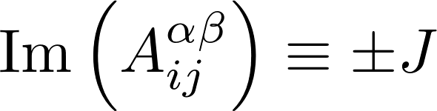
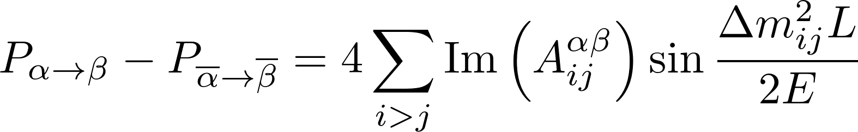
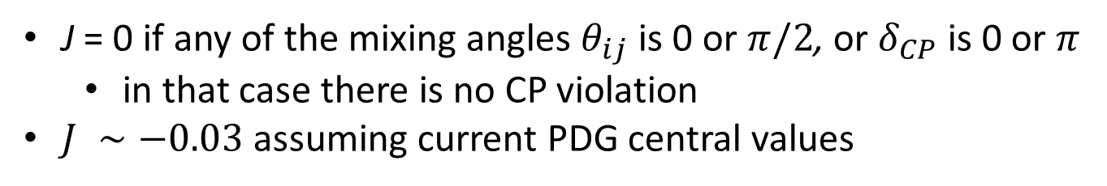
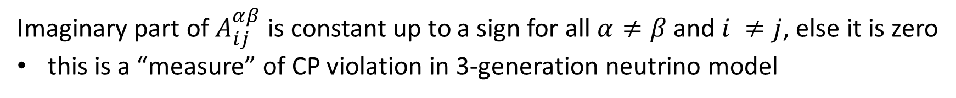
Jarlskog invariant
Definition of Jarlskog invariant
Imaginary part of $A_{ij}^{αβ}$ is constant up to a sign for all $α≠β$ and $i ≠j$, else it is zero
this is a “measure” of CP violation in 3-generation neutrino model
Jarlskog invariant in standard
3-gen PMNS parametrization
J = 0 if any of the mixing angles $θ_{ij}$is 0 or $π/2$, or $δ_{CP}$ is 0 or $π$
  in that case there is no CP violation
$J ∼−0.03$ assuming current PDG central values
CP violation “amplitude”:

Slide 12
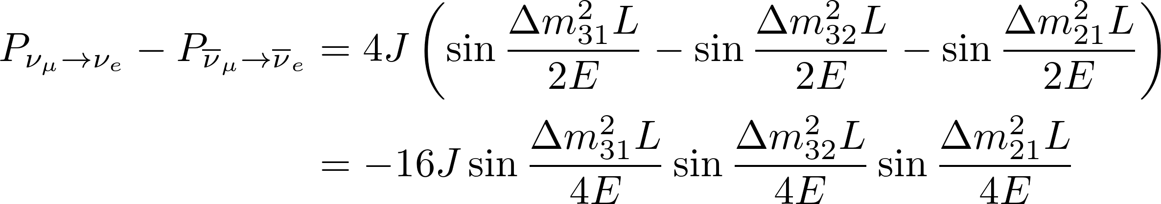
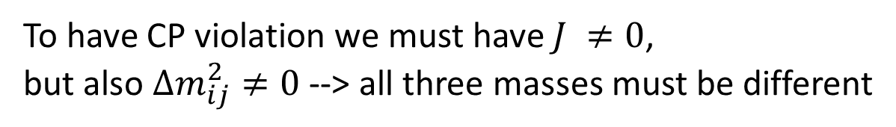
CP violation in ESSnuSB
General CP violation “amplitude”:
ESSnuSB CP violation
To have CP violation we must have $J ≠0$,
but also $Δm_{ij}^{2}≠0$ --> all three masses must be different

Slide 13
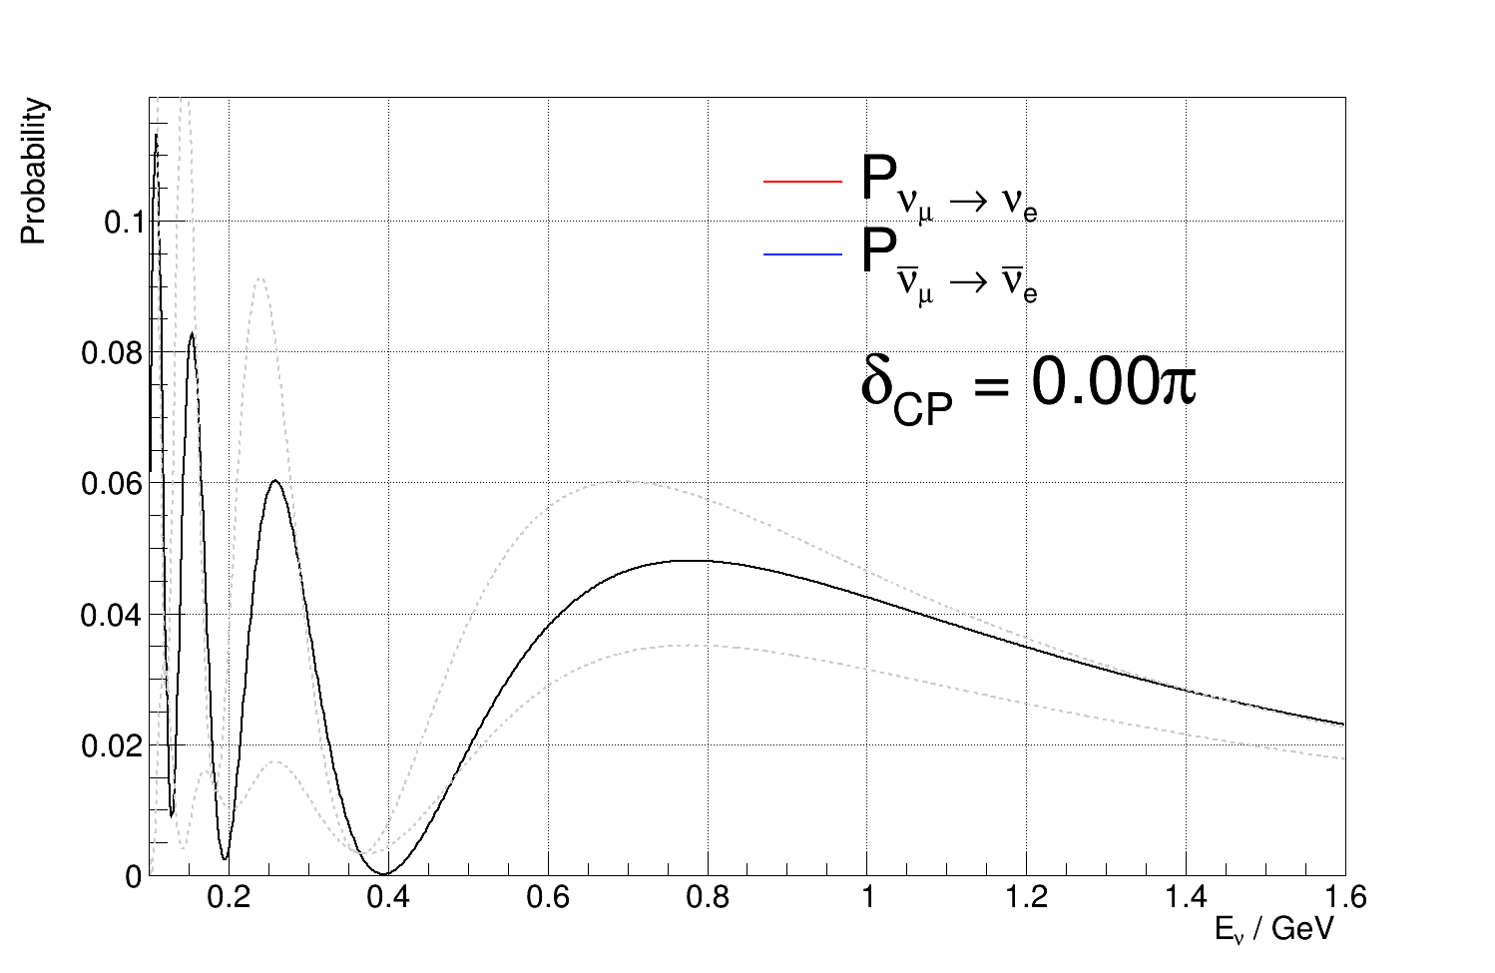
Effect of δ_{CP} on oscillations in vacuum
Thanks to my student L. Halić for patiently making plots specifically for this talk!

Slide 14
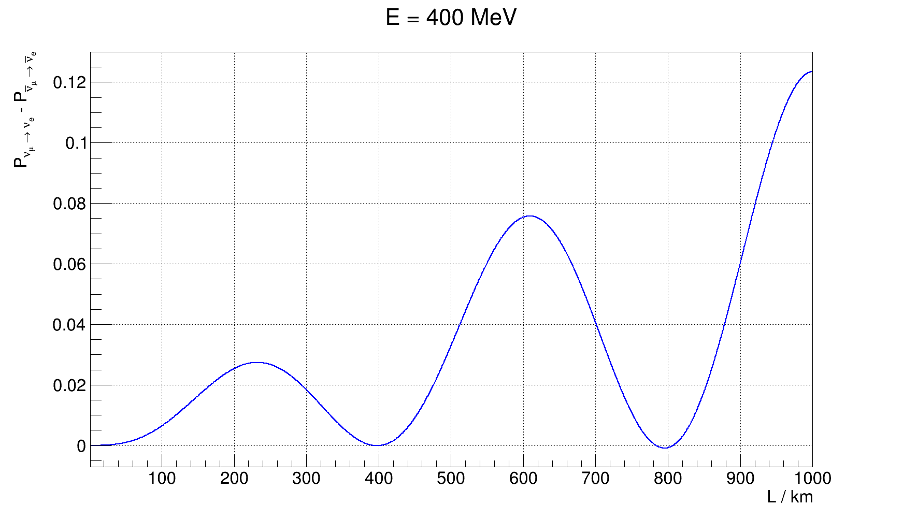
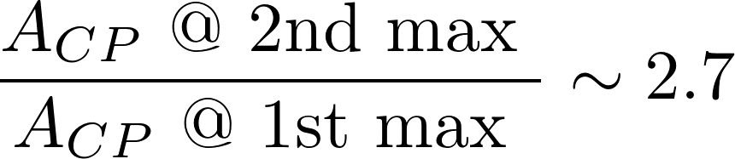
CP violation in ESSnuSB
2nd maximum
Does not depend on J, i.e. PMNS matrix elements
Depends only on mass splittings
1st maximum

Slide 15
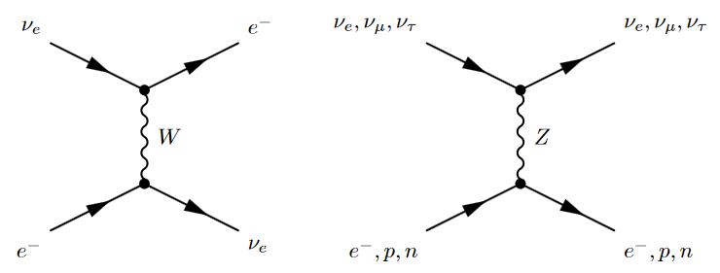

Matter effects
Distortion of oscillation probabilities due to elastic scattering of neutrinos with matter
Possible for $ν_{e}$ only
Possible for all flavours
Elastic neutrino scattering can proceed through:
  NC interactions for all flavour/mass eigenstates
  CC interactions with electrons for electron neutrinos
Therefore electron neutrinos see a slightly different effective potential than muon and tau neutrinos
  This modifies the evolution of flavour states in matter

Slide 16
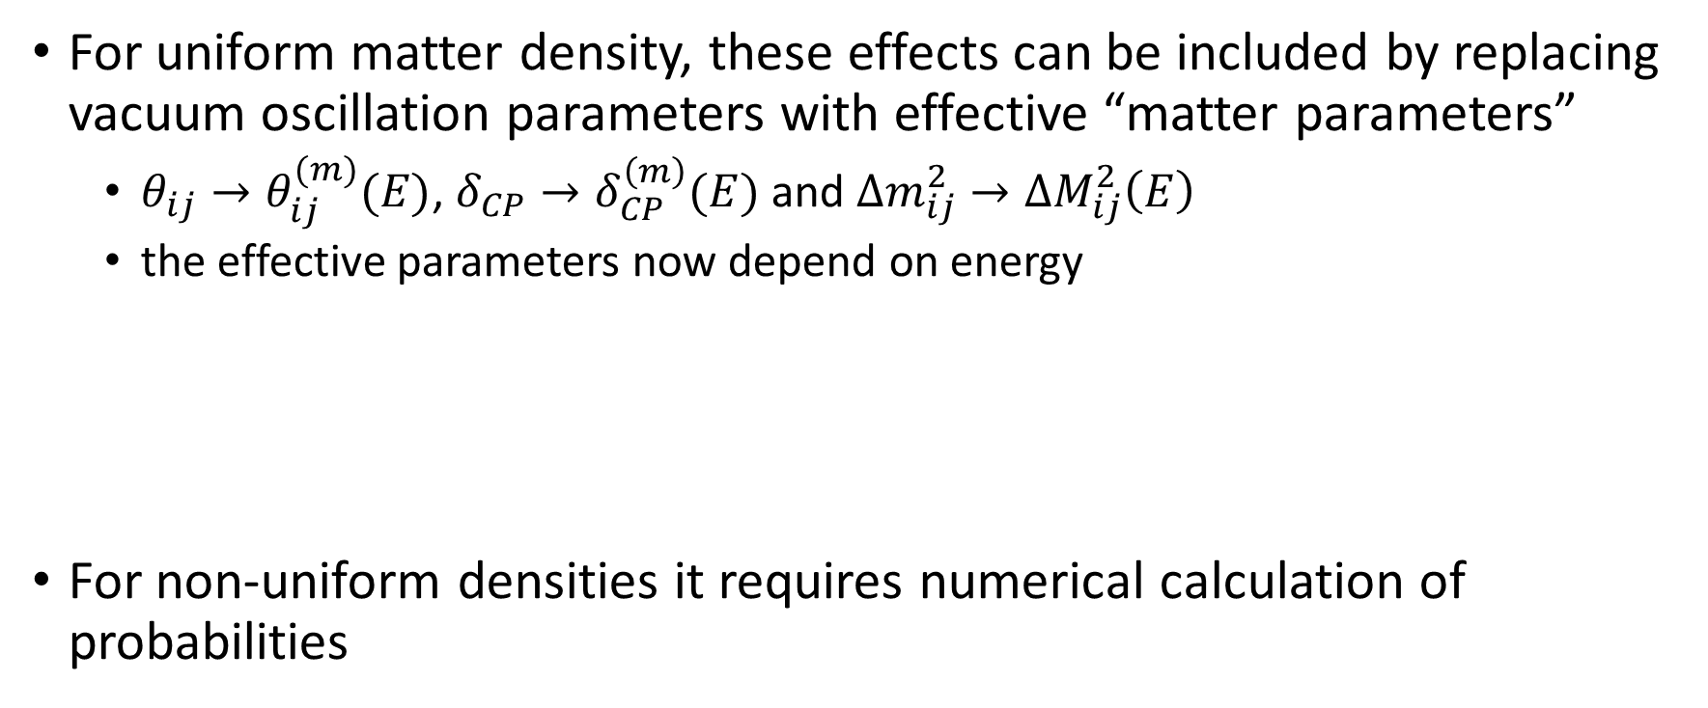
Matter effects
For uniform matter density, these effects can be included by replacing vacuum oscillation parameters with effective “matter parameters”
  $θ_{ij}→θ_{ij}^{(m)}(E)$, $δ_{CP}→δ_{CP}^{\left(m\right)}(E)$ and $Δm_{ij}^{2}→ΔM_{ij}^{2}\left(E\right)$
  the effective parameters now depend on energy
For non-uniform densities it requires numerical calculation of probabilities

Slide 17
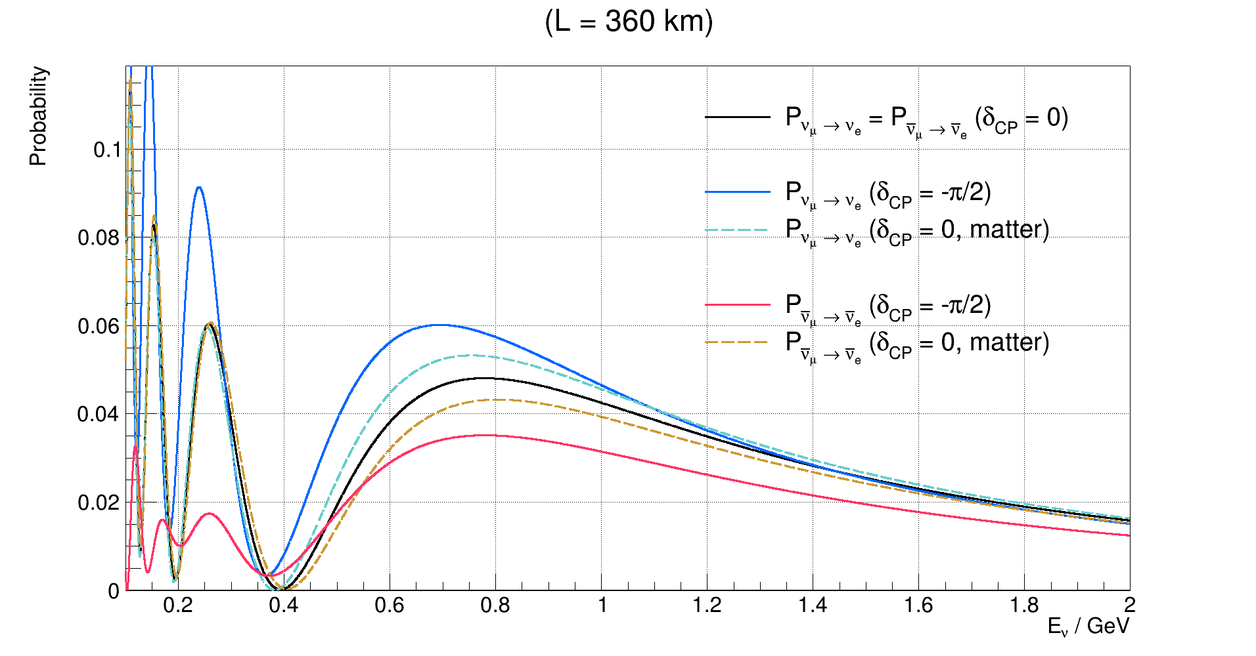
Matter effects
2nd maximum
1st maximum

Slide 18
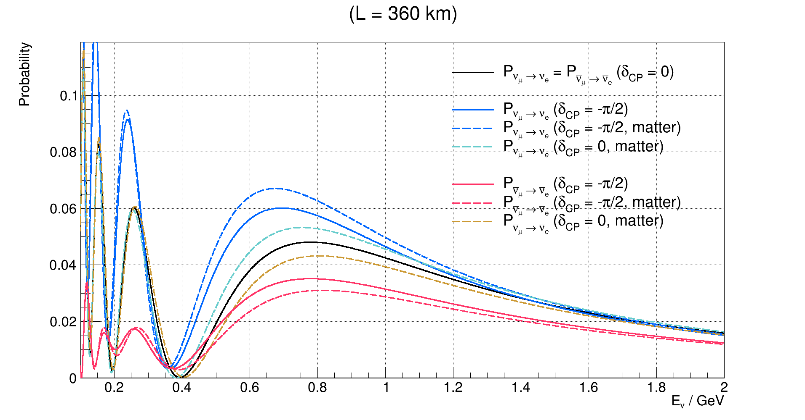
Matter effects
2nd maximum
1st maximum

Slide 19
Matter effects
2nd maximum
larger sensitivity to δ_{CP}
matter doesn’t matter
1st maximum
smaller sensitivity to δ_{CP}
matter can mimic CP violation

Slide 20
Matter effects
2nd maximum
larger sensitivity to δ_{CP}
matter doesn’t matter
1st maximum
smaller sensitivity to δ_{CP}
matter can mimic CP violation
But, there are less neutrino interactions here

Slide 21
Why 2nd maximum?
(summary)
The good
Vacuum CPV signal 2.7 times larger than at 1st max.
Fake CPV signal from matter effects very small.
The bad
You get less statistics because you have to either:
Move 3x further than 1st maximum - flux 9x smaller
Reduce energy 3x – cross-section at least 3x smaller
The optimal
Depends on the systematic error and beam intensity
3x signal at 2nd osc. maximum is less obscured by systematics, but we have less statistics (measured appearance events).
  If the signal at 2nd maximum is not obscured by larger statistical error, then 2nd maximum is better - Intense beam is needed
With no systematic error, first maximum is better
  more statistics, even though the effect is smaller.

Slide 22
ESSnuSB project
How to observe the CP violation in the 2nd oscillation maximum

Slide 23


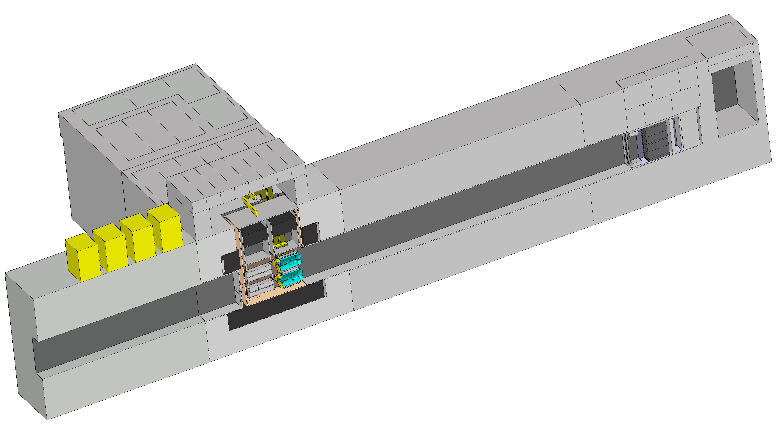
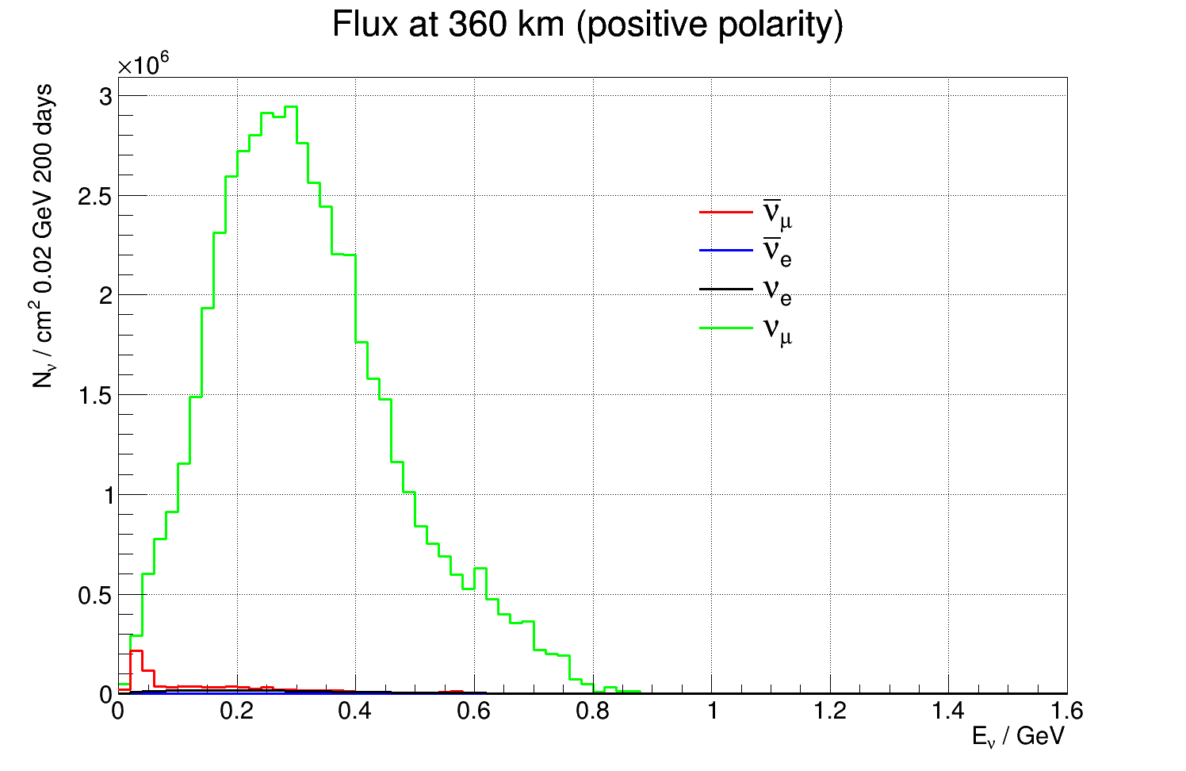
Neutrino beam production
Hot Cell
Able to manipulate/repair hadronic collector
Work under Radioactive Environment
Morgue
To Store radioactive wastes
Beam dump
Neutrino Beam
Power Supply Unit
16 modules (350 kA, 1.3 μs)
Located above the switchyard
Outside of radioactive part of Facility
Decay tunnel
Pions decay in-flight here
Beam Switchyard
Tunnel
Proton Beam
(Ep=2.5 GeV, 14 Hz) 4 x 1.25 MW
Hadronic Collector

Slide 24
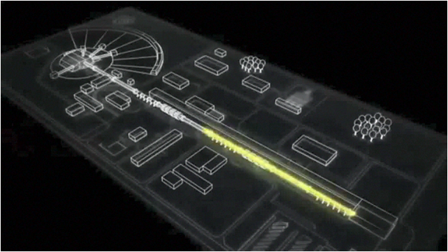
Can we go to 2nd maximum?
A very intense proton linac is in construction near Lund, Sweden.

Slide 25
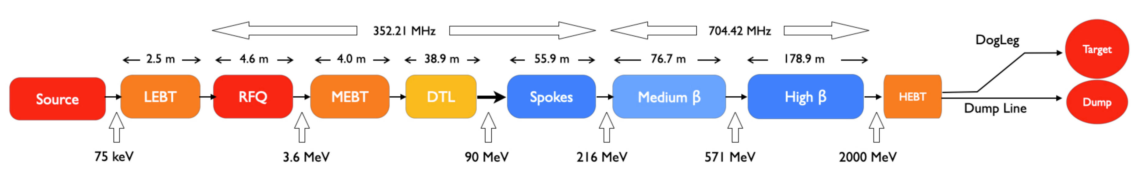
ESS proton linac
space for energy upgrades
The ESS will be a copious source of spallation neutrons.
5 MW average beam power.
125 MW peak power.
14 Hz repetition rate (2.86 ms pulse duration, 10¹⁵ protons).
Duty cycle 4%.
2.0 GeV kinetic energy protons
  up to 3.5 GeV with linac upgrades
>2.7x10²³ p.o.t/year.
450 mg of protons/year
at 95% speed of light!
First beam on target expected in 2024.

Slide 26
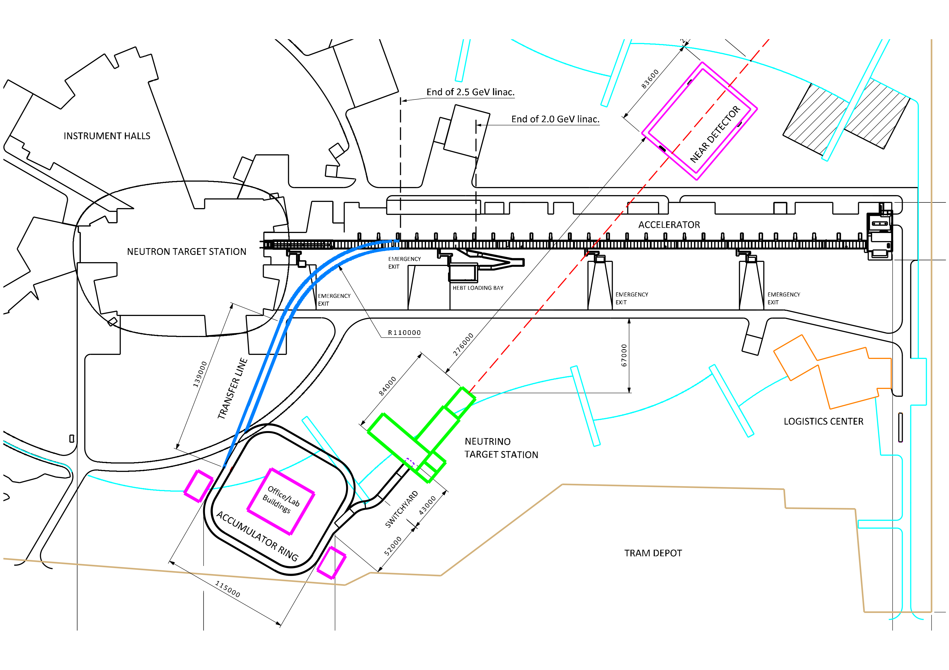
Upgrades to ESS
See Mamad’s talk for more details

Slide 27
Upgrades to ESS
Upgrade of the accelerator
14 Hz to 28 Hz
use H⁻ instead of protons in ESSNuSB cycles
increase energy to 2.5 GeV kinetic
See Mamad’s talk for more details

Slide 28
Upgrades to ESS
Upgrade of the accelerator
14 Hz to 28 Hz
use H⁻ instead of protons in ESSNuSB cycles
increase energy to 2.5 GeV kinetic
Build an accumulator ring
shorten ESS pulses from 2.86 ms to ≈ 1 μs
See Mamad’s talk for more details

Slide 29
Upgrades to ESS
Upgrade of the accelerator
14 Hz to 28 Hz
use H⁻ instead of protons in ESSNuSB cycles
increase energy to 2.5 GeV kinetic
Build an accumulator ring
shorten ESS pulses from 2.86 ms to ≈ 1 μs
Build a neutrino target station
4 identical targets and horns
need switchyard
See Mamad’s talk for more details

Slide 30
Upgrades to ESS
Build a near detector site
water Cherenkov detector
fine grained scintillator
emulsion detector
Upgrade of the accelerator
14 Hz to 28 Hz
use H⁻ instead of protons in ESSNuSB cycles
increase energy to 2.5 GeV kinetic
Build an accumulator ring
shorten ESS pulses from 2.86 ms to ≈ 1 μs
Build a neutrino target station
4 identical targets and horns
need switchyard
See Mamad’s talk for more details

Slide 31
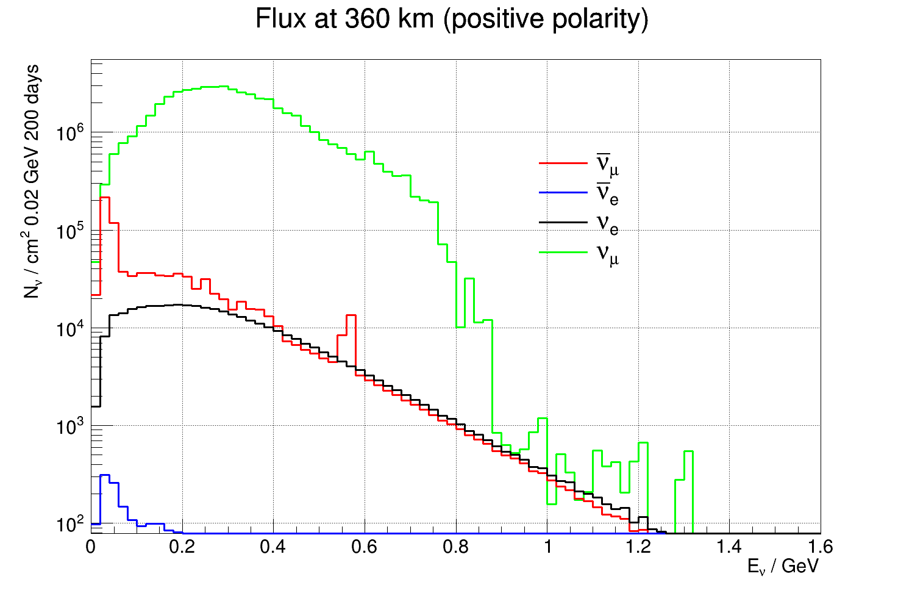
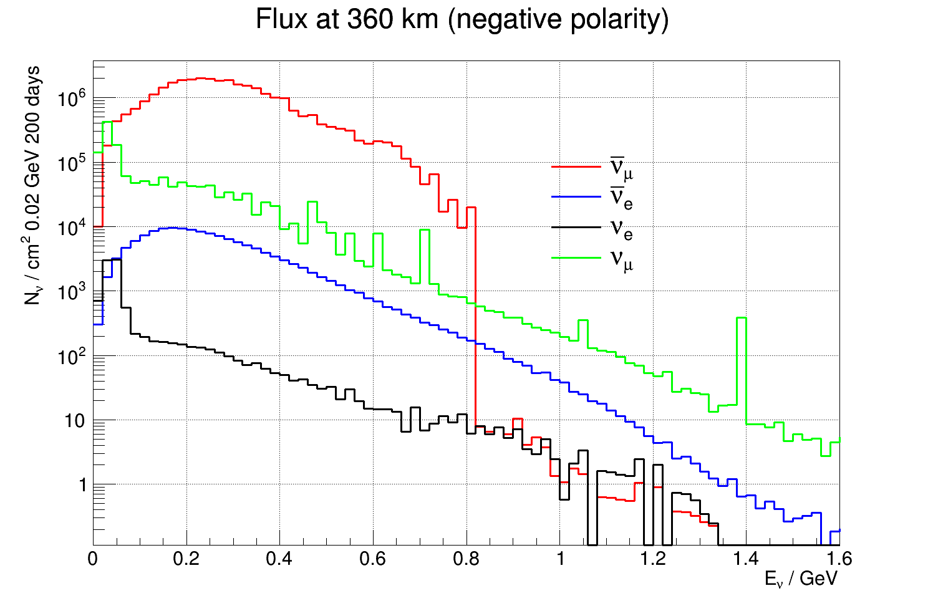
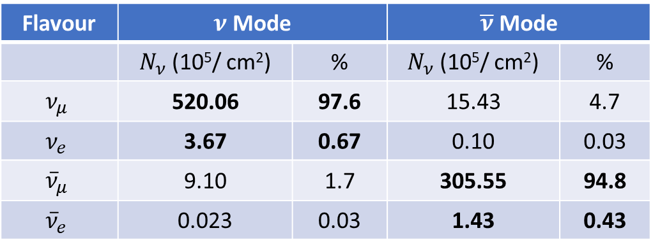
ESSνSB ν energy distribution
(after optimisation)
almost pure ν_{μ} beam
small ν_{e} contamination which will be used to measure ν_{e} cross-sections in a near detector
Flavour | $ν$ Mode |  | $\overline{ν}$ Mode
 | $N_{ν}$ (10⁵/ cm²) | % | $N_{ν}$ (10⁵/ cm²) | %
$$ν_{μ}$$ | 520.06 | 97.6 | 15.43 | 4.7
$$ν_{e}$$ | 3.67 | 0.67 | 0.10 | 0.03
$${\overline{ν}}_{μ}$$ | 9.10 | 1.7 | 305.55 | 94.8
$${\overline{ν}}_{e}$$ | 0.023 | 0.03 | 1.43 | 0.43
at 360 km from the target and per year (in absence of oscillations)

Slide 32
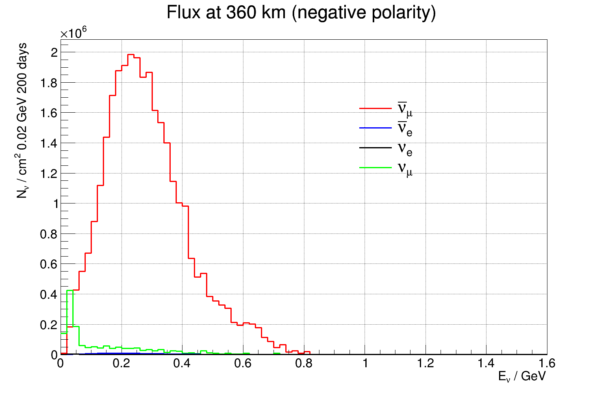
ESSνSB ν energy distribution
(after optimisation)
almost pure ν_{μ} beam
small ν_{e} contamination which will be used to measure ν_{e} cross-sections in a near detector
Flavour | $ν$ Mode |  | $\overline{ν}$ Mode
 | $N_{ν}$ (10⁵/ cm²) | % | $N_{ν}$ (10⁵/ cm²) | %
$$ν_{μ}$$ | 520.06 | 97.6 | 15.43 | 4.7
$$ν_{e}$$ | 3.67 | 0.67 | 0.10 | 0.03
$${\overline{ν}}_{μ}$$ | 9.10 | 1.7 | 305.55 | 94.8
$${\overline{ν}}_{e}$$ | 0.023 | 0.03 | 1.43 | 0.43
at 360 km from the target and per year (in absence of oscillations)

Slide 33
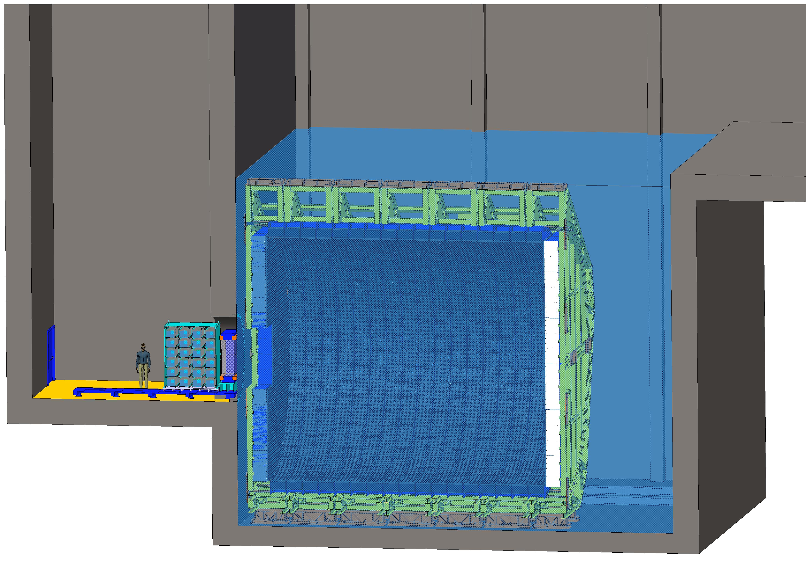
Near detectors
ν beam

Slide 34
Near detectors
ν beam
Near Water Cherenkov detector (0.77 kt fiducial)

Slide 35
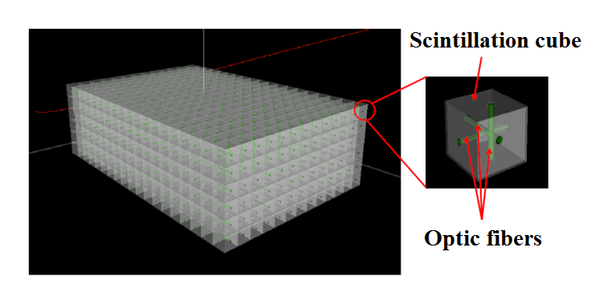
Near detectors
Super-FGD like detector
(1 t fiducial)
ν beam
Near Water Cherenkov detector (0.77 kt fiducial)

Slide 36
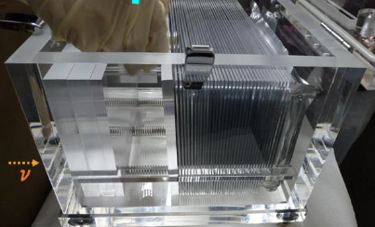
Near detectors
NINJA-like water-emulsion detector (1 t fiducial)
Super-FGD like detector
(1 t fiducial)
ν beam
Near Water Cherenkov detector (0.77 kt fiducial)

Slide 37
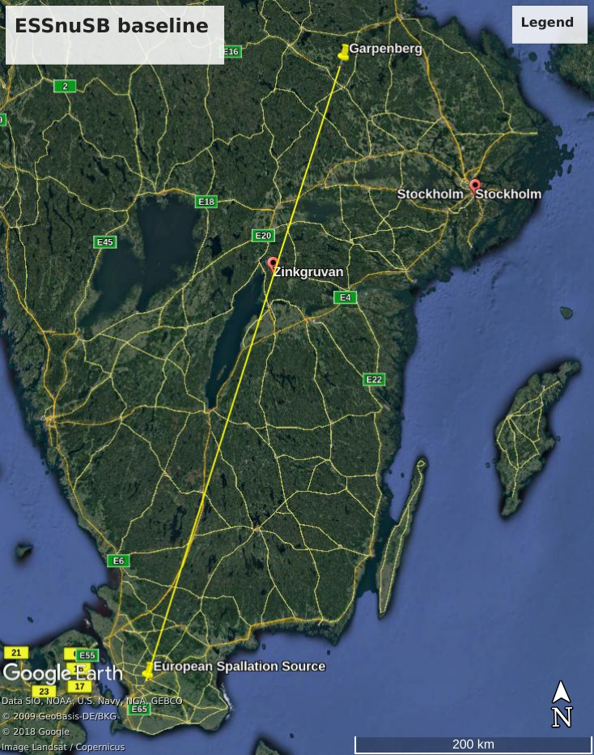
Far detector position
Selected baseline:
Zinkgruvan mine, 360 km from the source, partly covernig 1st and 2nd maximum
  Number of interactions at 2nd maximum similar to Garpenberg
Alternative (not selected)
Garpenberg mine, 540 km from the neutrino source, corresponding to 2nd oscillation maximum.

Slide 38
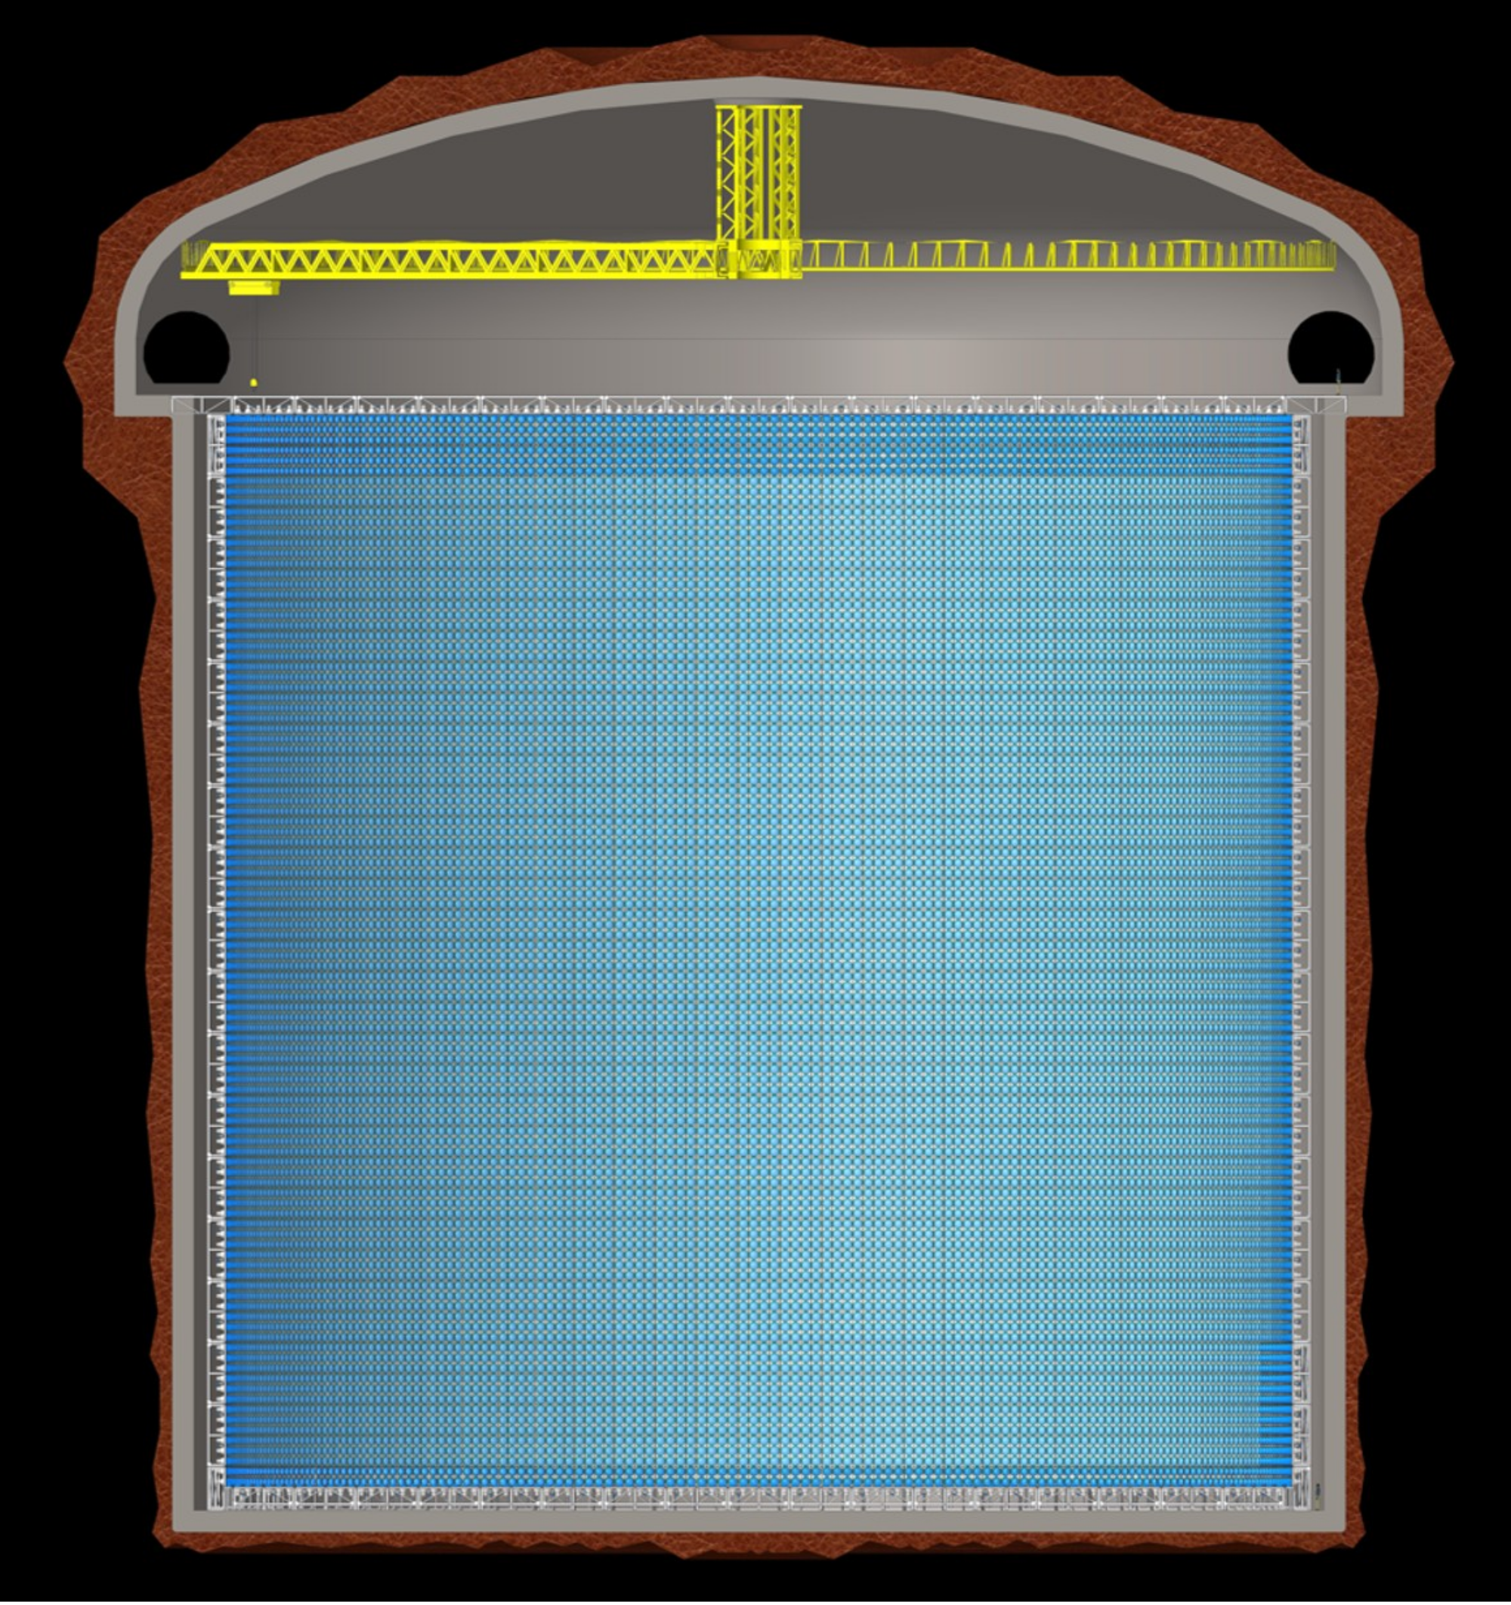
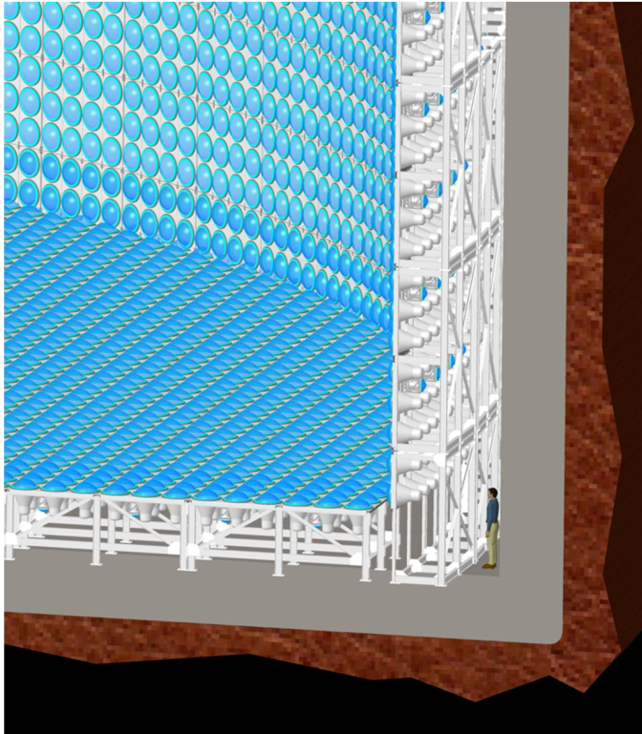
Far detector

Slide 39
Far detectors
Design
2 x 270 kt fiducial volume (~20xSuperK)
Readout: 2 x 38k 20” PMTs
30% optical coverage
  design here for 40% with an option that ¼ PMTs will not be installed
Can also be used for other purposes:
Proton decay
Astroparticles
Galactic SN ν
  Diffuse supernova neutrino background
Solar Neutrinos
Atmospheric Neutrinos

Slide 40
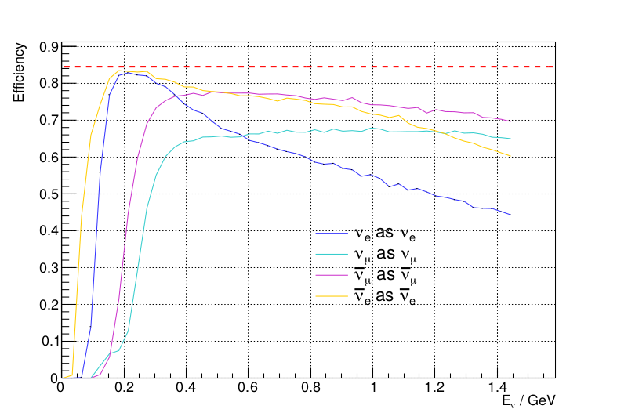
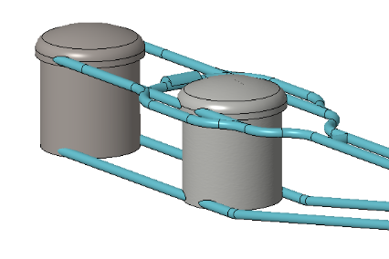
Improvements on sensitivity
Near detectors optimized for flux and cross-section measurement - 5% systematics within easy reach
Far detectors’ response optimized for ESSnuSB flux – very high efficiency and purity at ESSnuSB energies
Genetic Algorithm for Target Station optimization – more neutrinos
Efficiency ESSnuSB FD
MEMPHYS WC detector
Phys. Rev. ST Accel. Beams 16, 061001 (2013)
horn optimisation
538 kt
total fiducial

Slide 41
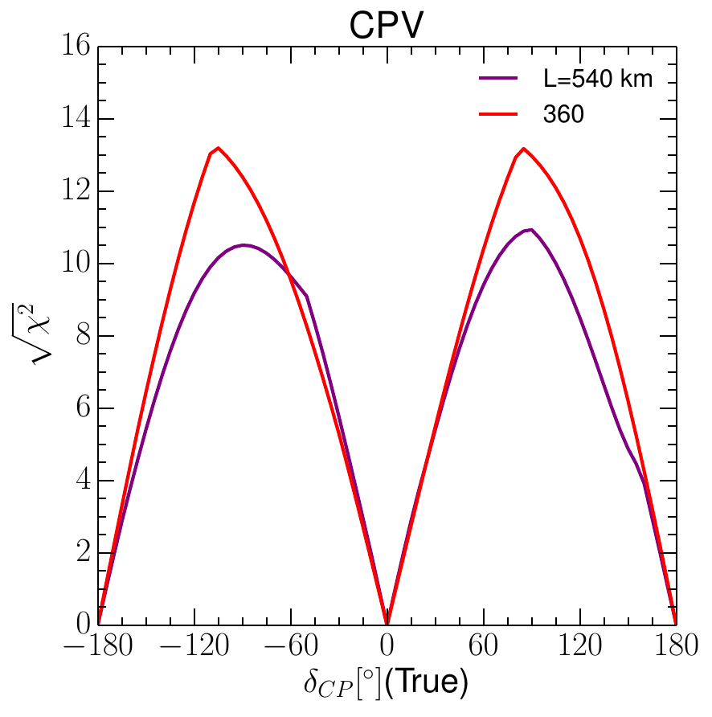
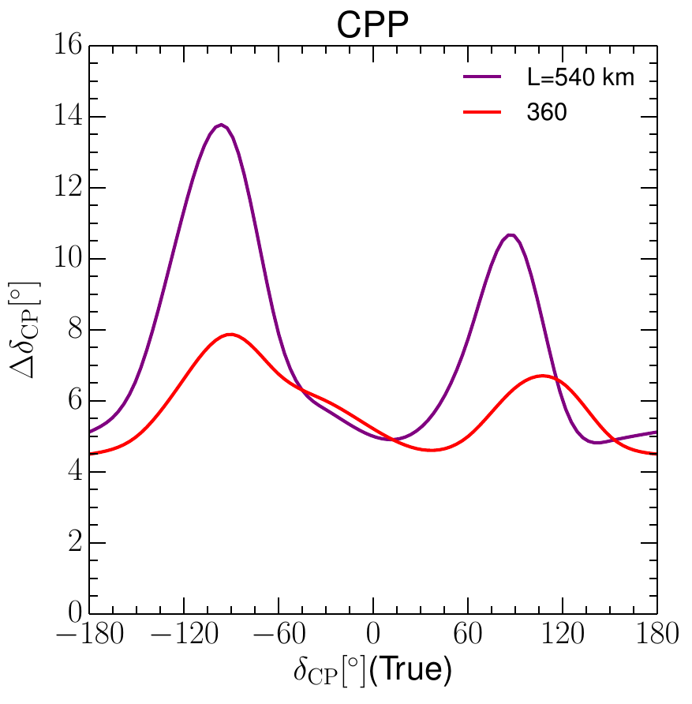
Updated physics performance of the ESSnuSB experiment,
Eur.Phys.J.C 81 (2021) 12, 1130
DOI:10.1140/epjc/s10052-021-09845-8, arXiv:2107.07585
State of analysis
June 2021
Sensitivity for δ_{CP} = ± π/2:
11 σ (540 km)
13 σ (360 km)
High precision of δ_{CP} measurement

Slide 42

Latest physics reach
Since our previous publication:
  Improved flux simulation
  Improved detector geometry simulation
  Improved handling of systematic errors
Will be published within the CDR soon

Slide 43
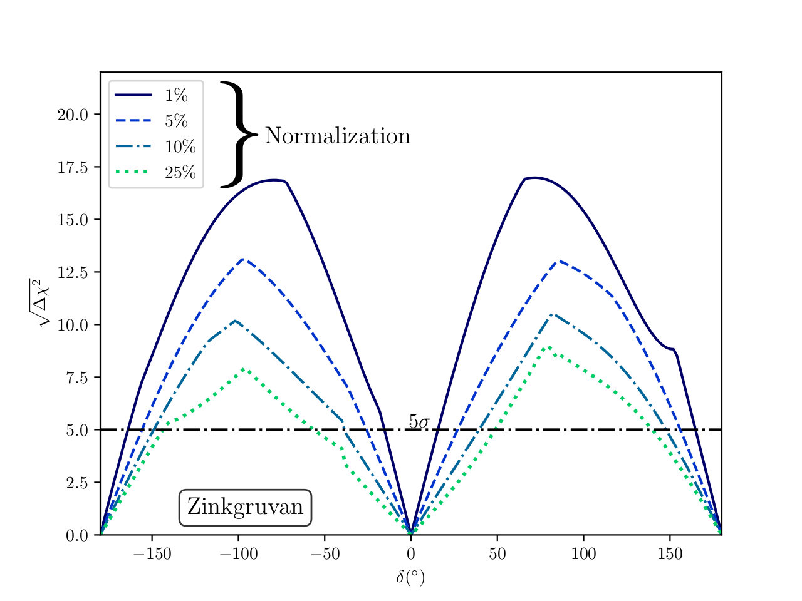
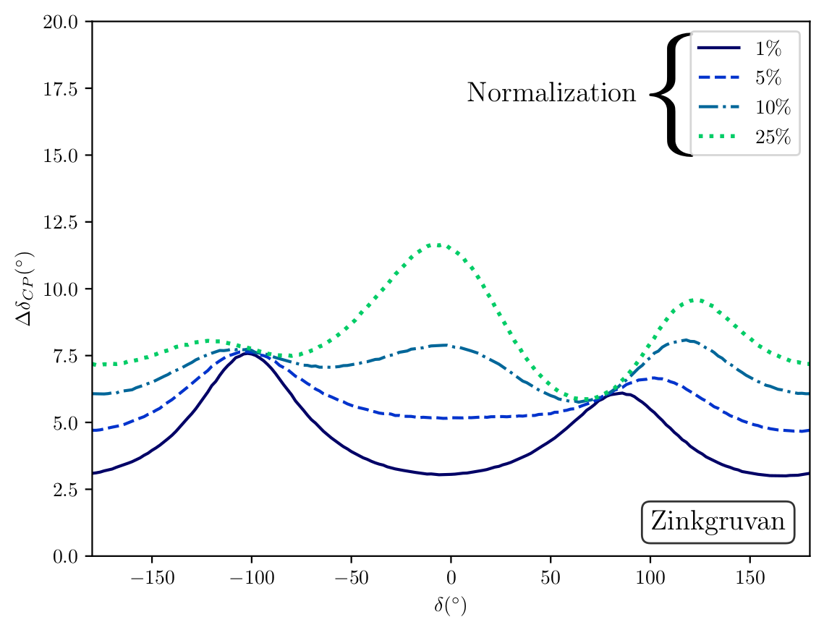
Effect of normalization uncertainty
Sensitivity
Precision

Slide 44
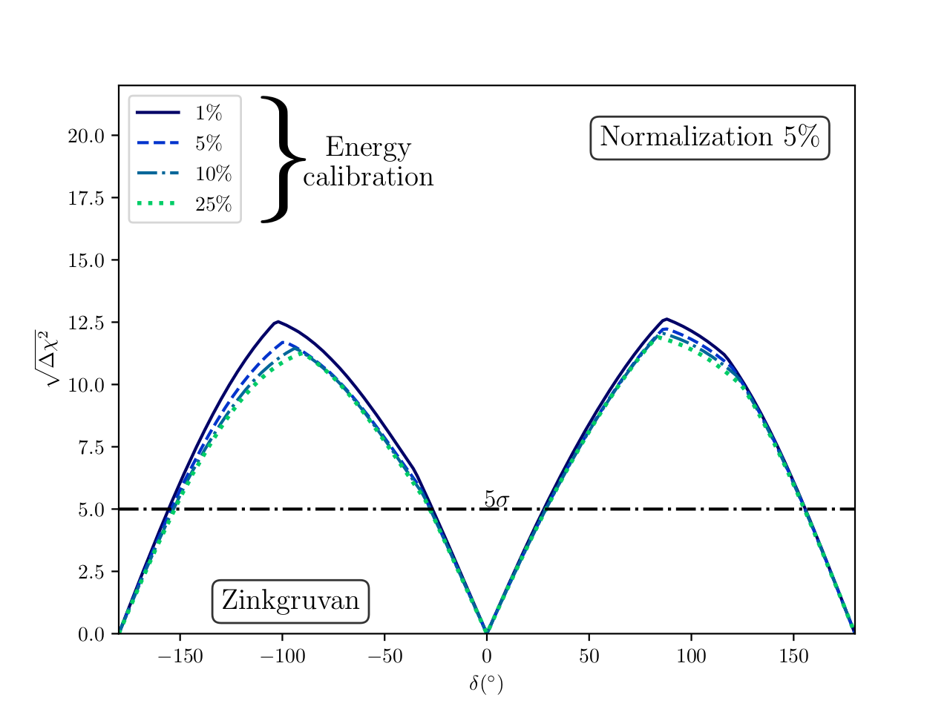
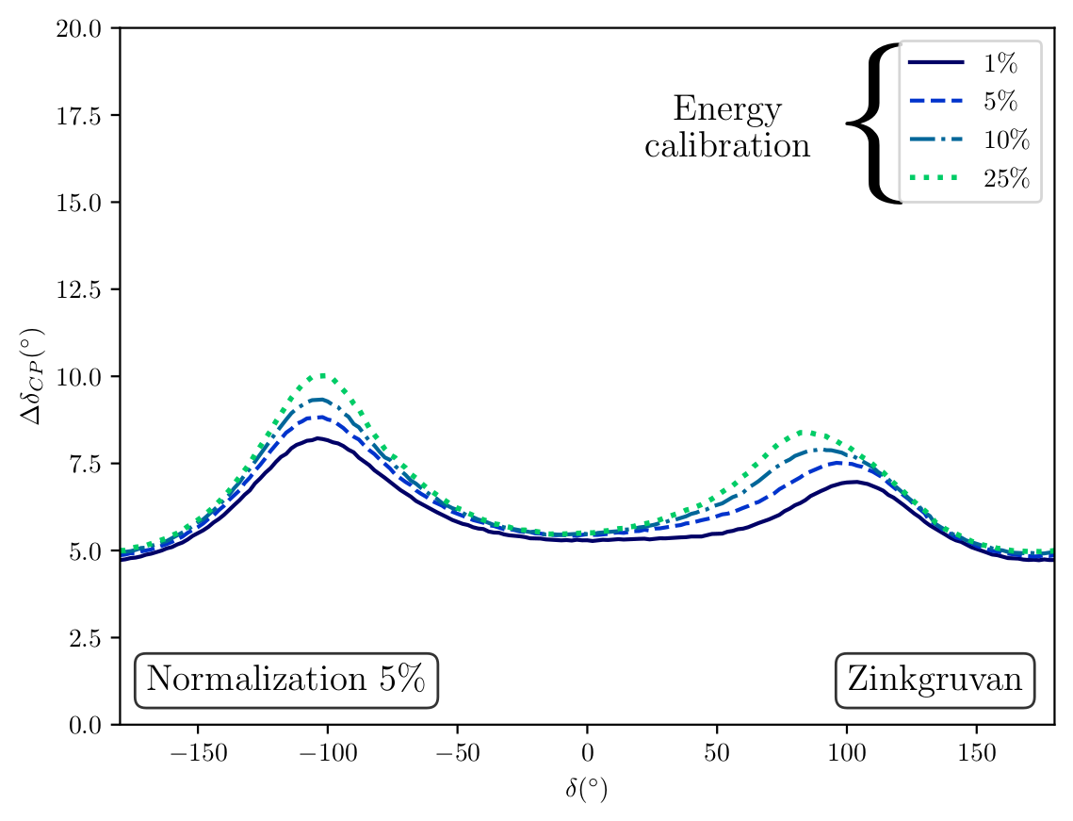
Effect of energy calibration uncertainty
Sensitivity
Precision

Slide 45
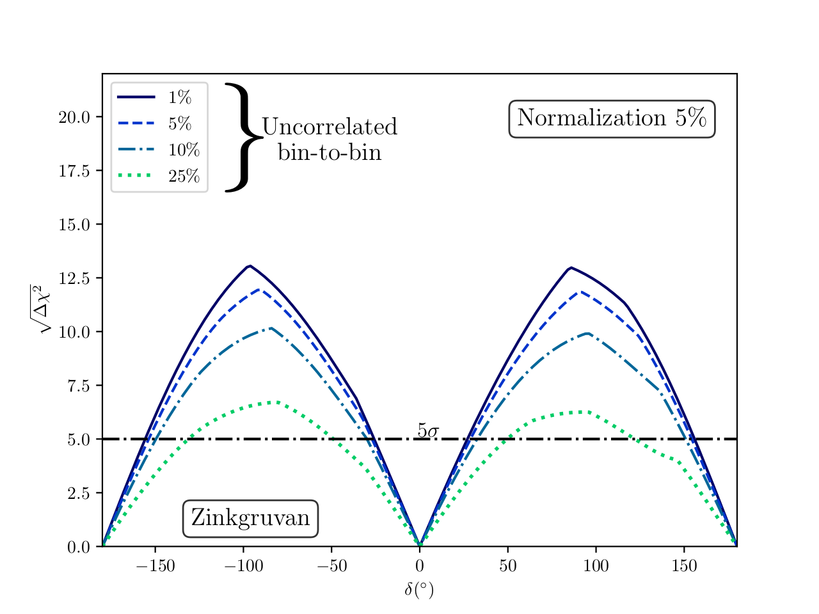
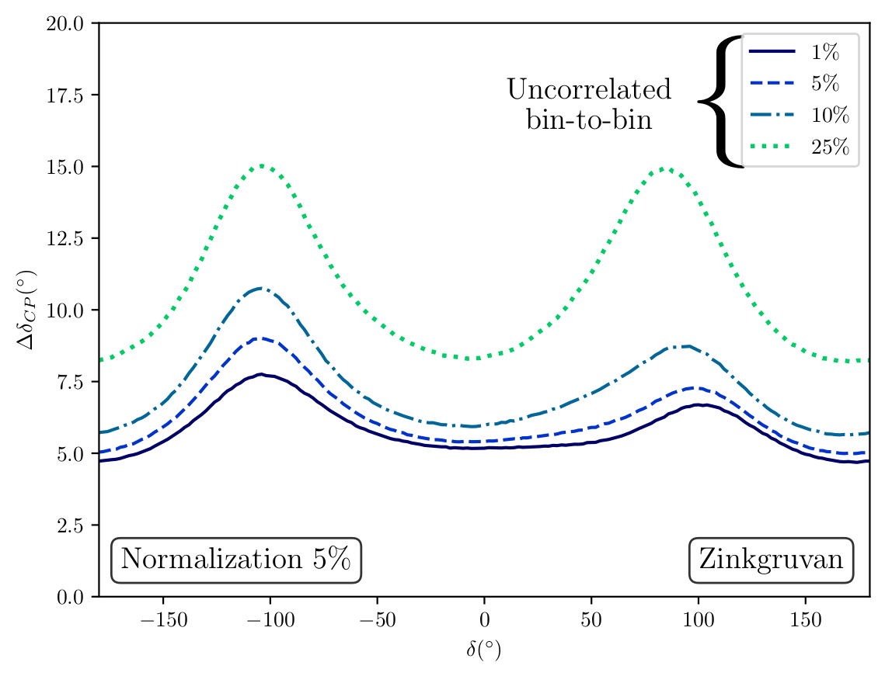
Effect of bin-to-bin uncorrelated uncertainty
Sensitivity
Precision

Slide 46
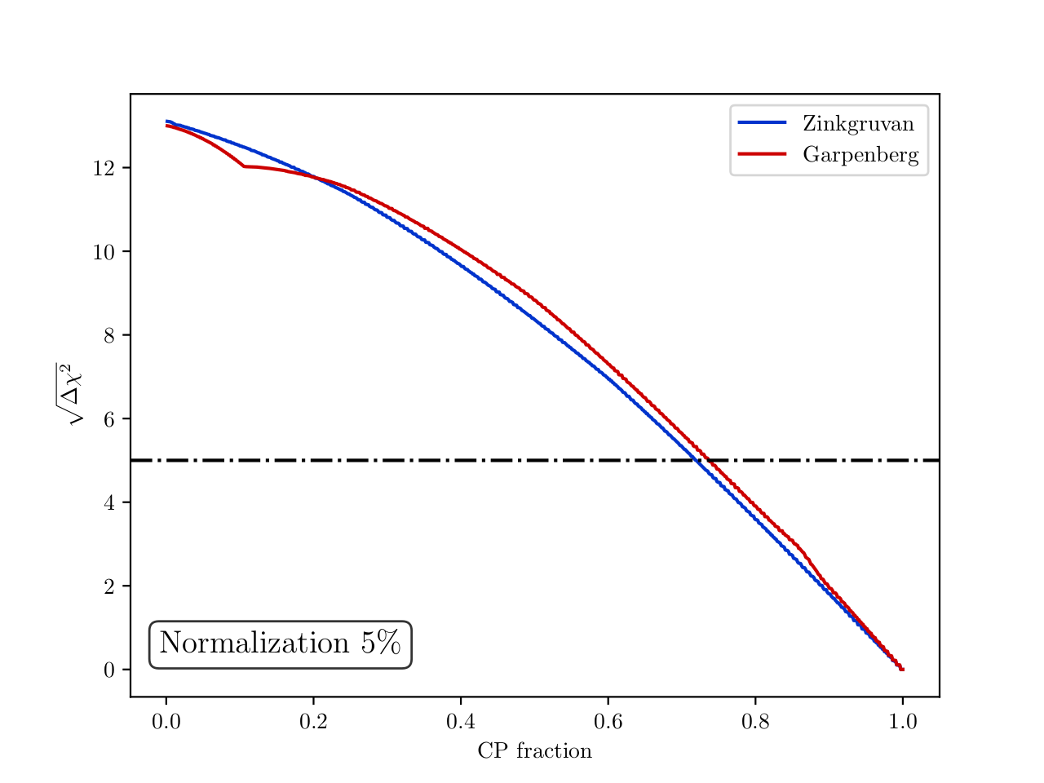
CP coverage
71% coverage of δ_{CP} range
with more than 5 σ

Slide 47
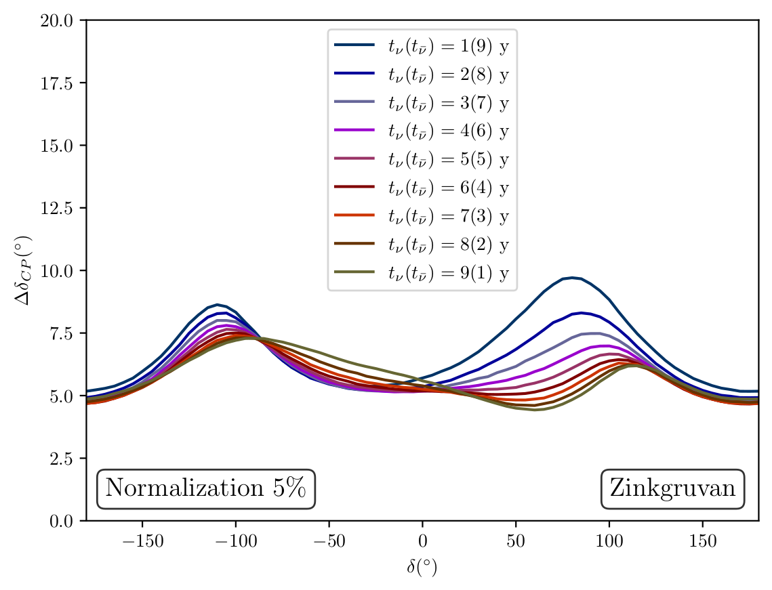
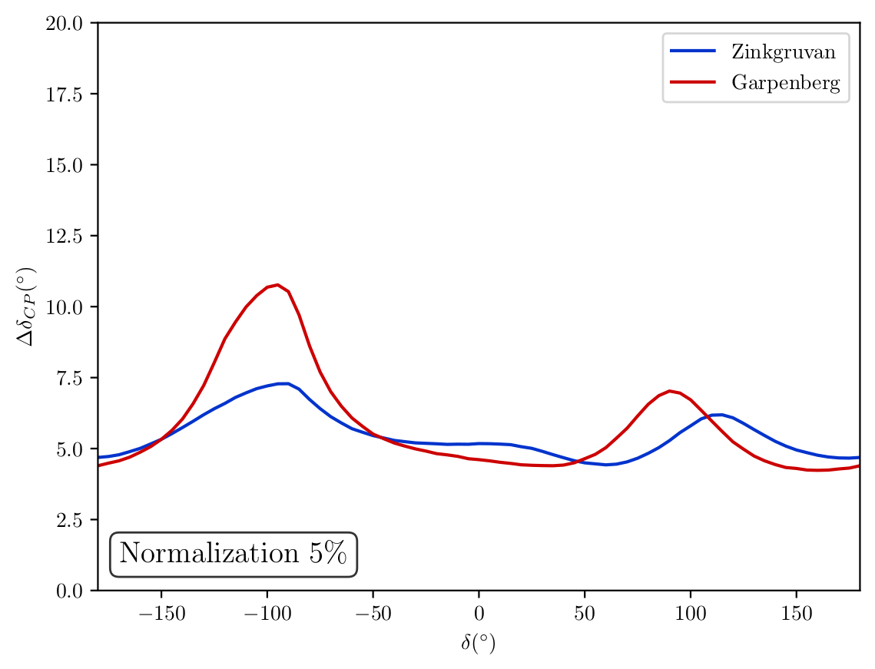
Optimization for precision
Supposing that value of δ_{CP} is roughly known at ESSnuSB time
Precision for different neutrino (antineutrino) run times
Optimal precision for known δ_{CP}

Slide 48

ESSνSB at the European level
A H2020 EU Design Study (Call INFRADEV-01-2017)
Title of Proposal: Discovery and measurement of leptonic CP violation using an intensive neutrino Super Beam generated with the exceptionally powerful ESS linear accelerator
Duration: 4 years
Total cost: 4.7 M€
Requested budget: 3 M€
15 participating institutes from
11 European countries including CERN and ESS
6 Work Packages
Approved end of August 2017
ESSνSB
BENE (2004-2008)
ISS (2005-2007)
EUROν (2008-2012)
LAGUNA (2008-2010)
LAGUNA-LBNO (2010-2014)
COST Action CA15139 (2015-2019)

Slide 49
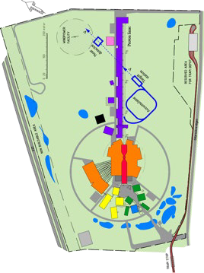
























Schedule for a 2nd generation
ESS-based neutrino Super Beam ESSnuSB
2036-:
Start of data taking
2029-2035:
2027-2028:
Construction of the facility and detectors, including commissioning
2023-2026:
Continuation of Design Study, final costing and an TDR to ESFRI
Preconstructi on Phase, International Agreements
2022: End of ESSνSB
Design Study,
preliminary costing and CDR
2018:
Beginning of ESSνSB
Design
Study (EU- H2020)
2016-2019:
Beginning of COST
Action EuroNuNet
2012:
Inception of the project
Nucl. Phys. B 885 (2014) 127

Slide 50

The ESSnuSB+ project proposal
Having finished the conceptual design of the facility for CP violation measurement, we need to take further steps
Start with the civil engineering and infrastructure development
Design prototyping facilities at ESS
Design facilities for very precise neutrino cross-section measurement: low energy nuSTORM (LEnuSTORM) and monitored beam (LEMB)
Explore additional physics opportunities offered by ESSnuSB with addition of LEnuSTORM and LEMB
We have received strong support from the ESS management
LEMB

Slide 51


The future (ESSnuSB+)

Slide 52



The future (ESSnuSB+)
Civil engineering
Gd doping
Mining
LEnuSTORM
New detector for LEnuSTORM
and monitored beam
Additional physics
R&D target station (1.25 MW).
Feeding LEnuSTORM and
monitored beam.
Monitored beam

Slide 53


ESSnuSB movies
https://www.youtube.com/watch?v=PwzNzLQh-Dw
https://www.youtube.com/watch?v=qAnvft0nAlg

Slide 54
Special thanks to my ESSnuSB colleagues!
The content presented here is a result of 4 years of collaborative effort of many people involved in ESSnuSB project.
Thank you all for making this possible!

Slide 55
Conclusions
ESSnuSB aims to observe CP violation in neutrino oscillations at the 2nd oscillation maximum using 538 kt WC detector
  2nd maximum makes the measurement resilient to systematic errors and matter effects
  Recent optimizations predict that in 10 years of data taking ESSnuSB will be able to
      reach 5 σ over 71% of δ_{CP} range
      reach δ_{CP} resolution of less than 8°
      determine neutrino mass hierarchy
ESS linac will be most powerful proton accelerator in the world
    can be used to generate intense neutrino beam to go to 2nd maximum
    neutron user programme will start in 2025, decision on neutrino programme pending
    proposed modifications would allow a rich additional physics programme at ESS
      muon physics, DAR experiments, short neutron pulses, ...
Large far detectors can also be used for rich astroparticle physics programme
The ESSnuSB Design Study has been supported by EU-Horizon 2020 during the period 2018-2022.
We are about to seek renewed support from EU-Horizon Europe for the period 2023-2026
  ESSnuSB+ received in March 2022 a letter of strong support from the ESS Director General Helmut Schober

Slide 56
Thank you for your attention

Slide 57
ESSνSB and (R&D) synergies
Dedicated series of workshops is organized
https://indico.cern.ch/event/849674/
Super Beam
nuSTORM
+Decay At Rest and Coherent scat.
(with short pulses)
Neutrino Factory
Muon Collider

Slide 58

Neutrino oscillations
Flavour state evolution
Relativistic space-time translation operator
Neutrino quantum state at
distance L and after time T
Neutrino quantum state at creation
Free particle energy operator
Free particle momentum operator
For mass eigenstates:
And finally:

Slide 59






Neutrino oscillations
Oscillation probability in vacuum
Oscillation probability:
Assuming:
- neutrino travels in the direction of its momentum
One gets the final relation:

Slide 60


PMNS matrix parametrization (Dirac neutrino)
Standard parametrization used in modern literature:
Analogue to Euler matrices used for 3D rotations
This is not the most general unitary matrix parametrization – a 3x3 unitary matrix has 6 phases
  5 phases can be canceled by rephasing charged lepton and neutrino fields
A single leftover phase is always present in the middle factor

Slide 61







Muon neutrino oscillations
Full parametrization ($δ_{CP}=0)$

Slide 62






Hot Cell
Able to manipulate/repair hadronic collector
Work under Radioactive Environment
Granular Target Concept
Target made of 3 mm titanium spheres cooled by transverse helium gas cooling
Morgue
To Store radioactive wastes
Beam dump
Power Supply Unit
16 modules (350 kA)
Located above the switchyard
Outside of radioactive part of Facility
Decay tunnel
Beam Switchyard
Tunnel
Proton Beam
(Ep=2.5 GeV, 14 Hz) 4 x 1.25 MW
Hadronic Collector
Beam Switchyard
Share the beam over
Four packed bed targets
MiniBoone Like Horn
Shape optimized with genetic algorithm

Slide 63








Neutrino beam production
$π^{+} →$ $μ^{+}+ν_{μ}$
(Positive polarity)
$π^{−} →$ $μ^{−}+ {\overline{ν}}_{μ}$
(Negative polarity)
Positive
polarity
Negative
polarity
Horn focussing
π⁺
π⁻
(At target level)
(After focussing)
Neutrino flux composition.
 | $φ_{ν}$ 10¹⁰.m⁻² | % | $φ_{ν}$ 10¹⁰.m⁻² | %
$ν_{μ}$ | 674 | 97.6 | 20 | 4.7
$${\overline{ν}}_{μ}$$ | 11.8 | 1.7 | 396 | 94.8
$ν_{e}$ | 4.76 | 0.67 | 0.13 | 0.03
$${\overline{ν}}_{e}$$ | 0.03 | 0.03 | 1.85 | 0.43
π⁻
π⁻
(At target level)
(After focussing)
Horn optimisation procedure
Horn parametrisation
Optimisation based on Genetic Algorithm
Figure of Merit based on δ_{cp}
Fraction of δ_{cp}

Slide 64


Zinkgruvan mine
Potential location in Site 2
Site 2 is considered as best considering access to main transport infrastructure and located in an area less disturbed by mining activities

Slide 65



ESSnuSB in the international context – CPV discovery
ESSnuSB March 2022 with 5% normalization error
DUNE Snowmass March 2022
Hyper-Kamiokande Snowmass March 2022

Slide 66



ESSnuSB in the international context – CPV resolution
ESSnuSB March 2022 with 5% normalization error
DUNE Snowmass March 2022
Hyper-Kamiokande Snowmass March 2022

Slide 67


Slide 68


Slide 69


Slide 70


