Slide 1
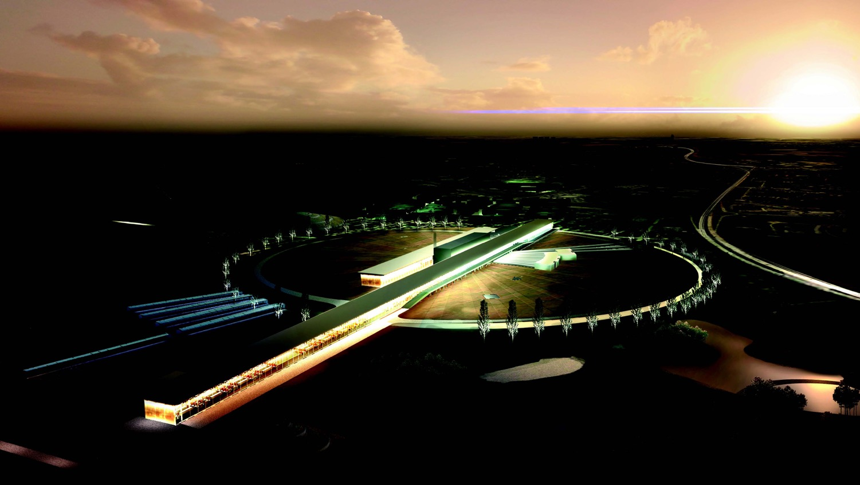


Neutrino Oscillations and CP Violation with the European Spallation Source neutrino Super Beam
Marcos Dracos
IPHC-Strasbourg

Slide 2
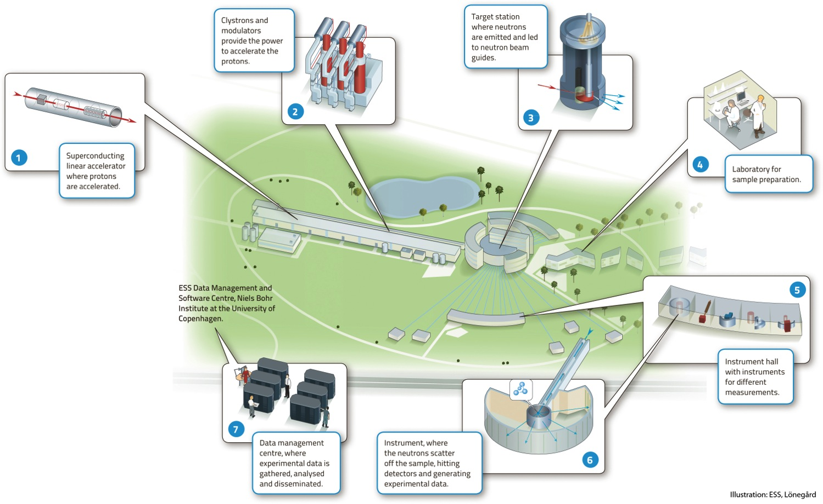

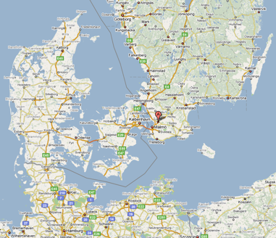
European Spallation Source
Neutron facility
under construction phase
(~2 B€ facility)

Slide 3




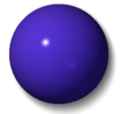
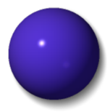






Science at ESS using neutrons
ESS is a neutron spallation source for neutron scattering measurements.
Neutron scattering offers a complementary view of matter
  in comparison to other probes such as x-rays from synchrotron light sources.
  The scattering cross section of many elements can be much larger for neutrons than for photons.
H
Li
C
O
S
Mn
Zr
Cs
X-rays
neutrons

Slide 4
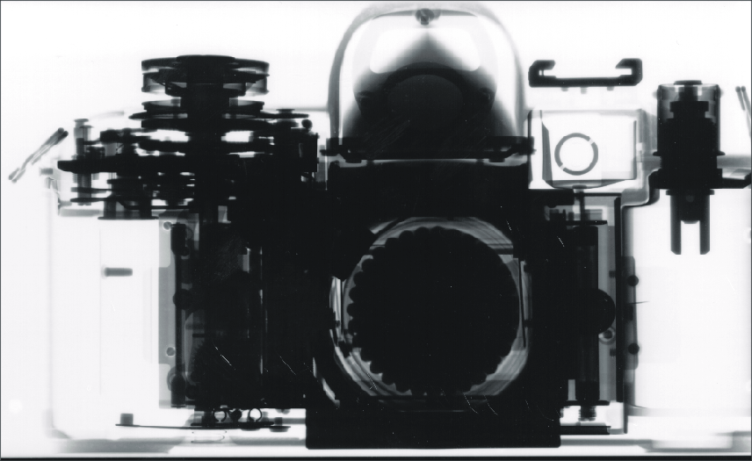
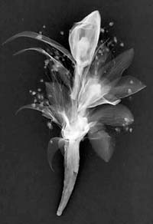
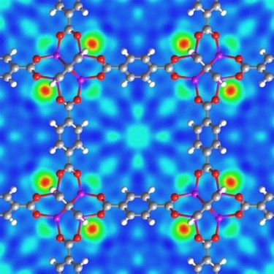
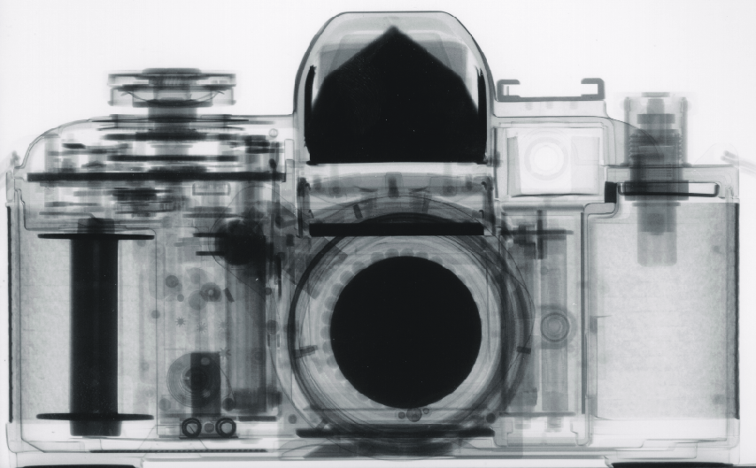
Neutron Scattering
Can reveal the molecular and magnetic structure and behavior of materials, such as:
  Structural biology and biotechnology,
  magnetism and superconductivity,
  chemical and engineering materials,
  nanotechnology,
  complex fluids,
  …
X-Ray Image
Neutron scattering of hydrogen in a metal organic framework
Neutron radiograph of a flower corsage
Neutron radiograph

Slide 5
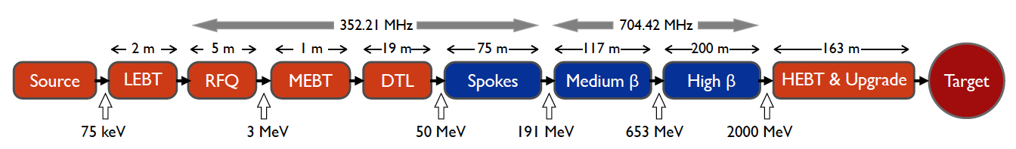
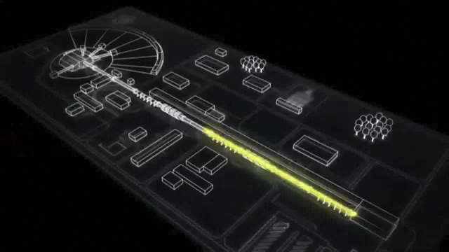
ESS proton linac
empty space for energy upgrades
The ESS will be a copious source of spallation neutrons.
5 MW average beam power.
125 MW peak power.
14 Hz repetition rate (2.86 ms pulse duration, 10¹⁵ protons).
Duty cycle 4%.
2.0 GeV protons
  up to 3.5 GeV with linac upgrades
>2.7x10²³ p.o.t/year.
8
x10¹⁴
ESS 5 MW
2015 design
7
λ = 1.5 Å
6
5
Brightness (n/cm²/s/sr/Å)
4
3
ESS 5 MW
2012 design (TDR)
2
UK TS2
32 kW
SNS
1-2 MW
JPARC
0.3-1 MW
Linac ready by 2023
UK TS1
128 kW
1
ILL 57 MW
0
time (ms)
1
2
3
4

Slide 6
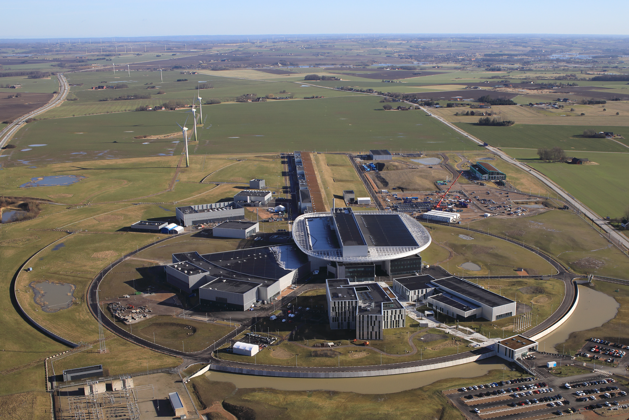

European Spallation Source
linac
Central Utility
Building
Exp. Hall
E01
Target
Monolith
Feb. 2022

Slide 7
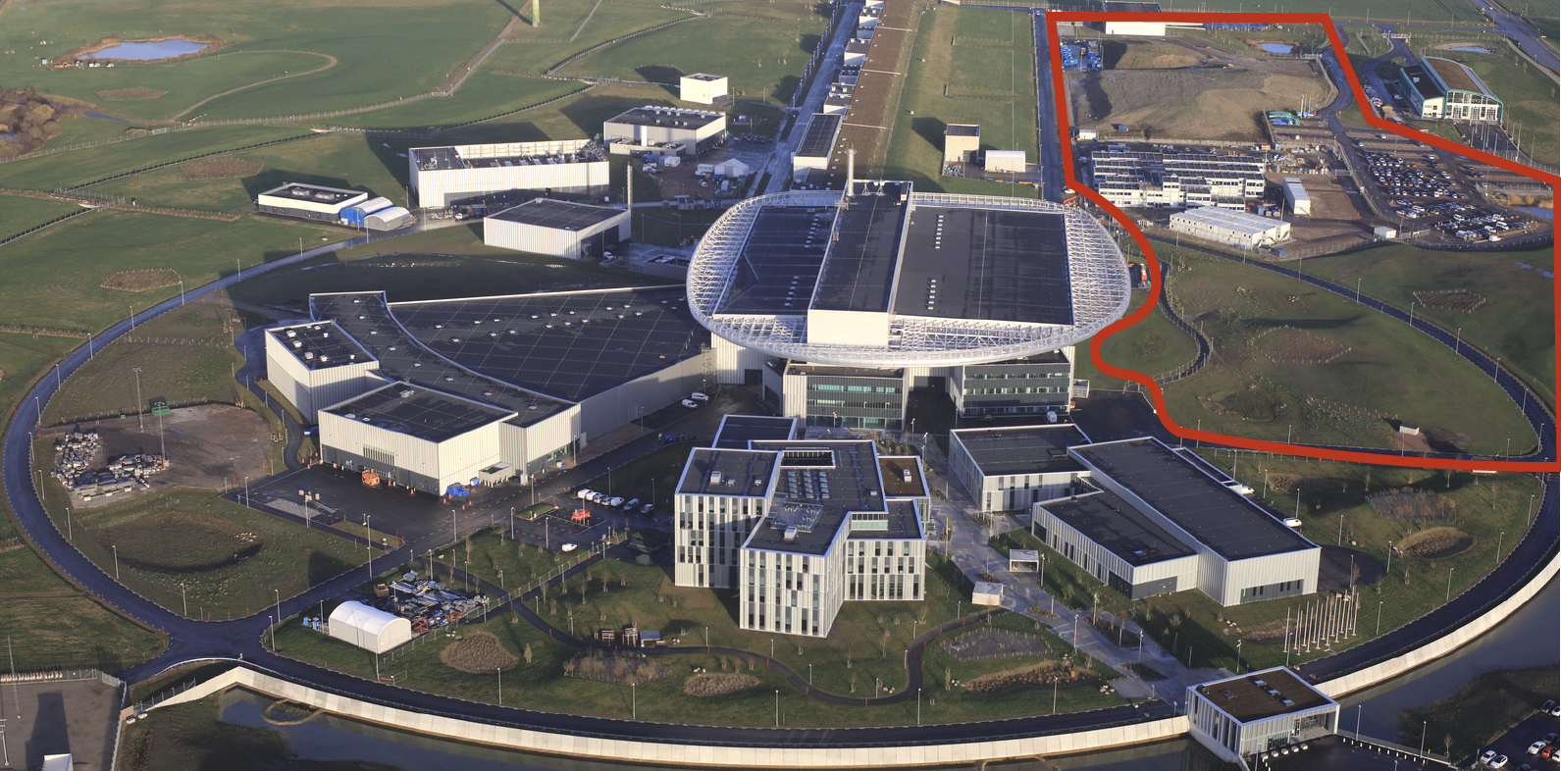
European Spallation Source as Neutrino Facility
ν

Slide 8
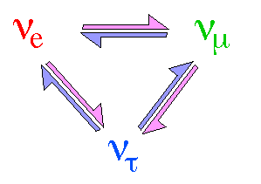
Neutrino Oscillations
Pontecorvo-Maki-Nakagawa-Sakata matrix
ν₃
well established now
θ₁₃
ν_{μ}
ν_{τ}
θ₂₃
θ₂₃
θ₁₂
ν₂
Usual parametrization
ν_{e}
ν₁
θ₁₂
θ₁₃
atmospheric,
accelerators
reactors,
accelerators
CP violation
solar,
reactors
δCP for neutrinos
-δCP for anti-neutrinos

Slide 9

Transition Probability in vacuum
(the time has been replaced by the distance)
with:
the transition probabilities do not depend on the particle masses but on the squared mass differences
Finally, the transition probabilities depend on the mixing matrix elements, the 2 squared mass differences and on the parameter L/E.
No transitions if:

Slide 10
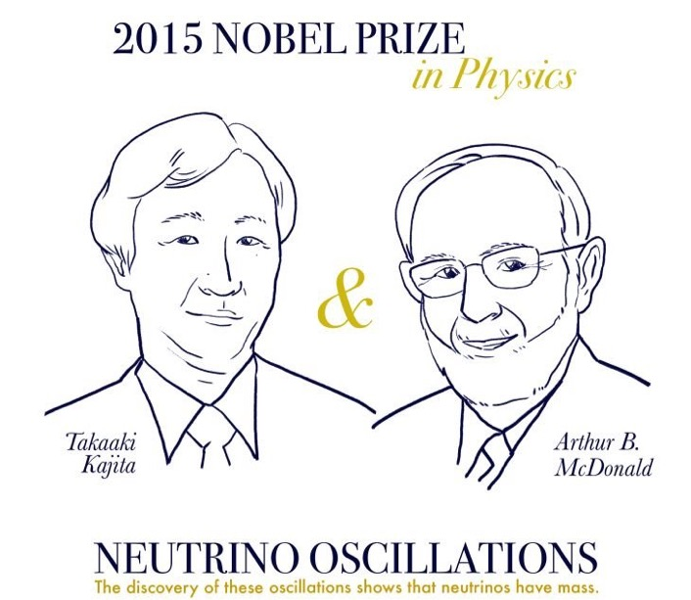
Neutrino Oscillations now well established

Slide 11
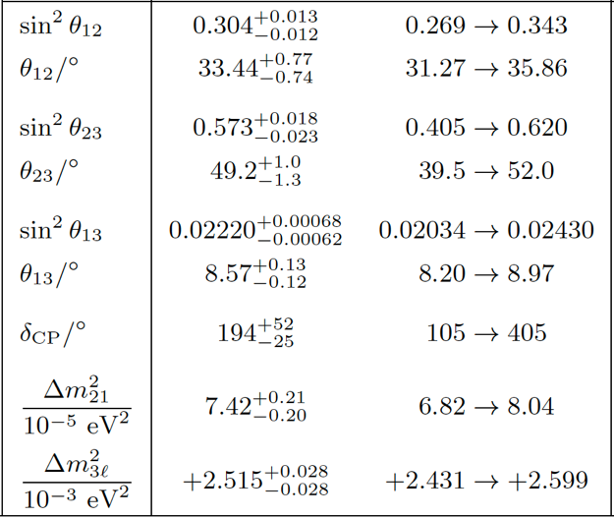
Present measurements
We can then write:
"large" mass splitting
?
?
"small" mass splitting
normal hierarchy
inverted hierarchy
~δ_{CP} (almost) unknown,
if different from 0 and π → CP violation → matter-antimatter asymmetry)

Slide 12
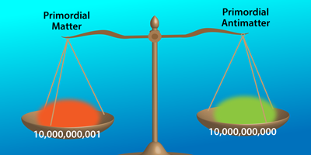
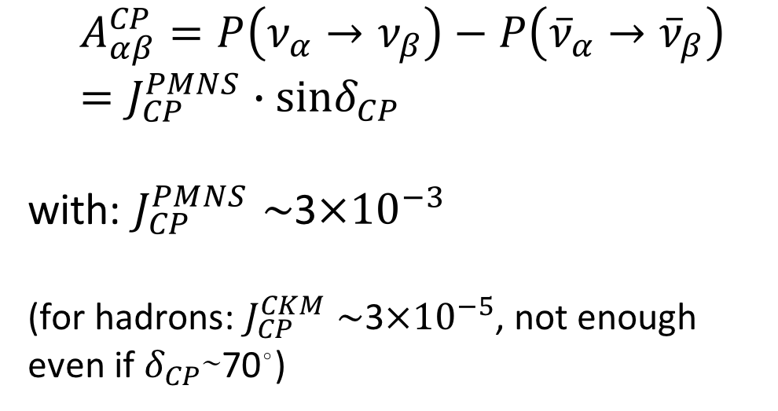
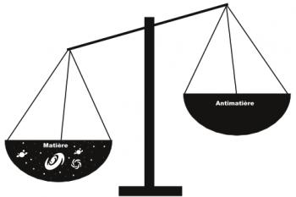
δ_{CP} and Matter-antimatter asymmetry magnitude
(Jarlskog invariant)
(from the already observed CP violation in the hadronic sector)
Theoretical models predict that if |sinδ_{CP}|≳0.7 (45°<δ_{CP}<135° or 225°<δ_{CP}<315°), this could be enough to explain the observed asymmetry.
(Nucl.Phys.B774:1-52,2007, arXiv:hep-ph/0611338)

Slide 13
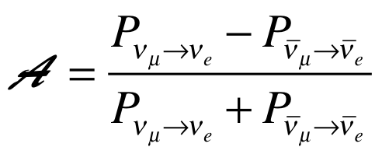
Oscillation probability
(neutrino beams)
"atmospheric"
"interference"
"solar"
matter effect
for antimatter: δ_{CP} →-δ_{CP} and a→-a
fake matter/antimatter asymetry due to matter effect
δ_{CP} dependence,
sizable matter effect for long baselines
Matter-antimatter asymmetry

Slide 14
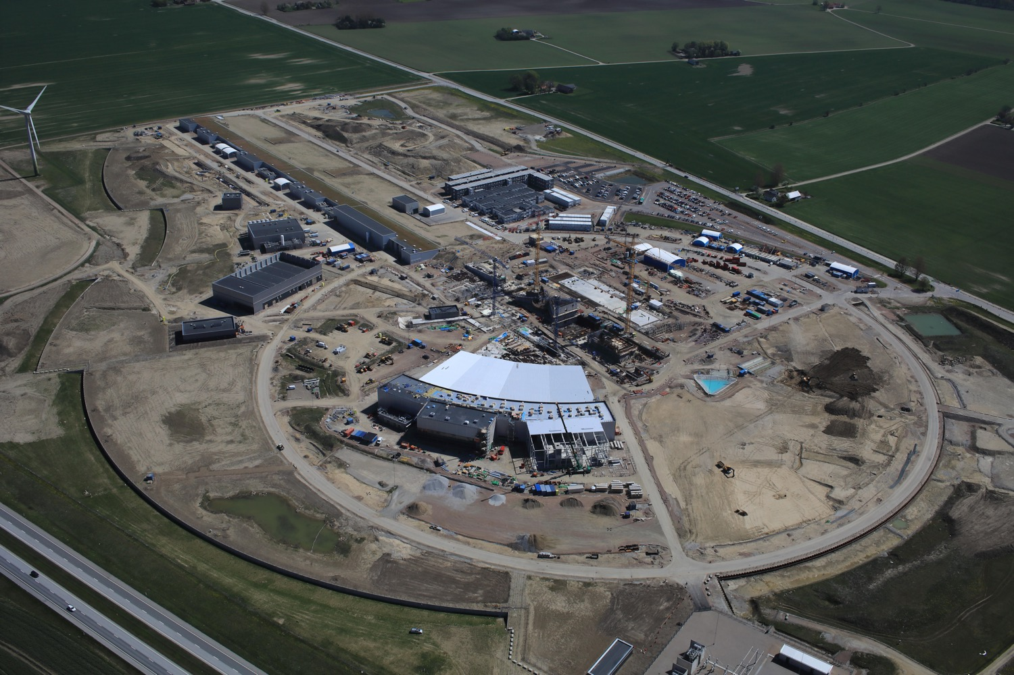

Use all this ESS linac power to go to the 2nd oscillation maximum
but why?

Slide 15
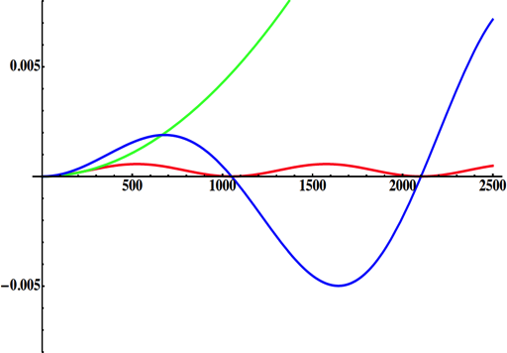
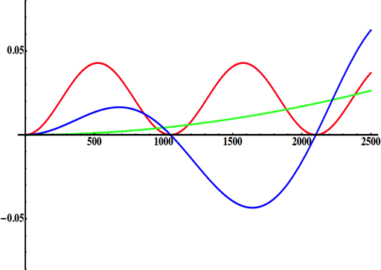
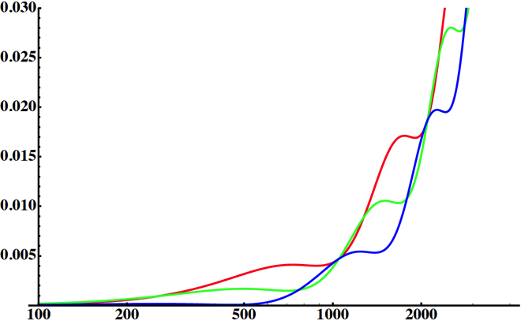
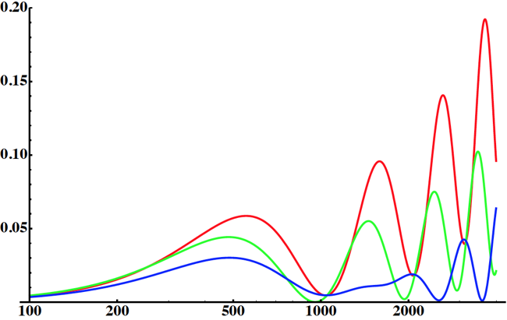
Neutrino Oscillations with "large" θ₁₃
solar
atmospheric
for "large" θ₁₃ 1st oscillation maximum is dominated by atmospheric term
for small θ₁₃ 1st oscillation maximum is better
atmospheric
solar
L/E
L/E
CP interference
(arXiv:1110.4583)
θ₁₃=1º
CP interference
θ₁₃=8.8º
solar
2nd oscillation maximum
P(ν_{μ}→ν_{e})
1st oscillation maximum
θ₁₃=1º
("small" θ₁₃)
δ_{CP}=-90
δ_{CP}=0
δ_{CP}=+90
θ₁₃=8.8º
("large" θ₁₃)
L/E
L/E
1st oscillation max.: A=0.3sinδ_{CP}
2nd oscillation max.: A=0.75sinδ_{CP}
more sensitivity at 2nd oscillation max.
(see arXiv:1310.5992 and arXiv:0710.0554)

Slide 16
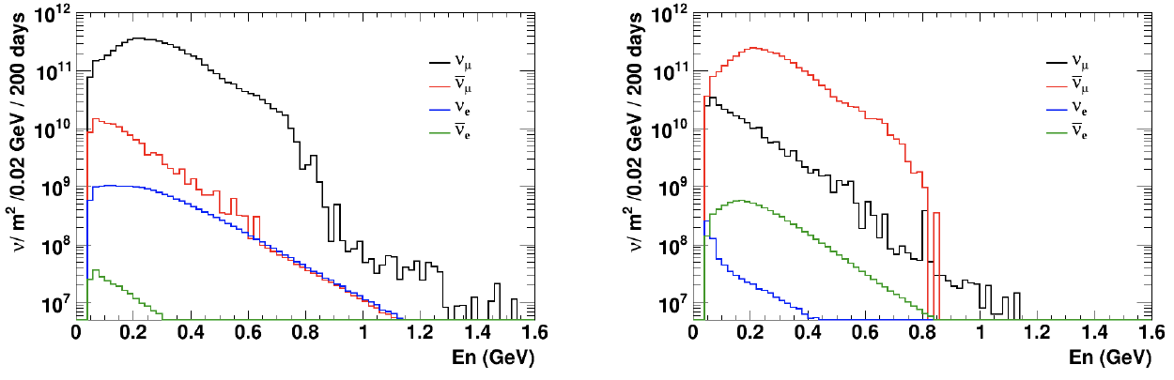
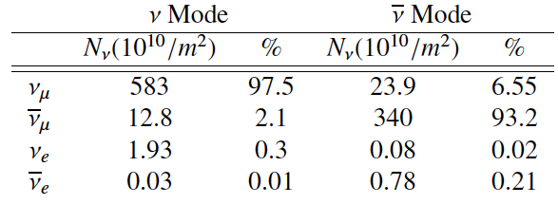
Having access to a powerful proton beam…
What can we do with:
5 MW power
2 GeV energy
14 Hz repetition rate
10¹⁵ protons/pulse
>2.7x10²³ protons/year
conventional neutrino (super) beam
proton beam
decay tunnel
p
hadrons
physics
π
ν
⨂B
target
hadronic collector
(focusing)
Detector
almost pure ν_{μ} beam
small ν_{e} contamination which could be used to measure ν_{e} cross-sections in a near detector
at 100 km from the target, per year (in absence of oscillations)

Slide 17
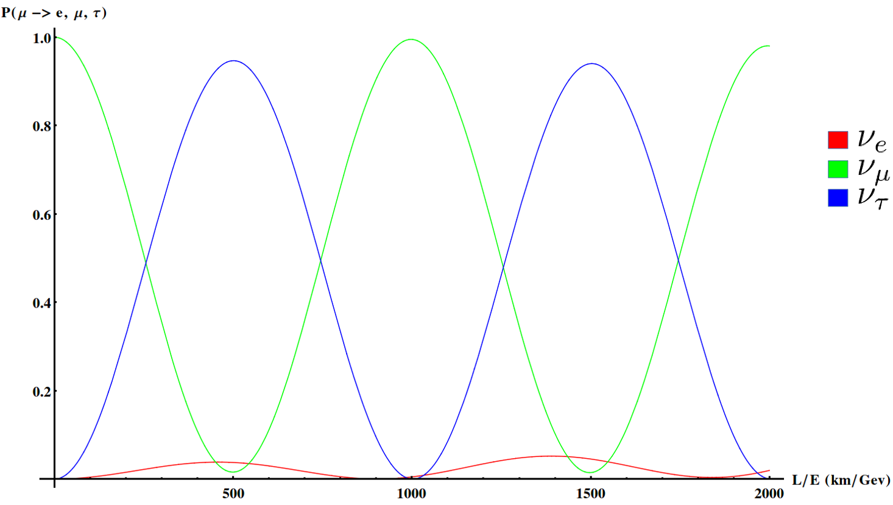
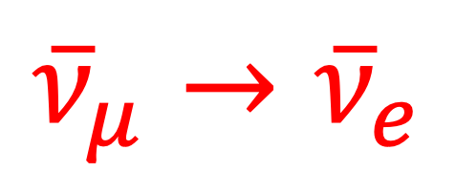
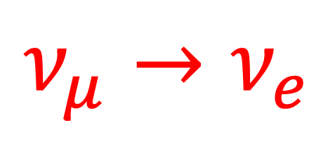
Oscillations to be studied
$$ν_{μ}→ν_{e}$$
$${\overline{ν}}_{μ}→{\overline{ν}}_{e}$$

Slide 18
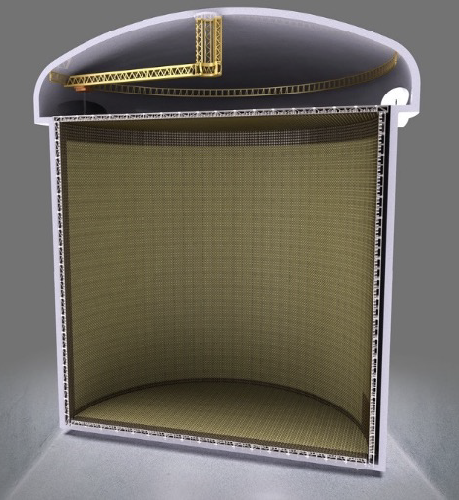
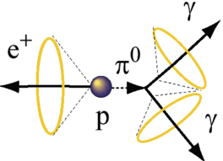
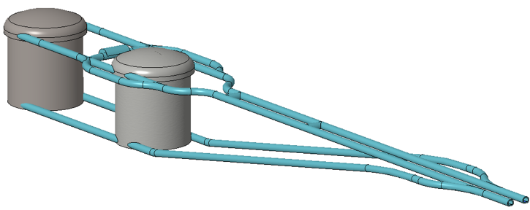
Can we go to the 2nd oscillation maximum using our proton beam?
Yes, if we place our far detector at around 500 km from the neutrino source.
Megaton Water Cherenkov detector
Neutrino Oscillations
Proton decay
Astroparticles
Understand the gravitational collapsing: galactic SN ν
  Supernovae "relics"
Solar Neutrinos
Atmospheric Neutrinos
75 m
75 m
500 kt fiducial volume (~20xSuperK)
Readout: ~20” PMTs
30% optical coverage

Slide 19
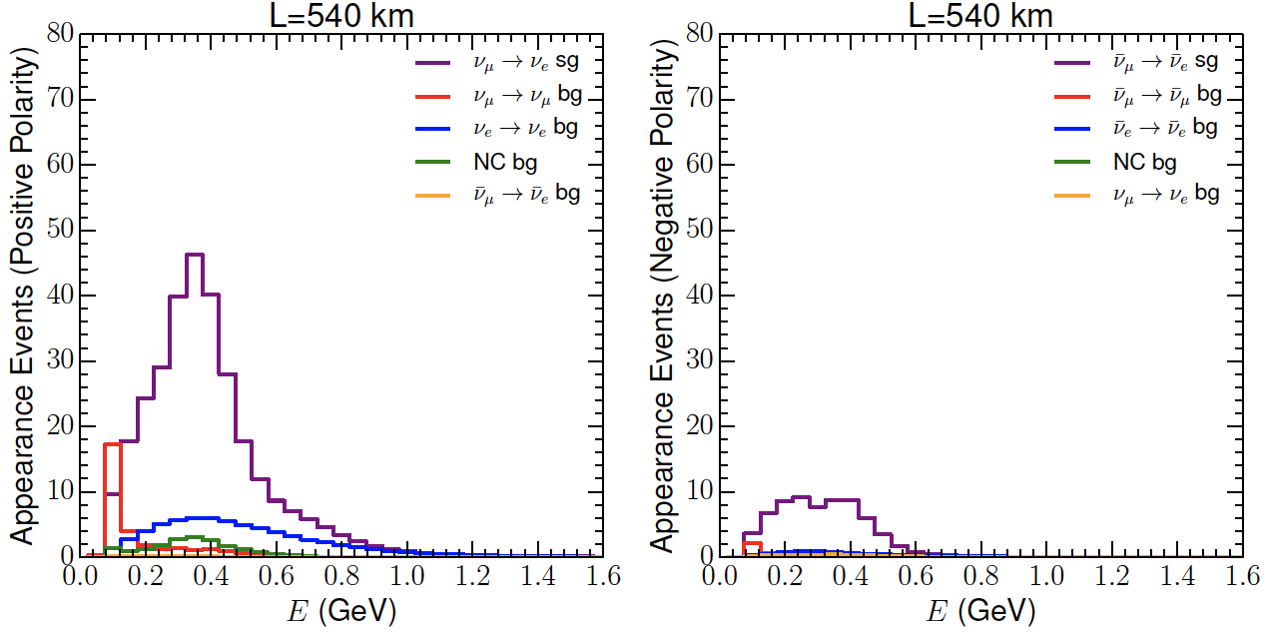
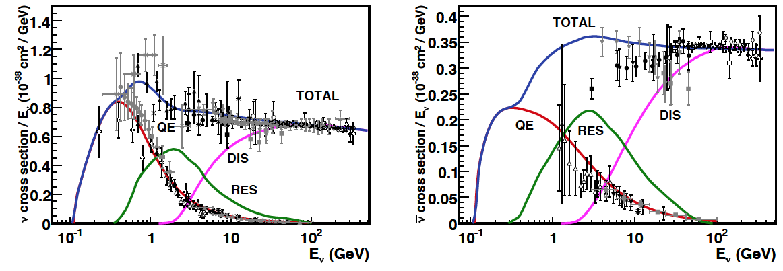
Neutrinos in the far detector
540 km (2.5 GeV), 10 years
neutrinos
anti-neutrinos
δ_{CP}=0
5 years
5 years
below ν_{τ} production, almost only QE events, not suffering too much by π⁰ background

Slide 20
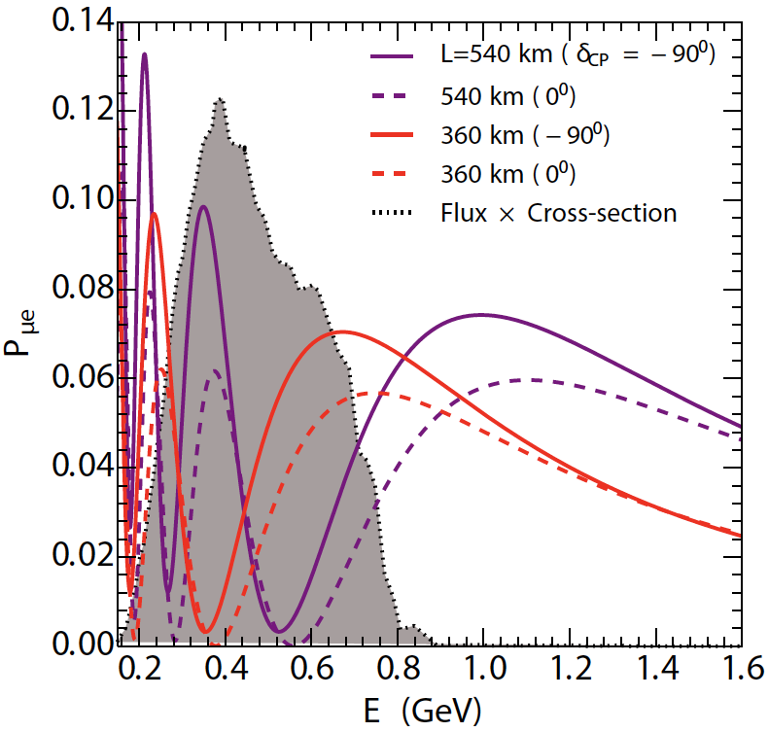
2nd Oscillation max. coverage
oscillation probability
2nd oscillation max.
well covered by the ESS neutrino spectrum
1st oscillation max.
full coverage of the 2nd oscillation max.

Slide 21
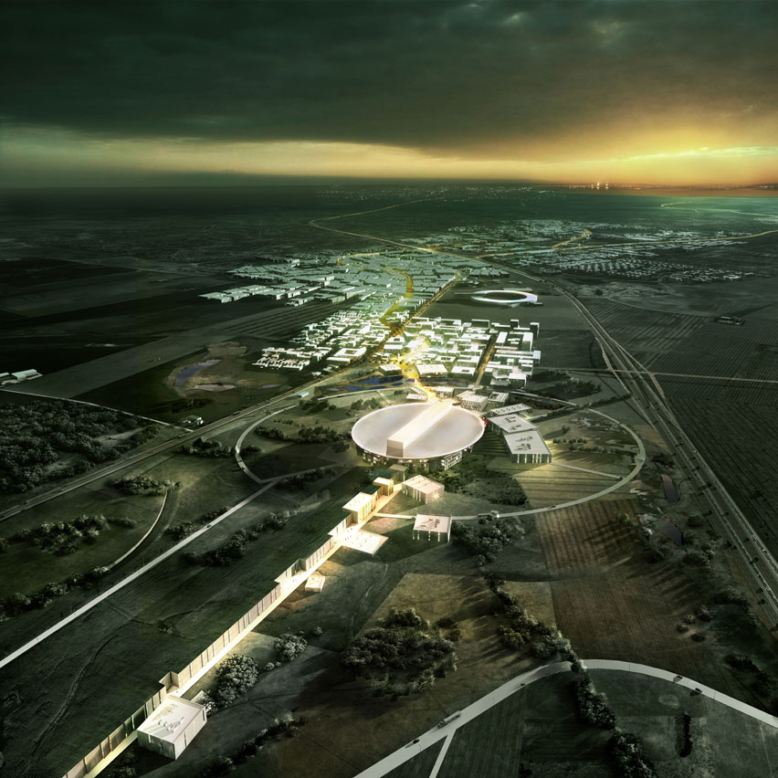
ESS modifications to produce a neutrino Super Beam
European Spallation Source Linac

Slide 22
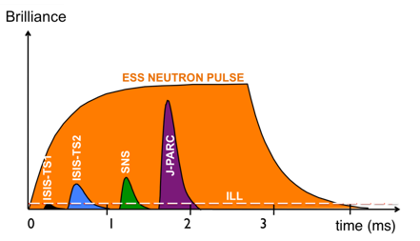
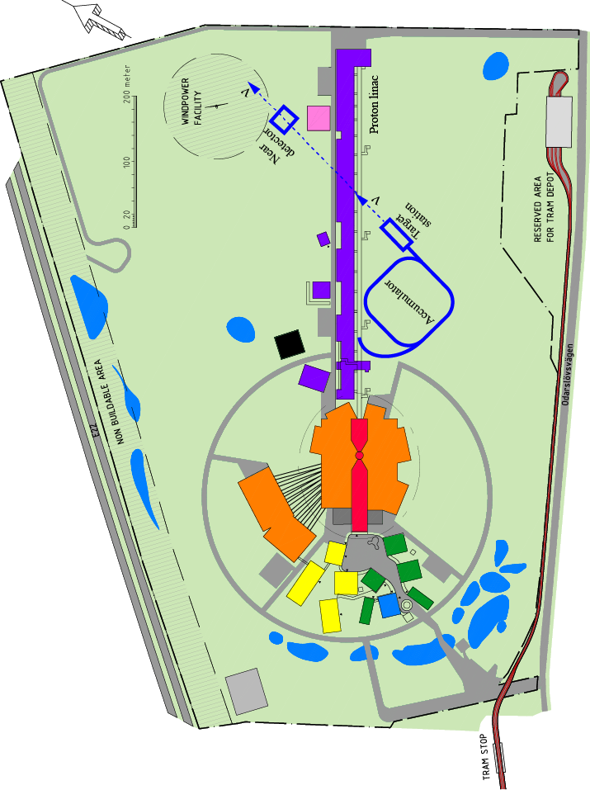
How to add a neutrino facility?
The neutron program must not be affected and if possible synergetic modifications.
Linac modifications: double the rate (14 Hz → 28 Hz), from 4% duty cycle to 8%.
Accumulator (C~400 m) needed to compress to few μs the 2.86 ms proton pulses, affordable by the magnetic horn (350 kA, power consumption, Joule effect)
  H⁻ source (instead of protons),
  space charge problems to be solved.
~300 MeV neutrinos.
Target station.
Underground detector.
Short pulses (~μs) will also allow DAR and coherent scattering experiments (as those proposed for SNS) using the neutron target.

Slide 23
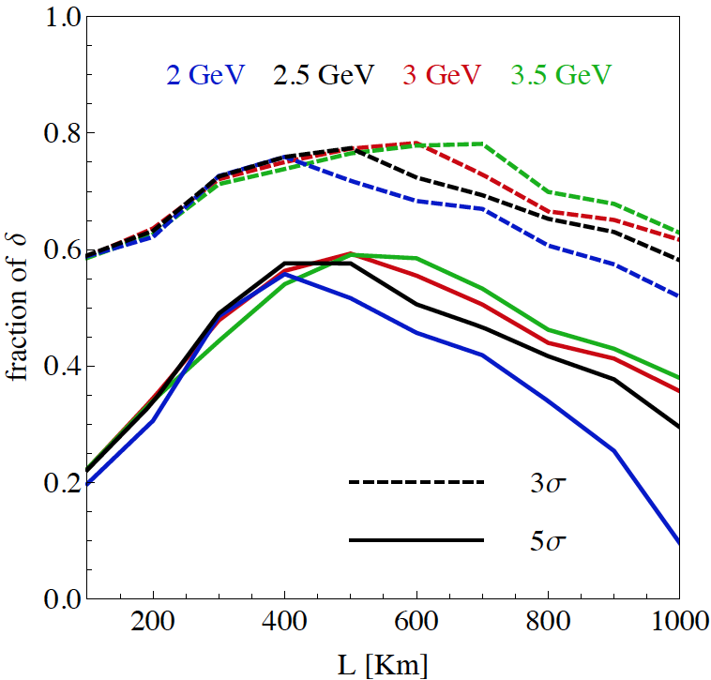
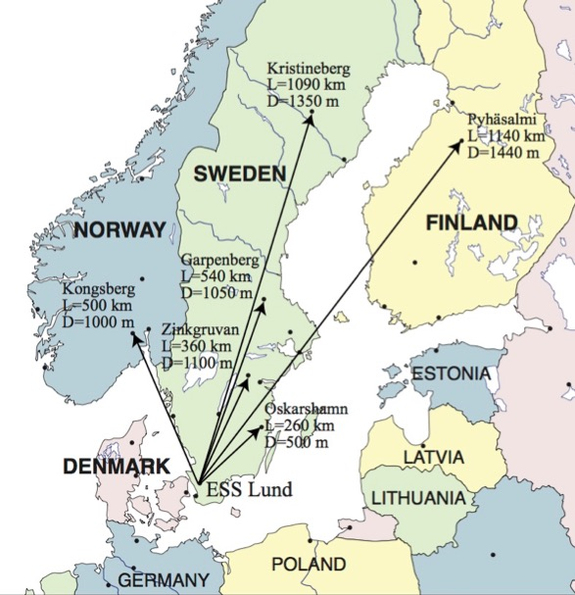
Which baseline?
CPV (Nucl. Phys. B 885 (2014) 127)
Garpenberg
Zinkgruvan
~60% δ_{CP} coverage at 5 σ C.L.
>75% δ_{CP} coverage at 3 σ C.L.
systematic errors: 5%/10% (signal/backg.)
Candidate active mines

Slide 24
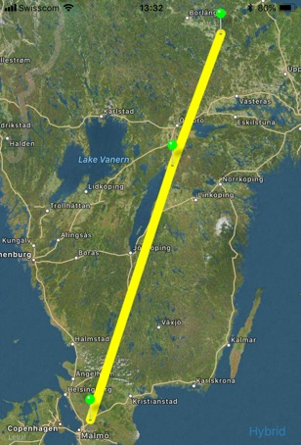
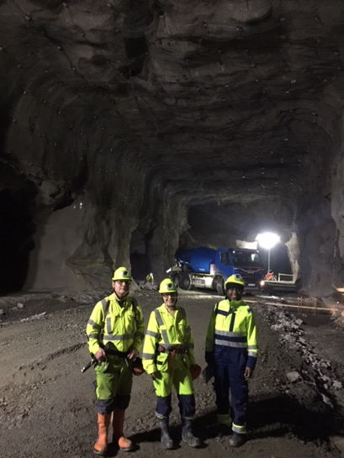
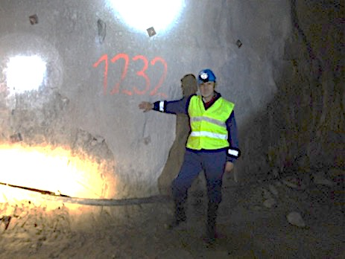
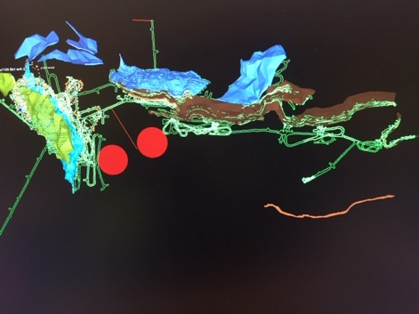
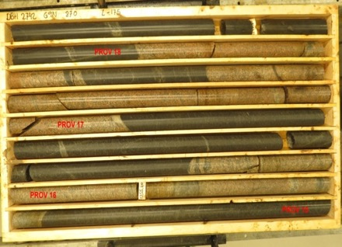
Candidate active mines
Garpenberg mine
  Distance from ESS Lund 540 km
  Depth 1200 m
  Truck access tunnel
Zinkgruvan mine
  Distance from ESS Lund 360 km
  Depth 1500 m
  Truck access tunnel
Garpenberg
(540 km)
Zinkgruvan
Zinkgruvan
(360 km)
Lund
possible location of MEMPHYS in
Zinkgruvan mine
Garpenberg
Granite drill cores

Slide 25
Preliminary Physics Performance
540 km
little dependence on mass hierarchy,
δ_{CP} coverage at 5 σ C.L. up to 60%,
δ_{CP} accuracy down to 6° at 0° and 180° (absence of CPV for these two values),
not yet optimized facility,
5/10% systematic errors on signal/background.
5/5 yrs

Slide 26
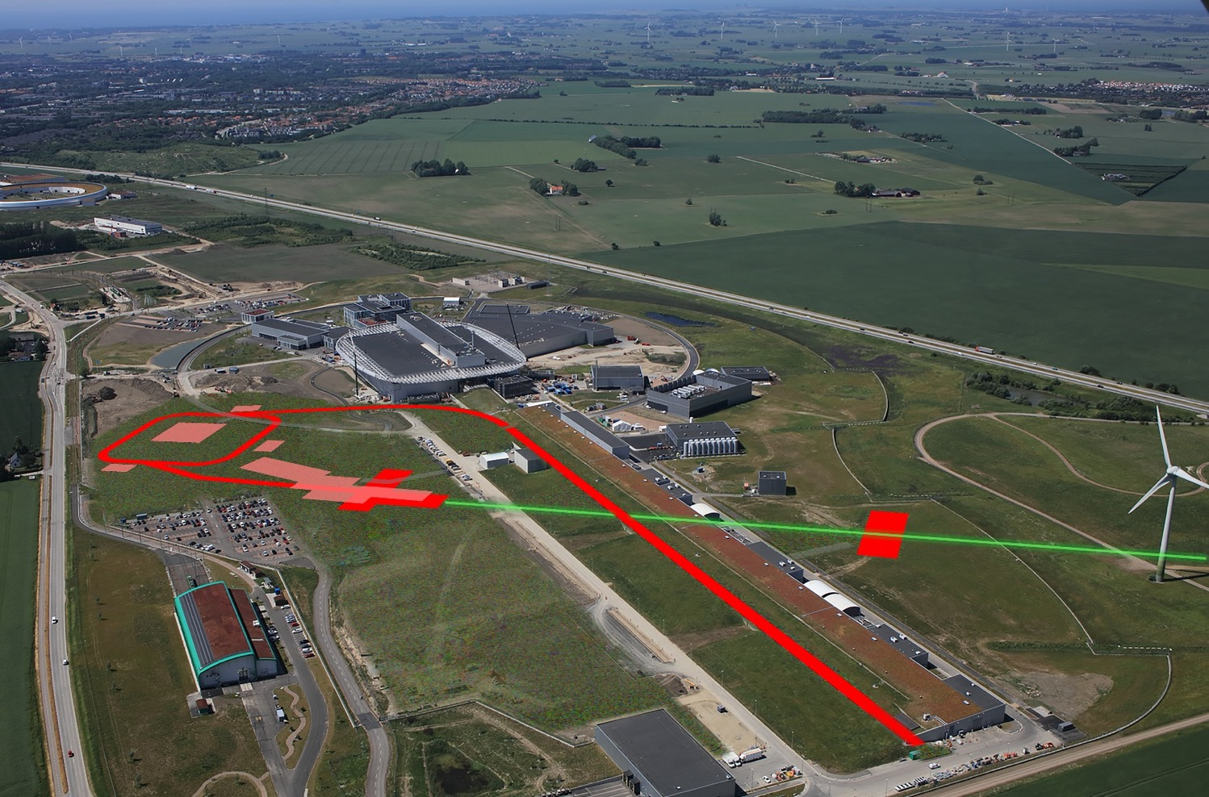
ESSνSB H2020 Design Study and feasibility

Slide 27
ESSνSB at the European level
A H2020 EU Design Study (Call INFRADEV-01-2017)
Title of Proposal: Discovery and measurement of leptonic CP violation using an intensive neutrino Super Beam generated with the exceptionally powerful ESS linear accelerator
Duration: 4 years
Total cost: 4.7 M€
Requested budget: 3 M€
15 participating institutes from
11 European countries including CERN and ESS
6 Work Packages
Approved end of August 2017
ESSνSB
BENE (2004-2008)
ISS (2005-2007)
EUROν (2008-2012)
LAGUNA (2008-2010)
LAGUNA-LBNO (2010-2014)
COST Action CA15139 (2015-2019)

Slide 28
Design Study ESSνSB
(2018-2022)
now finished end of March 2022
More information on:
http://essnusb.eu/
partners: IHEP, BNL, SCK•CEN, SNS, PSI, RAL, NU

Slide 29
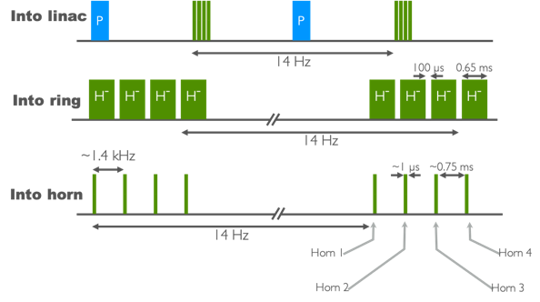
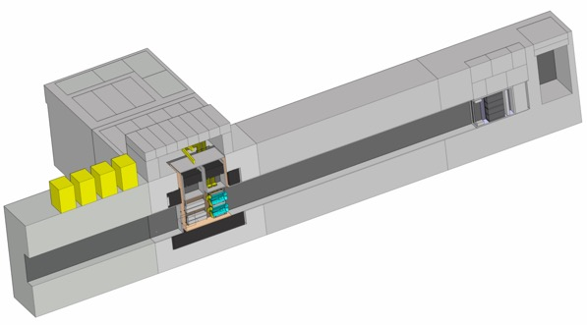
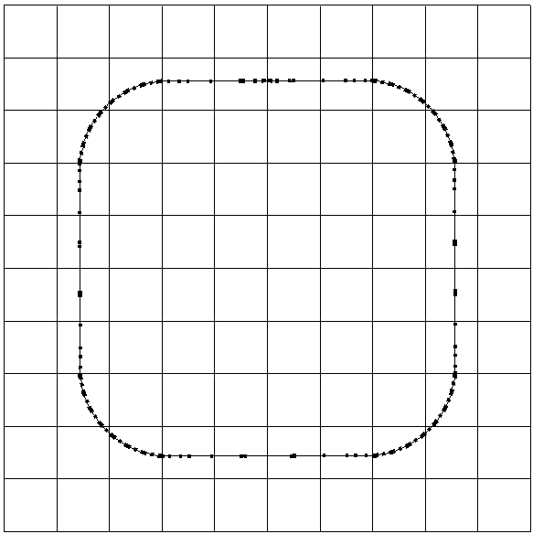


ESS modifications and operation
H⁻ source
time operation option
accumulator lattice
injection
neutrino beam
horn power supply
RF
beam dump
decay tunnel (50 m)
proton beam
target/horn x4
extraction
collimation
Switchyard

Slide 30




Detectors
Near detector
electron-muon separation
75 m
75 m
astroparticle physics program with the Far Detector

Slide 31

After many Optimisations
New Magriation Matrices for the far detector
Genetic Algorithm for Target Station optimisation
WC detector
ν_{e} reconstruction efficiency
(using T2K-like reconstruction algorithm)
horn optimisation
"new"
"old"

Slide 32
Improvements and Optimisations
540 km
360 km
540 km
360 km
ESSnuSB
θ₁₂ = 33.44°
θ₁₃ = 8.57°
θ₂₃ = 49.2°
Δm²₂₁ = 7.42e-5
Δm²₃₁ = +2.52e-3
2nd osc. max.
507 ktons far detector
https://arxiv.org/abs/2107.07585

Slide 33



Final results
Precision measurement
Δδ_{CP}<8° for all values
>72% after 10 years
equivalent to Neutrino Factory

Slide 34




Performance versus time
Already after 5 years very competitive performance
DUNE
HyperK

Slide 35



δ_{CP} and model predictions
https://arxiv.org/abs/1410.7573
Test of flavour symmetry models:
Typically, the models considered have a reduced number of parameters, leading to relations between the masses and/or mixing angles.
Examples are the so-called sumrules, e.g.:
https://arxiv.org/abs/1410.8056

Slide 36



Final ESSνSB facility configuration
near detector
accumulator
target station
far detector
https://arxiv.org/abs/2206.01208
Conceptual Design Report

Slide 37




Supporting institutions of ESSνSB
COST Action EuroNuNet (CA15139): ended March 2020
  https://euronunet.in2p3.fr
  video for scientists: https://www.youtube.com/watch?v=PwzNzLQh-Dw
EU-H2020 Design Study ESSνSB: on going up to March 2021 (3 months extension due to COVID19)
  https://essnusb.eu
  video for general public: https://www.youtube.com/watch?v=qAnvft0nAlg

Slide 38


Muons at the level of the beam dump
2.7x10²³ p.o.t/year
y (cm)
muons at the level of the beam dump
(per proton)
more than 4x10²⁰ μ/year from ESS compared to 10¹⁴ μ used by all experiments up to now (10¹⁸ μ for COMET in the future).
4.2x10²⁰ μ/year
(16.3x10²⁰ for 4 m²)
x (cm)
10⁻³
4.1x10²⁰ μ/year
muons/proton
input beam for future 6D μ cooling experiments (for muon collider),
low energy nuSTORM,
Neutrino Factory,
Muon Collider.
<E_{μ}>~0.5 GeV
<L_{μ}>~3 km

Slide 39
ESSνSB and (R&D) synergies
2.7x10²³ p.o.t/year
ν_{μ} + ‾ν_{e}
ν_{μ} or ‾ν_{μ}
ν_{e} + ‾ν_{μ}
Super Beam
nuSTORM
ESSνSB
+Decay At Rest and Coherent scat.
(with short pulses)
Neutrino Factory
Muon Collider
ESSμSB

Slide 40

Upcoming studies
(mainly cross-section measurements)
Design of a racetrack storage ring for low energy muons produced with a beam from the ESS linac.
Design a transfer system from the initial collection and extraction of pions behind the target station, up to the injection point.
Design a transfer line from the ESSνSB ring-to-switchyard transfer line to the nuSTORM target.
Design an injection scheme for the racetrack storage ring
Design a Monitored Neutrino Beam (low energy ENUBET)
Optimize the performance of the ESSνSB accelerator complex
Cross-section measurements with:
Low Energy nuSTORM: π⟶ μ ⟶ e+ν_{μ}+ν_{e}
Low Energy ENUBET: π ⟶ μ+ν_{μ}
Excellent supporting letter from the ESS director

Slide 41
ESSνSB+
(Horizon Europe)
Participant no. | Participant organisation name | Part. short name | Country
1 (Coordinator) | Centre National de la Recherche Scientifique | CNRS | France
2 | Université de Strasbourg | UNISTRA¹ | France
3 | Rudjer Boskovic Institute | RBI | Croatia
4 | Tokai National Higher Education and Research System, National University Corporation | NU² | Japan
5 | Uppsala Universitet | UU | Sweden
6 | Lunds Universitet | ULUND | Sweden
7 | European Spallation Source ERIC | ESS | Sweden
8 | Kungliga Tekniska Hoegskolan | KTH | Sweden
9 | Universitaet Hamburg | UHH | Germany
10 | University of Cukurova | CU | Turkey
11 | National Center for Scientific Research "Demokritos" | NCSRD | Greece
12 | Aristotelio Panepistimio Thessalonikis | AUTH¹ | Greece
13 | Sofia University St. Kliment Ohridski | UniSofia | Bulgaria
14 | Lulea Tekniska Universitet | LTU | Sweden
15 | European Organisation for Nuclear Research | CERN | IEIO³
16 | Universita degli Studi Roma Tre | UNIROMA3 | Italy
17 | Universita degli Istudi di Milano-Bicocca | UNIMIB | Italy
18 | Istituto Nazionale di Fisica Nucleare | INFN | Italy
19 | Universita degli Istudi di Padova | UNIPD¹ | Italy
20 | Consorcio para la construccion, equipamiento y explotacion de la sede espanola de la fuente Europea de neutrones por espalacion | ESSB | Spain
^{[1]} Affiliated Partner
^{[2]} Associated Institute
^{[3]} International European Interest Organisation
submitted last March
decision in September

Slide 42



Possible ESSνSB schedule
(2nd generation neutrino Super Beam)
2022: End of ESSνSB Design Study, CDR and preliminary costing
2012: inception of the project
2016-2019: beginning of COST Action EuroNuNet
2018: beginning of ESSνSB Design Study (EU-H2020)
2022-2026: Preparatory Phase, TDR
2026-2028: Preconstruction Phase, International Agreement
2028-2036: Construction of the facility and detectors, including commissioning
2037-: Data taking
arxiv.org/abs/2206.01208
Nucl. Phys. B 885 (2014) 127

Slide 43

Conclusion
The ESS proton linac will be soon the most powerful linac in the world.
ESS can also become a neutrino facility (ESSνSB ) with enough protons to go to the 2nd oscillation maximum and increase significantly the CPV sensitivity and precise measurement of δ_{CP}.
CPV: 5 σ could be reached over 70% of δ_{CP} range by ESSνSB with large physics potential with less than 8° precision.
The European Spallation Source will be ready by 2025, upgrade decisions by this moment.
Conceptual Design Report published on arXiv.
Rich muon program for future ESS upgrades.
New applications submitted or under preparation

Slide 44
Backup

Slide 45





General Layout of the target station
(inspired by J-PARC)
Shield Blocks
Horn Support Module
8 m concrete
Split Proton Beam
Horns and Targets
Collimators
Decay Volume
(He, 4x4x25 m³)
Neutrino Beam Direction
Beam Dump

Slide 46



Emulsions
Operating at J-PARC by Nagoya University
NINJA-type emulsion detector (ν-King) will be situated immediately upstream of the SFGD tracker for precise neutrino interaction cross-section measurements.
NINJA detector is an emulsion-based detector composed of modules using either iron or water as a target
  it is currently under operation at J-PARC by Nagoya University.
A conceptual design for the NINJA-like detector adapted to the ESSνSB project has been developed and included in the technical drawings of the Near Detector.
from OPERA experiment

Slide 47

Sakharov conditions
In order to generate the needed baryon asymmetry the following conditions must be satisfied:
Baryon number violation
  If not, no baryon number can be generated (o.k. in SM considering Sphalerons @ ~140 GeV)
C and CP violation
  Γ(A→B+C)=Γ(A-bar→B-bar+C-bar)
  CP violation already observed in the quark sector, but not enough
Departure from thermal equilibrium
  production/destruction rates of baryons are equal if thermal equilibrium Γ(A→B+C)=Γ(B+C→A)
  expansion of the universe

Slide 48



Comparisons
ESSnuSB March 2022 with 5% normalization error
DUNE Snomass March 2022
HyperK Snowmass March 2022

Slide 49


Physics Performance
during 10 years

Slide 50


Physics Performance

Slide 51
Comparisons
Comparison using the same systematic errors
Phys. Rev. D 87 (2013) 3, 033004 [arXiv:1209.5973 [hep-ph]]

Slide 52



Under construction long baseline projects
DUNE (USA)
T2HK (Japan)
~50% of δ_{CP} coverage
δ_{CP} resolution ~20° at δ_{CP} = 90°
with low systematic uncertainties assumptions

Slide 53
Fraction of δ_{CP}
Garpenberg
(540 km)
(E. Martinez-Fernandez)
Zinkgruvan
(360 km)
Lund
2 active mines aligned…
3% systematic error on the signal!
My personal opinion:
these scenarios are too optimistic for all facilities

Slide 54

Decay At Rest at ESS
Possible if short pulses (~μs)
π⁻
~99%
capture
ν_{e}
Well known neutrino spectra (DAR).
Very high neutrino intensities ~ 5x10¹⁵ ν/s.
Separate neutrinos of different flavors by time cut.
Role that neutrino-nucleus interactions play in the supernova explosion process and subsequent nucleosynthesis.
Accurate knowledge of neutrino-nucleus cross sections is important (almost no data exist).
This lack of knowledge significantly limits our understanding of supernovae and of terrestrial observations of cosmic neutrinos to probe the deepest layer of these powerful explosions.
p
A
μ⁺
τ ≈ 2.2 μs
DAR
e⁺
π⁺
τ ≈ 26 ns
ν_{μ}
Fragments
ν_{μ}

Slide 55
Kaon Decay At Rest at ESS

Slide 56

Coherent Scattering at ESS
SNS
sterile neutrinos,
neutrino magnetic moment,
non-standard interactions (NSI) mediated by new particles,
probes of nuclear structure,
improved constraints on the value of the weak nuclear charge,
reduction in neutrino detector mass may lead to a number of technological applications as non-intrusive nuclear reactor monitoring.
CEνNS is also expected to dominate neutrino transport in neutron stars, and during stellar collapse.
…

Slide 57


Coherent Scattering at ESS
JHEP 02 (2020) 123
ESS can generate the largest pulsed neutrino flux suitable for the detection of Coherent Elastic Neutrino-Nucleus Scattering (CEνNS ).
Innovative detector technologies able to profit from the order-of-magnitude increase in neutrino flux provided by the ESS, along with their sensitivity to a rich particle physics phenomenology accessible through high-statistics, precision CEνNS measurements, are under study.

Slide 58

Neutrino Interactions
ν
ν
ν
l
ν
ν
ν
l
π⁰
e
e
n
n
n
n
n
hadrons
Elastic
Quasi-Elastic (QE)
Resonant (RES)
Deep inelastic (DIS)
neutrinos
antineutrinos
According to neutrinos to be detected their interaction cross-section has to be taken into account.

Slide 59

δ_{CP} and model predictions
https://arxiv.org/abs/1504.00658

Slide 60



Muon Collider as Higgs Factory
Carlo Rubbia
arXiv:1908.05664
HIFI Uppsala Workshop 2-3 March 2020

Slide 61

Muons at ESS (ESSμSB)

Slide 62




What does it mean 5 MW?
    Same energy as a 16 lb (7.2kg) shot traveling at
    1100 km/hour
    Mach 0.93
  Same energy as a 1000 kg car traveling at 96 km/hour
  You boil 1000 kg of ice in 83 seconds

