Slide 1
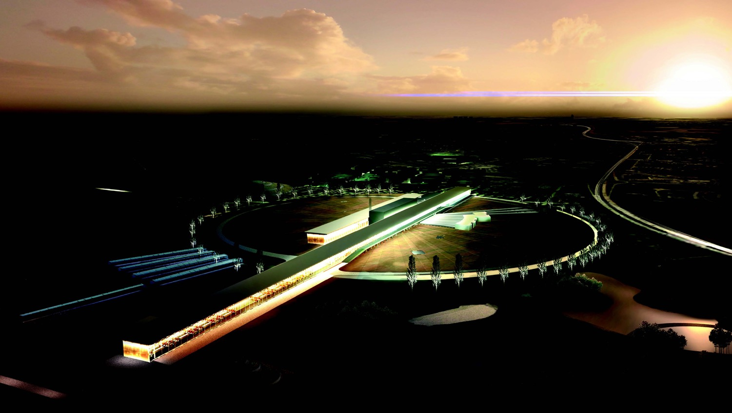

European Spallation Source neutrino Super Beam
What after?
Marcos Dracos
IPHC-Strasbourg

Slide 2
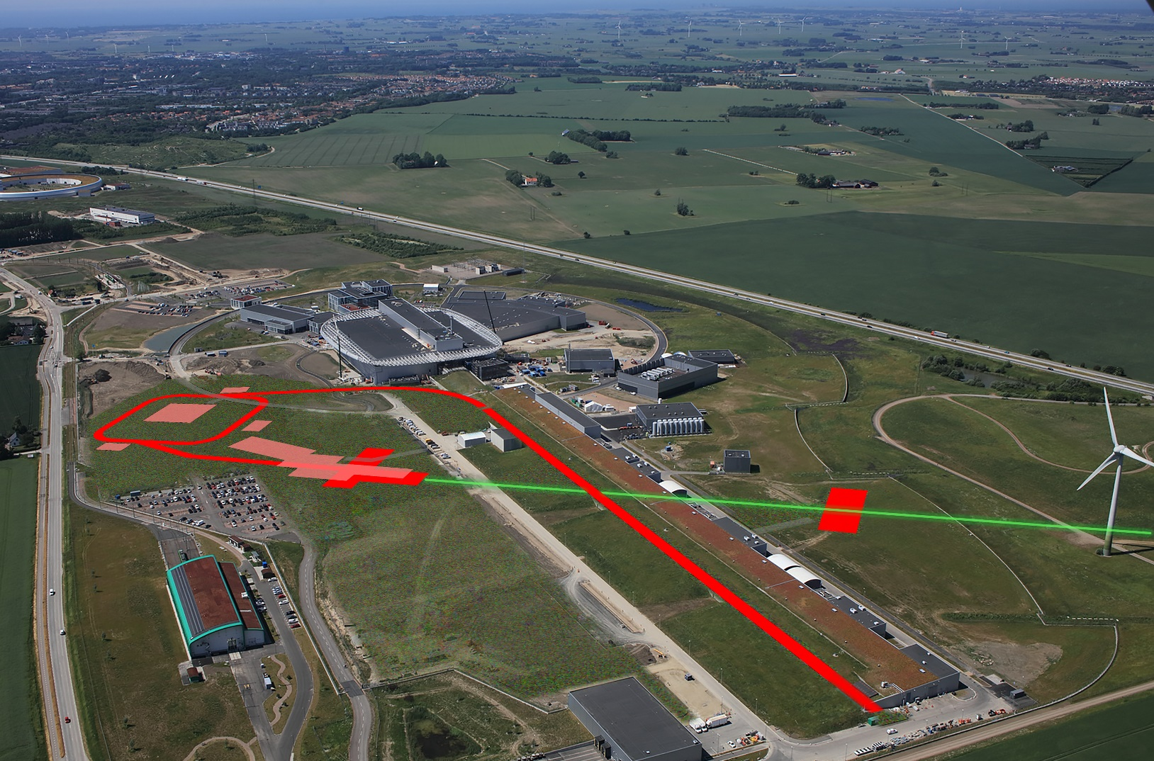
ESSνSB H2020 Design Study and feasibility

Slide 3
ESSνSB at the European level
A H2020 EU Design Study (Call INFRADEV-01-2017)
Title of Proposal: Discovery and measurement of leptonic CP violation using an intensive neutrino Super Beam generated with the exceptionally powerful ESS linear accelerator
Duration: 4 years
Total cost: 4.7 M€
Requested budget: 3 M€
15 participating institutes from
11 European countries including CERN and ESS
6 Work Packages
Approved end of August 2017
ESSνSB
BENE (2004-2008)
ISS (2005-2007)
EUROν (2008-2012)
LAGUNA (2008-2010)
LAGUNA-LBNO (2010-2014)
COST Action CA15139 (2015-2019)

Slide 4
Design Study ESSνSB
(2018-2022)
now finished end of March 2022
More information on:
http://essnusb.eu/
partners: IHEP, BNL, SCK•CEN, SNS, PSI, RAL, NU

Slide 5
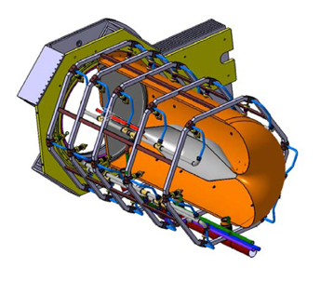
After many Optimisations
New Magriation Matrices for the far detector
Genetic Algorithm for Target Station optimisation
WC detector
ν_{e} reconstruction efficiency
(using T2K-like reconstruction algorithm)
horn optimisation
"new"
"old"

Slide 6
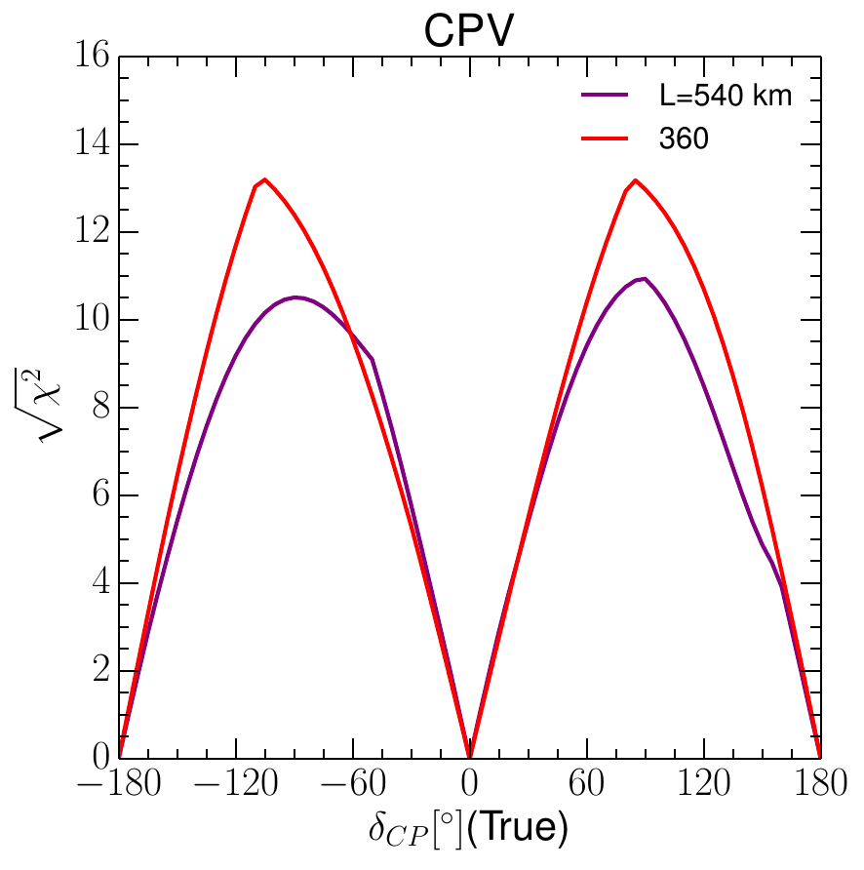
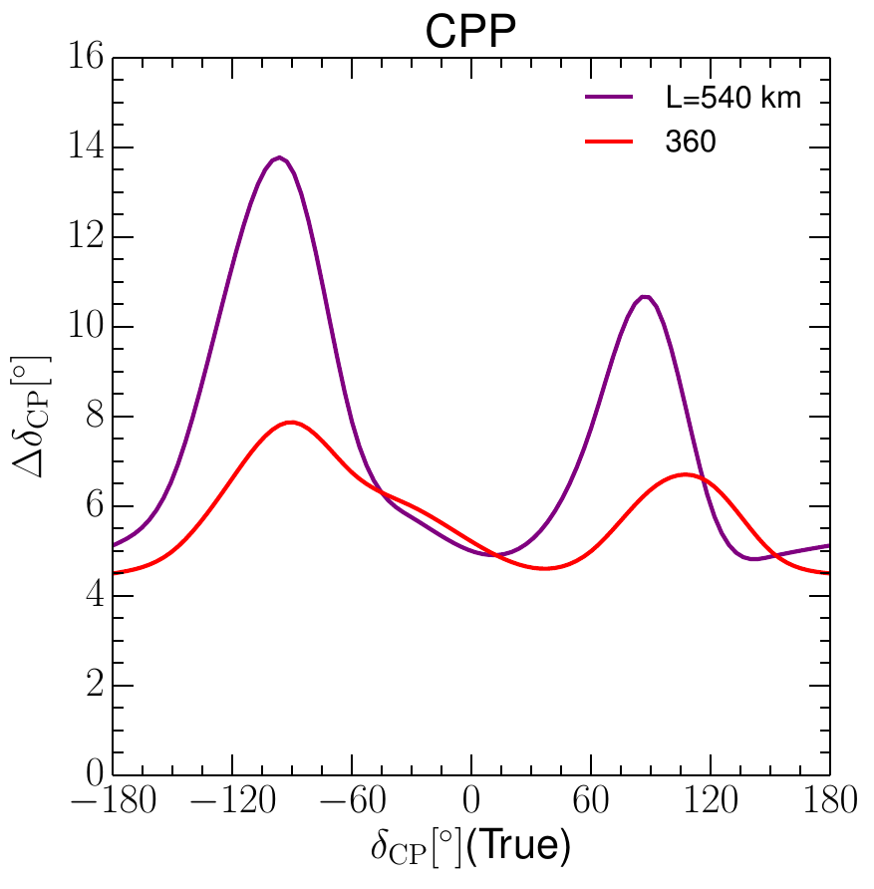
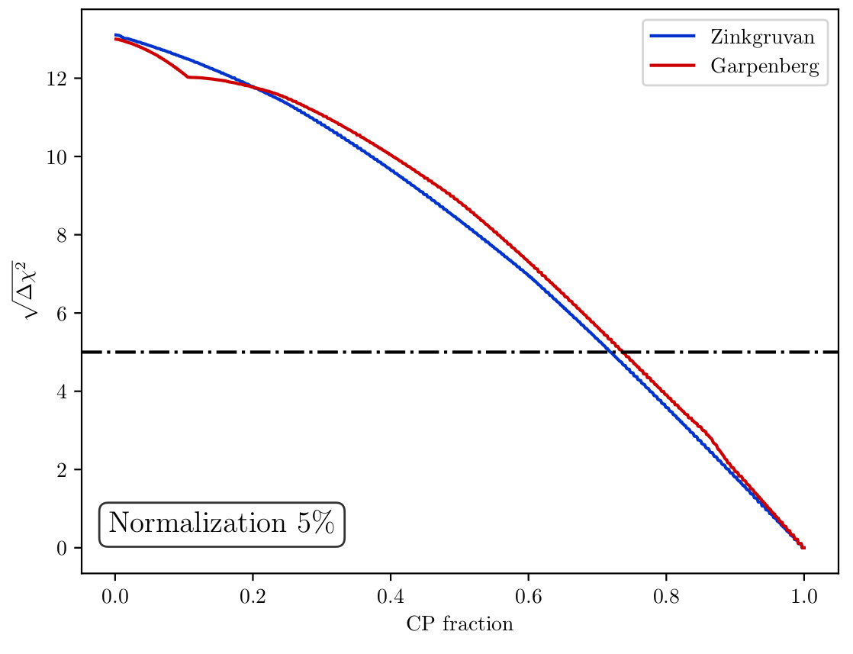
Final results
Precision measurement
Δδ_{CP}<8° for all values
>72% after 10 years
equivalent to Neutrino Factory

Slide 7
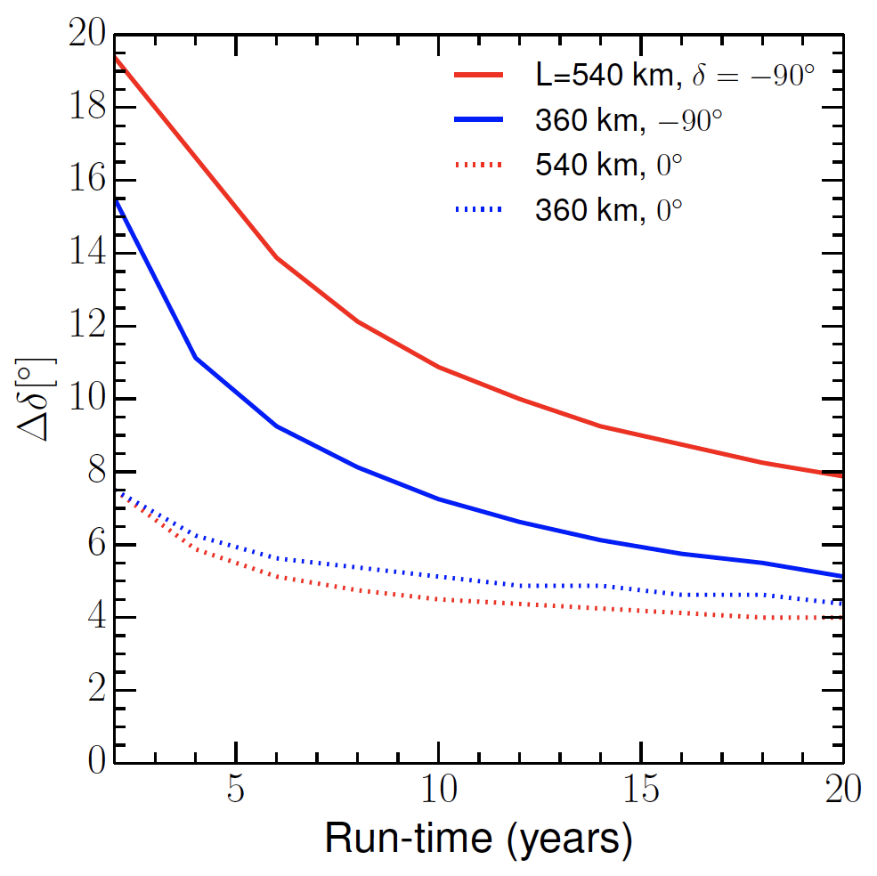
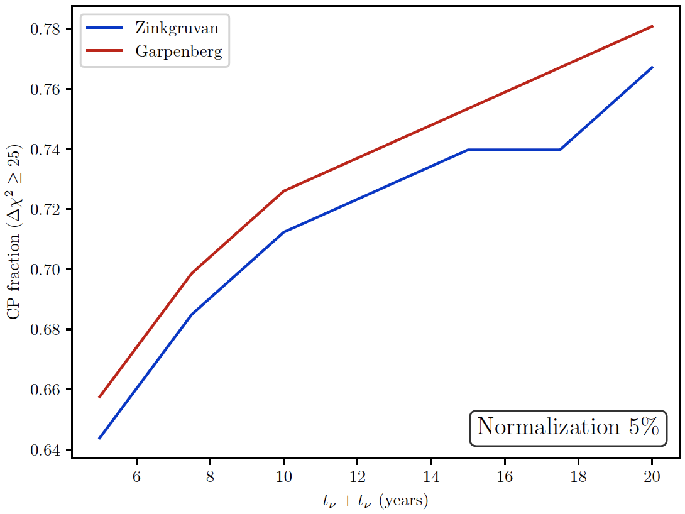
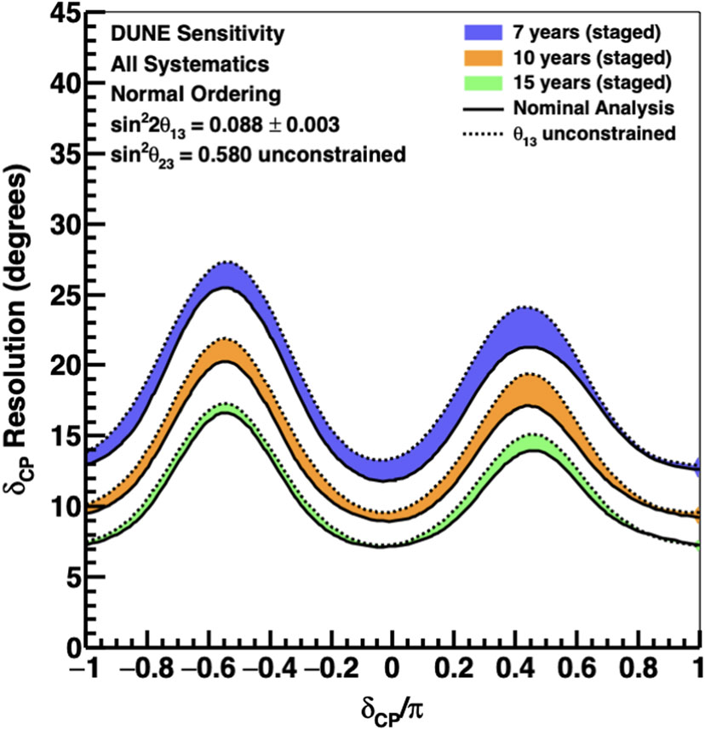
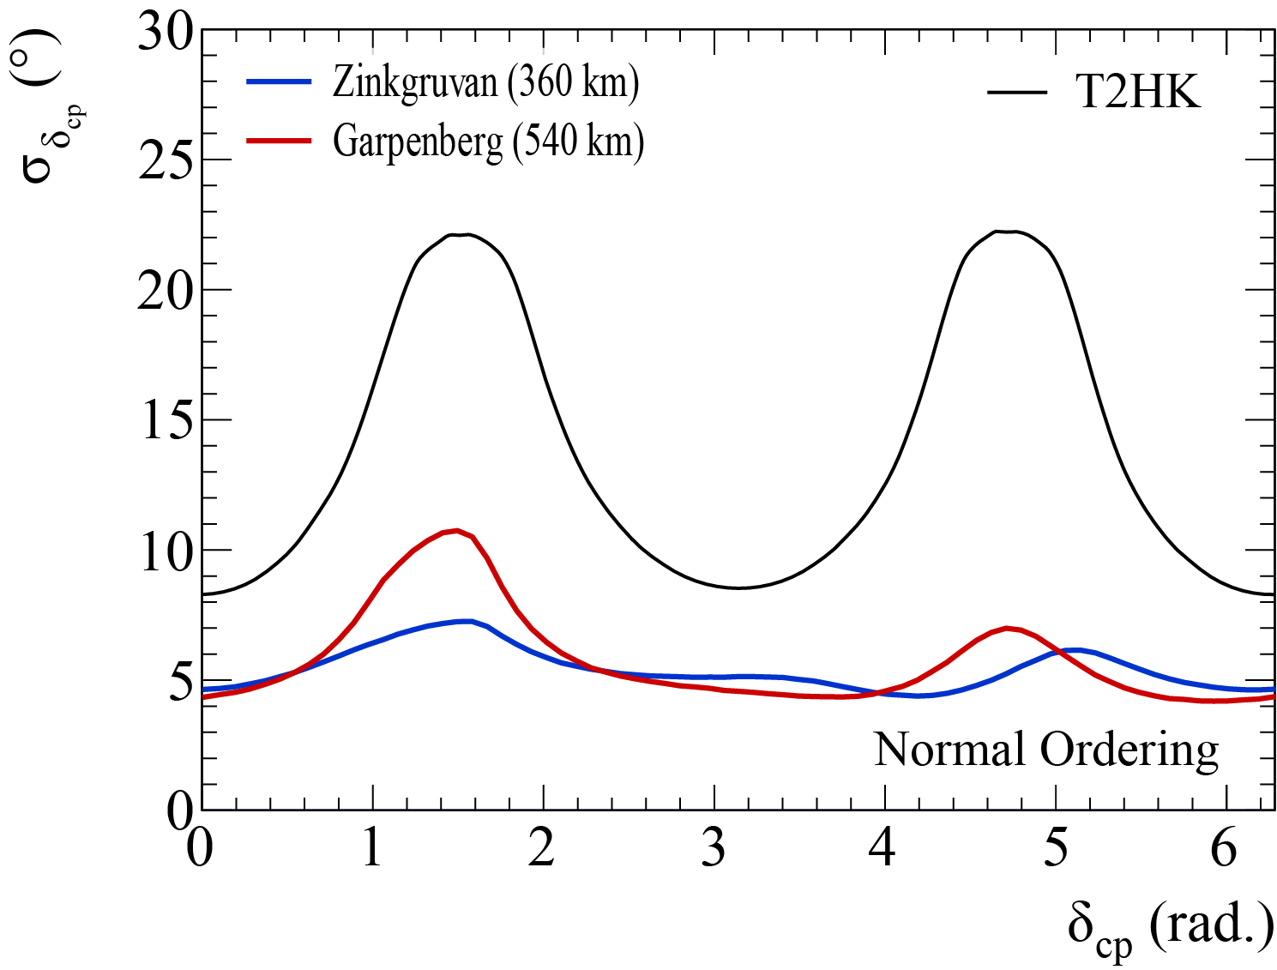
Performance versus time
Already after 5 years very competitive performance
DUNE
HyperK

Slide 8
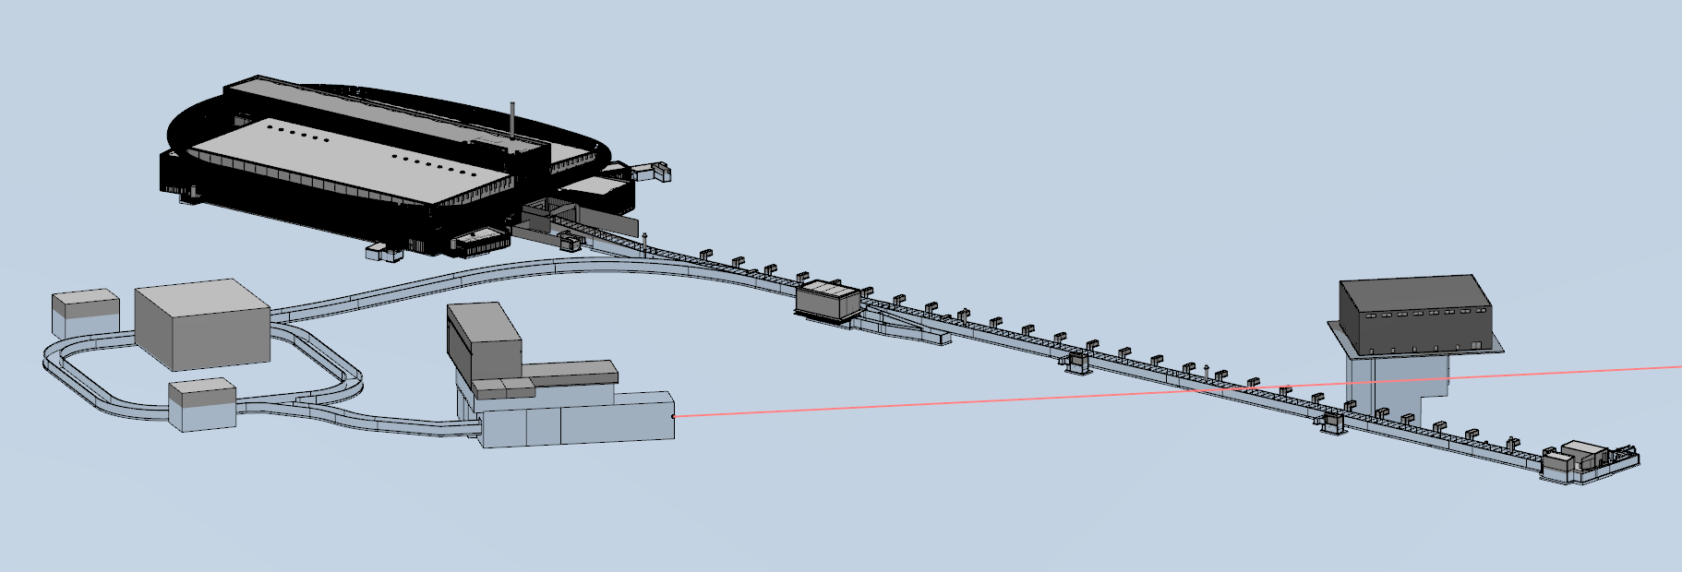
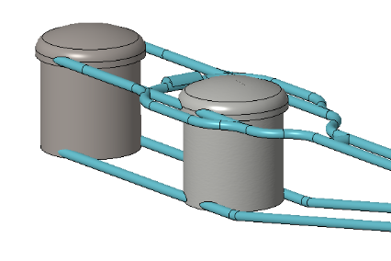

Final ESSνSB facility configuration
near detector
accumulator
target station
far detector
https://arxiv.org/abs/2206.01208
Conceptual Design Report

Slide 9
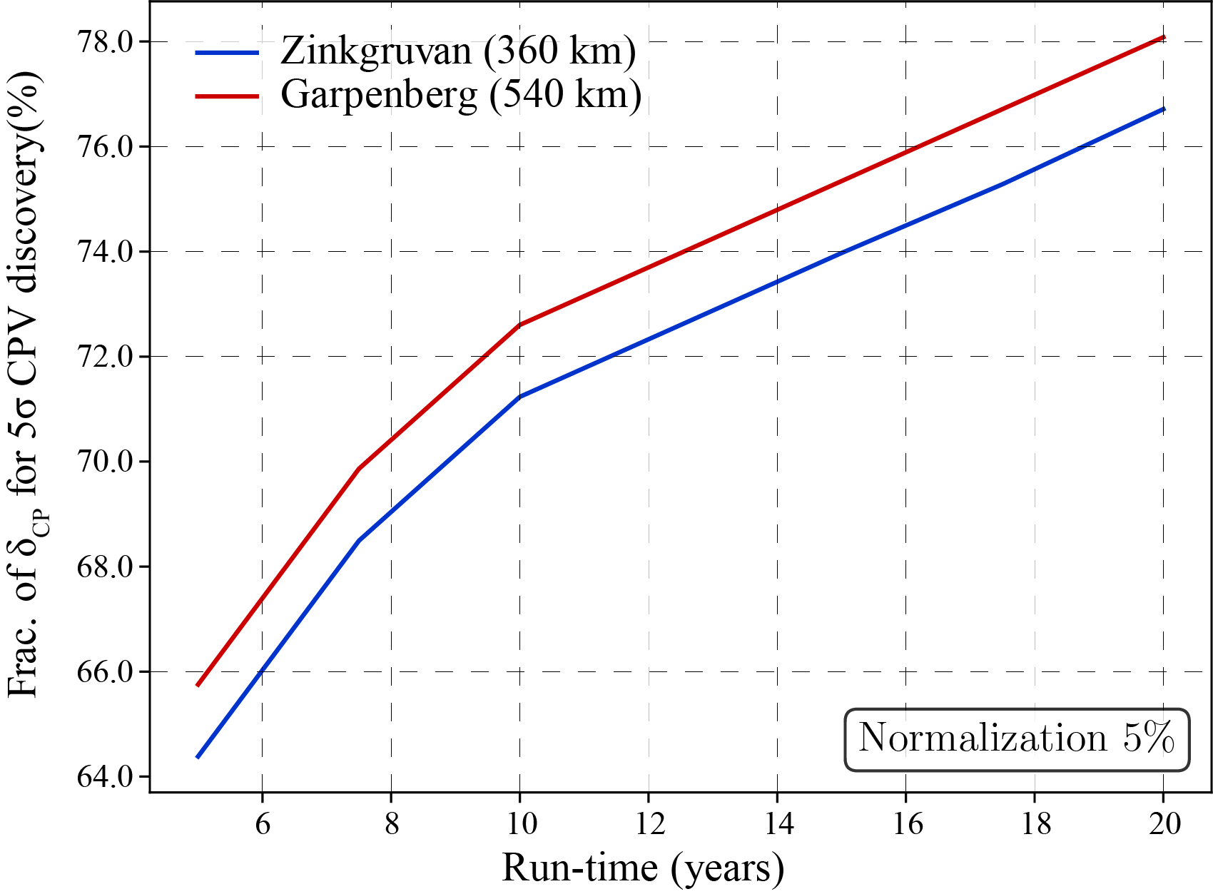
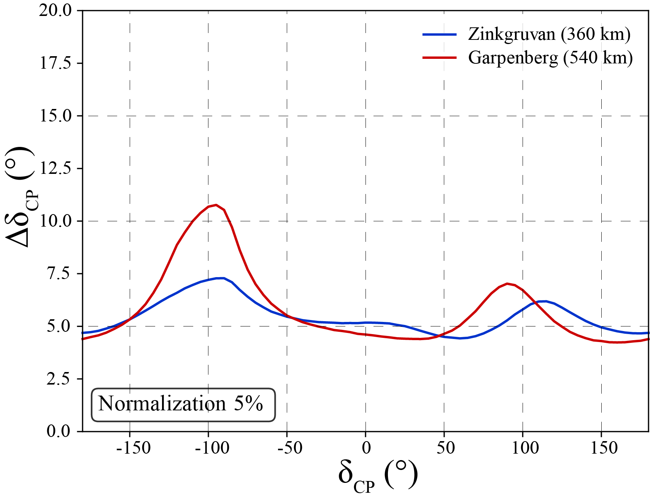
ESSνSB → ESSνSB+
The ESSνSB Consortium has produced a comprehensive Conceptual Design Report (CDR) of the complete ESSνSB neutrino facility proving the feasibility of all proposed elements. In this CDR, it is demonstrated that the initially foreseen physics performance has surpassed all earlier expectations by covering after 10 years of data collection more than 70% of δ_{CP} with a confidence level of more than 5 σ to reject the no-CPV hypothesis. The expected measurement precision of the value of δ_{CP} is better than 8° for all δ_{CP} values, making it the most precise proposed experiment by a large margin.
We need to make it happen

Slide 10
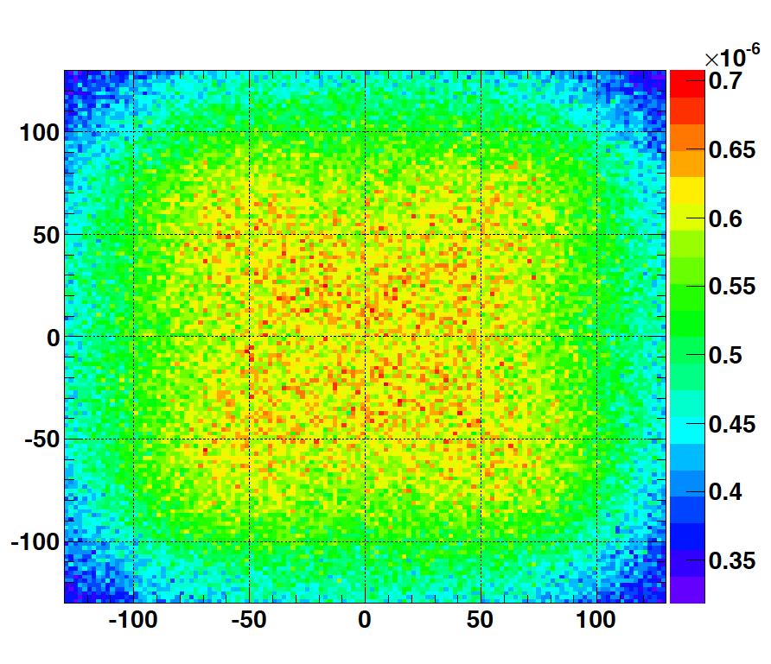
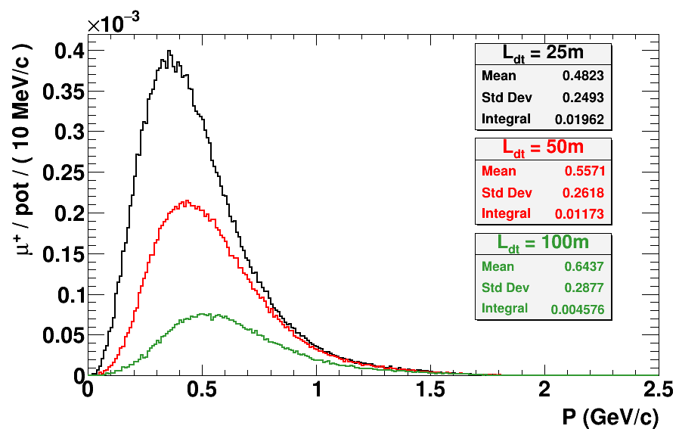
Muons at the level of the beam dump
2.7x10²³ p.o.t/year
y (cm)
muons at the level of the beam dump
(per proton)
more than 4x10²⁰ μ/year from ESS compared to 10¹⁴ μ used by all experiments up to now (10¹⁸ μ for COMET in the future).
4.2x10²⁰ μ/year
(16.3x10²⁰ for 4 m²)
x (cm)
10⁻³
4.1x10²⁰ μ/year
muons/proton
input beam for future 6D μ cooling experiments (for muon collider),
low energy nuSTORM,
Neutrino Factory,
Muon Collider.
<E_{μ}>~0.5 GeV
<L_{μ}>~3 km

Slide 11
ESSνSB and (R&D) synergies
2.7x10²³ p.o.t/year
ν_{μ} + ‾ν_{e}
ν_{μ} or ‾ν_{μ}
ν_{e} + ‾ν_{μ}
Super Beam
nuSTORM
ESSνSB
+Decay At Rest and Coherent scat.
(with short pulses)
Neutrino Factory
Muon Collider
ESSμSB

Slide 12
Upcoming studies
(mainly cross-section measurements)
Design of a racetrack storage ring for low energy muons produced with a beam from the ESS linac.
Design a transfer system from the initial collection and extraction of pions behind the target station, up to the injection point.
Design a transfer line from the ESSνSB ring-to-switchyard transfer line to the nuSTORM target.
Design an injection scheme for the racetrack storage ring
Design a Monitored Neutrino Beam (low energy ENUBET)
Optimize the performance of the ESSνSB accelerator complex
Cross-section measurements with:
Low Energy nuSTORM: π⟶ μ ⟶ e+ν_{μ}+ν_{e}
Low Energy ENUBET: π ⟶ μ+ν_{μ}

Slide 13
ESSνSB+
Research and Innovation actions
Innovation actions
Design Study
HORIZON-INFRA-2022-DEV-01
Title of Proposal: Study of the use of the ESS facility to accurately measure the neutrino cross-sections for ESSνSB leptonic CP violation measurements and to perform sterile neutrino searches and astroparticle physics.
Acronym of Proposal: ESSνSB+

Slide 14
ESSνSB+
Participant no. | Participant organisation name | Part. short name | Country
1 (Coordinator) | Centre National de la Recherche Scientifique | CNRS | France
2 | Université de Strasbourg | UNISTRA¹ | France
3 | Rudjer Boskovic Institute | RBI | Croatia
4 | Tokai National Higher Education and Research System, National University Corporation | NU² | Japan
5 | Uppsala Universitet | UU | Sweden
6 | Lunds Universitet | ULUND | Sweden
7 | European Spallation Source ERIC | ESS | Sweden
8 | Kungliga Tekniska Hoegskolan | KTH | Sweden
9 | Universitaet Hamburg | UHH | Germany
10 | University of Cukurova | CU | Turkey
11 | National Center for Scientific Research "Demokritos" | NCSRD | Greece
12 | Aristotelio Panepistimio Thessalonikis | AUTH¹ | Greece
13 | Sofia University St. Kliment Ohridski | UniSofia | Bulgaria
14 | Lulea Tekniska Universitet | LTU | Sweden
15 | European Organisation for Nuclear Research | CERN | IEIO³
16 | Universita degli Studi Roma Tre | UNIROMA3 | Italy
17 | Universita degli Istudi di Milano-Bicocca | UNIMIB | Italy
18 | Istituto Nazionale di Fisica Nucleare | INFN | Italy
19 | Universita degli Istudi di Padova | UNIPD¹ | Italy
20 | Consorcio para la construccion, equipamiento y explotacion de la sede espanola de la fuente Europea de neutrones por espalacion | ESSB | Spain
^{[1]} Affiliated Partner
^{[2]} Associated Institute
^{[3]} International European Interest Organisation
Excellent supporting letter from the ESS director

Slide 15
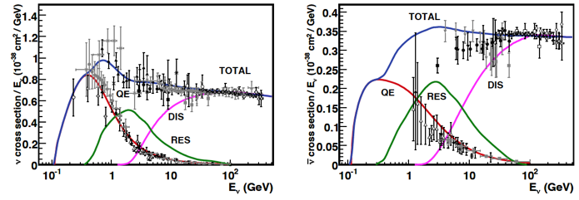
ESSνSB+
ν
ν
ν
l
ν
ν
ν
l
π⁰
e
e
n
n
n
n
n
hadrons
Elastic
Quasi-Elastic (QE)
Resonant (RES)
Deep inelastic (DIS)
neutrinos
antineutrinos
Missing measurements at the ESSνSB region: below 500 MeV

Slide 16
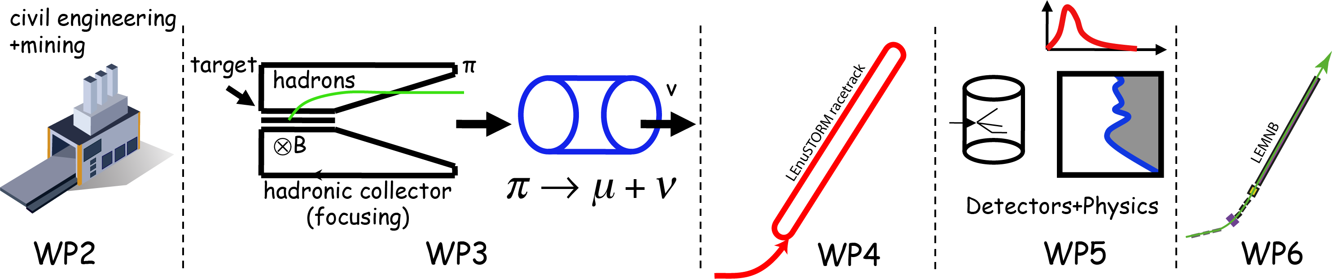
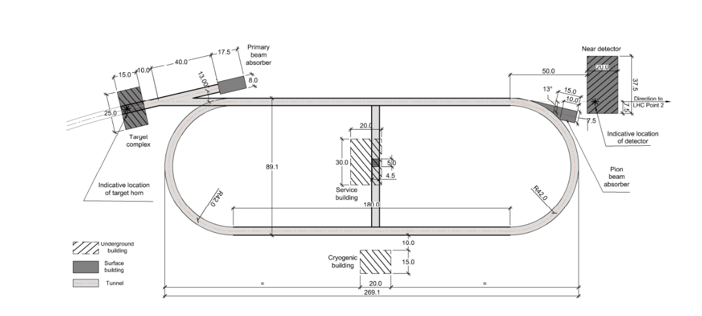
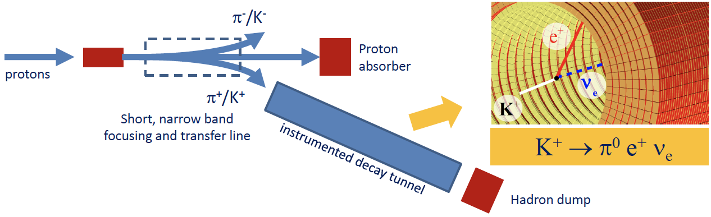

ESSνSB+ WP
cross-sections
sterile neutrinos
cross-sections
"High Energy" nuSTORM
"High Energy" ENUBET
build a "Low Energy" version

Slide 17
ESSνSB+ WP
Engineering and Infrastructures
Civil engineering studies will be performed of the already proposed installations of ESSνSB.
During the same period, analogue studies will be performed at the Zinkgruvan mine at the place where the ESSνSB far detector will be installed.
  The analysis of the already existing data will be completed and described in a comprehensive report.
Target Station
An optimised design of the hadron collector for neutrino production has been produced during the ESSνSB studies. A first evaluation of whether this design is well suited also for pion collection for LEnuSTORM and LEMNB usage will be done.
A pion beam simulation will be performed. The resulting characteristics will be provided to WP4, WP5 and WP6 to define the initial design of the other ESSνSB+ parts.

Slide 18
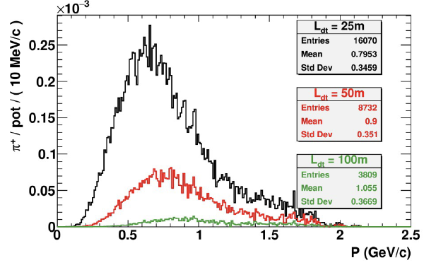
ESSνSB+ WP
LEnuSTORM
Lattice and beam optics design will be elaborated from the existing higher energy proposals.
Shape and dimensions of the racetrack ring will be established.
The study will include the transfer lines from the ESSνSB complex to the target and from the initial capture an extraction up to the injection point in the ring.
LEMNB
A preliminary design of the ca 30 m long EMNB decay tunnel will be made on the basis of the H2020 ESSνSB Design Study and ERC ENUBET project.
Muons from pion decays, which are produced with an average emission angle of order 50 mrad at 1 GeV, are monitored at the single-particle level using sampling calorimeters for muon/pion separation.
Thanks to the additional sample of electron neutrinos originating from the decay in flight, the ESS monitored neutrino beam will be able to assess also the electron neutrino versus muon neutrino difference of cross-sections below 1 GeV.
During the final two years of the Design Study, a more elaborated scheme will be proposed optimising all stages in order to obtain the highest statistics in as short period as possible, for neutrino cross-sections measurements to satisfy the ESSνSB needs.

Slide 19
ESSνSB+ WP
Detector and physics performance:
Design of an additional detector which will be used by LEnuSTORM and LEMNB for cross-section measurements;
  it will also be used as LEnuSTORM near detector for sterile neutrino searches.
The near detector of ESSνSB will be used as a far detector of LEnuSTORM.
The WP will also use the information provided by all the other WPs to determine and maximise the physics reach of LEnuSTORM and LEMNB, taking into account the additional information coming from concurrently running experiments that may become available.
It will also compare the performance of ESSνSB+ with that of other planned or proposed facilities.
The potential of the ESSνSB far detector doped with Gadolinium for non-beam related physics (natural neutrino sources, proton decay) will be studied.
This WP will be strongly involved in the dissemination task, mainly by presenting and promoting the physics performance achieved by the Design Study at international conferences and workshops.

Slide 20
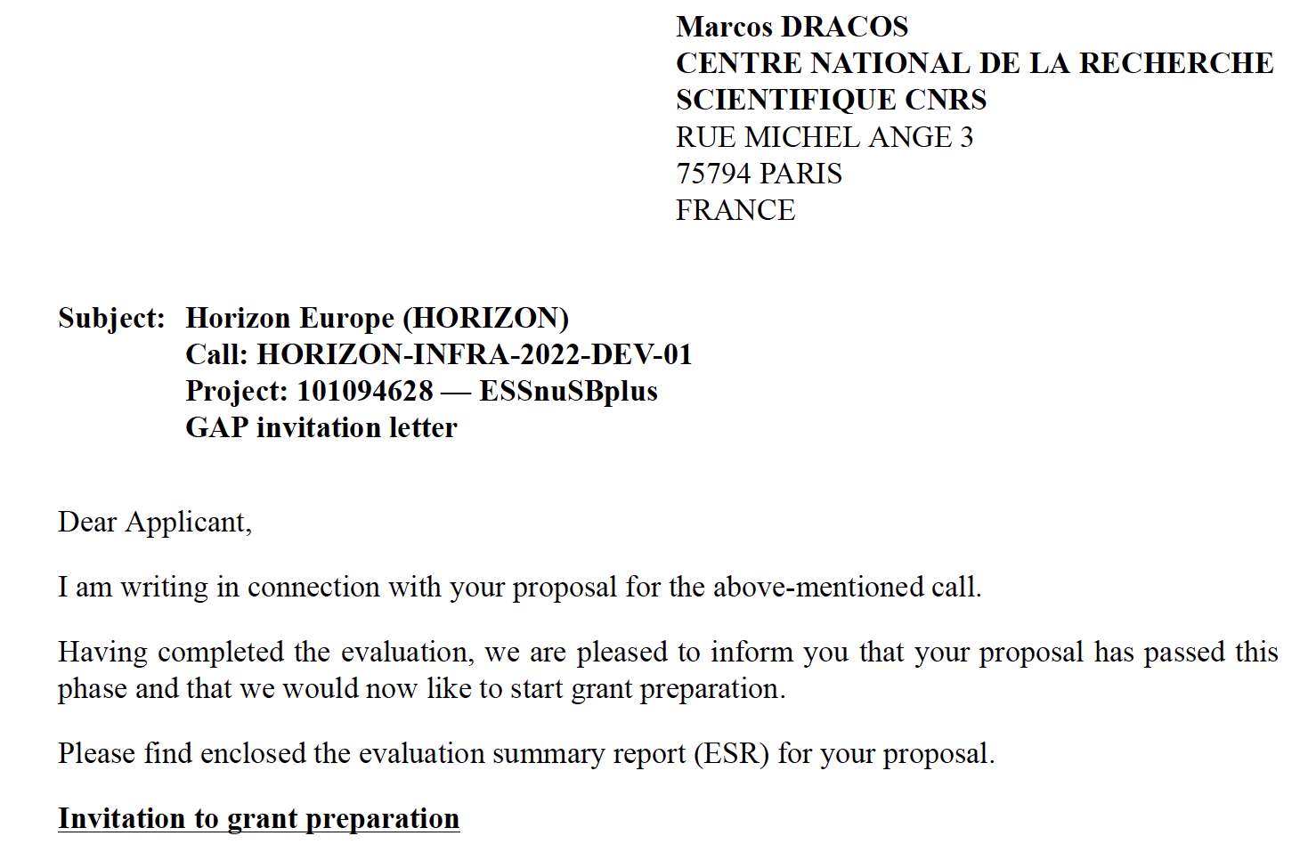

ESSνSB+
And the EU decision arrived earlier than expected… 26/07/2022
3 M€
14/15

Slide 21
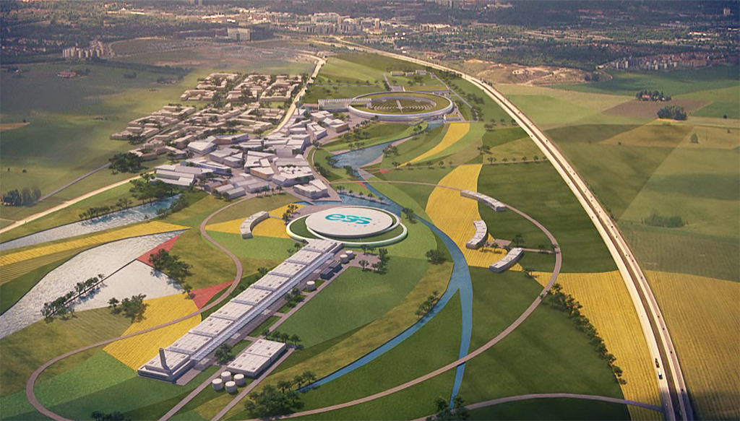
Conclusion
ESS can also become a neutrino facility, ESSνSB, already proved to have a very high physics performance and potential.
CPV: 5 σ could be reached over 70% of δ_{CP} range by ESSνSB with large physics potential with less than 8° precision.
Complementary tasks of this project have been added in a second Design Study helping to make the whole project happen.
  Precise neutrino cross-section measurements.
  Sterile neutrino searches.
  Muon studies
Rich muon program for future ESS upgrades.
New application submitted and now approved

Slide 22
Backup

Slide 23
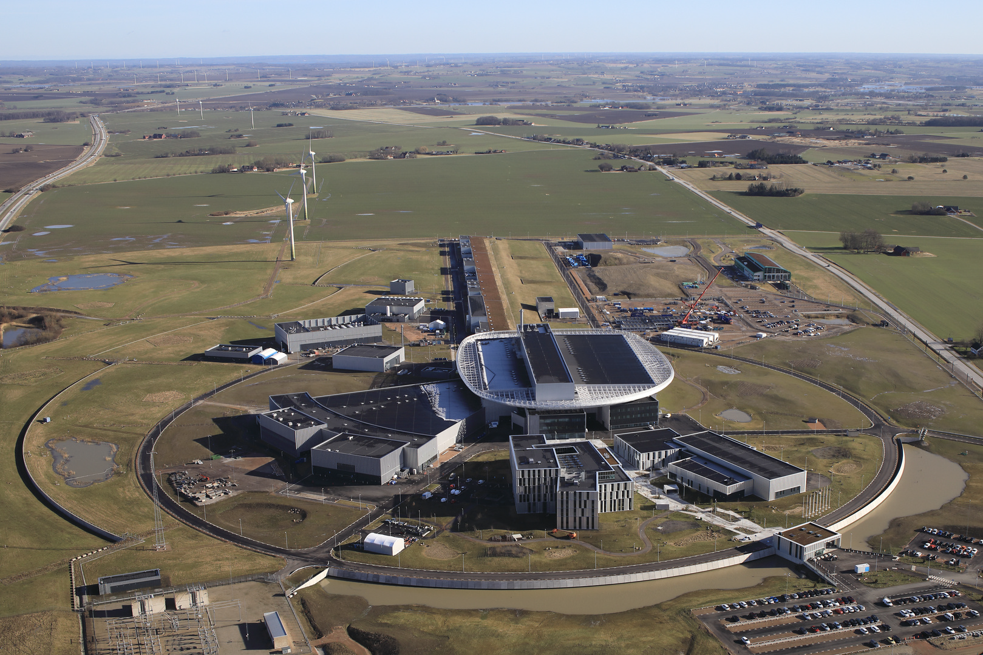

European Spallation Source
linac
Central Utility
Building
Exp. Hall
E01
Target
Monolith
Feb. 2022

Slide 24
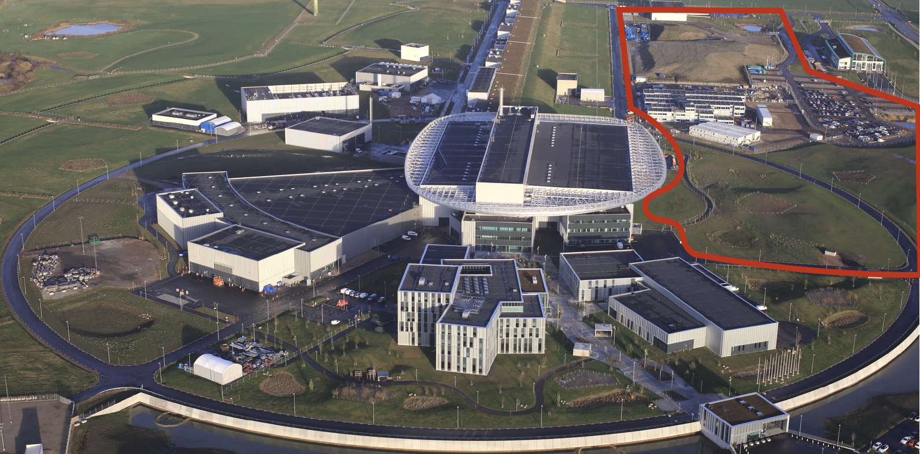
European Spallation Source as Neutrino Facility
ν

Slide 25
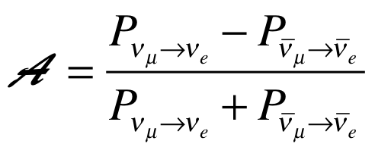
Oscillation probability
(neutrino beams)
"atmospheric"
"interference"
"solar"
matter effect
for antimatter: δ_{CP} →-δ_{CP} and a→-a
fake matter/antimatter asymetry due to matter effect
δ_{CP} dependence,
sizable matter effect for long baselines
Matter-antimatter asymmetry

Slide 26
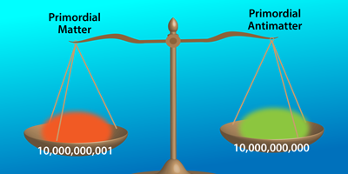
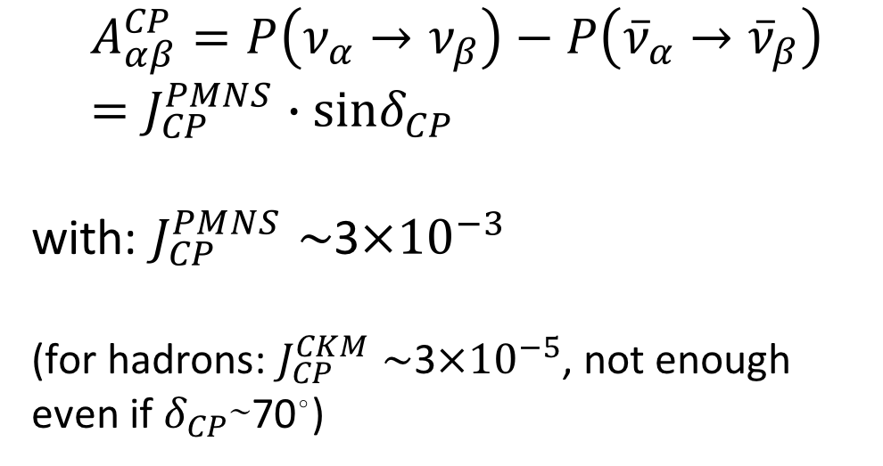
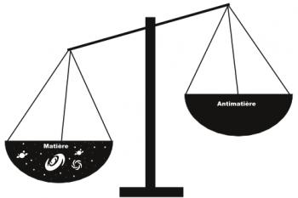
δ_{CP} and Matter-antimatter asymmetry magnitude
(Jarlskog invariant)
(from the already observed CP violation in the hadronic sector)
Theoretical models predict that if |sinδ_{CP}|≳0.7 (45°<δ_{CP}<135° or 225°<δ_{CP}<315°), this could be enough to explain the observed asymmetry.
(Nucl.Phys.B774:1-52,2007, arXiv:hep-ph/0611338)

Slide 27
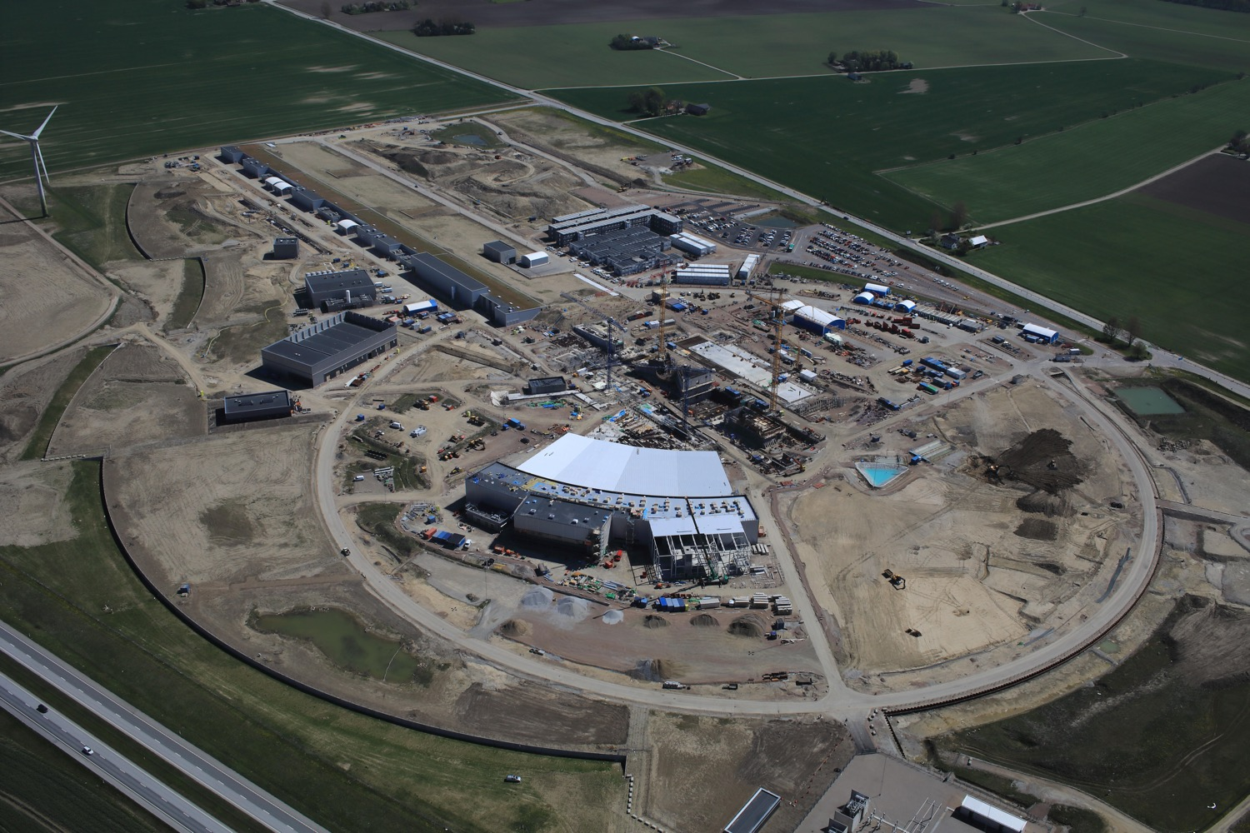

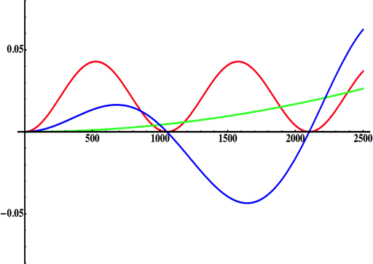
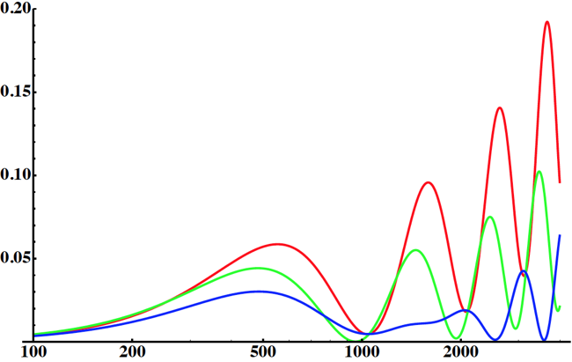
Use all this ESS linac power to go to the 2nd oscillation maximum
but why?
for "large" θ₁₃ 1st oscillation maximum is dominated by atmospheric term
atmospheric
solar
L/E
CP interference
δ_{CP}=-90
δ_{CP}=0
δ_{CP}=+90
2nd oscillation maximum
θ₁₃=8.8º
("large" θ₁₃)
1st oscillation max.: A=0.3sinδ_{CP}
2nd oscillation max.: A=0.75sinδ_{CP}
L/E

Slide 28
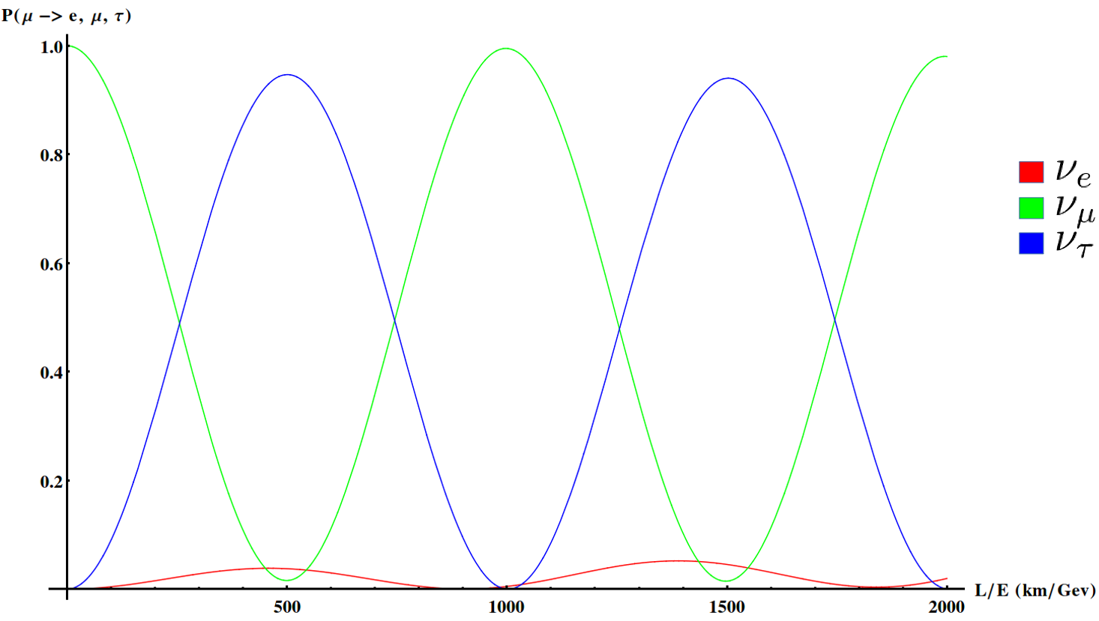
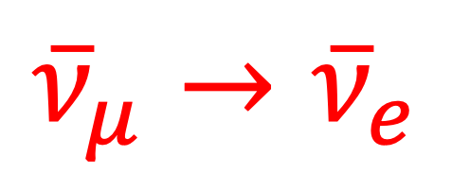
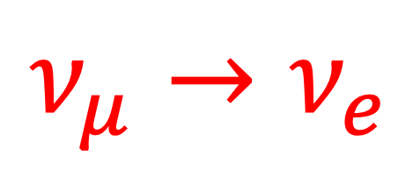
Oscillations to be studied
$$ν_{μ}→ν_{e}$$
$${\overline{ν}}_{μ}→{\overline{ν}}_{e}$$

Slide 29
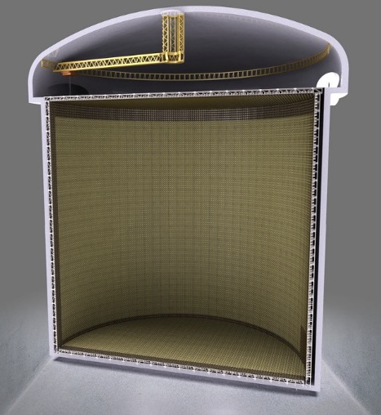
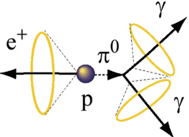
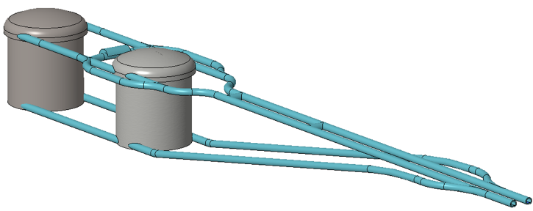
Can we go to the 2nd oscillation maximum using our proton beam?
Yes, if we place our far detector at around 500 km from the neutrino source.
Megaton Water Cherenkov detector
Neutrino Oscillations
Proton decay
Astroparticles
Understand the gravitational collapsing: galactic SN ν
  Supernovae "relics"
Solar Neutrinos
Atmospheric Neutrinos
75 m
75 m
500 kt fiducial volume (~20xSuperK)
Readout: ~20” PMTs
30% optical coverage

Slide 30
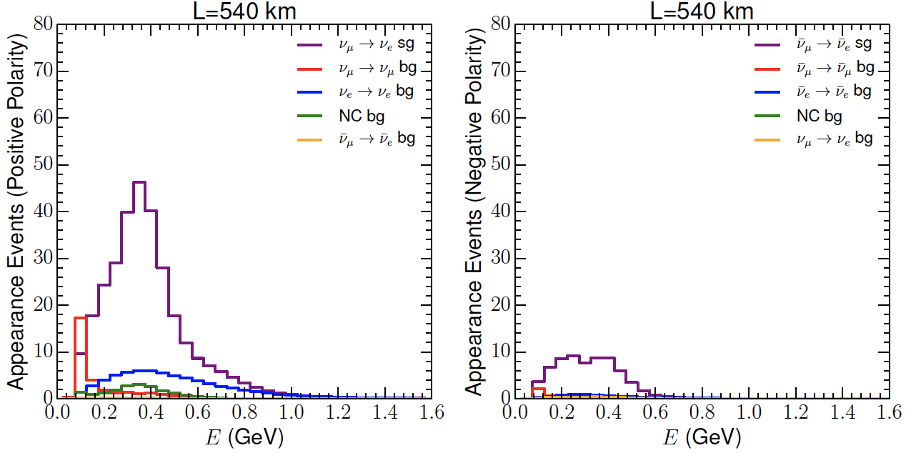
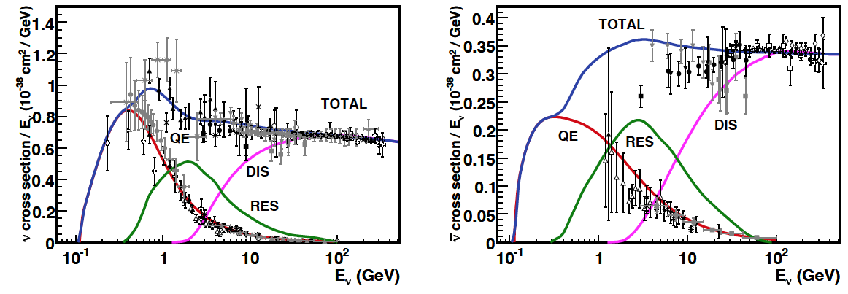
Neutrinos in the far detector
540 km (2.5 GeV), 10 years
neutrinos
anti-neutrinos
δ_{CP}=0
5 years
5 years
below ν_{τ} production, almost only QE events, not suffering too much by π⁰ background

Slide 31
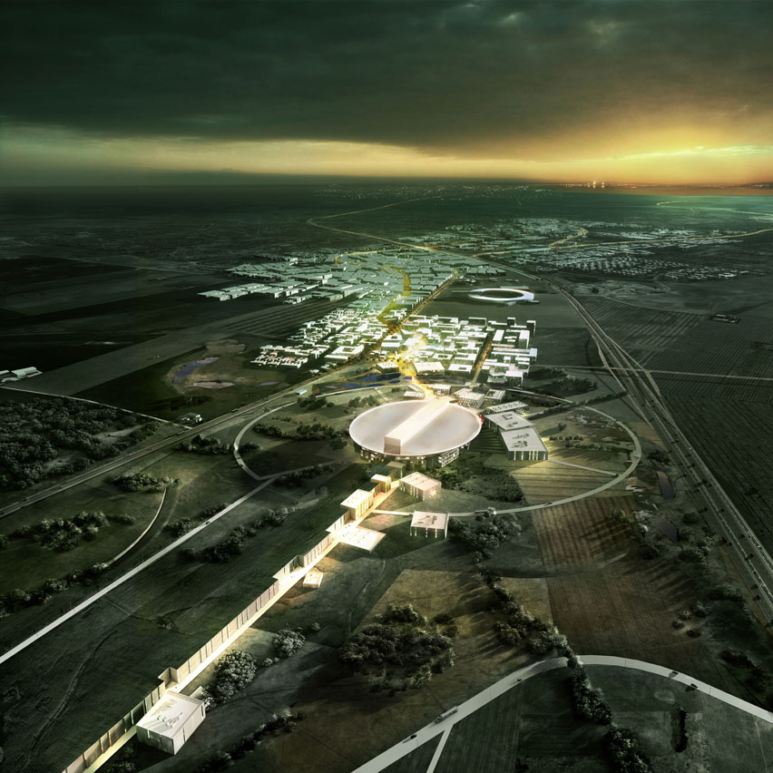
ESS modifications to produce a neutrino Super Beam
European Spallation Source Linac

Slide 32
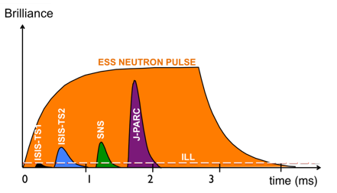
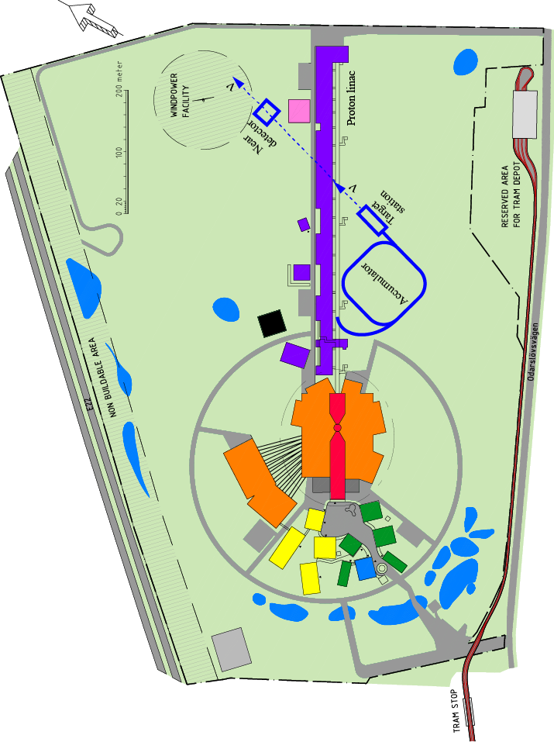
How to add a neutrino facility?
The neutron program must not be affected and if possible synergetic modifications.
Linac modifications: double the rate (14 Hz → 28 Hz), from 4% duty cycle to 8%.
Accumulator (C~400 m) needed to compress to few μs the 2.86 ms proton pulses, affordable by the magnetic horn (350 kA, power consumption, Joule effect)
  H⁻ source (instead of protons),
  space charge problems to be solved.
~300 MeV neutrinos.
Target station.
Underground detector.
Short pulses (~μs) will also allow DAR and coherent scattering experiments (as those proposed for SNS) using the neutron target.

Slide 33
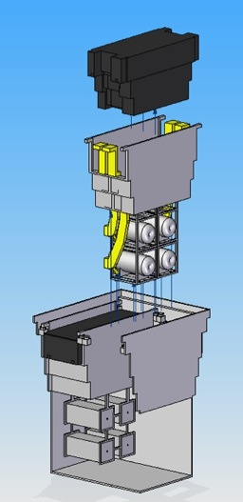
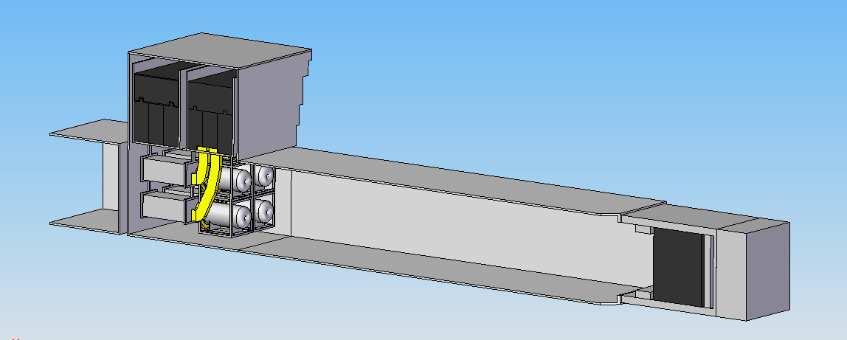
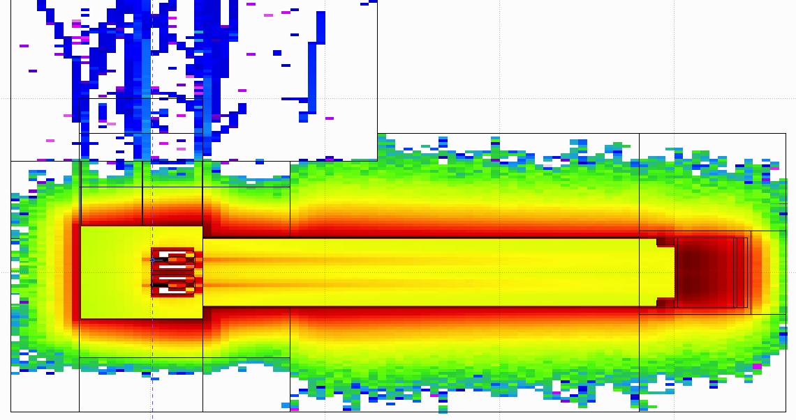
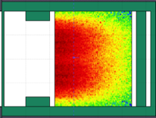
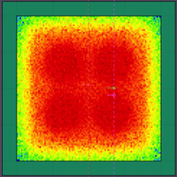
General Layout of the target station
(inspired by J-PARC)
Shield Blocks
Horn Support Module
8 m concrete
Split Proton Beam
Horns and Targets
Collimators
Decay Volume
(He, 4x4x25 m³)
Neutrino Beam Direction
Beam Dump

Slide 34
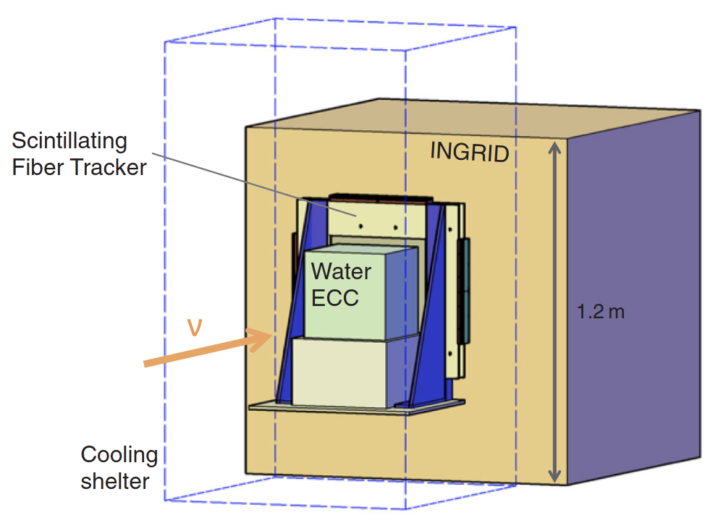
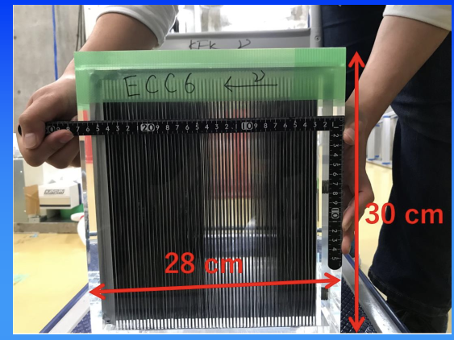

Emulsions
Operating at J-PARC by Nagoya University
NINJA-type emulsion detector (ν-King) will be situated immediately upstream of the SFGD tracker for precise neutrino interaction cross-section measurements.
NINJA detector is an emulsion-based detector composed of modules using either iron or water as a target
  it is currently under operation at J-PARC by Nagoya University.
A conceptual design for the NINJA-like detector adapted to the ESSνSB project has been developed and included in the technical drawings of the Near Detector.
from OPERA experiment

Slide 35




ESS modifications and operation
H⁻ source
time operation option
accumulator lattice
injection
neutrino beam
horn power supply
RF
beam dump
decay tunnel (50 m)
proton beam
target/horn x4
extraction
collimation
Switchyard

Slide 36




Detectors
Near detector
electron-muon separation
75 m
75 m
astroparticle physics program with the Far Detector

Slide 37



Comparisons
ESSnuSB March 2022 with 5% normalization error
DUNE Snomass March 2022
HyperK Snowmass March 2022

Slide 38


Physics Performance
during 10 years

Slide 39


Physics Performance

Slide 40
Comparisons
Comparison using the same systematic errors
Phys. Rev. D 87 (2013) 3, 033004 [arXiv:1209.5973 [hep-ph]]

Slide 41


Under construction long baseline projects
DUNE (USA)
T2HK (Japan)
~50% of δ_{CP} coverage
δ_{CP} resolution ~20° at δ_{CP} = 90°
with low systematic uncertainties assumptions

Slide 42

Fraction of δ_{CP}
Garpenberg
(540 km)
(E. Martinez-Fernandez)
Zinkgruvan
(360 km)
Lund
2 active mines aligned…
3% systematic error on the signal!
My personal opinion:
these scenarios are too optimistic for all facilities

Slide 43





Mitigation of high power effects
(4-Target/Horn system for EUROnu Super Beam)
Packed bed canister in symmetrical transverse flow configuration (titanium alloy spheres)
4-target/horn system to mitigate the high proton beam power (4 MW) and rate (50 Hz)
target inside the horn
Helium Flow
proton beam switchyard

Slide 44



Muon Collider as Higgs Factory
Carlo Rubbia
arXiv:1908.05664
HIFI Uppsala Workshop 2-3 March 2020

Slide 45

Muons at ESS (ESSμSB)

Slide 46



Possible ESSνSB schedule
(2nd generation neutrino Super Beam)
2022: End of ESSνSB Design Study, CDR and preliminary costing
2012: inception of the project
2016-2019: beginning of COST Action EuroNuNet
2018: beginning of ESSνSB Design Study (EU-H2020)
2022-2026: Preparatory Phase, TDR
2026-2028: Preconstruction Phase, International Agreement
2028-2036: Construction of the facility and detectors, including commissioning
2037-: Data taking
arxiv.org/abs/2206.01208
Nucl. Phys. B 885 (2014) 127

Slide 47



European Spallation Source
Neutron facility
under construction phase
(~2 B€ facility)

Slide 48




δ_{CP} and model predictions
https://arxiv.org/abs/1410.7573
Test of flavour symmetry models:
Typically, the models considered have a reduced number of parameters, leading to relations between the masses and/or mixing angles.
Examples are the so-called sumrules, e.g.:
https://arxiv.org/abs/1410.8056

