Slide 1
ESSnuSB from source to target and plans for the future
Presentation PPFGA
PRESENTED BY Natalia milas

Slide 2
Summary
The ESS project
Status of the construction and the facility
A brief diversion: Accelerator physics and Beam Dynamics
What is ESS𝜈SB/ESS𝜈SB+?
Status of the project
Conclusions/Next Steps

Slide 3
1
The ESS Project

Slide 6
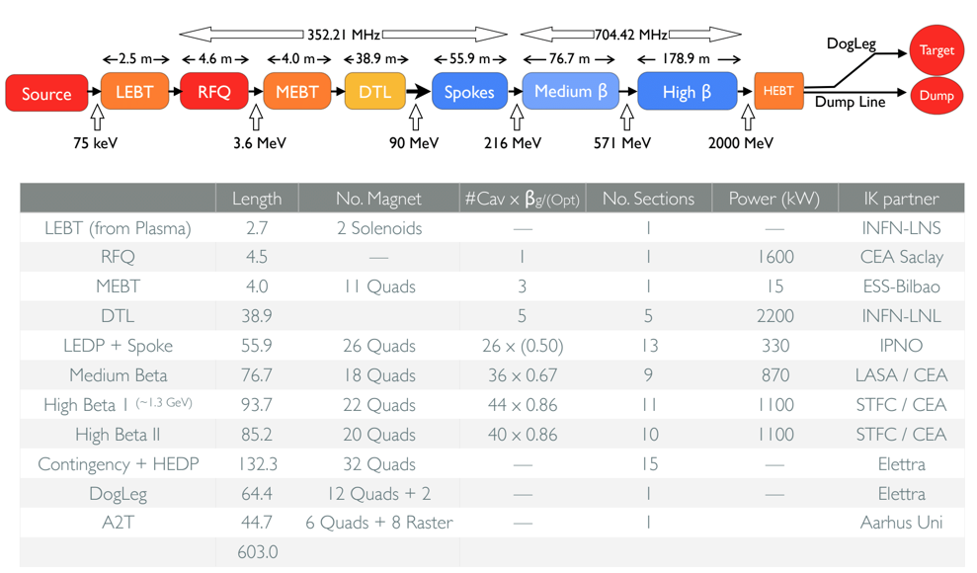
The ESS Linac

Slide 7
Some photos of the accelerator
Source, LEBT, RFQ and MEBT

Slide 8
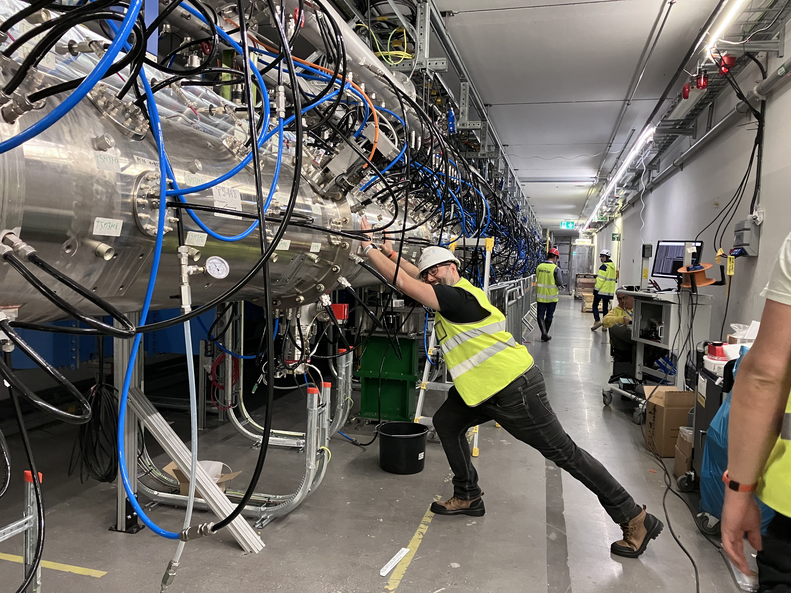
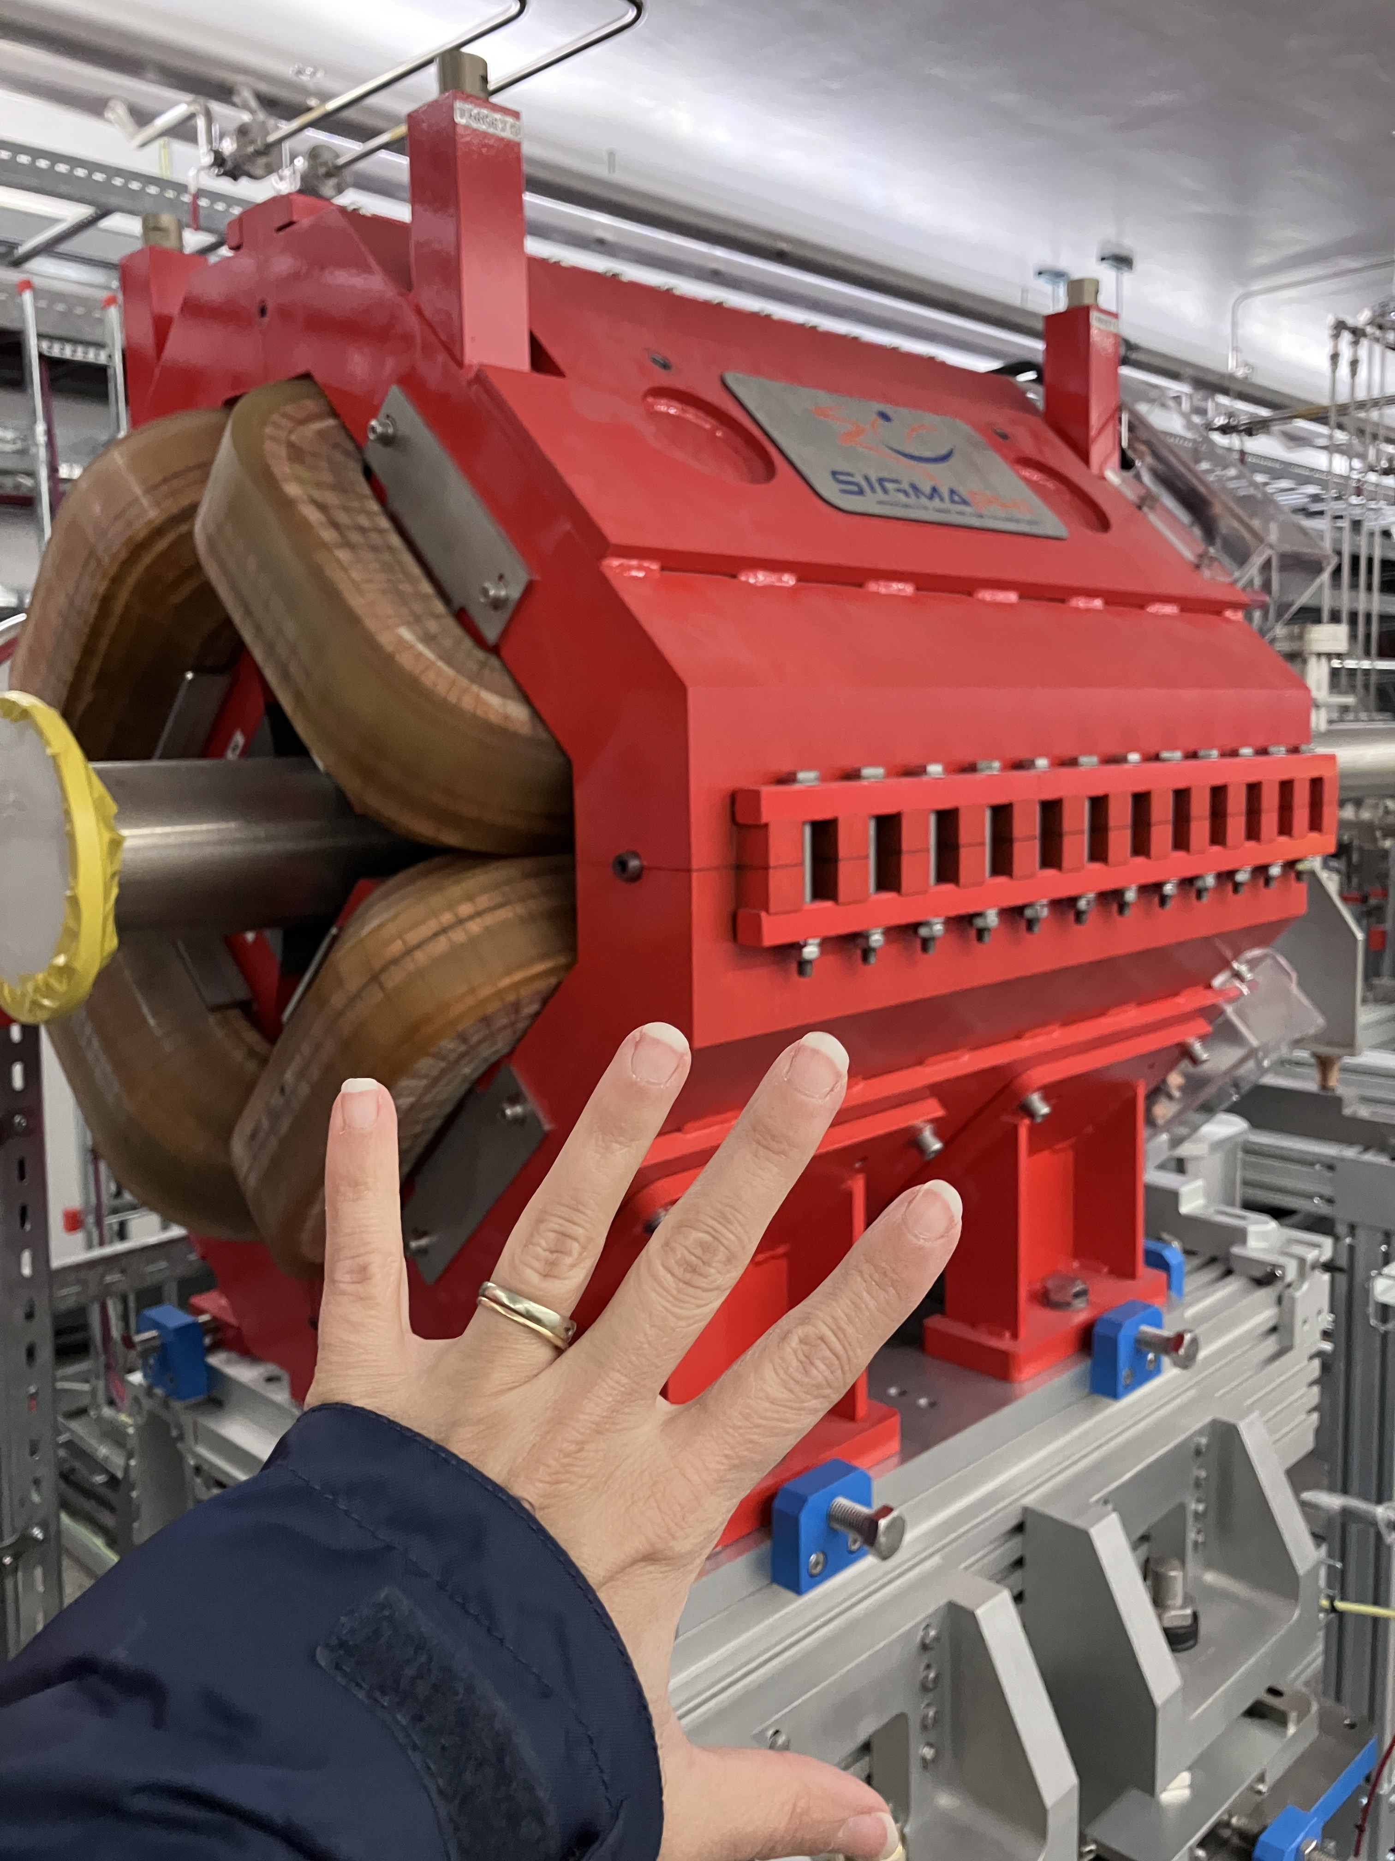
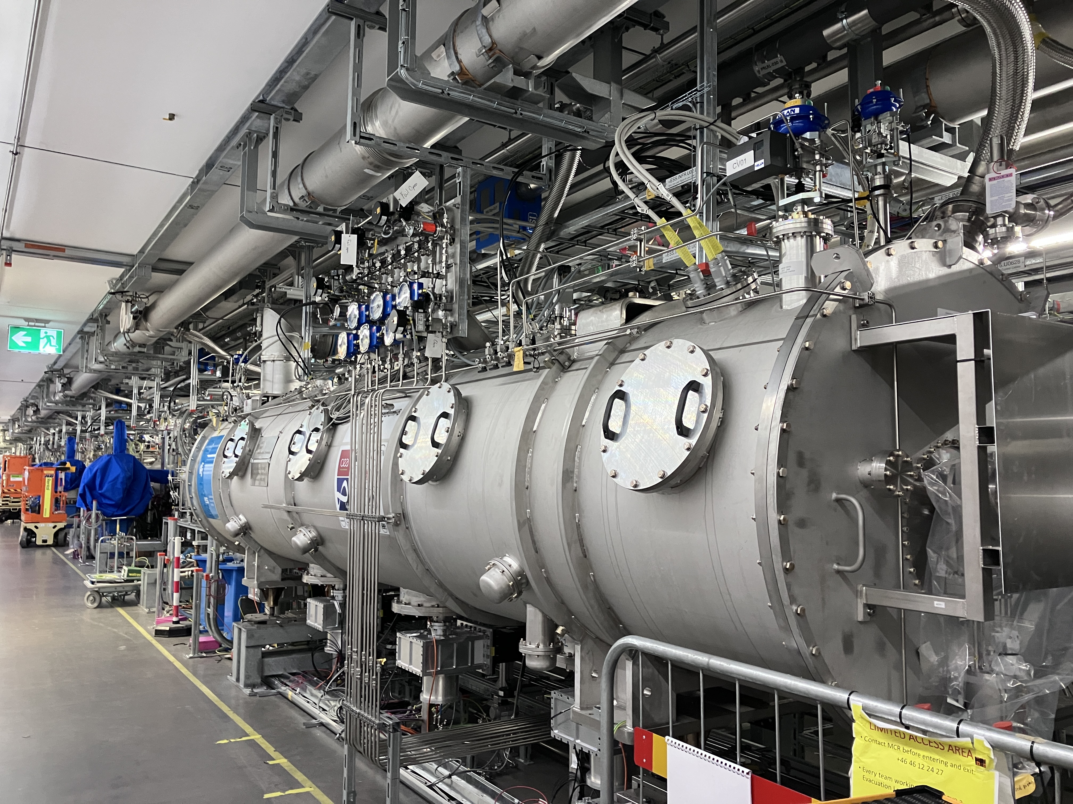
Some photos of the accelerator
DTL, Spokes and tunnel

Slide 9
Some photos of the accelerator
Target

Slide 10
2
Accelerator Physics and Beam Dynamics

Slide 11
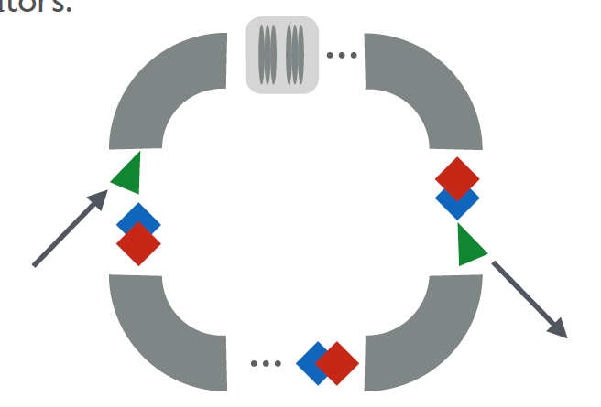
Synchrotrons vs Linacs
Linac
Synchrotrons

Slide 12
Synchrotrons vs Linacs
Main differences
Linear accelerators:
Are mainly filled with cavities (and focusing elements)
Do not have an ultimate energy
Are single pass (errors do not accumulate)
Can provide any pulse length (train of bunches)
Circular accelerators (synchrotrons):
Are mainly filled with dipoles and focusing elements
Are limited in their ultimate energy
Beam is accelerated for several thousands to millions of turns (errors accumulate)
Maximum pulse length is limited to the circumference of the ring

Slide 13
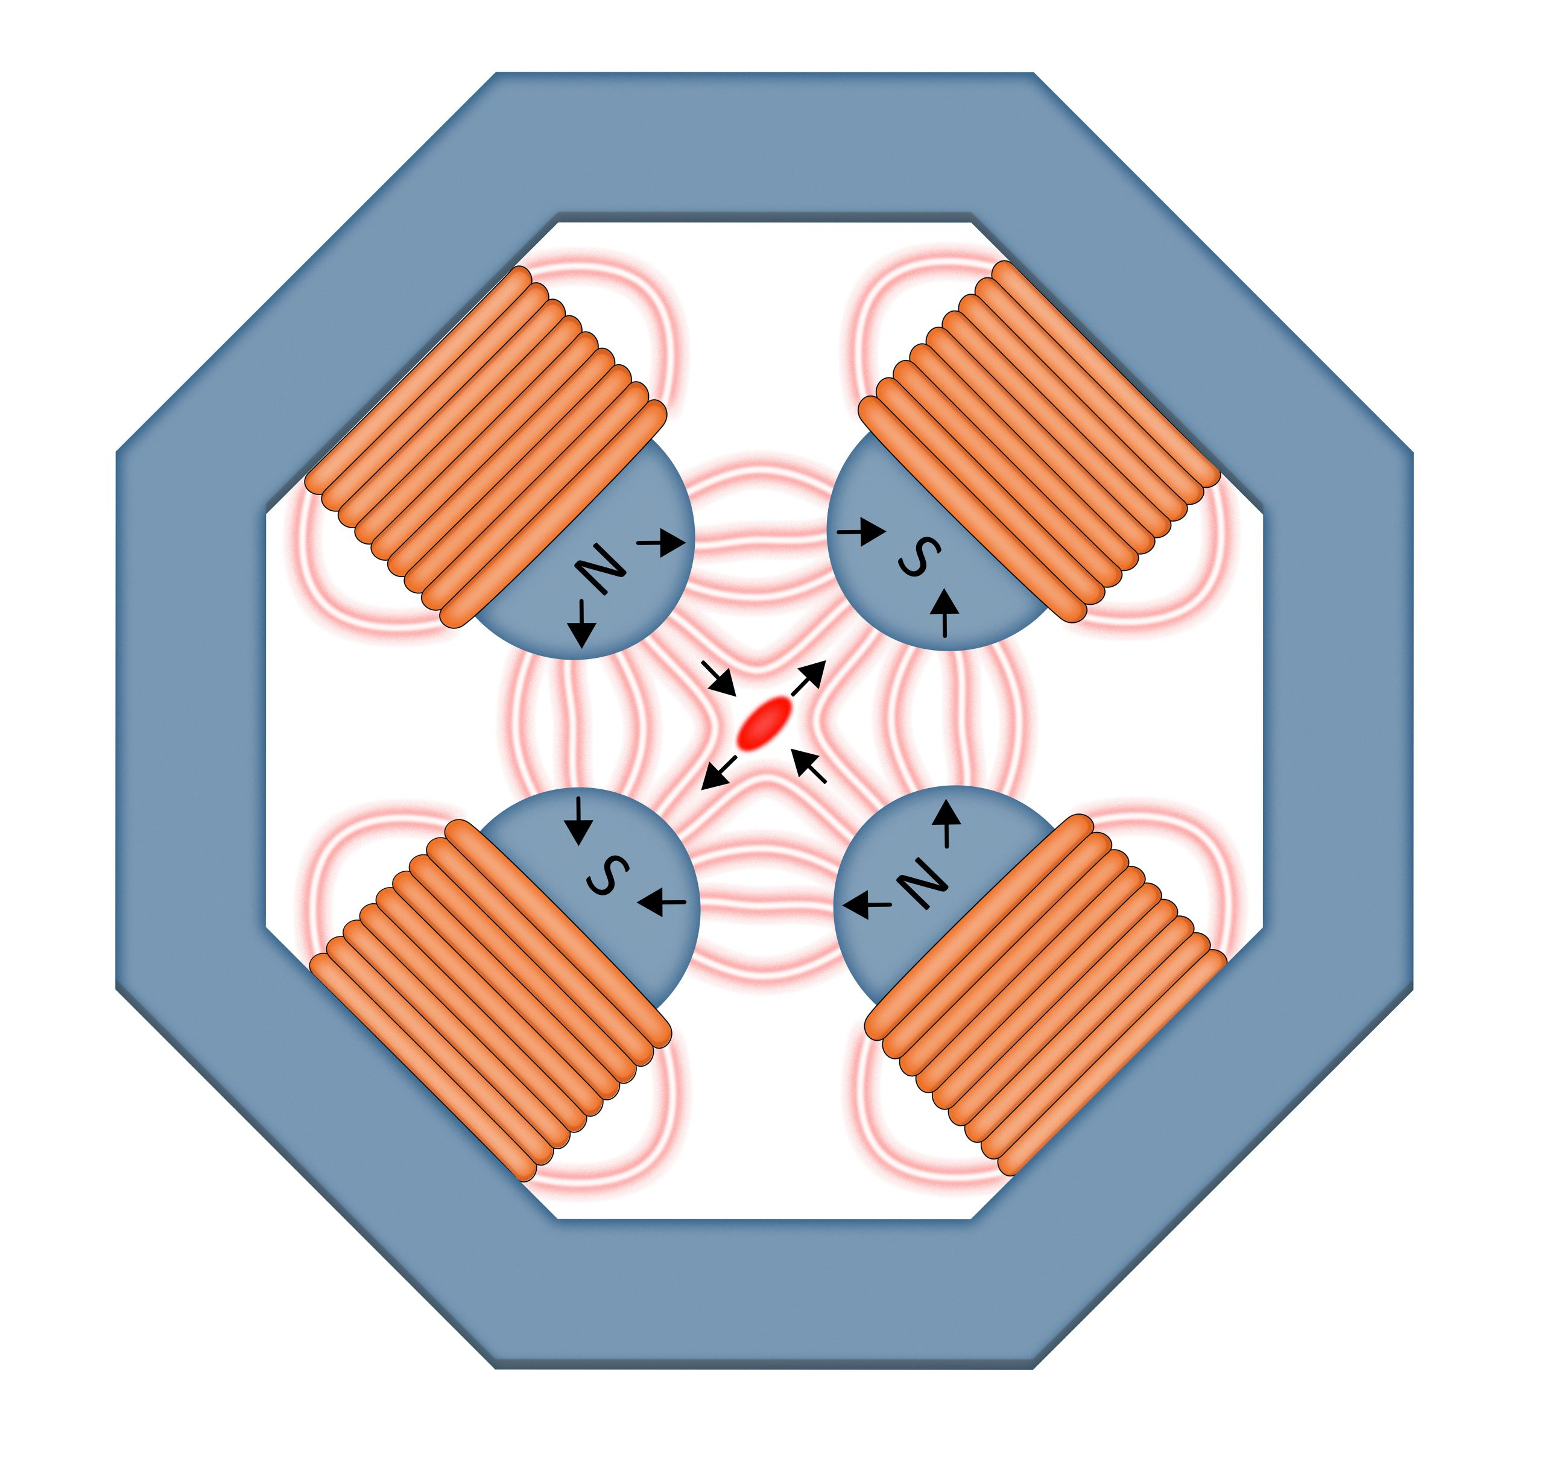
Main elements in an accelerator
Dipoles Magnets
Quadrupole Magnets
x
f
$$F_{x}=−ax=−qv_{z}B_{y}$$
Total focus is only achieved by using doublets
$$F=q v_{z} B= \frac{m{v_{z}}^{2}}{ρ}$$
$$F_{x}=ay=qv_{z}B_{y}$$
Defines of the main trajectory
Inherently energy dependent

Slide 14
Main Accelerator Elements
RF Cavities
DC accelerators are limited in their ultimate energy (20 MeV), to reach higher
energies another acceleration principle is needed
$$L_{cell,n}=v_{z,n} t= β_{n}ct=β_{n}λ_{rf}$$

Slide 15
Space Charge effects
Unless the beam has a very special distribution, the space charge forces are
non-linear.
A non-linear force will increase the beam emittance.
It also has a defocusing effect which could be approximated be a series of defocusing lenses.
In rings the space charge will also affect the tune of the ring
As the forces are much stronger in lower energies the beam should be confined in all the three planes, horizontal, vertical and longitudinal.
$$F_{tot}=(1− β^{2})F_{E}$$

Slide 16
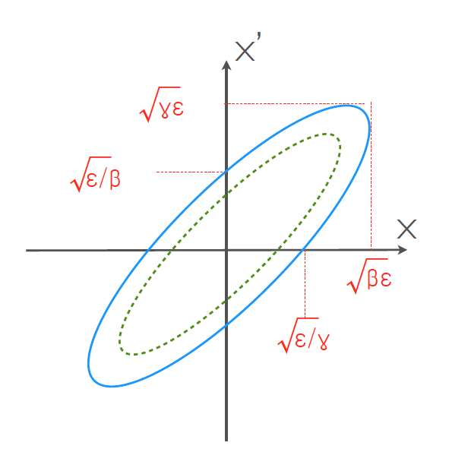
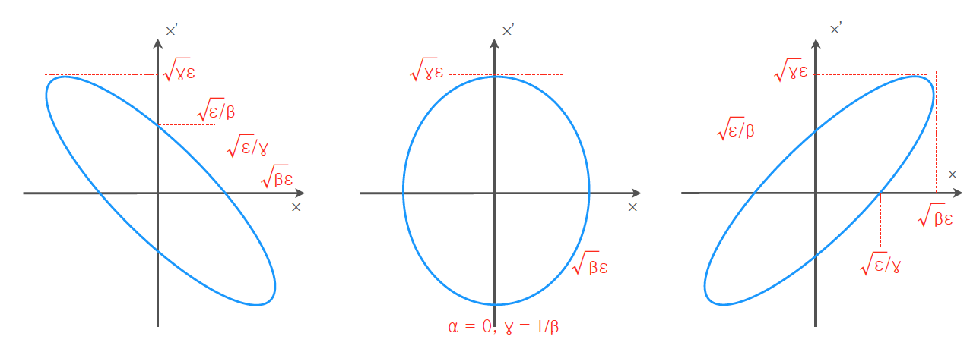
Hills equation
All in all we have harmonic oscillators
Equation of motion for paraxial particles in periodic systems:
where kx(s) and ky(s) are periodic focusing functions (coming from quadrupoles and dipoles), and s is the distance along the design trajectory. We have then simple harmonic oscillators in both planes (in the linear case).
$$x^{”}+K_{x}\left(s\right)x=0$$
$$y^{”}+K_{y}\left(s\right)y=0$$
$$x\left(s\right)=A\left(s\right)cos⁡(Q_{x}s+φ(s)$$
$$γx^{2}+2αxx^{′}+β{x^{′}}^{2}=A^{2}$$
In the absence of nonlinear forces, the ellipse area, the emittance, is a constant of motion, Liouville’s theorem

Slide 17
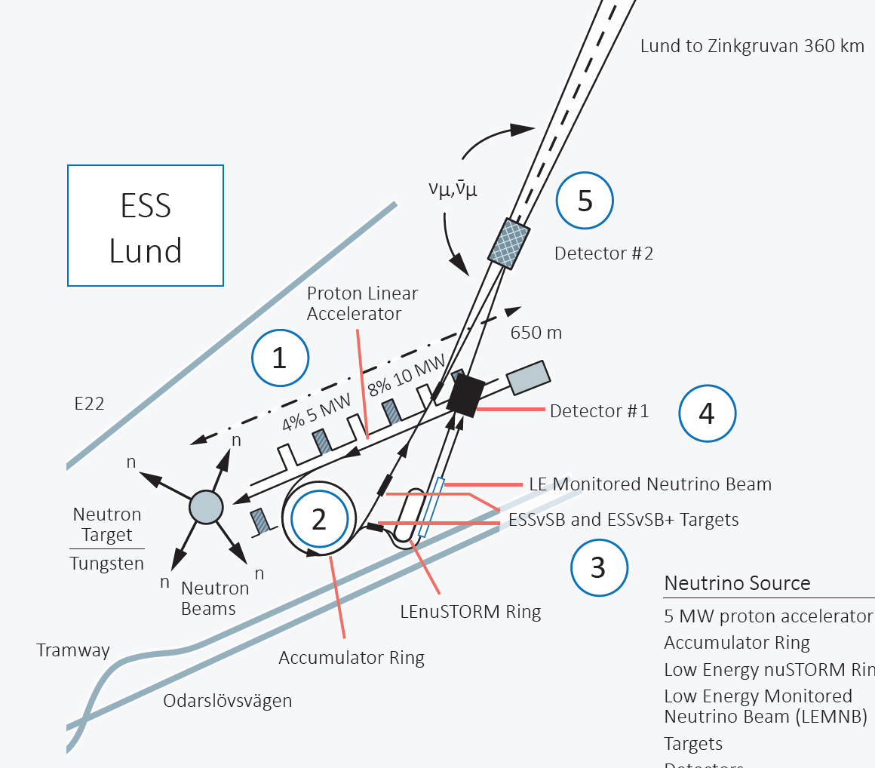
3
The ESS𝜈SB Project

Slide 18
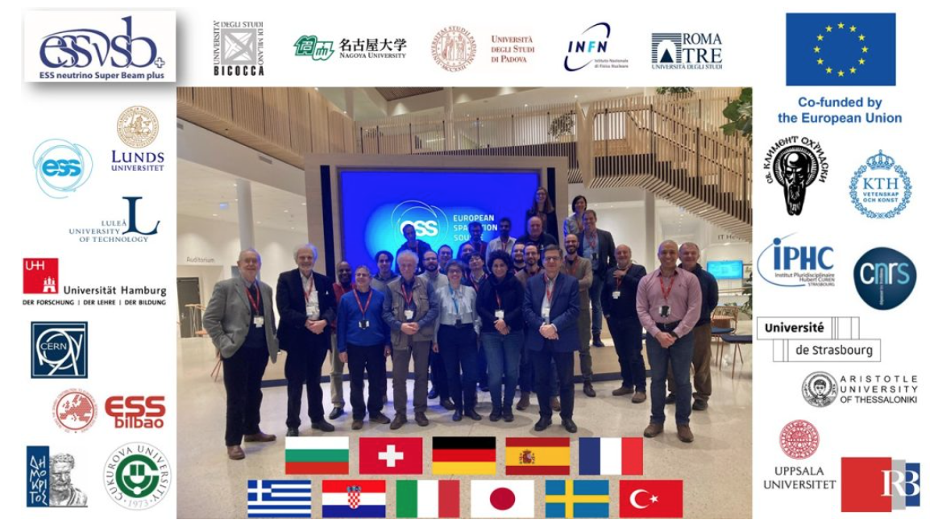
The ESS𝜈SB Project
Goal: to precisely measure the value of the leptonic charge-parity violating phase
How: by generating a muon (anti-)neutrino intense ”super” beam and looking at the electron neutrino appearance in a large water cherenkov far detector.
With 5 MW beam from the ESS linac we can measure at the second oscillation maximum
where we are less limited by systematic uncertainties and thus have a higher sensitivity.
Neutrino Detector
540 kilotonnes Water
1 km underground
Zinkgruvan
360 km
11 partner Nations (ESSνSB+
kick-off meeting in Jan. 2023)
Lund

Slide 19
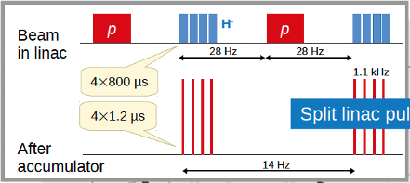
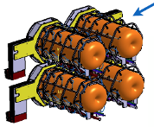
ESS𝜈SB High Level Parameters
Split the linac pulses in 4 batches
6
Near Neutrino detector
H⁻ to reduce losses at ring injection
1
5
LEνSTORM and LEMNB detector
3
2
4
Target and horn:
Max 1.25 MW/target beam power
Max ~1.5 us pulse duration
Low Energy νSTORM ring and Monitored Neutrino
Beam for neutrino cross section measurements and sterile neutrino searches
Accumulator ring to compress each batch

Slide 20
ESS𝜈SB High Level Parameters
Linac Parameters:
Beam Energy
Beam Current
Rep. Rate
Pulse length
Losses
Ions
ESS𝜈SB beam:
Beam Energy
Beam Current
Rep. Rate
Pulse length
Losses
Ions
2 GeV
62.5 mA
14 Hz
2.86 ms
< 1 W/m
p
2.5 GeV
62 mA (50 mA)
14 Hz
< 3.5 ms
< 1 W/m
H⁻
Drivers Design:
High power
High availability
5 Mw
> 95%

Slide 21
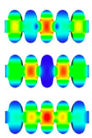
Linac Design
No problems with HOMs due to chopping pattern
704 MHz klystrons: upgraded at end of life
Modulators: upgraded, additional capacitor chargers
Cryogenic system: OK at 28 Hz rep. rate
New H⁻ source
Extract beam to ESSnuSB

Slide 22
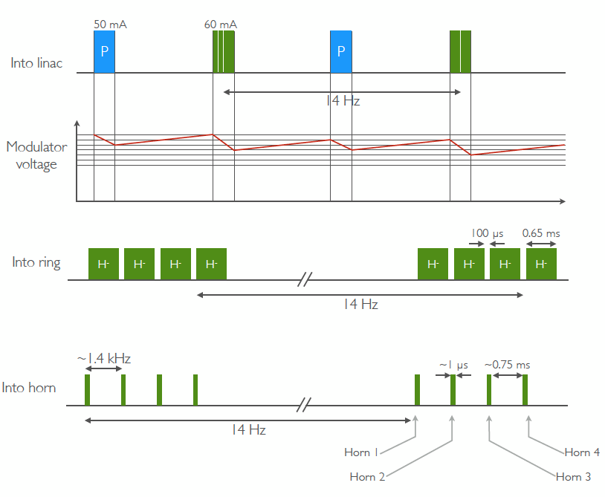
A New Front-End and Pulsing Scheme
Possibility of merging the two bean before the RFQ
Smaller footprint and easier to fit in the tune
More difficult dynamics for both beam with the 30 deg option

Slide 23
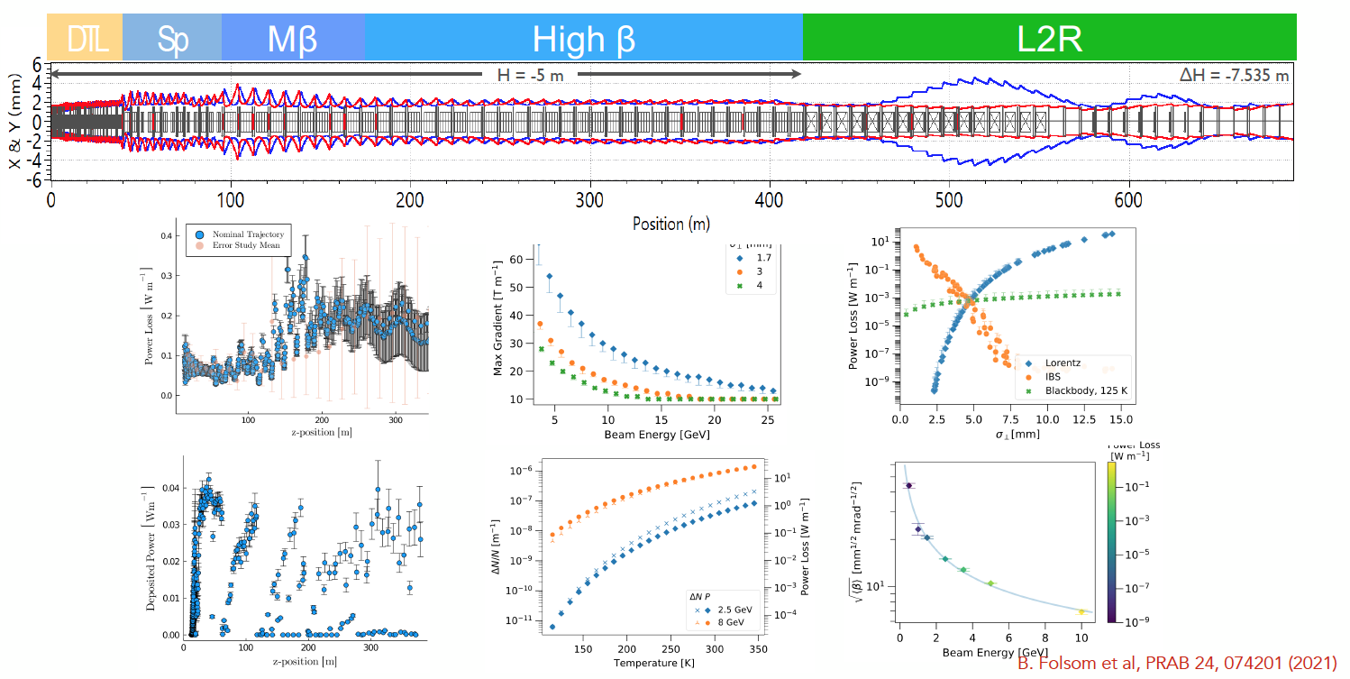
Linac Design

Slide 24
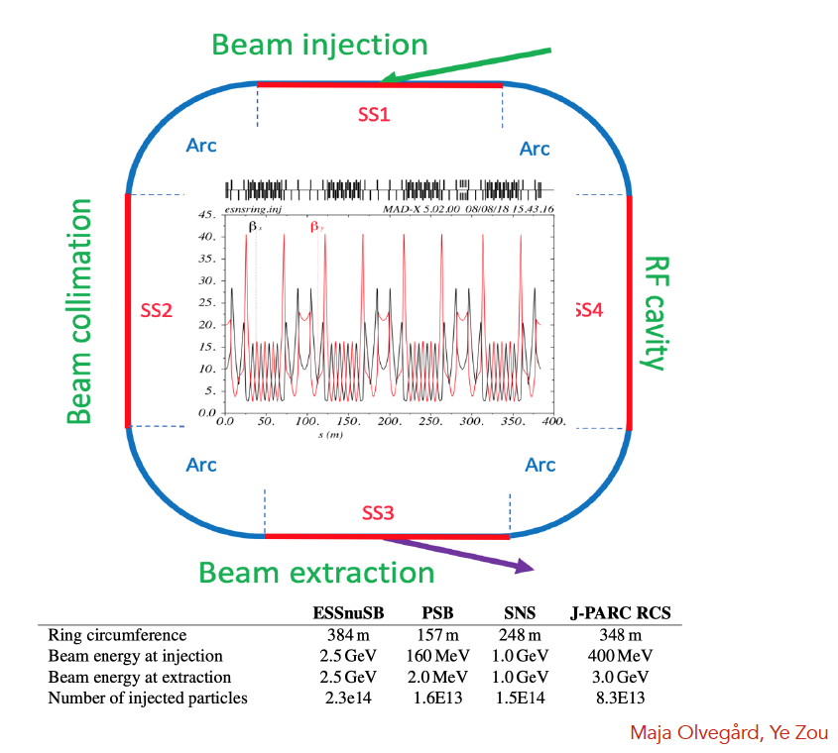
Accumulator Ring Design
Main challenges
• Beam loss control due to very high beam power
• Space-charge tune shift due to very high beam intensity
• Instabilities (e-p instability)
Lattice design
• Circumference: 384 m
• 4-fold symmetry
• 4 straight sections (SS1~SS4) and 4 arc sections (Arc)
• Fixed injection chicane and fast programmable bump for injection painting

Slide 25
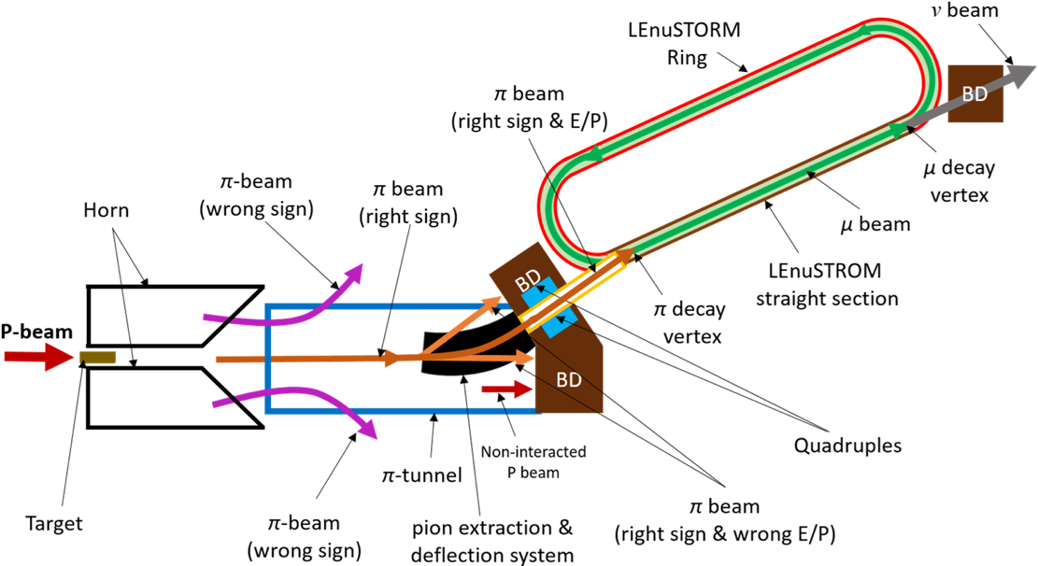
LE𝜈Strom Facitlity
Cross section measurements

Slide 26
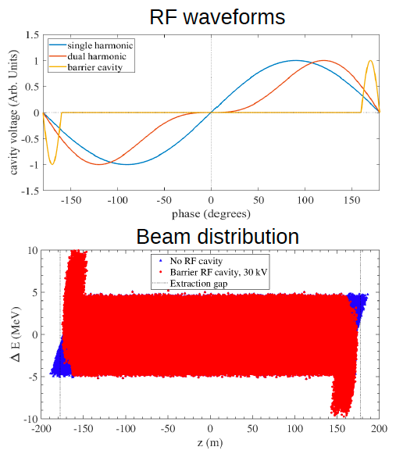
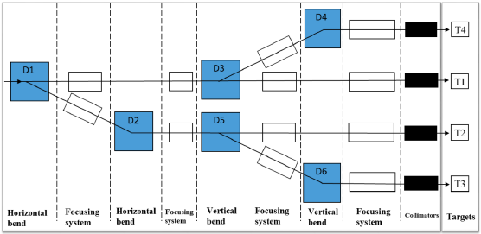
Accumulator RF and Switchyard Design
RF cavity
• RF cavity to keep the extraction gap clean while keep energy spread small
• Barrier bucket is chosen due to its very small leakage risk and small energy spread (±0.15%)
• Aperture optimized to make rise-time requirement easier to reach
Y. Zou, Uppsala University
E. Bouquerel, IPHC Strasbourg

Slide 27
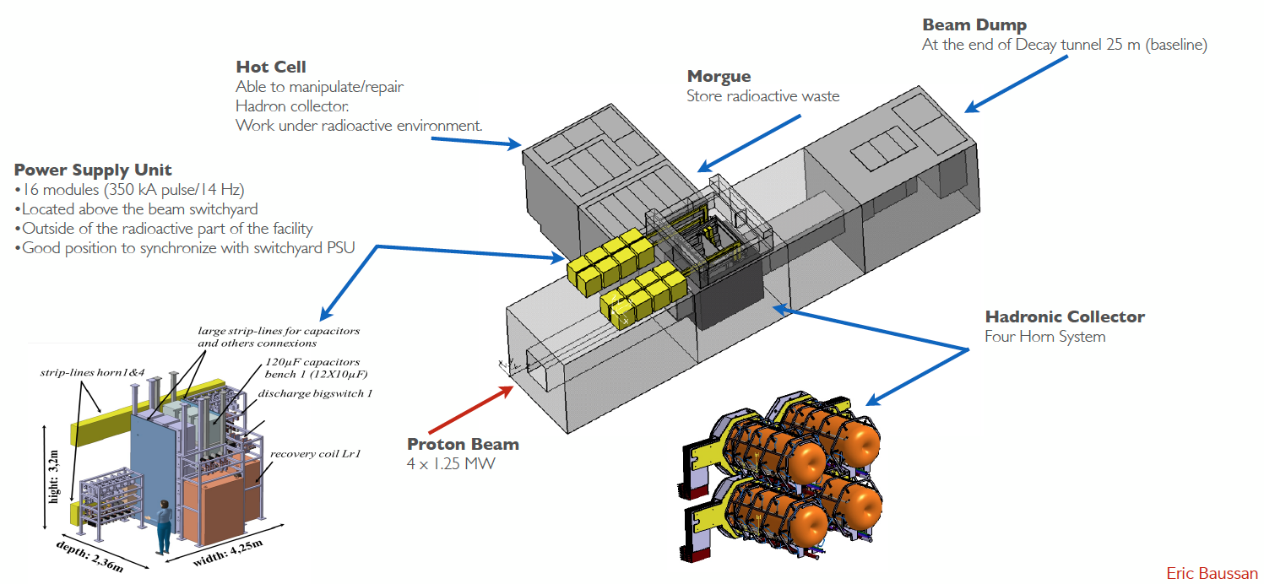
Target Design
Packed Bed Target: Power 1.25 – 1.6 MW. Potential heat removal rates at the hundreds of kW level. Helium cooling (10 bars). Separated from the horn
Focusing System: 4-horn+4 target system to accommodate the MW power scale. Packed bed target integrated into the inner conductor : very good physics results.

Slide 28
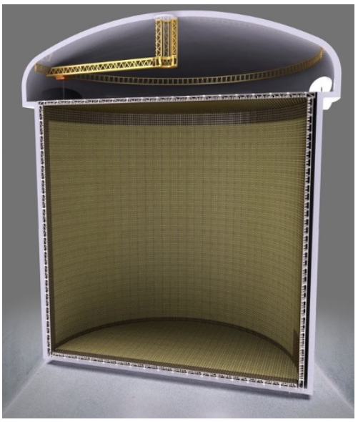
Detectors
Two water Cherenkov detectors
• Far detector (370 km from target)
– Pi x 372 x 74 m3 >0.5 Megaton of ultra pure water as the far detector . That is 10 times the volume of the super-Kamiokande.
– 540k m3 total fiducial volume
– 100k 20” PMTs gives 40% coverage
– 1500 meter deep underground
– To decrease the noise and background from cosmic radiation
• Near detector (250 m from target)
– Pi x 4.722 x 11 m3

Slide 29
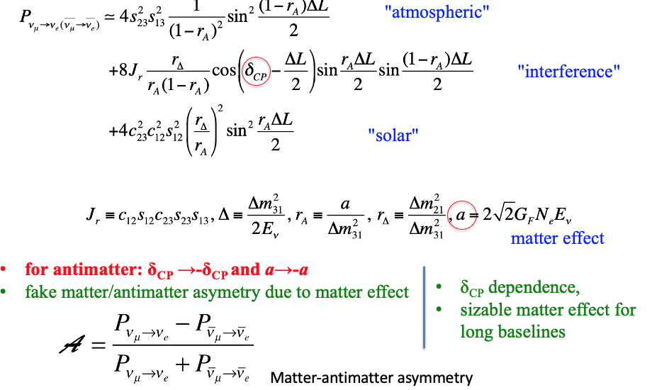
The physics case for ESS𝜈SB
Oscillation Probability
M. Dracos, NuFact2023

Slide 30
𝛿_{CP} Matter-antimatter assymetry
Why is the scale tipped?
M. Dracos, NuFact2023

Slide 31
Neutrino Oscilations
Sensitivity to 2nd maxima
M. Dracos, NuFact2023

Slide 32
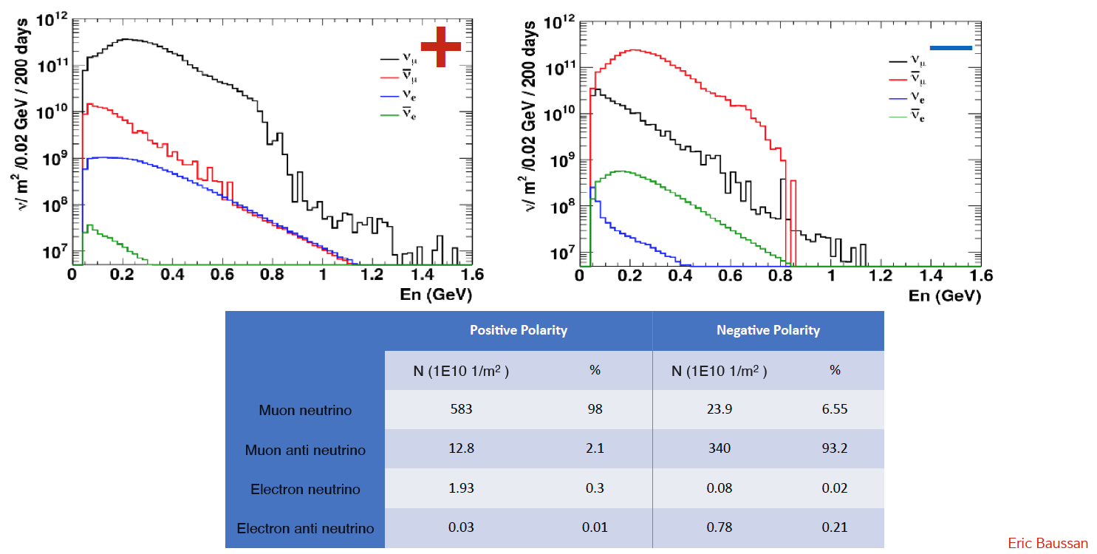
Expected Neutrino Flux

Slide 33
Neutrinos in the Far Detector

Slide 34
Next Steps
We are finishing commissioning of part of the linac by 2026 and first users will start in 2027.
We continue improving and ramping up the linac towards the final design of 5 MW. It will take time
ESS𝜈SB project is currently ongoing on the Plus phase and will be very active until 2026. After that we need to secure funding to start the TDR and talk serious business with authorities if we indeed want to start data collection but ~2038
Physics reach of ESS𝜈SB:
Neutrino Oscillations, Proton decay, Astroparticles, Understand the gravitational collapsing, Supernovae "relics”, Solar Neutrinos, Atmospheric Neutrinos, etc..
It is possible to visit the lab if you happen to be around Sweden/Lund!

Slide 35
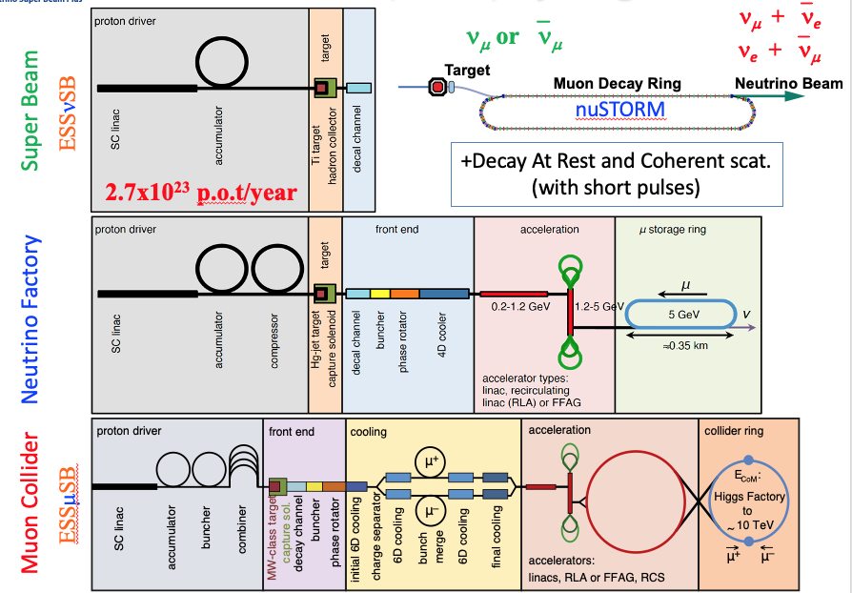
Looking into the (very) far future?
Synergies

Slide 36
Thank you! Obrigada! Questions?

