Slide 1

ESS𝜈SB: Status and Future Plans
ICHEP 2026
PRESENTED BY Natalia milas on behalf of the collaboration

Slide 2
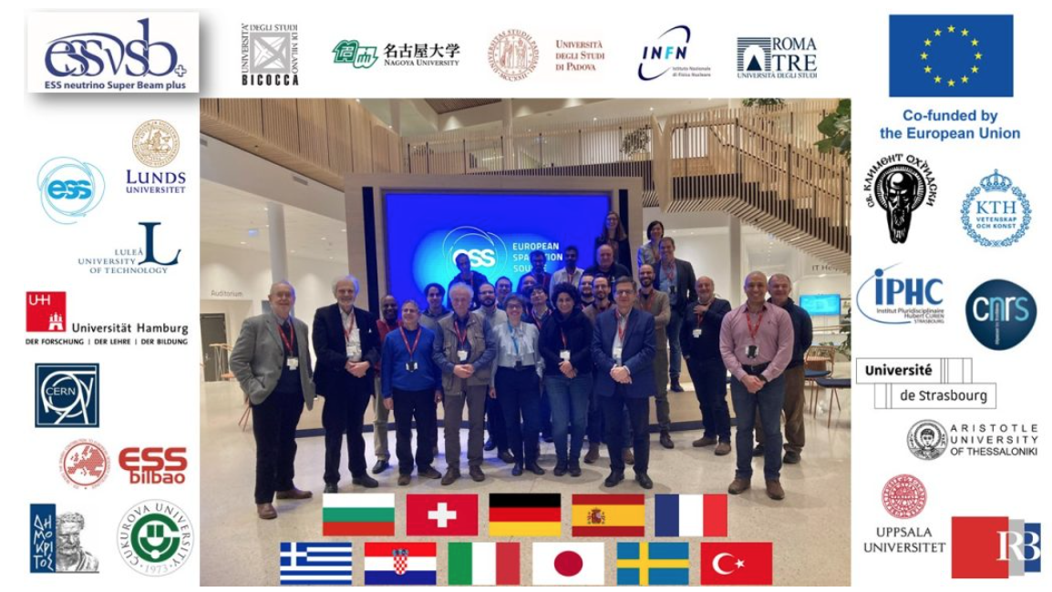
The ESS𝜈SB Project
Goal: to precisely measure the value of the leptonic charge-parity violating phase
How: by generating a muon (anti-)neutrino intense ”super” beam and looking at the electron neutrino appearance in a large water cherenkov far detector.
With 5 MW beam from the ESS linac we can measure at the second oscillation maximum
where we are less limited by systematic uncertainties and thus have a higher sensitivity compared to the 1st maximum.
Neutrino Detector
540 kilotonnes Water
1 km underground
Zinkgruvan
At 2nd maximum:
larger sensitivity to δ_{CP}
matter doesn’t matter
At 1st maximum:
smaller sensitivity to δ_{CP}
matter can mimic CP violation
360 km
11 partner Nations (ESSνSB+
kick-off meeting in Jan. 2023)
Lund

Slide 3
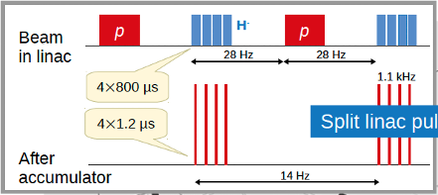
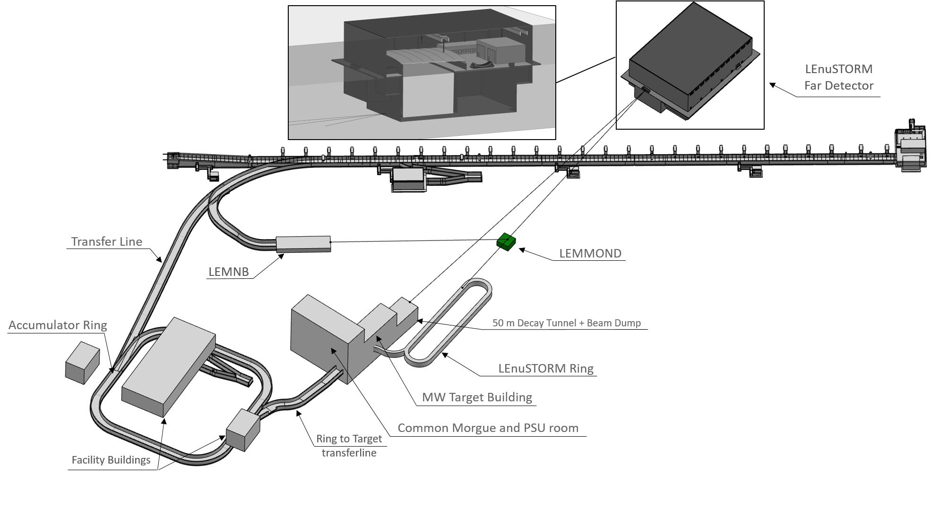
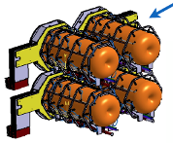
ESS𝜈SB+ High Level Parameters
7
Far Neutrino detector
(Zinkgruvan)
6
Split the linac pulses in 4 batches
3
5
Near Neutrino detector
H⁻ to reduce losses at ring injection
LEνSTORM and LEMNB detector
4
1
3
Target and horn:
Max 1.25 MW/target beam power
Max ~1.5 us pulse duration
2
Accumulator ring to compress each batch
Low Energy νSTORM ring and Monitored Neutrino
Beam for neutrino cross section measurements and sterile neutrino searches

Slide 4
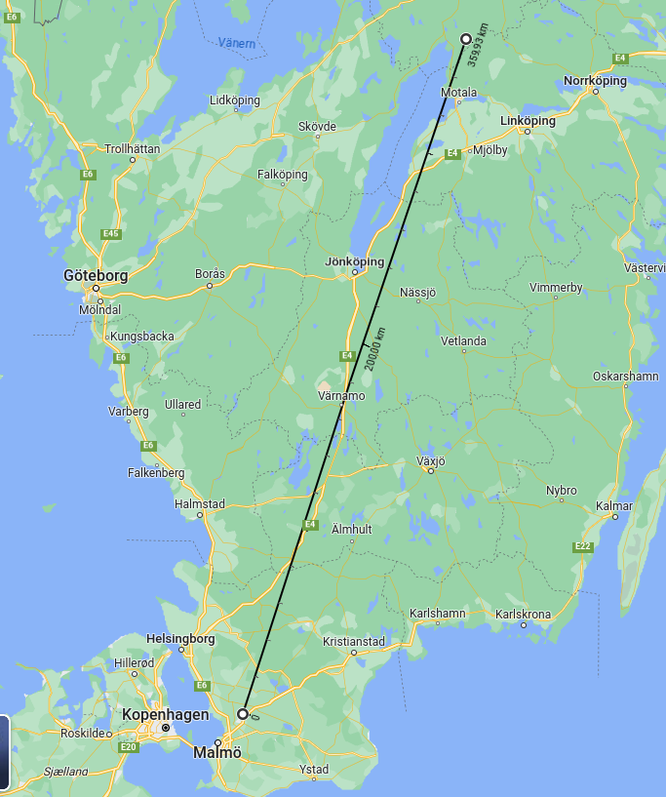


ESSνSB & ESSνSB+
Designing and optimizing the experiment for CP violation measurements
  Far Detectors (Zinkgruvan)
  Water Cherenkov Detector (Lund – ESS)
  Super Fine-Grained Detector (Lund – ESS)
  Viking – NINJA-like emulsion detector (Lund - ESS)
Studying and optimizing the experiment for cross section measurements, non-beam physics and BSM
  LEMMOND (LEnuSTORM and LEMNB detector)
  Studying Gd doping in far and near water Cherenkov detectors
  Studying the capabilities of non-beam physics (supernova, atmospheric, reactor, …)
  Studying BSM theories (sterile neutrinos, non-standard interaction, …)

Slide 5

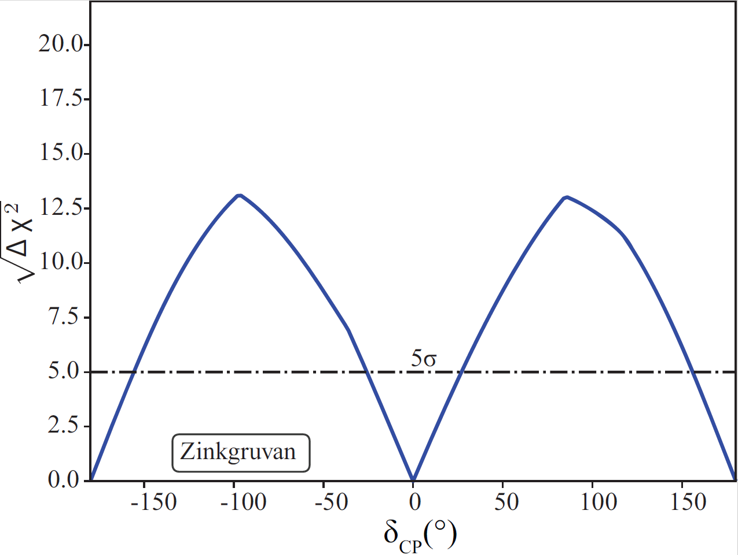

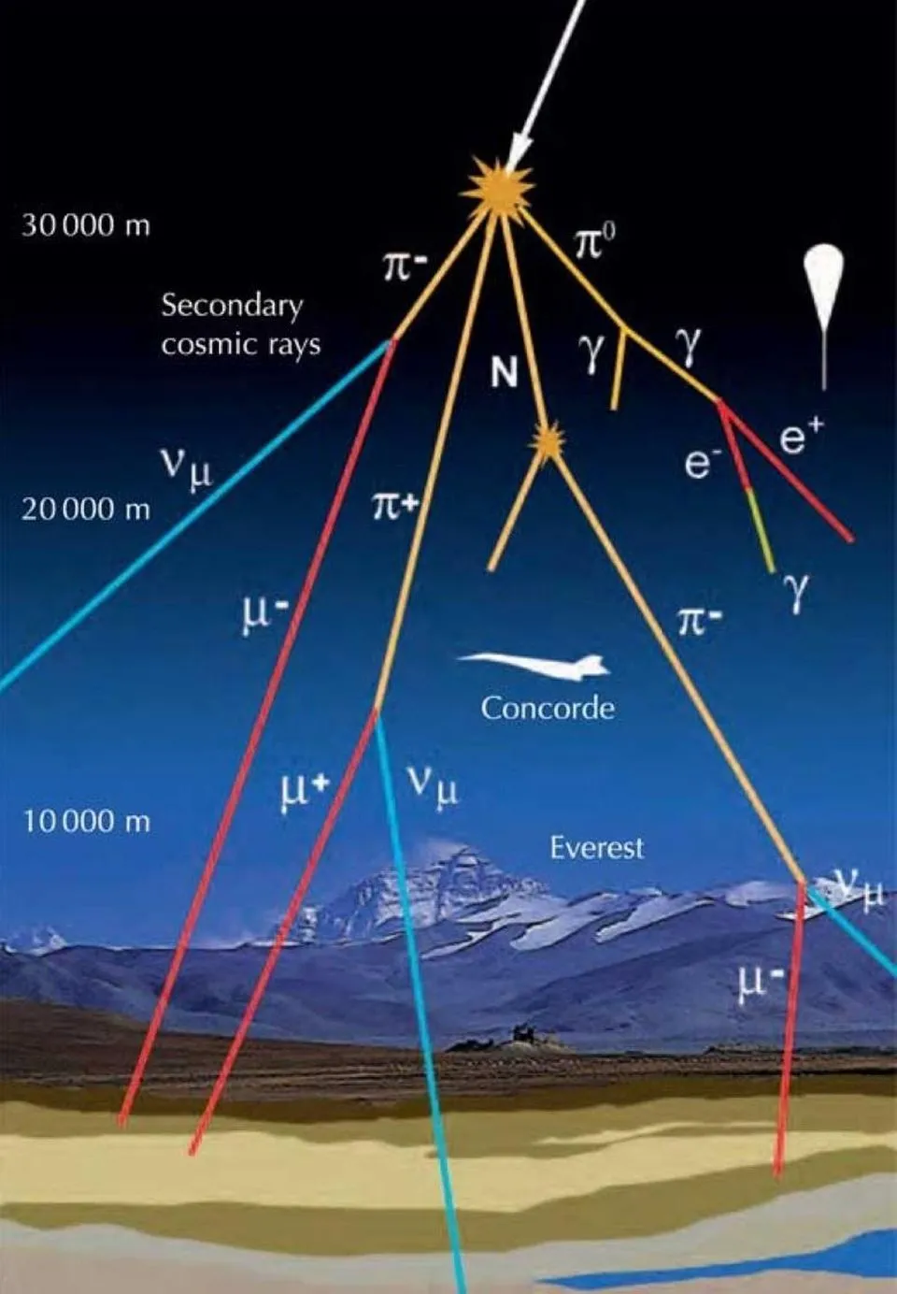
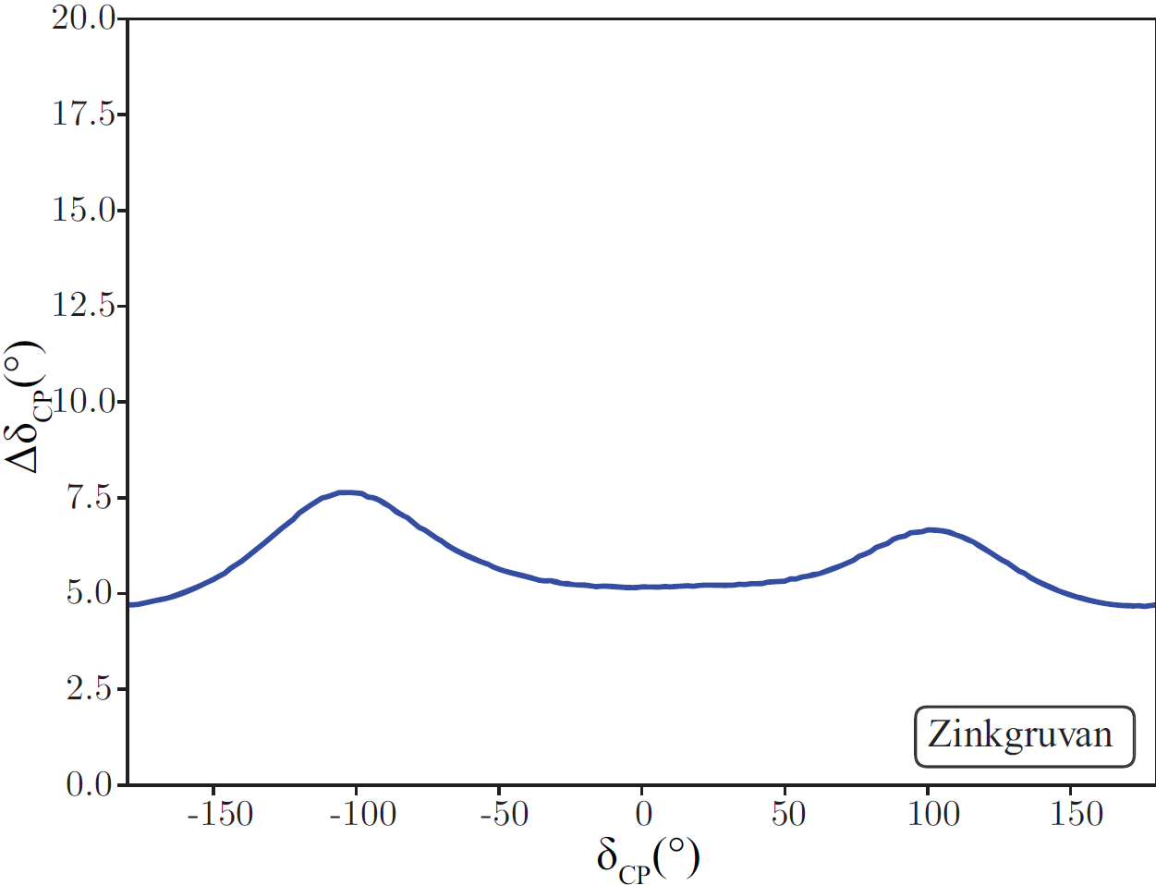
Long - baseline physics (360 km)
  CP violation search
  Precise measurement of δCP parameter
  Various new physics scenarios
  Around 12σ sensitivity for CP violation for δCP = ± 90°
  δCP precision of less than 8° for all value
Short – baseline physics (50 m – 250 m)
  Sterile neutrino search
  Non – standard interactions
  Constraining BSM theories via
  neutrino – electron scattering
  CP violation discovery
Ongoing or planned study
  Atmospheric neutrinos
  Supernovae neutrinos
  Diffuse supernovae background neutrinos
  Geoneutrinos
  Reactor neutrinos
  Solar neutrinos
  δCP precision

Slide 6
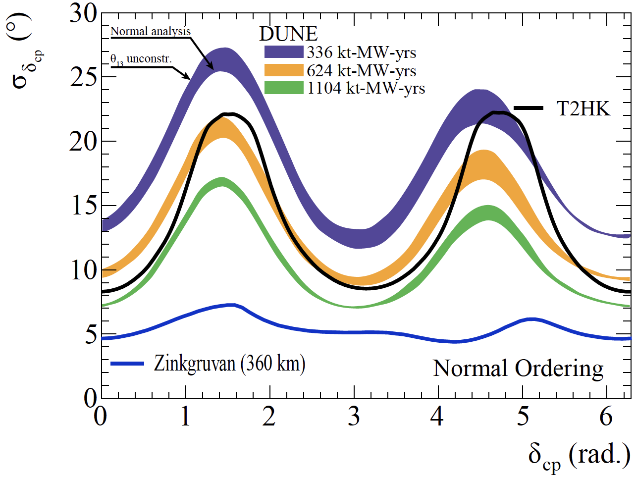
Comparison with current Projects
precision
ESSνSB

Slide 7
ESS𝜈SB+Ongoing Studies
(mainly cross-section measurements)
Design of a racetrack storage ring for low energy muons produced with a beam from the ESS linac.
Design a transfer system from the initial collection and extraction of pions behind the target station, up to the injection point.
Design a transfer line from the ESSνSB ring-to-switchyard transfer line to the nuSTORM target.
Design an injection scheme for the racetrack storage ring
Design a Monitored Neutrino Beam (low energy ENUBET)
Optimize the performance of the ESSνSB accelerator complex
Cross-section measurements with:
Low Energy nuSTORM: π⟶ μ ⟶ e+ν_{μ}+ν_{e}
Low Energy ENUBET: π ⟶ μ+ν_{μ}

Slide 8
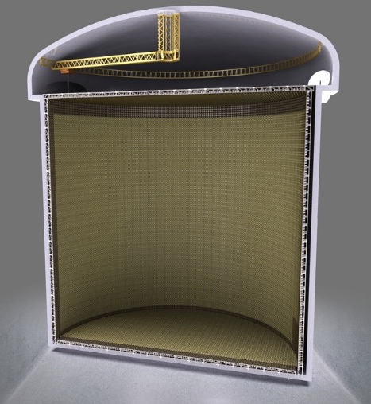
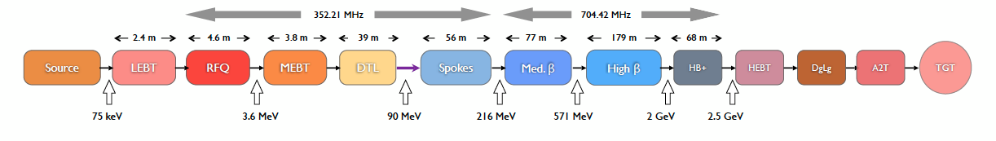
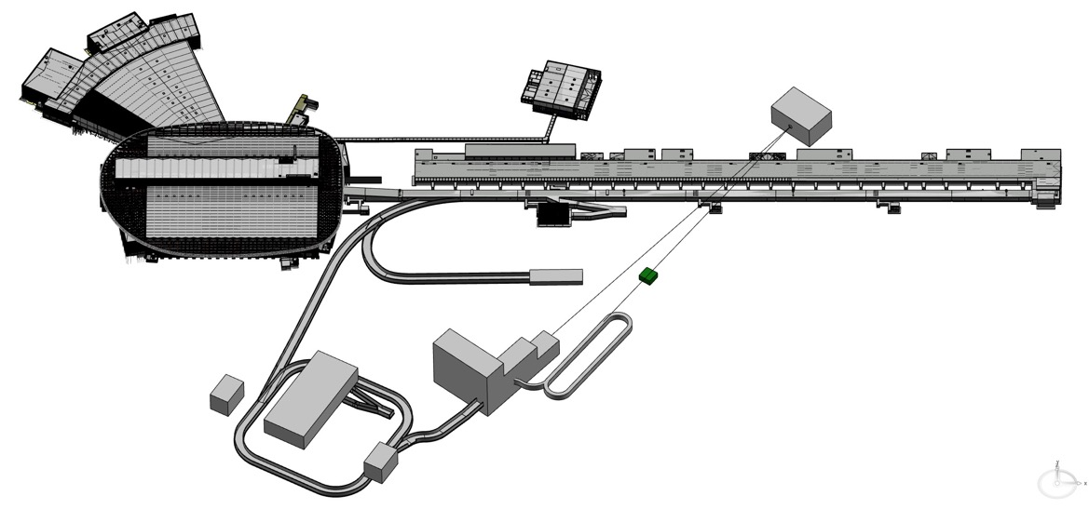
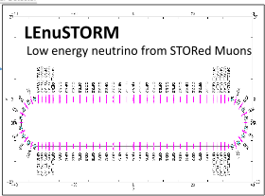
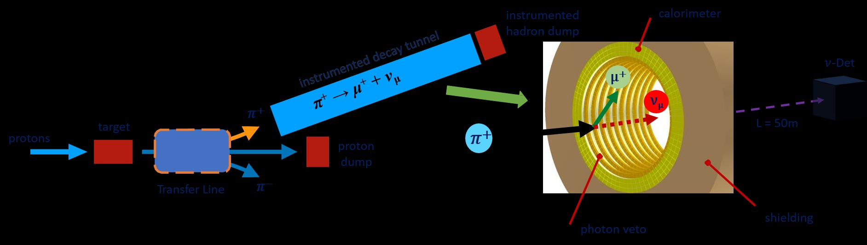
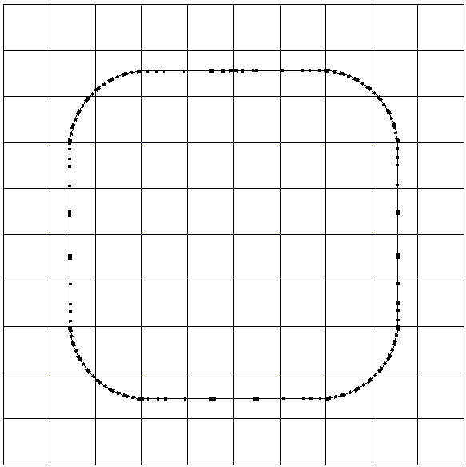
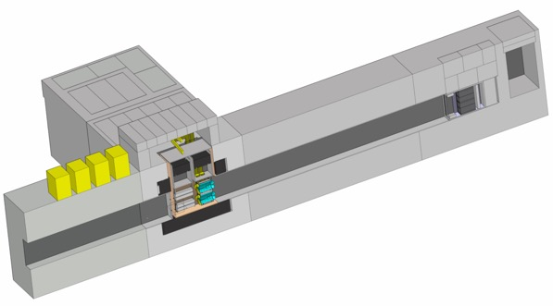
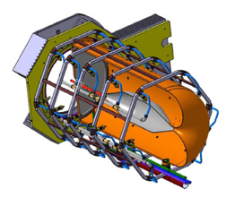
ESS𝜈SB Latest Design
Double the linac beam power
360 km
Far Detector
Near Detector
Spallation target
ν
Monitored ν beam
Near Near
Detector (LEMMOND)
H⁻
injection
LEnuSTORM
RF
p
Neutrino production target
p
extraction
Accumulator ring
collimation
¼ of the total proton power
also able to host the final 4 target/horn system

Slide 9
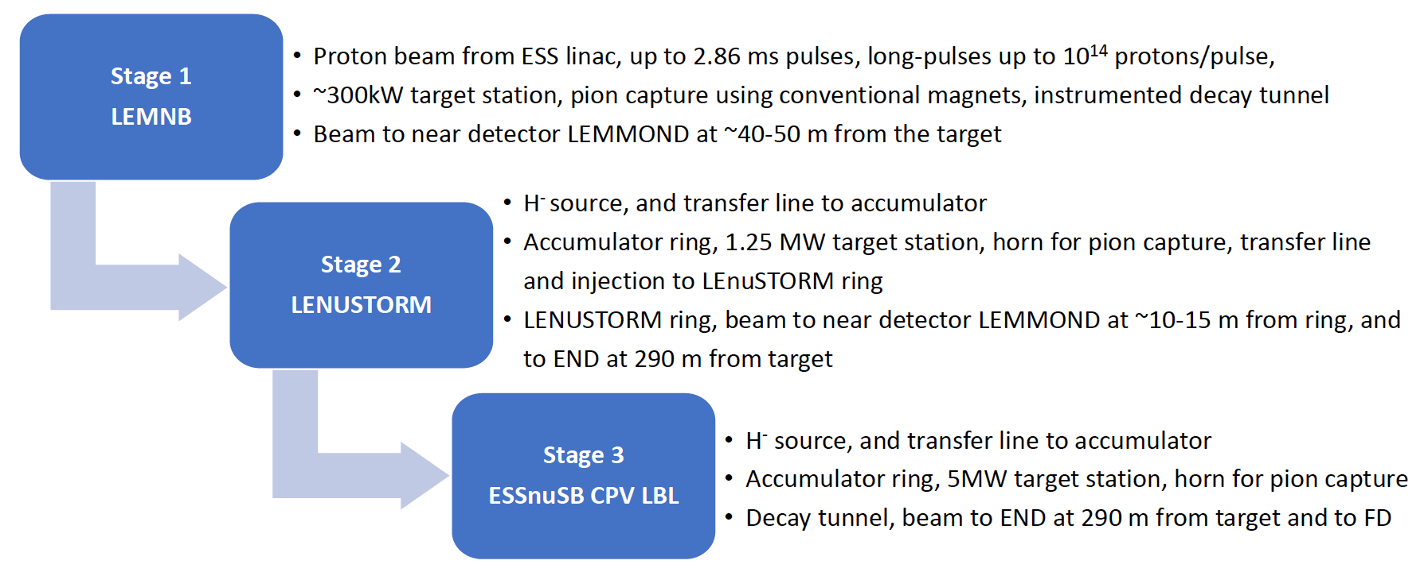
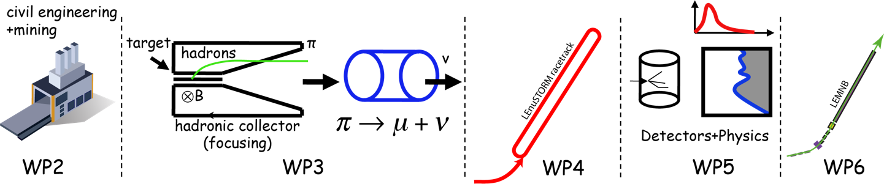
ESS𝜈SB Project Staging
cross-sections
sterile neutrinos
Civil engineering
Target Station
cross-sections

Slide 10
2018
2022
2026
2030
2033
Interference with ESS
Phase | Stage I | Stage II | Stage III
Construction | 2034-2036 (2y) | 2034-2038 (4y) | 2036-2041 (5y)
Installation | 2036-2039 (3y) | 2038-2041(45) (3y-7y) | 2041-2046 (FD: 5y)
Switch | - | 2045-2046 (2y) | 2052-2055 (1y cool-down + 2y)
Operation | 2039-2045 (1y comm + 5y) | 2046-2052 (2y comm + 5y) | 2055-2075 (0.5y comm + 20y)
ESSnuSB
LBLν exp
ESSnuSB+
LEMNB
LEνSTORM
EC projects
Far Detector Eng
ESS site Eng
Discussion
Funding Agencies
Approval
Beam commissioning (1y)
CDR
CDR
pTDR
2035
2036
Env. Study – Permission
Assumes initial permission for Stage I in 2y
2039
2045
CE: extraction from ESS Linac, TL, LEMNB target, LEMMOND cavern
Inst : includes ESS linac modifications to 28 Hz
Two interruptions to ESS: for CE and Linac modifications
Stage I
Tech. Design
ESS Linac Mods to 28MHz, LEMNB, LEMMOND
CE
Inst
Physics
2038
2047
2052
CE: L2A, Accumulator, L2T, TCC, LEnuSTORM, ND
Inst : includes ESS linac modifications to 28 Hz + H-
Note: installation can finish earlier but needs to wait for the completion of Stage I
Interruption to ESS to connect and commission the H- source
Tech. Design
ESS Linac Mods H-, RFQ, L2A, Acc, L2T, TCC, T2R, LEnuSTORM, ND
Stage II
CE
Inst
Physics
2041
2046
2054
2055
Inst : includes 2y to switch from previous stage
Stage III
Tech. Design
TCC, ND, FD
2075
CE-FD
2065
Low-energy ν_{μ} ν_{e} cross-section results
Inst - FD
Phys
CP-violation in leptonic sector precision measurements
Inst
Physics

Slide 11
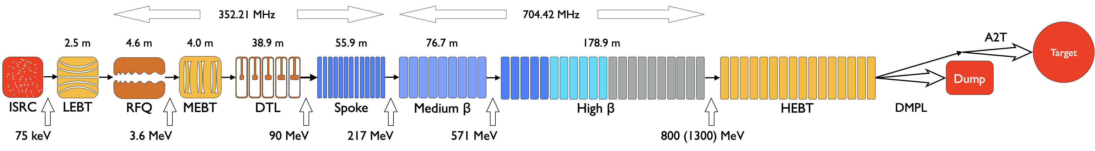
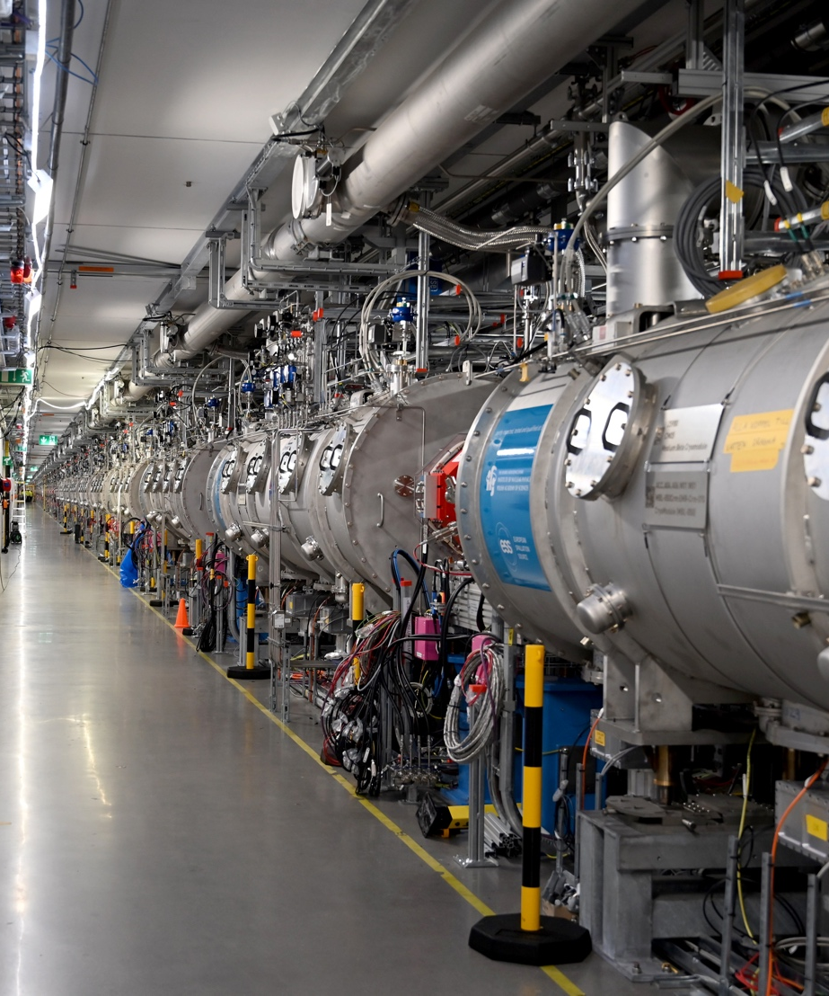
ESS Facility Status
Accelerator under commissioning now
  Accelerator has installed capacity for 2 MW beam
  6 extra cryomodules will bring it to 3 MW in the near future
  Plan for full design 5MW not defined
  Commissioning ongoing and power ramp-up and user operations to start end of 2027/start of 2028
  Max beam power so far: 1.3 kW

Slide 12
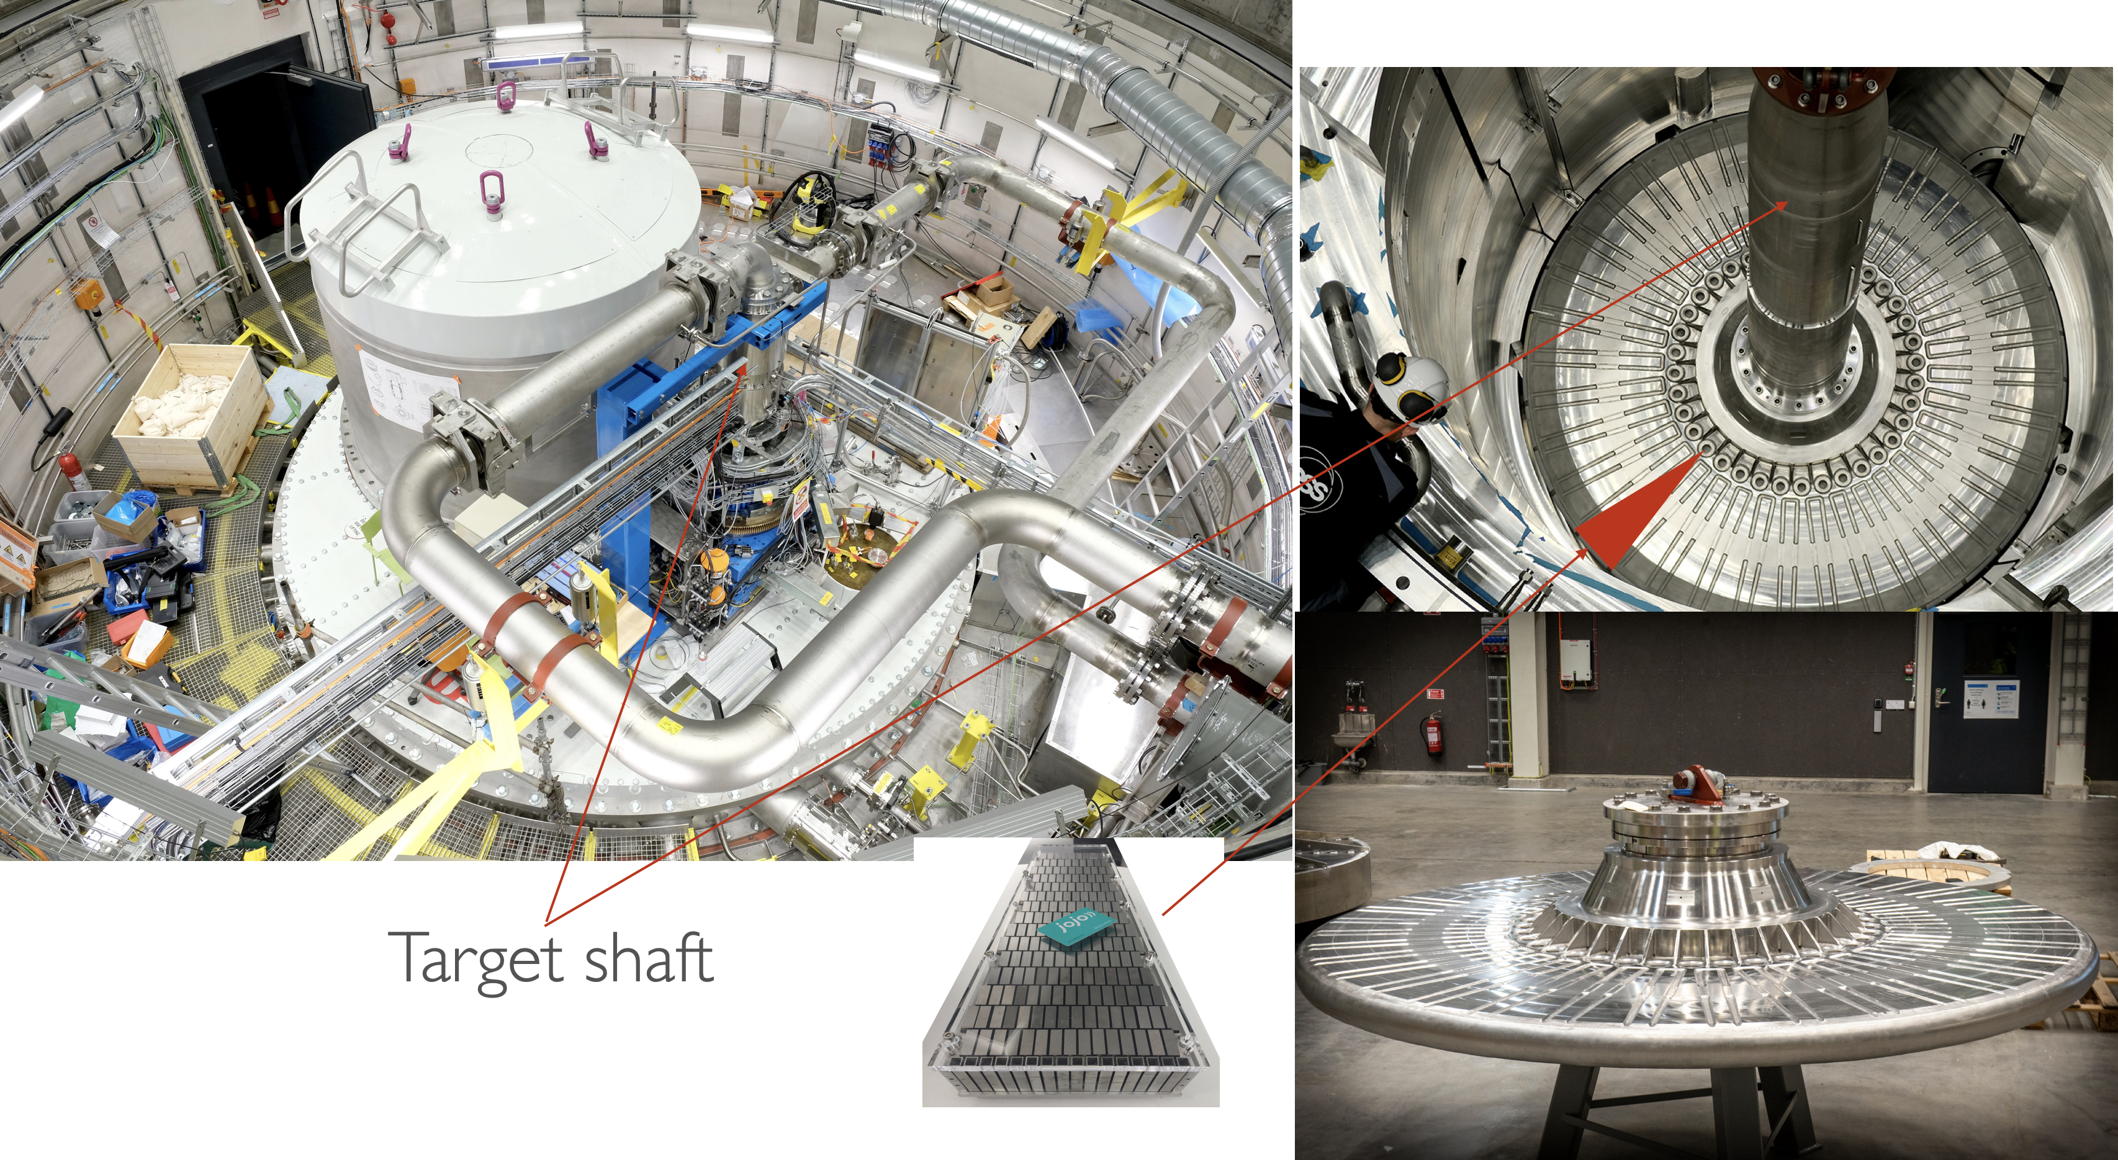
ESS Facility
Target and Instruments to come
  Moderator accident in Dec 2025 pushed schedule by 1 year
  6 instruments ready to receive neutron beam

Slide 13
ESS Facility Timeline
BOT
27 Jan '27
Mar
Apr
May
Jun
Jul
Aug
Sep
Oct
Nov
Dec
Jan
Feb
Today
Easter
May Day
Holidays
Ascension Day
National Day
Midsummer
Summer Vacation
Hostlov
Christmas/NY
2 Mar '26 - 3 Jul '26
BOD2
4 Jul '26 - 2 Aug '26
Machine Stop
2026 ACC Operations
(Jan 2026)
3 Aug '26 - 16 Aug '26
ESS Summer Maintenance
17 Aug '26 - 30 Aug '26
Machine Restart
31 Aug '26 - 4 Dec '26
BOD3
5 Dec '26 - 3 Jan '27
Machine Stop
Machine Restart
4 Jan '27 - 15 Jan '27
BOT Commissioning
18 Jan '27 - 27 Jan '27
20 Apr '26 - 24 Apr '26
SCL-INP Switch
Spring Stop
20 Apr '26 - 24 Apr '26
Spring Maintenance Week
20 Apr '26 - 24 Apr '26
Kraftringen Upgrades Main Grid
Facility SAR5 (Provisional)
30 Jun '26 - 31 Aug '26
Reviews
Facility SRR5 (Provisional)
8 Sep '26 - 12 Oct '26
BOT System Permit
18 Jan '27 - 19 Jan '27
BOT Beam Authorisation
20 Jan '27

Slide 14

Further Poposed Studies: Far Detector
HORIZON-INFRA-2026-01-DEV-03: Consolidation of the Research Infrastructure landscape – Individual support for evolution, long term sustainability and emerging needs of pan-European research infrastructures
Title of Proposal: Design and feasibility study of the engineering of the large underground ESSnuSB Far Detectors for fundamental neutrino oscillation research with as added benefits of their use for mineral exploration and energy-storage
Acronym of Proposal: ESSνSB-FD
Proposal submitted in June 2026! Response expected in October 2026

Slide 15
Outlook
  Most of the new studies are finalized for all WP (this current grant ends January 2027)
The ESS proton linac is about to become the most powerful linac in the world.
ESS can also become a neutrino facility (ESSνSB ) with enough protons to go to the 2nd oscillation maximum and increase significantly the CPV sensitivity and make precise measurement of δ_{CP}.
CPV: 5 σ could be reached over 70% of δ_{CP} range by ESSνSB with large physics potential with less than 8° precision.
Conceptual Design Report published including costing on arXiv.
New studies for intermediate stages are under way.
New proposal to submitted for the Far Water Cherenkov detector.

Slide 16
Thank you!
Questions?

